Slide 1

Public Health 101
The Ten Essential Public Health Services
Created in partnership between the:
Kentucky Department for Public Health
and
University of Louisville
School of Public Health and Information Sciences

Slide 2
Key Questions
What is public health? Why is it important?
What are the 3 core functions and 10 essential public health services, and how do they impact the public’s health?
How is public health structured in the United States to deliver these core functions and services?

Slide 3
Learning Objectives
At the end of this presentation, the student will be able to:
  Describe the roles and responsibilities of public health.
  Describe the 3 core functions and 10 essential public health services.
  Describe the unique roles and responsibilities of public health at the federal, state, local, tribal and territorial levels.

Slide 4
Public Health: An Overview

Slide 5


Health is
… a dynamic state of complete physical, mental, spiritual, and social well-being and more merely the absence of disease or infirmity.*
And Public Health is …
… the science of protecting and improving the health of people and their communities. This work is achieved by promoting health lifestyle, researching disease, and injury prevention, and detecting, preventing and responding to infectious diseases.**
Source: *WHO, 1998; ** CDC Foundation, n.d
Notes:
If we look at the definition of health, we see that it encompasses a broad range of conditions.
Health requires
physical,
mental,
spiritual, and
social well-being.
Ensuring conditions so that people can be healthy is the job of public health. And in order to ensure physical, mental, spiritual, and social well-being, public health requires that society work together, collectively

Slide 6
Public Health
Every day, the public health field is working – often behind the scenes – to prevent hazards and keep people healthy. For example, public health is responsible for:
  Tracking disease outbreaks and vaccinating communities to avoid the spread of disease.
  Developing school nutrition programs to ensure kids have access to healthy food.
  Advocating laws to keep people safe, including smoke-free indoor air and seatbelts.
  Tobacco cessation programs.
  Responds to disasters and assists communities in recovery.
  And so much more!
Notes:
For an introductory video of public health, visit the American Public Health Association website https://www.apha.org/what-is-public-health

Slide 7
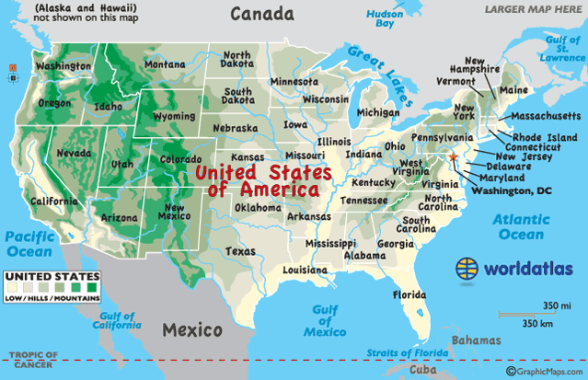
Recent Health Threats/Events in U.S.
1990-present Opioid Epidemic
2014 Flint Water Crisis
2018 California Wildfires
March 11, 2020* – May 11, 2023** COVID-19 Pandemic
2022 Eastern Kentucky Flooding
Ongoing - Foodborne outbreaks
These events required responses from more than one geographical area and more than one agency, increasing collaboration and cooperation.
Image source: World Atlas, https://www.worldatlas.com/webimage/countrys/namerica/usstates/timezone.htm
Notes:
Each previous public health response contributed to public health’s ability to respond to COVID-19.
Flint Water Crisis
On April 25, 2014, the City of Flint, Michigan changed their municipal water supply source from the Detroit-supplied Lake Huron water to the Flint River. The switch caused water distribution pipes to corrode and leach lead and other contaminants into municipal drinking water. In October 2016, Flint residents were advised not to drink the municipal tap water unless it had been filtered through a NSF International approved filter certified to remove lead. Although the city reconnected to the original Detroit water system that same month, the potential damage was already done and a state of emergency was declared on January 16, 2016
COVID-19 pandemic: March 11, 2020
*After more than 118,000 cases in 114 countries and 4,291 deaths, the WHO declares COVID-19 a pandemic.
** Biden Administration ended the COVID-19 public health emergency declarations on May 11, 2023.
California Wildfires - The 2018 wildfire season was the deadliest and most destructive wildfire season on record in California, with a total of over 7,500 fires burning an area of over 1,670,000 acres, the largest area of burned acreage recorded in a fire season. For more information, visit https://www.fire.ca.gov/incidents/2018
Eastern Kentucky Flooding - between July 25th and July 30th, 2022, several complexes of training thunderstorms developed south of I-64 and brought heavy rain, deadly flash flooding, and devastating river flooding to eastern Kentucky and central Appalachia. These thunderstorms, at times, caused rainfall rates in excess of 4"/hr across complex terrain that led to widespread devastating impacts.
Foodborne outbreaks-to view a list of current and past outbreaks, visit the CDC List of Multistate Foodborne Outbreak Notices https://www.cdc.gov/foodsafety/outbreaks/lists/outbreaks-list.html

Slide 8
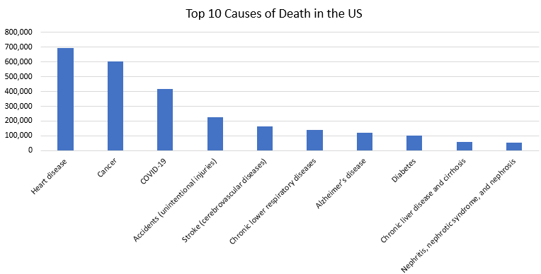
Top 10 causes of Death in the US
Source: Mortality in the United States, 2021, CDC
Notes:
Heart disease 695,547
Cancer 605,213
COVID-19 416,893
Accidents (unintentional injuries) 224,935
Stroke (cerebrovascular diseases) 162,890
Chronic lower respiratory diseases 142,342
Alzheimer’s disease 119,399
Diabetes 103,294
Chronic liver disease and cirrhosis 56,585
Nephritis, nephrotic syndrome, and nephrosis 54,358
Many of these causes of death can be prevented by public health services and programs.
Have we made progress toward reducing or preventing these deaths? If so, how?

Slide 9
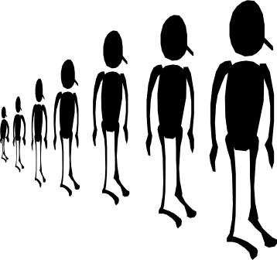
What does medicine do?
What does public health do?
Treats illness
Focus on individual patients
Prevents illness
Focus on populations
Notes:
Public health touches EVERY individual, EVERY day.
Addressing the cause of death and emergencies cannot be done one person at a time.

Slide 10
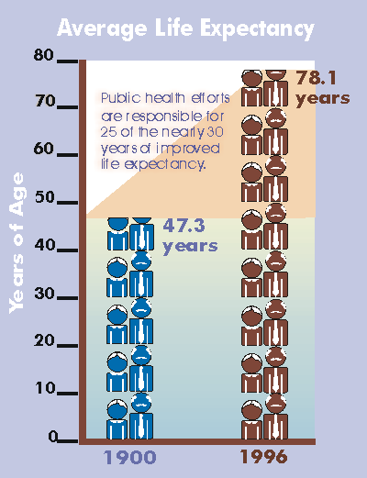
Average Life Expectancy
Thank you
public health
for the extra 25 years of life!
Image Source: National vital Statistics System, National Center for Health Statistics
Notes:
Public health efforts are responsible for 25 of the nearly 30 years of improved life expectancy in the US from 1900 to 1996.

Slide 11
Ten Great Public Health Achievements in the USA,
1900 - 1999
Vaccinations
Motor-vehicle safety
Safer workplaces
Control of infectious diseases
Decline in deaths from coronary heart disease and stroke
Safer and healthier foods
Family planning
Fluoridation of drinking water
Recognition of tobacco use as a health hazard
Source: https://www.cdc.gov/mmwr/preview/mmwrhtml/00056796.htm
Notes:
Note to Presenter: You might focus on 2 or 3, not all
Current life expectancy in 2021 is 76.3 years
Life expectancy has been extended (in part) by these achievements:
Vaccination—There are now 50,000 fewer cases of smallpox than occurred in 1900; 900,000 fewer cases of measles than occurred in 1941; 21,000 fewer cases of polio than occurred in 1951. Programs of population-wide vaccinations resulted in the eradication of smallpox; elimination of polio in the Americas; and control of measles, rubella, tetanus, and diphtheria in the US and other parts of the world.
Motor vehicle safety—Since 1925, the annual death rate from motor vehicle travel has decreased 90%. Seat belts have saved approximately 85,000 lives; child safety seats have reduced risk of infant death by 69%. Community awareness and DWI (driving while intoxicated) regulations have helped reduce alcohol-related deaths by 32%.
Control of infectious diseases—Infections (such as typhoid and cholera), major causes of illness and death early in the 20th century, have been reduced dramatically by improved sanitation. Also, the discovery of antimicrobial therapy has been critical to successful public health efforts to control infections such as tuberculosis and sexually transmitted diseases.
Decline in deaths from coronary heart disease and stroke—Deaths from coronary heart disease and stroke have declined due to risk-factor modification, such as smoking cessation and blood pressure control. Since 1972, death rates for coronary heart disease has decreased 51%.
Recognition of tobacco use as a health hazard—Recognition of tobacco use as a health hazard in 1964 has resulted in reduced use and reduced exposure to secondhand tobacco smoke.
Healthier mothers and babies—Healthier mothers and babies are a result of better hygiene and nutrition, antibiotics, access to health care, technology in maternal and neonatal medicine, and immunizations. Since 1900, infant mortality has decreased more than 90%, and maternal mortality has decreased 99%.

Slide 12
How has Public Health Extended Life Expectancy?
The foundation of public health lies within the 3 core functions defined by the Institute of Medicine (IOM).
  Assessment
  Policy Development
  Assurance
Public health is guided by the Ten Essential Public Health Services and is applied to every facet of public health (federal → state → local and tribes and territories)

Slide 13
Background Ten Essential Public Health Services
The Essential Public Health Services serves as the description of the activities that public health systems should undertake in all communities.
  Originally developed by a federal workgroup in 1994
  Revised in 2019 to reflect the current public health landscape
  Purpose:
    To inform descriptions and definitions of public health practice.
    To outline the activities public health systems should deliver to the communities they serve.

Slide 14
Ten Essential Public Health Services
Assess and monitor population health
Investigate, diagnose, and address health hazards and root causes
Communicate effectively to inform and educate
Strengthen, support, and mobilize communities and partnerships
Create, champion, and implement policies, plans and laws
Utilize legal and regulatory actions
Enable equitable access
Build a diverse and skilled workforce
Improve and innovate through evaluation, research, and quality improvement
Build and maintain a strong organizational infrastructure for public health
Notes:
The ten essential services are shown here:
Assess and monitor population health status, factors that influence health, and community needs and assets
Investigate, diagnose, and address health problems and hazards affecting the population
Communicate effectively to inform and educate people about health, factors that influence it, and how to improve it
Strength, support, and mobilize communities and partnerships to improve health
Create, champion, and implement policies, plans and laws that impact health
Utilize legal and regulatory actions designed to improve health protect the public’s health
Assure and effective system that enables equitable access to the individual services and care needed to be healthy
Build and support a diverse and skilled public health workforce
Improve and innovate public health functions through ongoing evaluation, research, and continuous quality improvement
Build an maintain a strong organization infrastructure for public health.

Slide 15
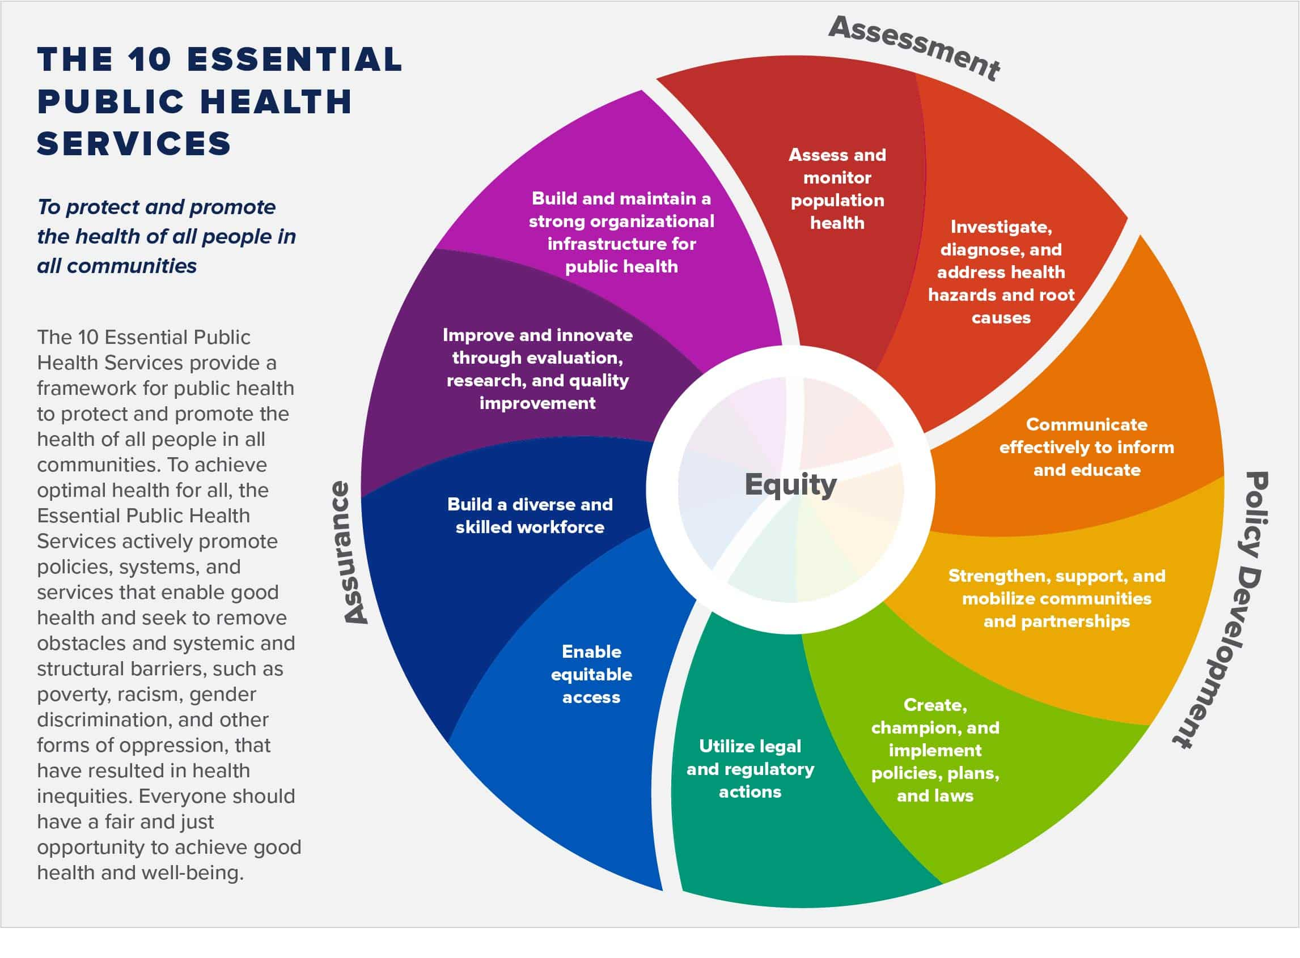
Ten Essential Public Health Services Wheel
At the heart of the core functions and the essential services are health equity, which public health cannot function without.
Centering equity means that all public health work must reach toward two aims simultaneously:
Improving overall health
Advancing equity
Image source: Centers for Disease Control and Prevention, https://www.cdc.gov/public-health-gateway/php/about/index.html)
Notes:
The Ten Essential Services relate to the Three Core Functions.
Public Health in the United States is framed around three core functions of public health:
Assessment
Policy Development
Assurance
Each Core function is linked to essential services that a public health department should be providing, at the state or local level.
Under the core function assessment:
Assess and monitor population health
Investigate, diagnose and address health hazards and root causes
Under the core function policy development:
Strengthen, support, and mobilize communities and partnerships
Create, champion, and implement policies, plans, and laws
Utilize legal and regulatory actions
Under the core function Assurance:
Enable equitable access
Bild a diverse and skilled workforce
Improve and innovate through evaluation, research, and quality improvement
Build and maintain a strong organizational infrastructure for public health
At the heart of the core functions and the essential services are is health equity, which public health cannot function without.
Centering equity means that all public health work must reach toward two aims simultaneously: improving overall health and advancing equity. It is unacceptable to intentionally or unintentionally increase health inequities in the interest of improving health for a subset of the population.

Slide 16
Ten Essential Public Health Services Activity
Materials:
  Essential Service Cards - one card for each essential service (10 cards total).
  Activity Cards - one card detailing a public health activity that falls within each essential service (10 cards total).
  Ball of string.
Instructions:
  Stand to form a circle - 1 group of 10
  Starting with Essential Service #1 - the facilitator will read the card out loud.
  Identify the Activity Card that aligns with Essential Service Card #1.
  Essential Service #1 card holder will toss the ball of to the identified Activity Card holder.
  Repeat steps 2,3 and 4 until all the cards have been read.

Slide 17
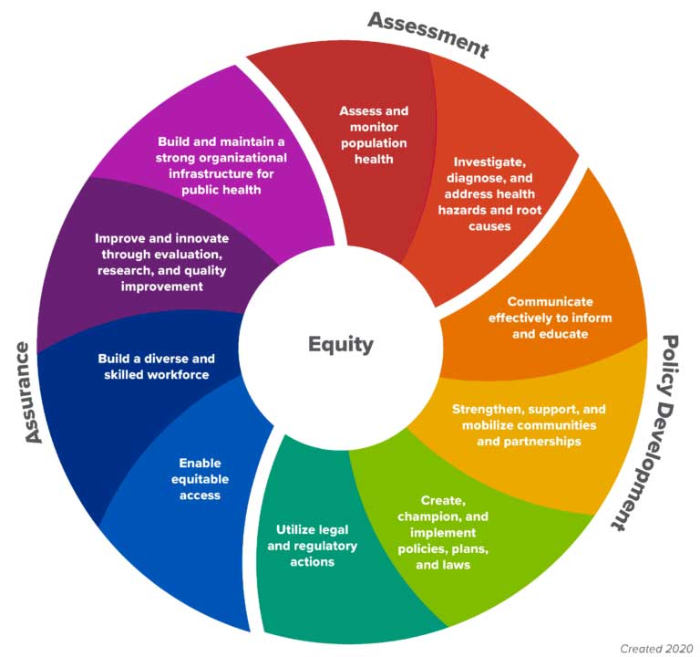
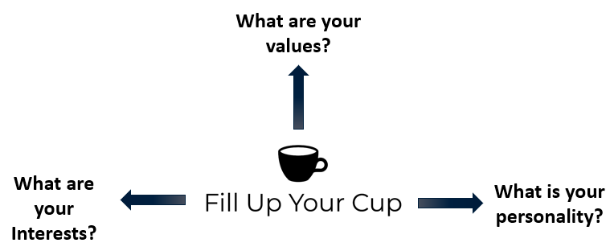
Career Exploration using the Wheel
Image source: Centers for Disease Control and Prevention, https://www.cdc.gov/public-health-gateway/php/about/index.html)
Notes:
Encourage students to consider how the Ten Essential Public Health Services wheel can guide their career exploration.
What are the students' interests, values, personality types?
What essential service interests them the most?
Examples of public health careers within each essential service include:
Assess and monitor population health status, factors that influence health, and community needs and assets.
Epidemiologist
CDC health scientist
Investigate, diagnose, and address health problems and hazards affecting the population.
Biostatistician
Nurse practitioner
Environmental health specialist
Communicate effectively to inform and educate people about health, factors that influence it, and how to improve it.
Health promotion specialist
Health educator
Strengthen, support, and mobilize communities and partnerships to improve health.
Community health workers
Case managers
Create, champion, and implement policies, plans, and laws that impact health.
Lobbyist
Health policy analyst
Utilize legal and regulatory actions designed to improve and protect the public’s health.
Emergency management director
Occupational safety specialist
Preparedness Field Coordinator
Assure an effective system that enables equitable access to the individual services and care needed to be healthy.
LHD Director
DEI coordinator
Healthy equity consultant
Build and support a diverse and skilled public health workforce.
Public health workforce director
University career services coordinator
Improve and innovate public health functions through ongoing evaluation, research, and continuous quality improvement.
Public health program evaluator
Quality assurance program manager
Build and maintain a strong organizational infrastructure for public health.
Health administrator
Grant specialist

Slide 18
Structure of Public Health in the United States

Slide 19
Governmental Public Health
State and Local Health Departments have the primary responsibility for public health under the US Constitution
State and the District of Columbia Health Departments
Local Health Departments
Indian Health Service and Tribal Health Departments
Territorial and Freely Associated States Health Departments
*
**
> 3,300
8
51
> 50
****
***
* CDC State & Territorial Health Department Websites
** 2022 National Profile of Local Health Departments. National Association of County and City Health Officials. Washington, DC
**** CDC State & Territorial Health Department Websites
Notes:
***There are 574 federally-recognized tribes, and they are all served by one or more of the following agencies, Indian Health Service (HIS) Area Offices, IHS Tribal Epidemiology Centers (https://www.ihs.gov/epi/tecs/currently-funded-tec/), the National Indian Health Boards (https://www.nihb.org/about_us/area_health_boards.php), tribal consortiums [Alaska Native Tribal Health Consortium, Southern Plains Tribal Health Board, United Indian Health Services, American Indian Health Commission, etc.]), and individual tribes with their own health departments, like the Navajo Nation (but they also rely on IHS too!). Individual tribal health departments would only be with the largest and/or wealthiest tribes (e.g., Navajo and Cherokee nations are huge and have their own health departments – though still served by IHS services as well - but some other tribes are wealthy due to gambling proceeds or through other means so might have their own health departments

Slide 20
Federal Public Health
Roles and Responsibilities

Slide 21
Federal Public Health Responsibilities
Ensure all levels of government have the capabilities to provide essential public health services
Act when health threats may span more than one state, a region, or the entire nation
Act where the solutions may be beyond the jurisdiction of individual states
Act to assist the states when they lack the expertise or resources to effectively respond in a public health emergency (e.g., a disaster, bioterrorism, or an emerging disease)
Facilitate the formulation of public health goals (in collaboration with state and local governments and other relevant stakeholders)
Source: Trust for America’s Health. Public Health Leadership Initiative: An Action Plan for Healthy People in Healthy Communities in the 21st Century. Washington, DC. 2006
Notes:
NOTE to Presenter: Pick one or two to discuss/elaborate; all are listed for completeness
Ensure all levels of government have the capabilities to provide essential public health services
Act when health threats may span more than one state, a region, or the entire nation
Act where the solutions may be beyond the jurisdiction of individual states
Act to assist the states when they lack the expertise or resources to effectively respond in a public health emergency (e.g., a disaster, bioterrorism, or an emerging disease)
Facilitate the formulation of public health goals (in collaboration with state and local governments and other relevant stakeholders)

Slide 22
Other Roles of Federal Public Health
Providing leadership, through regulatory powers, in setting health
  Goals
  Policies
  Standards
Contributing operational and financial resources
Financing research and higher education
Supporting the development of scientific and technological tools needed to improve the effectiveness of public health infrastructure at all levels
Source: Trust for America’s Health. Public Health Leadership Initiative: An Action Plan for Healthy People in Healthy Communities in the 21st Century. Washington, DC. 2006

Slide 23
State Health Departments
Roles and Responsibilities

Slide 24
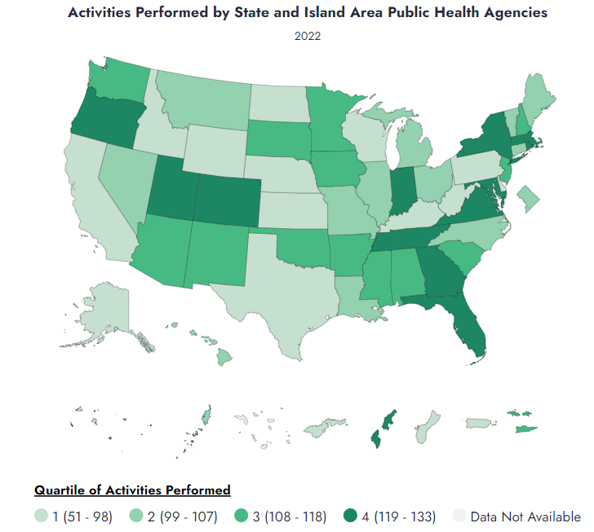
State Roles
Screening for diseases and conditions
Treatment for diseases
Technical assistance and training
State laboratory services
Epidemiology and disease surveillance
Source: Association of State and Territorial Health Officials (ASTHO) Profile of State and Territorial Public Health Survey
Notes:
Screening for diseases and conditions (e.g., newborn screening, HIV/AIDS, TB, diabetes)
Treatment for diseases (e.g., TB, STDs, HIV/AIDS, diabetes)
Technical Assistance and Training (e.g., emergency responders, hospitals, data management, policy development, local health departments)
State Laboratory Services (e.g., bioterrorism agents test, food-borne illness testing, influenza typing, environmental toxins, newborn screening)
Epidemiology and Surveillance (e.g., data collection and epidemiology on behavioral risk factors, communicable/infectious diseases, vital statistics, chronic diseases)
To view specific public health activities delivered by state health departments, visit the ASTHO Profile of State and Territorial Public Health report https://astho.shinyapps.io/profile/
Report home > activities > select year > specific activities > select activity

Slide 25
Local Health Departments
Roles and Responsibilities

Slide 26
State and Local Health Department Governance Classification System
Centralized or largely centralized structure: Local health units are primarily led by employees of the state
Decentralized or largely decentralized structure: Local health units are primarily led by employees of local governments.
Mixed structure: Some local health units are led by employees of the state, and some are led by employees of local government. No single structure predominates.
Shared or largely shared structure: Local health units might be led by employees of the state or by employees of local government. If they are led by state employees, then local government has the authority to make fiscal decisions and/or issue public health orders; if they are led by local employees, then the state has authority.
Source: The ASTHO Profile of State Public Health, Volume 5
Notes:
Public health governance structures vary from state to state. The relationship between state health agencies and regional/local public health departments also differs across states. These structural differences have important implications for the delivery of essential public health services. Identifying these differences is integral to understanding the roles, responsibilities, and authorities across levels of government for services provided within the community.

Slide 27
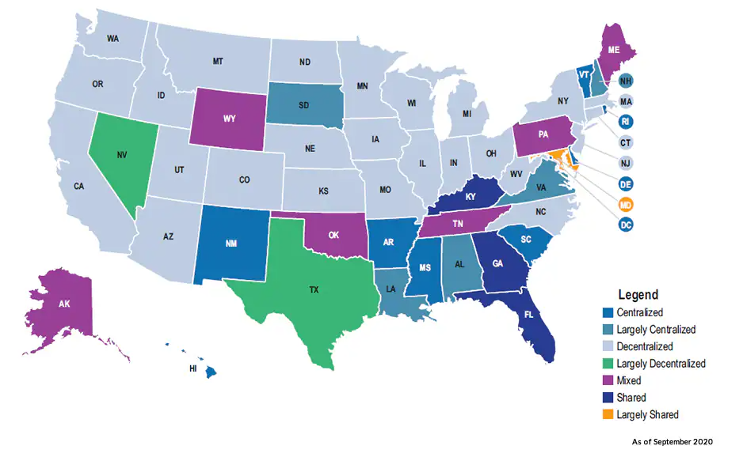
State and Local Health Department Governance Classification Map
Image Source: CDC-Health Department Sites and Governance
Notes:
Governance Health Structures
Public health governance structures vary from state to state. The relationship between state health agencies and regional/local public health departments also differs across states. These structural differences have important implications for the delivery of essential public health services. Identifying these differences is integral to understanding the roles, responsibilities, and authorities across levels of government for services provided within the community.
Types of governance health structures:
Centralized or largely centralized structure: Local health units are primarily led by employees of the state
Decentralized or largely decentralized structure: Local health units are primarily led by employees of local governments.
Mixed structure: Some local health units are led by employees of the state and some are led by employees of local government. No single structure predominates.
Shared or largely shared structure: Local health units might be led by employees of the state or by employees of local government. If they are led by state employees, then local government has the authority to make fiscal decisions and/or issue public health orders; if they are led by local employees, then the state has authority.
Source: The ASTHO Profile of State Public Health, Volume 5

Slide 28
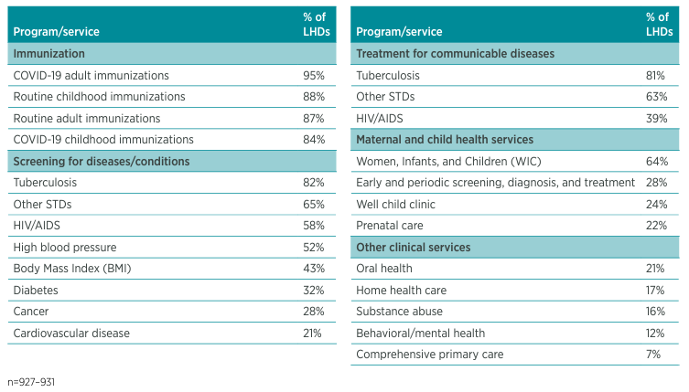
National Profile of Local Health Departments
Clinical programs and services provided directly in the past year
Source: 2022 National Profile of Local Health Departments. National Association of County and City Health Officials. Washington, DC.
Notes:
These are the most frequent services and activities provided by local health departments in the US.

Slide 29
Public Health in the U.S. Insular Areas
(Territories and Freely Associated States)

Slide 30
What are the U.S. Insular Areas?
The Five US Territories
  American Samoa
  Commonwealth of the Northern Mariana Islands
  Guam
  Puerto Rico
  US Virgin Islands
The Three Freely Associated States
  Republic of the Marshall Islands
  Federated States of Micronesia
  Republic of Palau
Source: CDC US Territories and Freely Associated States, 2023
Notes:
The 5 US territories
Puerto Rico
Guam
US Virgin Islands
American Samoa
Commonwealth of the Northern Mariana Islands
The 3 Freely Associated States—sovereign nations in a Compact of Free Association (COFA) with the US
The COFA is a long-term agreement between the US and 3 countries that were formerly part of the Trust Territory of the Pacific Islands. The COFA guarantees financial assistance in exchange for full international defense authority and responsibility. It helps protect our strategic interests in the Pacific region. The 3 countries are
Republic of the Marshall Islands
Federated States of Micronesia
Republic of Palau
Even though they are sovereign nations, the Freely Associated States are typically eligible for the same federal public health grants as the US states.

Slide 31
Public Health Challenges in the U.S. Insular Areas
Geographic location
Cultural differences
Economy
Education
Morbidity and mortality
Notes:
Geography—Insular Areas are typically isolated and remote islands with small and widely dispersed populations (except Puerto Rico); poses challenges to access to public health services and difficulty in implementing programs (e.g., the Federated States of Micronesia are made up of more than 600 islands spread out over an area that would span about 2/3 of the way across the US, but their population is just over 100,000).
Culture—Caribbean and Pacific Island cultures, values, customs, beliefs, and social norms often are very different from the American mainland. Federally funded and designed public health programs may be less relevant.
Economy—Economies are typically very small and fragile, resulting in inadequate public health systems that rely almost exclusively on support from the US.
Education—Access to quality education at the primary, secondary, and college level is very limited; those who get a good education often leave the islands for greater career opportunities, thus the public health workforce is often underqualified and underpaid.
Morbidity and mortality—The Insular Areas lie somewhere between developed and developing countries and unfortunately their public health problems include the worst of both. On the one hand, they suffer from developing world public health threats like multidrug-resistant TB, Dengue fever and Hansen’s disease. On the other hand, they have some of the highest rates of obesity and diabetes in the world. And they are particularly vulnerable to becoming a corridor for emerging public health threats originating in Asia to make their way to the US.

Slide 32
Public Health in American Indian and Alaska Native Tribes

Slide 33
Tribal Public Health
There are 574 federally recognized American Indian and Alaska Native (AI/AN) tribes spread across much of the United States.*
Tribal Health Departments - a corporation or organization operated under the jurisdiction of a federally recognized tribe, or association of federally recognized tribes, and is funded by the tribe(s) and/or contract service(s) from the Indian Health Service (IHS).
Tribal Health Organizations – include Tribal Health Departments, Indian Health Service Units, Area Indian Health Boards and Urban Indian Health Centers.
Notes:
*as of 1/08/24 – Tribal Health -- CDC, https://www.cdc.gov/tribal/tribes-organizations-health/tribal_groups.html

Slide 34
In Conclusion
Schools
Nursing Homes
A Well-Functioning Public Health System has:
  Strong partnerships
  Effective communication channels
  Resource sharing
  Equitable access to person-centered care
EMS
Neighborhood Organizations
Community Centers
Nonprofit
Organizations
Hospitals
Home Health
Drug Treatment
Public Health Agency
Laboratories
Doctors
Mental Health
Law Enforcement
Faith Institutions
Fire
Transit
Community health Centers
Tribal Health
Employers
Elected Officials
Corrections
Image source: National Association of Chronic Disease Directors, https://chronicdisease.org/cahc/building-healthy-military-communities-toolkit/working-with-public-health/
Notes:
Overall public health system
The public health system includes all public, private, and voluntary entities that contribute to public health activities within a given area.
Entities within a public health system can include hospitals, physicians, managed care organizations, environmental agencies, social service organizations, educational systems, community-based organizations, religious institutions, and many others.
All of these organizations play a role in working to improve the public’s health.

