Slide 1
E-Cigarette Presentation for Adults
Name
Date

Slide 2
Agenda
What are e-cigarettes?
Why are youth attracted to them?
What’s wrong with nicotine?
What do we do?

Slide 3
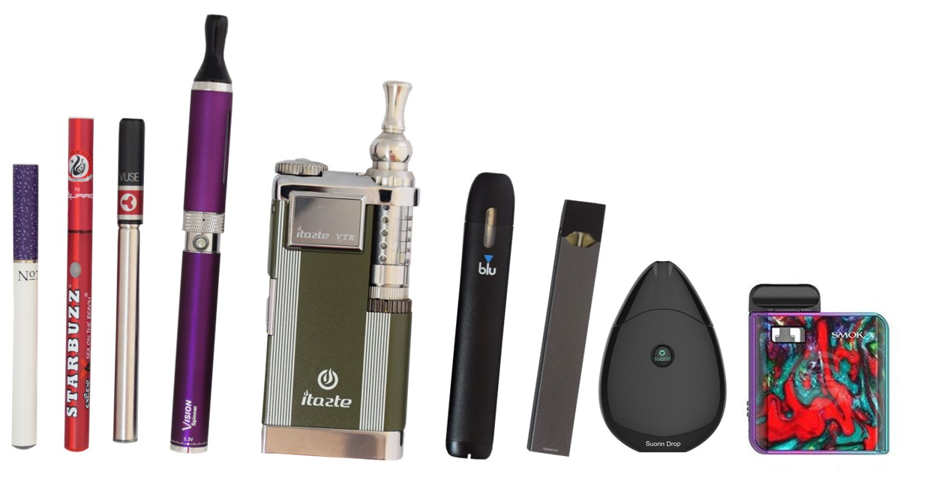

Notes:
From left to right
Cigalike e-cigarettes
E-hookah
Vape pen
Mod or box mod
Pod-based systems
Refillable pod-based system
JUUL is currently the most popular e-cigarette on the market, but youth are starting to diversify as JUUL’s technology spreads to other products.

Slide 4
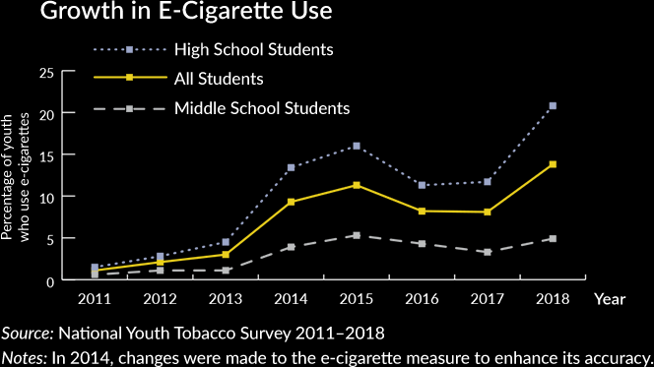
Notes:
This data is from the National Youth Tobacco Survey. As you can see, there was a jump in use starting in 2013, but it was a temporary jump. Frankly the earlier generation of e-cigarettes just weren’t that good at delivering nicotine. Teens were trying them for the novelty, but they weren’t staying with them.
Then in 2017, teens discovered JUUL. The increase in youth e-cigarette use an be entirely attributed to JUUL at this point. Worryingly, many of those teens would not be using a tobacco product if it weren’t for JUUL.

Slide 5
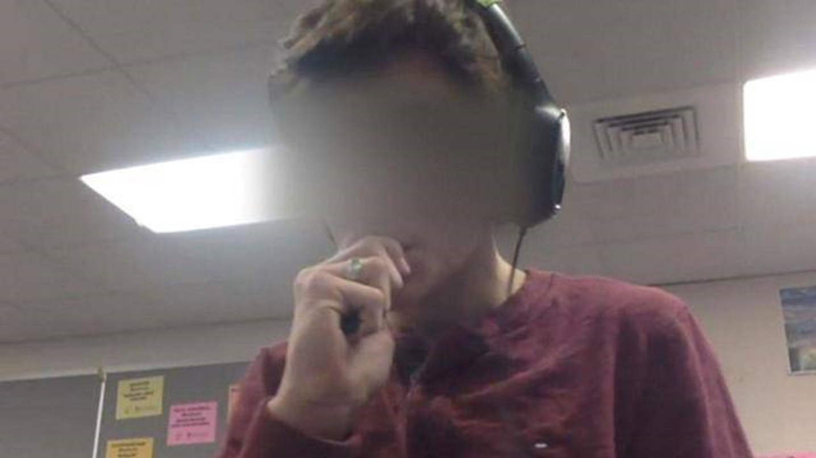
Notes:
Because JUUL are so discrete, students are able to use them in environments where it would be difficult to use other types of tobacco products, like classrooms, bathrooms, and school buses.

Slide 6
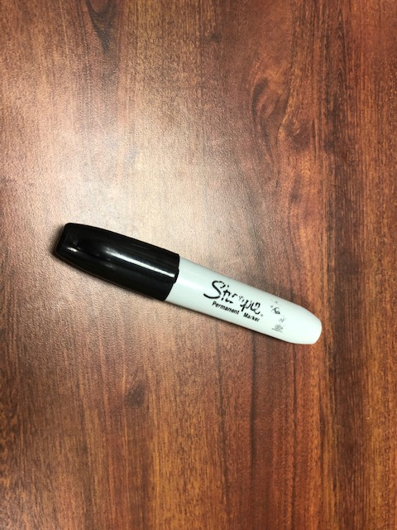
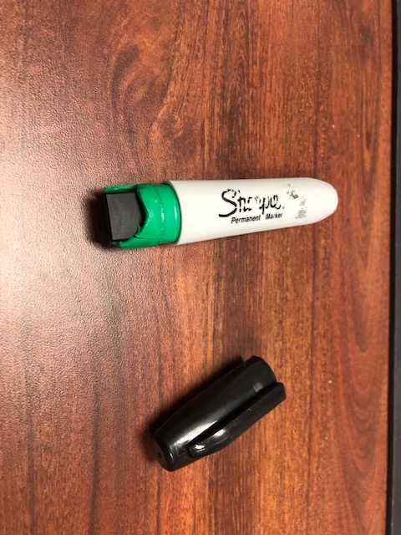
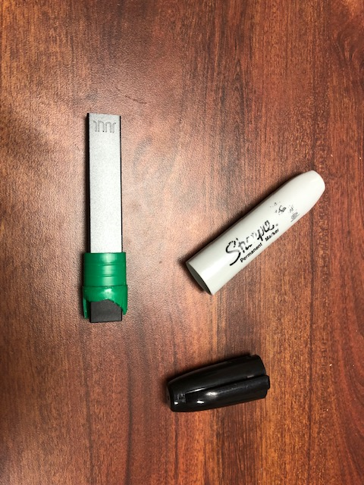
Notes:
Students also find ways to hide products in plain sight, such as this JUUL hidden inside a sharpie.

Slide 7
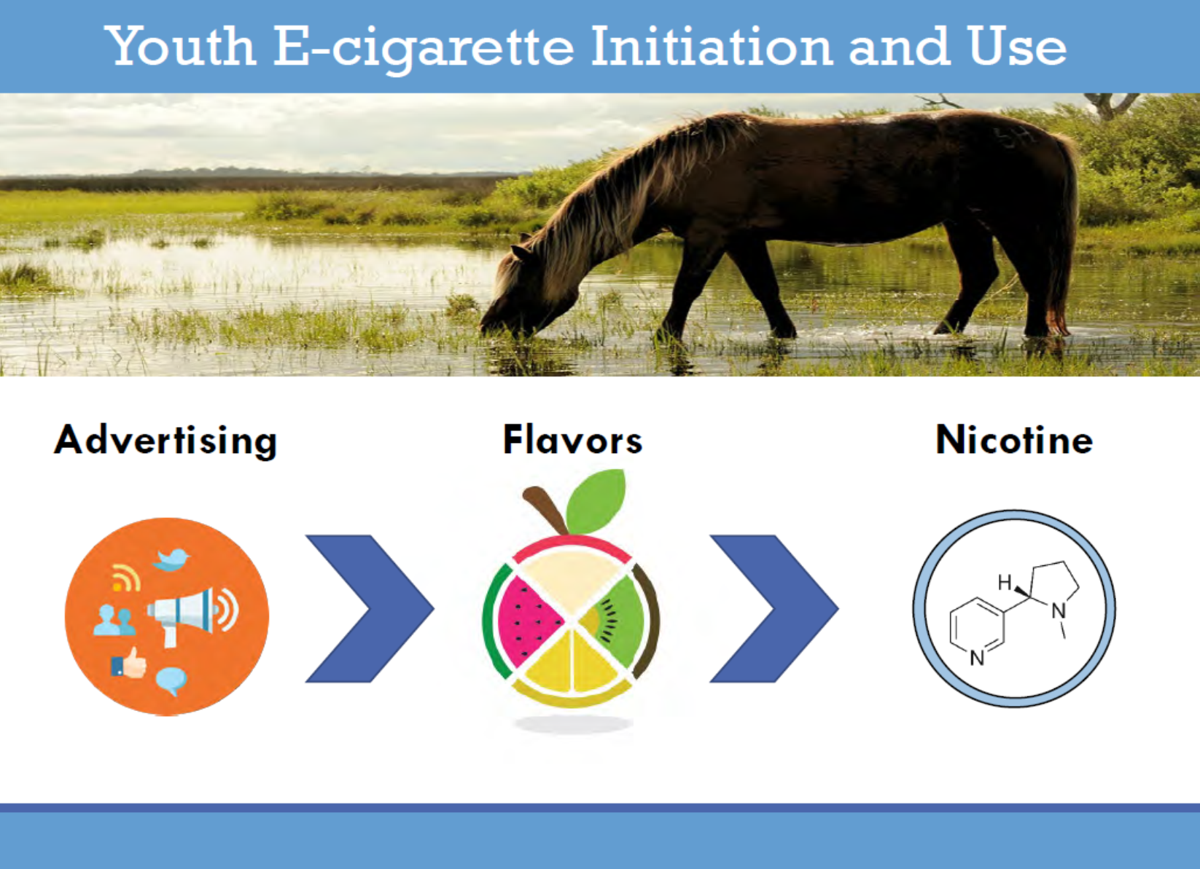
Notes:
Wo why do so many teens use e-cigarettes?
The advertising brings the horse to the water
The flavors make it drink
The nicotine keeps the horse drinking
Students are attracted by the advertising, try e-cigarettes because of the flavors, and they keep using because of the nicotine.

Slide 8
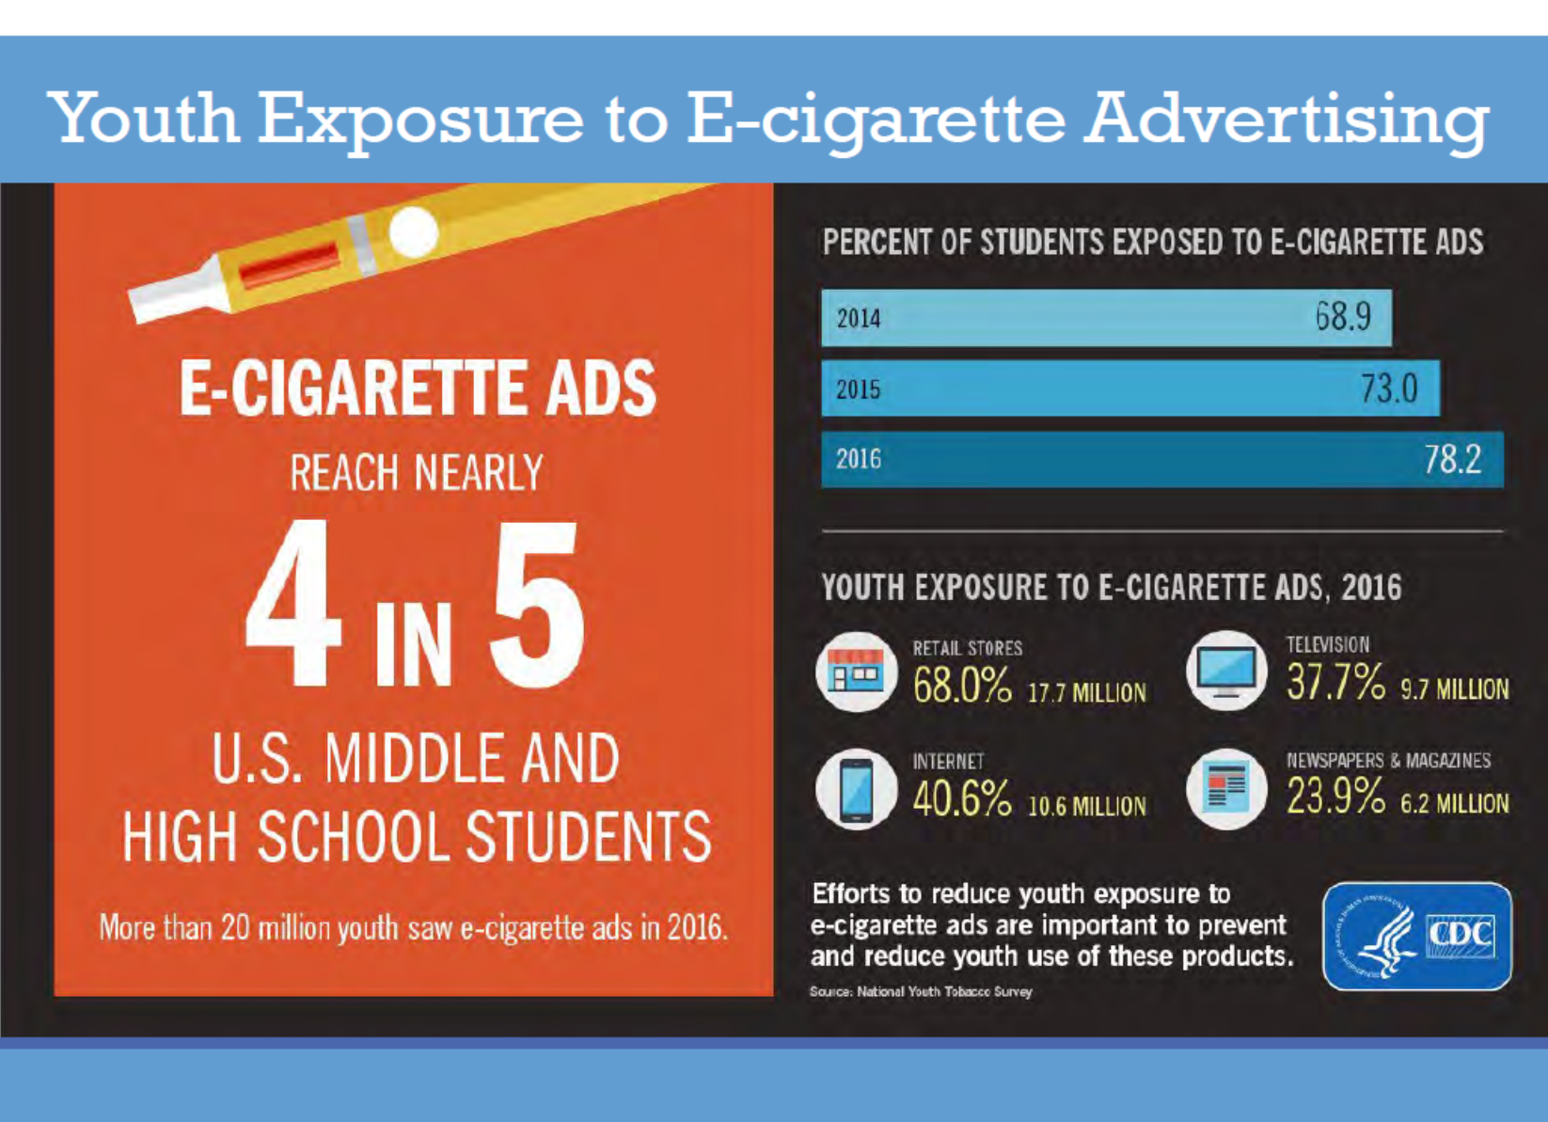
Notes:
Most teens have seen ads for e-cigarettes. The most common spot is at convenience stores and gas stations, where the e-cigarette ads are on the front door and by the checkout counter.

Slide 9

JUUL Launch
Notes:
JUUL launched in 2015. They conducted a sampling tour at music festivals. Visitors to the booth could have a free sample of JUUL if they agreed to snap a selfie and post it to their account.

Slide 10
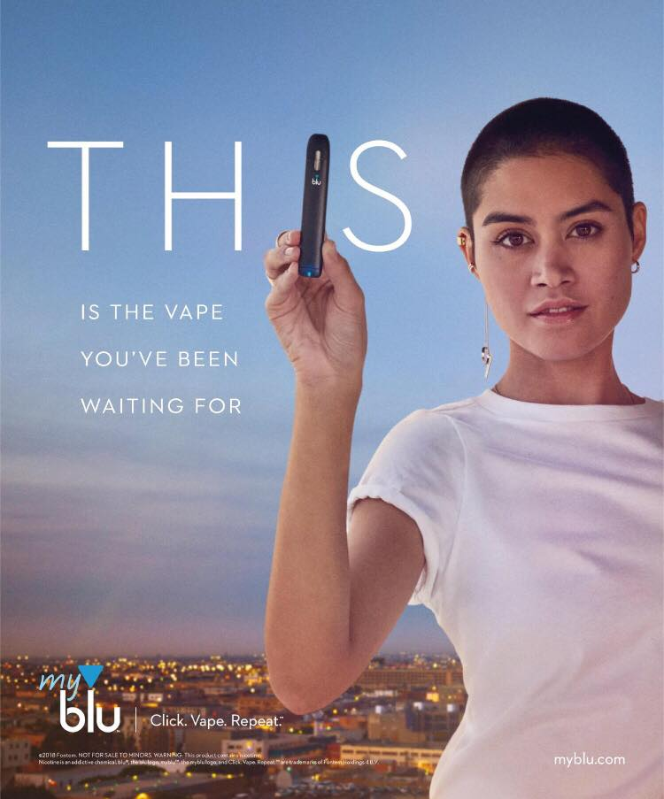
Who’s the Target Audience?
Notes:
Early ads for JUUL on billboards, Time Square, and magazines featured hip young models with bright, youth-friendly colors. Is this the type of ad that would appeal to the typical adult trying to quit smoking?
The ad on the left launched in the spring of 2018. The model resembles student activist Emma Gonzalez from Parkland Florida. The model has the same style of clothing, the shaved heard and is standing in a “power” pose, similar to activists in the 60s. This ad came out just a few months after the shooting at Stoneman Douglas High School.

Slide 11
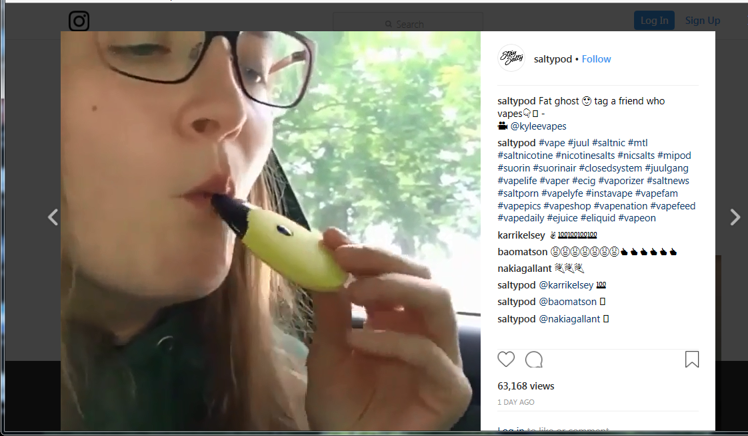
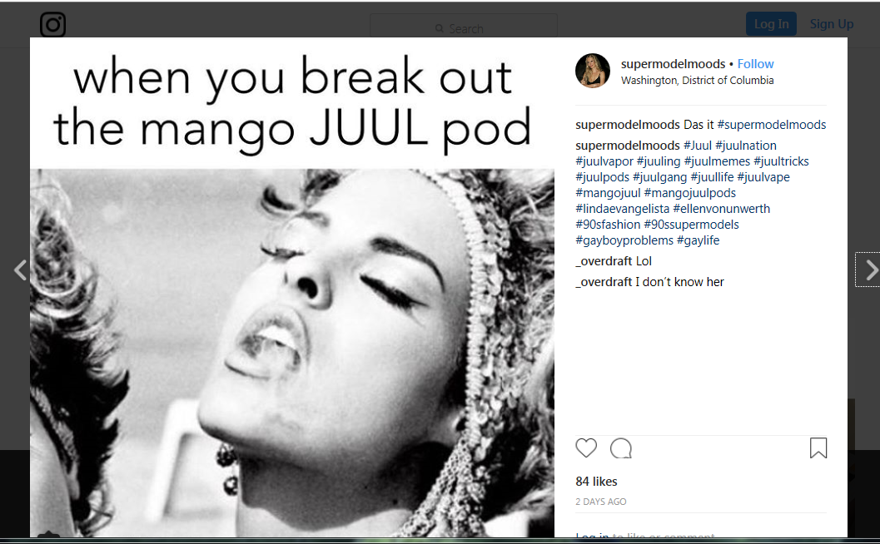
Notes:
In addition to paid ads, teens themselves advertise for products on social media. They share videos of themselves using products, showing vape tricks, laughing at jokes and memes. This creates a social norm where it makes using e-cigarettes normal, acceptable and appear to be fun.

Slide 12

Notes:
How does this make you feel? Do you think a flavor like this was designed with adults in mind?

Slide 13

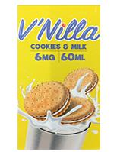
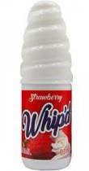
Flavorings
Notes:
Teens are attracted to e-cigarettes because of what they hear, but they try them because of the flavors. Take a look at these products – are they food or e-juice?
While these are some of the most egregious examples (and these particular products have been removed from the market by the FDA), there are currently 15,500 flavors of e-cigarettes on the market.

Slide 14
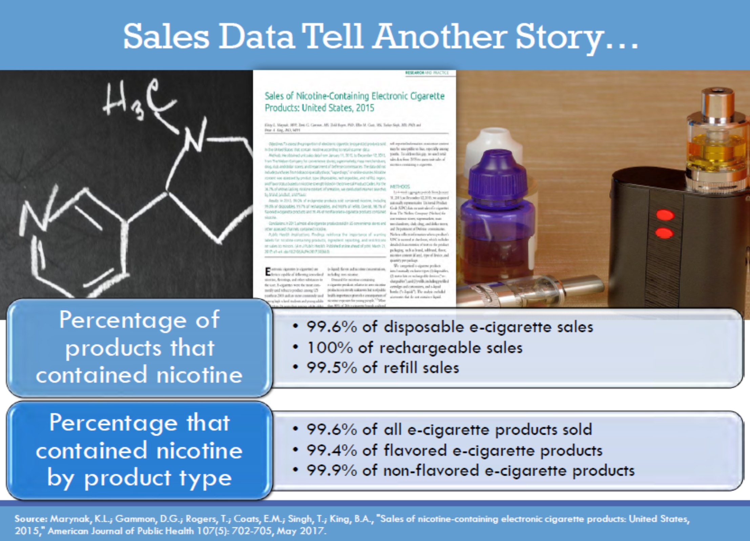
Notes:
Of course we know that e-cigarettes do not contain just flavoring. Nielsen data of e-cigarette sales show that between 99% and 100% of the products sold contain nicotine.

Slide 15
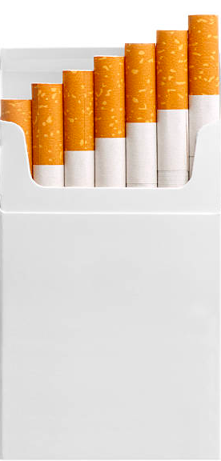

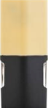
 | Amount | Equivalent
1 pack cigarettes | 20 cigarettes (contains 8 mg per cigarette, but only inhale 1 mg)
1 JUUL pod | 0.7 mL pod “5% nicotine by volume”
1 PHIX pod | 1.5 mL pod “5% nicotine by volume”
ALL SALT-BASED E-JUICE/LIQUID CONTAINS NICOTINE!
Notes:
All JUUL and other pod-based systems contain nicotine. All salt-based liquid contains nicotine. Originally, JUUL had said one pod had as much nicotine as a package of cigarettes. However, newer labeling of pods show one pod has 40 mg of nicotine per pod. This is more equivalent to two packs of cigarettes. JUUL has changed the language on their website to reflect this more accurate reporting – four years after the product was introduced to the market. Phix claims they have as much nicotine as two packages of cigarettes, but they have 5% nicotine and twice the volume of JUUL – so maybe four packs?

Slide 16
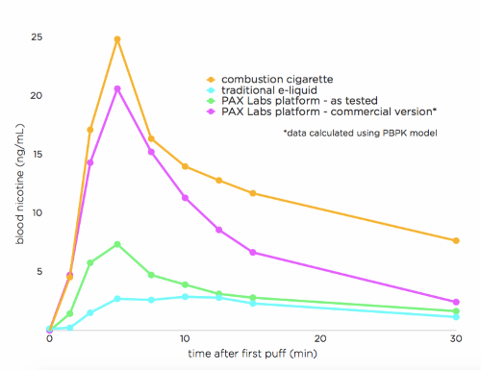
Notes:
Specifically, pod-based e-cigarettes use nicotine salts. Older styles of e-cigarettes used freebase nicotine, which did not provide a strong or long-lasting hit. Nicotine salts more closely mimic the nicotine spike that one would get with a combustible cigarette. This makes JUUL potentially as addictive as combustible cigarettes.
(The x axis shows time in minutes. The y axis shows the concentration of nicotine in the blood. The gold line shows the spike of nicotine from a puff of a cigarette. The pink line shows the spike of nicotine from nicotine salts).

Slide 17
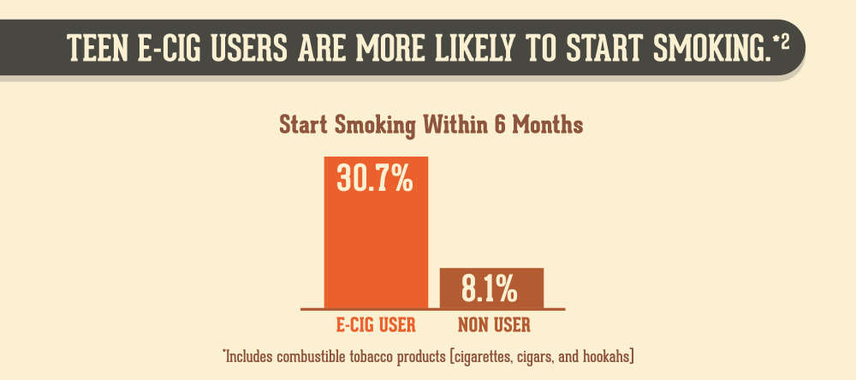
Notes:
Data also shows that teens don’t stop with e-cigarettes. Once teens have the addiction to nicotine, the behavior of using tobacco, and the social aspect of tobacco use, it is easy to transition to combustible cigarettes. In fact teens who use e-cigarettes are between two and four times more likely to start smoking than their non-e-cigarette using peers. Some people say, isn’t it better for teens to use e-cigarettes instead of smoking? But this shows that teens who use e-cigarettes will become smokers.

Slide 18



Definitions
GAS: A substance with indefinite expansion. When you let a gas out of it’s bottle, it will usually keep spreading out until it’s completely mixed with the air.
VAPOR: It can mean the same as gas, but it may also be used to describe a visible exhalation, such as steam or fog.
AEROSOL: A mixture of liquid particles suspended in a gas. Instead of just mixing with the air like a pure gas, aerosols can leave drops behind.
Notes:
Is vaping safe? Let’s go through some science and definitions.
Take a deep breath and exhale. You inhale oxygen and exhale carbon dioxide. Those gases expand through the room and mingle with the air.
Imagine boiling a pot of water to make some pasta. You lean over the pot, dump the pasta in, and then stand up. You breathe in the water vapor and breathe out. Do you see a cloud? No, the water vapor is invisible.
Finally, an aerosol is a mixture of liquids and solids suspended in a gas. Think hair spray or spray paint. You spray an aerosol in the air and it stays in the air for a bit, but then the liquid and particles fall to the ground and surfaces.

Slide 19
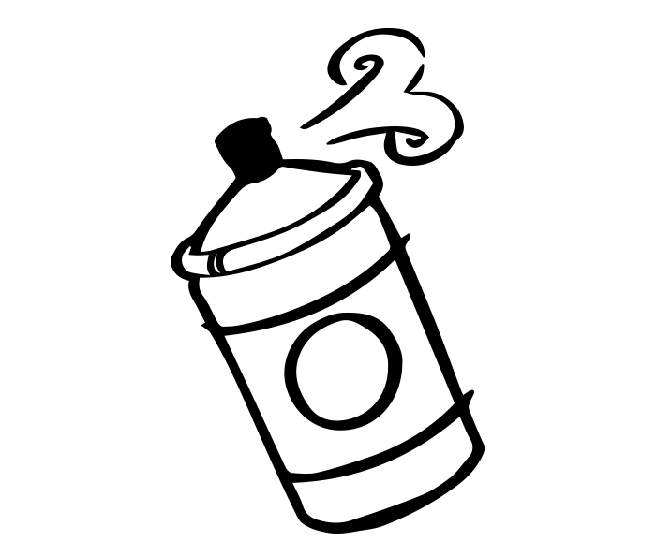

It’s an Aerosol, Not a Vapor
Notes:
So do e-cigarettes create water vapor? No, it’s an aerosol!

Slide 20
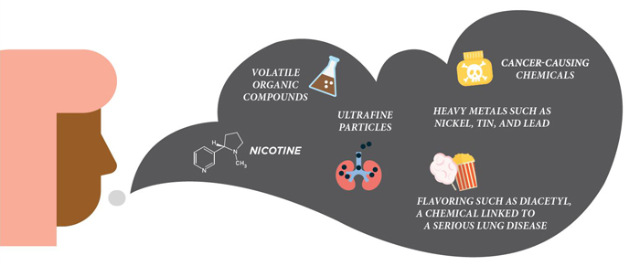
Notes:
E-cigarette aerosol contains many chemicals and compounds with potential health concerns. These include nicotine, ultrafine particles that go deep into the lungs, heavy metals such as nickel, tin, and lead, flavorings that are safe to eat but dangerous to breathe, volatile organic compounds, and other cancer causing chemicals.

Slide 21
What’s in E-Cig Aerosol?
Chlorobenzene
Crotonaldehyde
Propionaldehyde
Benzaldehyde
Valeric acid
Hexanal
Fluorine
Anthracene
Pyrene
Acenaphthylene
Acenapthene
Fluoranthene
Benz(a)anthracene
Chrysene
Retene
Benzo(a)pyrene
Indeno(1,2,3-cd)pyrene
Benzo(ghi)perylene
Acetone
Acrolein
Silver
Nickel
Tin
Sodium
Strontium
Barium
Aluminum
Chromium
Boron
Copper
Selenium
Arsenic
Nitrosamines,
Polycyclic aromatic hydrocarbons
Cadmium
Silicon
Lithium
Lead
Magnesium
Manganese
Potassium
Titanium
Zinc
Zirconium
Calcium
Iron
Sulfur
Vanadium
Cobalt
Rubidium
Propylene glycol
Glycerin
Flavorings (many)
Nicotine
NNN
NNK
NAB
NAT
Ethylbenzene
Benzene
Xylene
Toluene
Acetaldehyde
Formaldehyde
Naphthalene
Styrene
Benzo(b)fluoranthene
Notes:
In fact, here is a list of all the chemical compounds that have been found in e-cigarette aerosol. This is certainly not water vapor! Considering this list of ingredients, is it any surprise that e-cigarettes have been shown to increase risk of heart attack, increase risk of stroke, and increase risk of Chronic Obstructive Pulmonary Disorder?

Slide 22
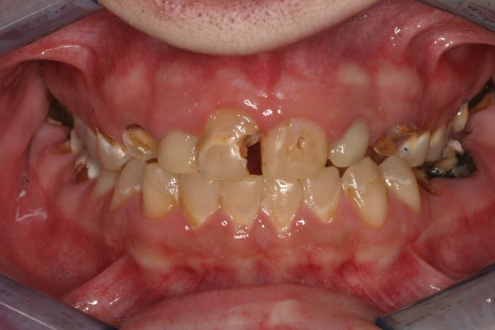
Notes:
There are a couple of ingredients in e-cigarette aerosol that are problematic for oral health.
The first is propylene glycol. When propylene glycol is used orally, it breaks down to acetic acid, lactic acid, and propionaldehyde, which are toxic to enamel and soft tissue. Additionally, propylene glycol dries out the mouth, which causes an increase in cavities and gum disease.
The second problematic ingredient, or ingredients, are the vegetable glycerin and flavorings. The combination of vegetable glycerin with the flavorings allow more cavity causing bacteria to stick to teeth and reduces enamel hardness.
Finally, there is the nicotine. Nicotine constricts the blood vessels in the mouth, reducing blood flow to the teeth and gums. It also impacts the immune system response and decreases connective tissue turnover. The end result is a higher chance of developing gum disease and tooth loss.

Slide 23
“We don’t think a lot about addiction here because we’re not trying to design a cessation product at all … anything about health is not on our mind.”
Notes:
Now how many here believe JUUL was created as an “alternative for adult smokers?” Here is a quote from one of the engineers who created JUUL.

Slide 24

Does the maker of Marlboro cigarettes want to end smoking?
Notes:
Furthermore, in December 2018, Altria, the maker of Marlboro cigarettes, bought a 35% share in JUUL. All major cigarette companies have their own e-cigarette brand. Do cigarette makers want to end smoking? Do they want everyone to stop using? Or are they pushing products they know will extend addiction?

Slide 25
Challenges to Quitting
Physical addiction to nicotine
Emotional and psychological connections
Behavioral habits
Social connections
Notes:
Let’s talk quitting. You have students vaping in your class. You found your teen with a JUUL in his bedroom. How do we help them quit?
There are four main barriers to quitting.
The physical addiction to nicotine.
The emotional connection to using tobacco. You’ve heard people say cigarettes are their best friend? Had a fight with a friend, worried about a class, difficult time at home with the family, and tobacco is a friend who can help them cope.
The behavioral aspect of tobacco use. With adults it’s usually the first cigarette of the day with a cup of coffee. With teens it may be using in the car after school, going to that one bathroom between 3rd and 4th period, something you do while studying.
The social connections are especially important for teens. Tobacco use almost always starts off as a social activity. A group of friends getting ready to go watch the game. Friday night watching movies. Sitting in the back of the school bus and laughing about not getting caught. And the social connection here includes social media, which provides hundreds or thousands of hits of validation for tobacco use.

Slide 26
Signs of Addiction
Cravings, or feeling like they really need to use tobacco
Going out of their way to get tobacco
Feeling anxious or irritable if they want to use tobacco but can’t
Continuing to use tobacco because it is hard to stop
Notes:
Teenagers can be addicted to tobacco even if they are not daily users. What does addiction look like in a teen?
Cravings, or feeling like they really need to use tobacco.
Going out of their way to get tobacco. So if a student is getting in trouble over and over for using tobacco in school, think – is this misbehavior? Or is this an addiction?
Feeling anxious or irritable if they want to use tobacco or can’t. This an be hard with teens, because mood swings are part of puberty, but if they are used to using tobacco right after dinner and you come to their room to talk and interrupt, they are not going to be happy.
Finally, the hallmark of any addiction, is continuing to use tobacco because it is hard to stop. Even if teens want to stop using, they keep using again and again and again.

Slide 27
Increase Motivation to Quit
How is quitting relevant to you?
What do you know about the risks?
What would be rewarding about quitting?
What roadblocks are there to quitting?
Repeat! Repeat! Repeat!
Notes:
Motivational interviewing is a technique to help people find their own reasons and techniques to change difficult behavior. We can use the 5 R’s to help teens, and others, find motivation to quit.
How is quiting relevant to you? What makes you think you need to quit?
What do you know about the risks of using? Focus on the short term problems, such as the cost, dry mouth, school problems, feeling loss of control, etc.
What would be rewarding about quitting? Would you feel better? Have money for cool new things? Get along with your favorite teacher a little bit better?
What roadblocks are there to quitting? What makes quitting difficult? Friends? Family? Dealing with stress? Problem solve ways to overcome these difficulties.
Repeat! Repeat! Repeat! Quitting is a process that can take many attempts. Teens especially need a supportive community to provide the structure necessary to quit. Be prepared to have this conversation multiple times with the same teen and be aware that motivation may come and go. That is normal! You are helping plant the seeds to successfully quit, if not today, then in the future.

Slide 28
Beat Your Cravings!
Notes:
Distract: Find something else to do to take your mind off of tobacco.
Drink: Try water, herbal tea, or sparkling water. Avoid caffeine. It gives your mouth something to do and some flavor. Relieves dehydration.
Delay: Most cravings last ten minutes or less. Think of cravings like waves crashing to the store. They feel strong, but they do recede and you have time before another craving comes.
Deep Breaths: Try deep breathing that relaxes the body and relieves tension.
Discuss: Talk about your cravings with a trusted adult or friend who will help remind you of your reasons to avoid using.

Slide 29

But what about my friends?
Notes:
The most challenging aspects for teens will probably be friends. While as parents we might want our teens to stop hanging out with friends who are using tobacco. And sometimes that may be an option. But that may not be an option according to your teen! So how do you quit tobacco but not quit your friends?
Find new ways to hang out and in new places. Make sure you are at homes that do not allow tobacco use. Go places where you cannot use, like the mall or shopping. Avoid places where it is easy to use, or you have used in the past. Break that behavioral connection.
Talk to your friends about wanting to quit and why you want to quit. Ask them to support you and tell them how they can support you. Don’t offer you tobacco. Don’t talk about using. Remind you why you want to quit in the times it’s hard.
If you have friends who use tobacco a lot, try spending more time on the phone or texting for a few weeks and less time hanging out in person where you may be tempted.
For the adults, help teens practice the skills they will need to negotiate friendships. Practice with them. Role play saying “no to tobacco use,” saying “I can’t hang out at that one house because they smoke inside,” “I need some space right now.”

Slide 30
Resources to Quit
“QUITKY” to 797979
www.quitnowky.org
“QUIT” to 202-804-9884
www.thisisquitting.org
Smokefree.teen.gov
Notes:
Are there resources out there to help teens quit? Yes! But teens will not be successful if they do not have a comprehensive support network, including parents, teachers, friends, and healthcare providers.
Some teenagers are eligible for nicotine replacement therapy. Check with your pediatrician to see if that is an option.
Quit Now Kentucky is available for teens ages 15 and older and has a special protocol just for e-cigarette use.
This is quitting and the 202 text number are from the Truth Initiative, a national campaign to prevent teen tobacco use. They have text messaging and an app.
And smokefree.teen.gov is from the National Cancer Institute and includes an app and text messaging.
NRT – ask your Dr

Slide 31
Barriers to Reducing Tobacco Use
Tobacco easily accessible
Smoking in public legal
Unfettered advertising
Poor access to cessation help
Individual
Tobacco Addiction
Notes:
On a final note, what can we as a society do to reduce tobacco use, including e-cigarettes?
What makes it harder to stop tobacco use?
If tobacco is easily accessible. If it is cheap, available at most stores, and if parents and friends are willing to give them away, teens will use tobacco.
If smoking and vaping are legal in restaurants, workplaces, and on school property, more teens will use tobacco.
If there is unfettered, meaning unrestricted, advertising for tobacco, including e-cigarette ads promoting smoking cessation on the radio, in newspapers and magazines, and online, more teens will use tobacco.
And finally, if it is hard to get help to quit using tobacco, more people will continue to use tobacco.

Slide 32
Facilitators to Reducing Tobacco Use
Tobacco more expensive and less accessible
Smoke-free policies
Counter-marketing and promotion restrictions
Easy access to help
Individual
Tobacco Addiction
Notes:
What makes it easier to reduce tobacco use?
If tobacco is more expensive, if it is sold in fewer stores, if there are not kid-friendly flavors, fewer teens will use tobacco.
If there are comprehensive smoke-free policies, fewer teens will use tobacco.
If there are hard-hitting mass media campaigns, fewer teens will use tobacco.
And if we make it easy for teens who want to quit to quit – they’ll quit!

Slide 33
Citations
Farrelly MC, Duke JC, Nonnemaker J, et al. Association Between The Real Cost Media Campaign and Smoking Initiation Among Youths — United States, 2014–2016. MMWR Morb Mortal Wkly Rep 2017;66:47–50. DOI: http://dx.doi.org/10.15585/mmwr.mm6602a2.
Frum, S and Neymark A. Vaping and oral health: It’s worse than you think. Perio-Implant Advisory. January 10, 2019. Available at: https://www.perioimplantadvisory.com/articles/2019/01/vaping-and-oral-health-it-s-worse-than-you-think.html
JUUL Sampling Tour. Available at: https://becore.com/portfolio/juul-sampling-tour/. Accessed Jan. 17, 2019
National Cancer Institute. Nicotine and Addiction. Available at: https://teen.smokefree.gov/the-risks-of-tobacco/nicotine-addiction. Accessed Jan. 17, 2019.
Nitasha Tiku. “Startup behind the Lambo of vaporizers just launched an intelligent e-cigarette.” The Verge. April 21, 2015. Available at: https://www.theverge.com/2015/4/21/8458629/pax-labs-e-cigarette-juul
Stanford Tobacco Prevention Toolkit. Stanford University. Available at: https://med.stanford.edu/tobaccopreventiontoolkit/about.html
World Health Organization. Toolkit for delivering the 5A’s and 5R’s brief tobacco interventions in primary care. 2014. Available at: https://apps.who.int/iris/bitstream/handle/10665/112835/9789241506953_eng.pdf;jsessionid=BCEA0A93361C1E79087618EC7A3B431A?sequence=1

