Slide 1

Welcome to the
2023 Kentucky Asthma Symposium
Asthma and Appalachia:
An Old Disease in a Changing World

Slide 2

Rahel Basse, MPH
Rahel Basse is the Program Manager for the Kentucky Asthma Management Program (KAMP) within the Kentucky Department for Public Health and has worked with the KAMP since 2019. She holds a Bachelor of Science degree in Biological Sciences and a Master of Public Health degree in Environmental and Occupational Health. She has ten years of experience in public health that includes work in higher education, local communities, K-12 schools, the Kentucky Division of Occupational Safety & Health Compliance, and the Kentucky Office of Community Health Workers. She currently serves as the Secretary of the Kentucky Asthma Partnership.

Slide 3
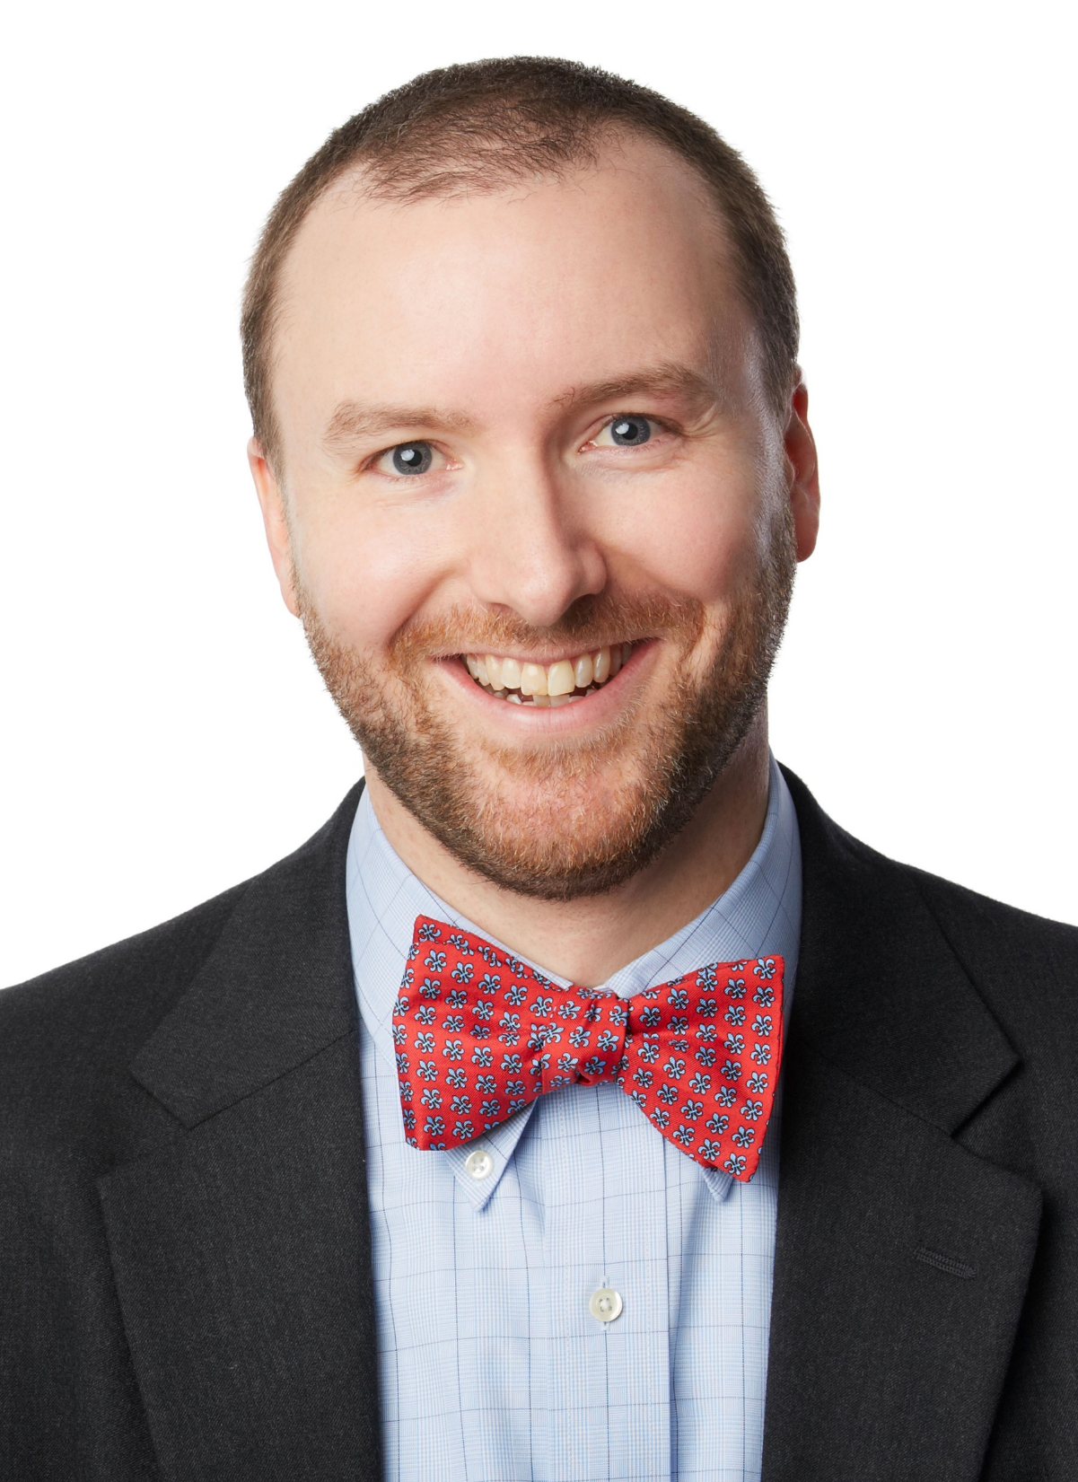
Douglas R. Lotz, MD FACAAI
Douglas R. Lotz, MD is a Medical Director and Senior Partner with Family Allergy & Asthma based in Louisville, KY. He also serves as Clinical Instructor in the Department of Pediatrics, Division of Allergy and Immunology at the University of Louisville School of Medicine. Dr. Lotz received his medical degree from the University of Louisville School of Medicine. He then completed his residency in both internal medicine and pediatrics at the University of Cincinnati/Cincinnati Children’s Hospital. From there, Dr. Lotz moved to St. Louis to complete his fellowship in allergy and immunology at St. Louis University School of Medicine. Dr. Lotz is a fellow in the American College of Allergy, Asthma and Immunology, and a member of the American Academy of Allergy, Asthma and Immunology, the American Academy of Pediatrics and the American College of Physicians. He is also the current Chair of the Kentucky Asthma Partnership and serves on the Kentucky Region Local Leadership Board of the American Lung Association.

Slide 4
James Crum, DO
Dr. Brandon Crum is a native of Eastern Kentucky and former coal miner. He is a board certified radiologist and certified B Reader at United Medical Group in Pikeville, KY. His clinic is one of the largest private black lung clinics in the country and has one of the largest databases on Central Appalachian miners in the world. Dr. Crum is world renown for his work in occupational lung disease, has multiple publications and active research on occupational lung disease and continues to work closely with the CDC and NIOSH to improve the safety for miners across the world.

Slide 5
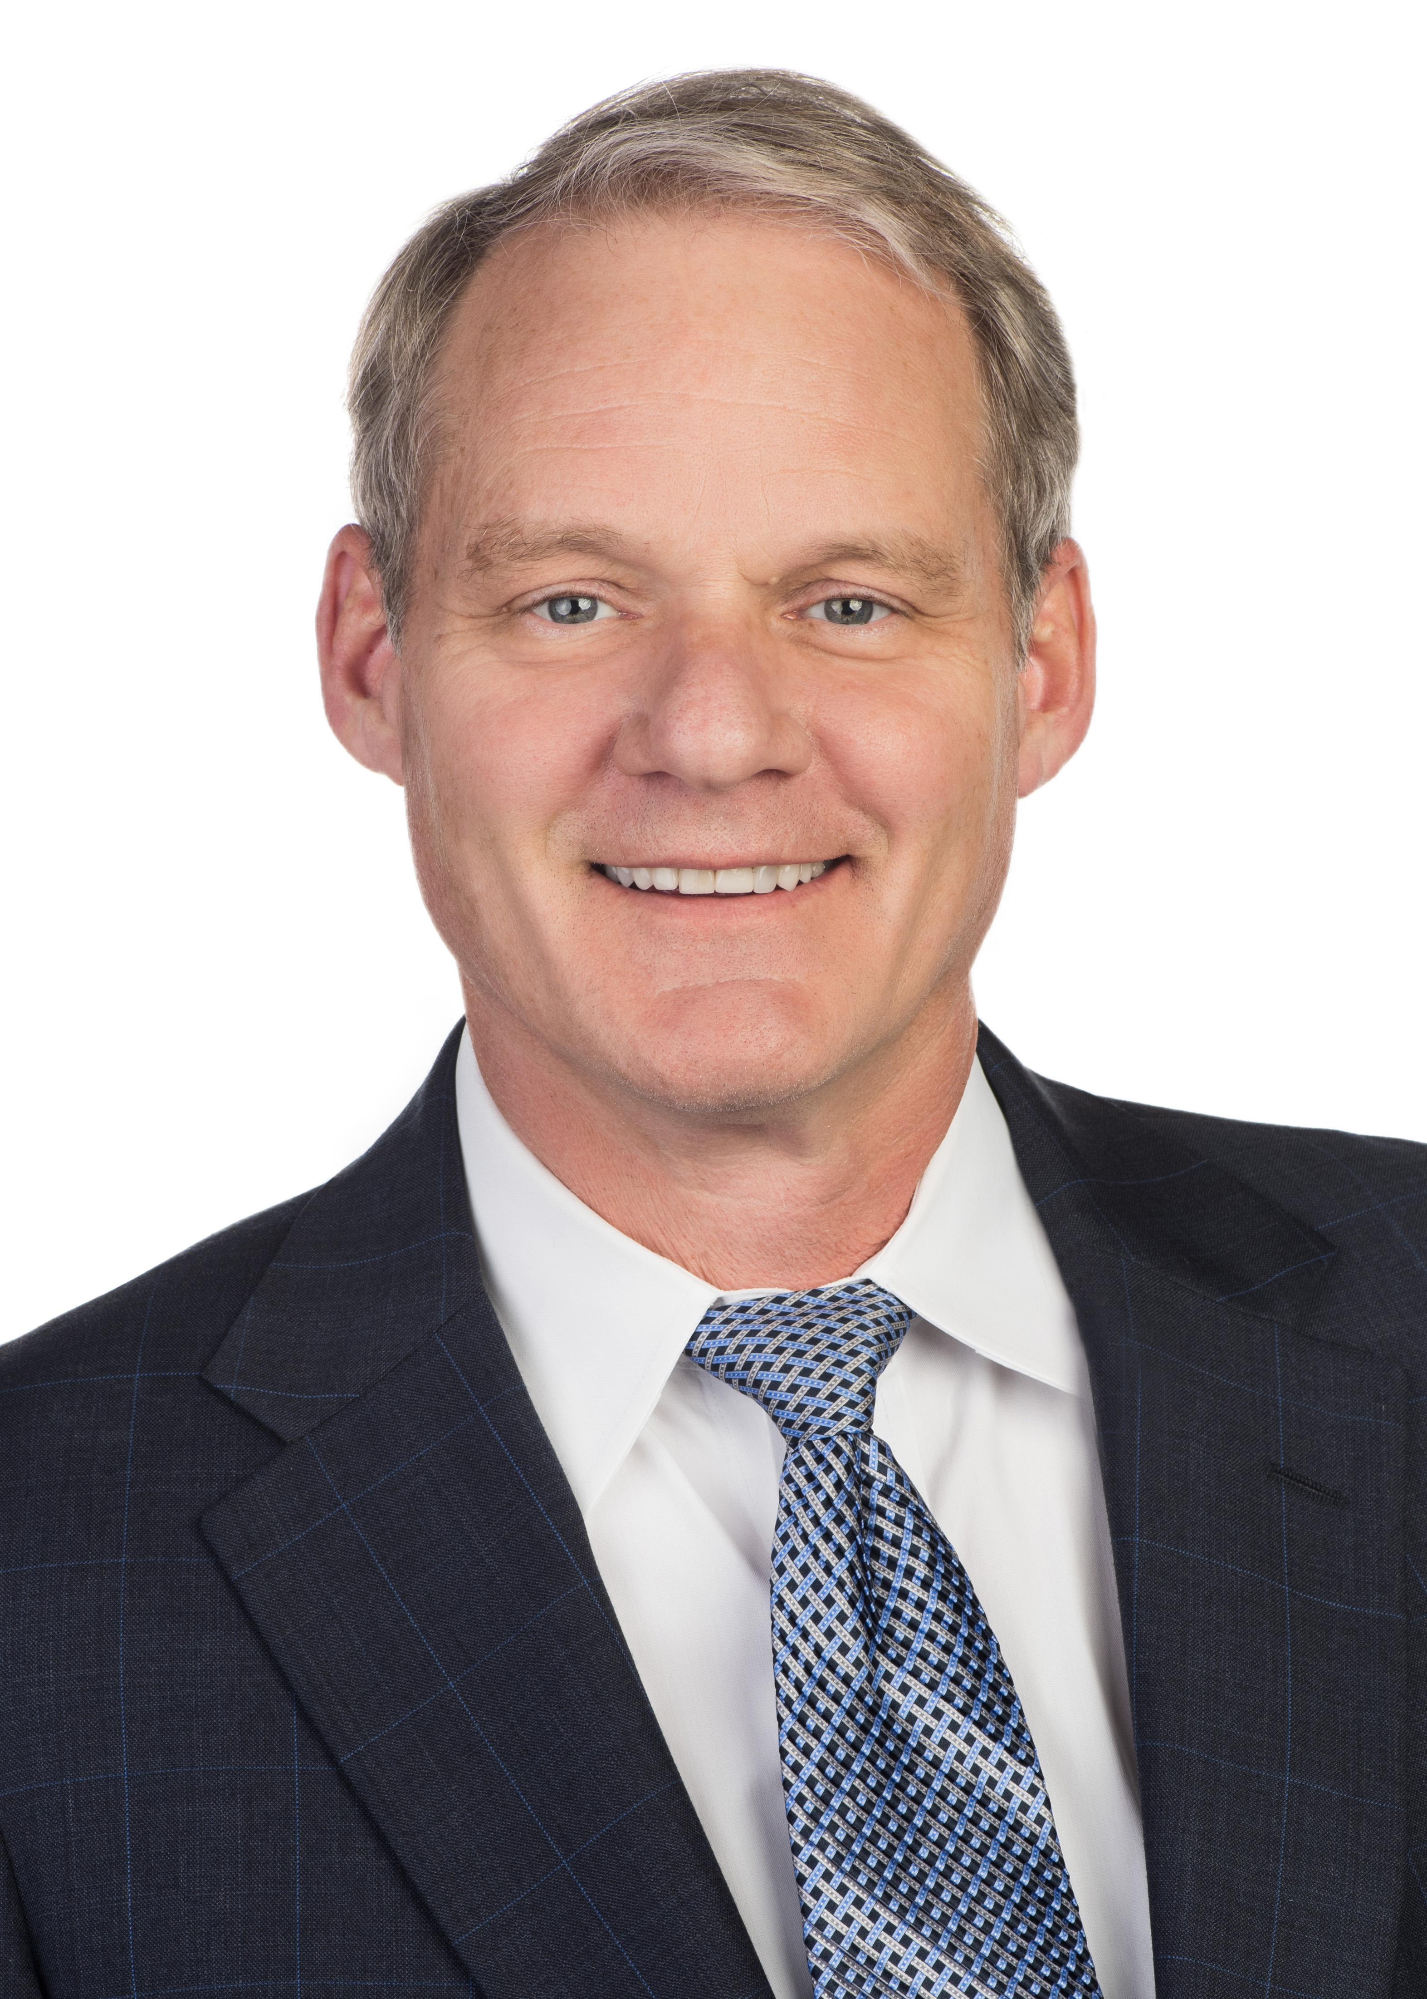
Mark Corbett, MD
Mark Corbett, MD has been in Private practice in Allergy/Immunology for 31 years and is currently in Louisville Kentucky with Family Allergy. Dr. Corbett also serves as Clinical Professor of Pediatrics at the University of Louisville and is the Immediate Past President of the ACAAI where he has served on the ACAAI Board of Regents from 2008-2010 and 2019-2023. Dr. Corbett served as President of both the Kentucky and Greater Louisville Allergy Societies, he served on the American Board of Allergy and Immunology from 2005-2010 where he was Chair in 2010 and he served at the ABMS on the MOC committee from 2010-2015.

Slide 6
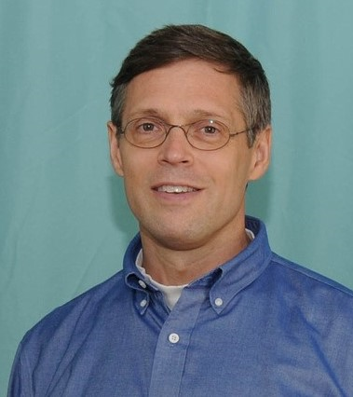
Michael Carnes, DO, FAAO
Dr. Michael Carnes graduated from Des Moines University College of Osteopathic Medicine in 1997 and completed his residency in osteopathic manipulative medicine at St. Barnabas Hospital, Bronx, NY. He has been practicing and teaching students and residents for the past decade here in Pikeville, and in Muskegon, MI for the decade previous. He served on the American Osteopathic Board of Neuromusculoskeletal Medicine from 2008 to 2019.

Slide 7
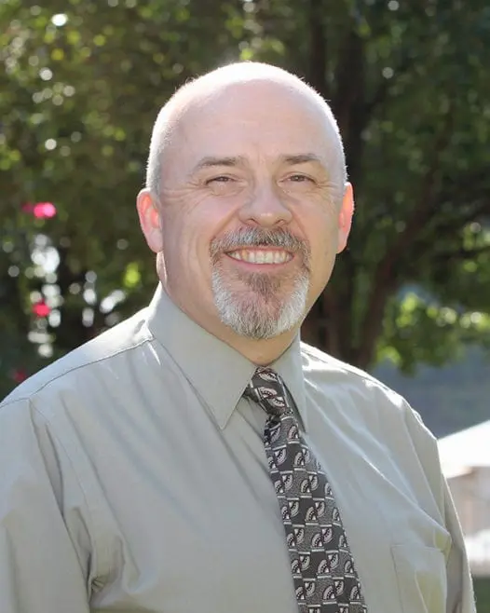
Danny Driskill, JD, EMT-P
Danny Driskill has served as the University of Pikeville Kentucky College of Osteopathic Medicine’s Simulation Director since 2016. He is currently an Associate Professor in KYCOM’s Department of Family Medicine, and a part-time paramedic with the Prestonsburg Fire Department. His 38 years of clinical experience include 16 years as a critical care flight paramedic. He has also practiced law in California and New Mexico, and has been a healthcare educator since 1990.

Slide 8
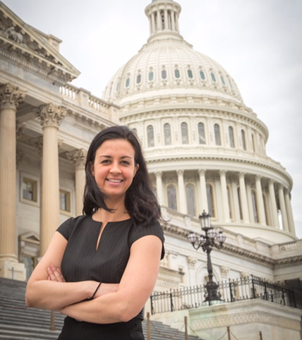
Brittany Meyer, Esq.
Brittany Meyer is the American Lung Association’s national director of healthy indoor air. Before coming to this role, she spent over a decade in policy and lobbyist positions in a variety of health-focused non-profit organizations. Most recently, she worked at the Michael J. Fox Foundation for Parkinson’s Research where she led a coalition of groups seeking to ban neurodegenerative pesticides and other chemicals. She focused on environmental law at the Washington College of Law in Washington DC and spent two years at the Environmental Protection Agency. She has an undergraduate degree focused on neuroscience from the University of California, Los Angeles.

Slide 9
Faculty Disclosure Statement:
All planners, speakers, authors, reviewers, and staff members involved with content development for continuing education activities sponsored by the
Southern Kentucky Area Health Education Center (AHEC) are expected to disclose any real or perceived conflict of interest related to the content of the activity.
Detailed disclosures will be included in participant materials or given prior to the start of the activity.
At the time of production, all individuals involved, had stated their disclosures.
Disclaimer
Southern Kentucky Area Health Education Center (AHEC) presents this activity for educational purposes only.
Participants are expected to utilize their own expertise and judgment while engaged in the practice of medicine. The content of the presentation is provided solely by presenter(s) who have been selected for presentations because of recognized expertise in their field.

Slide 10
CONFLICT OF INTEREST PROGRAM
DISCLOSURE STATEMENTS
2023 Kentucky Asthma Symposium
May 12, 2023
None of the planners, speakers, authors, reviewers,
and staff members have anything to disclose.

Slide 11
Continuing Education
After participating in all presentations, participants that need CE credit will need to visit:
https://sokyahec.thinkific.com/courses/2023-Asthma-May12
Evaluation will be available at approximately 3pm today.
You will have 2 weeks from the date of the program to complete the evaluation and receive a certificate.

Slide 12








Thank you to our
2023 Kentucky Asthma Symposium
Sponsors!
BRONZE LEVEL SPONSORS
GOLD LEVEL SPONSORS
EXHIBITOR LEVEL SPONSORS
SILVER LEVEL SPONSORS

Slide 13
2023 Kentucky Asthma Partnership
Asthma and Appalachia:
An Old Disease in a Changing World
Thank you for attending today!

