Slide 1
Indoor air quality:
Impacts of Residential Combustion on Health and the Environment

Slide 2
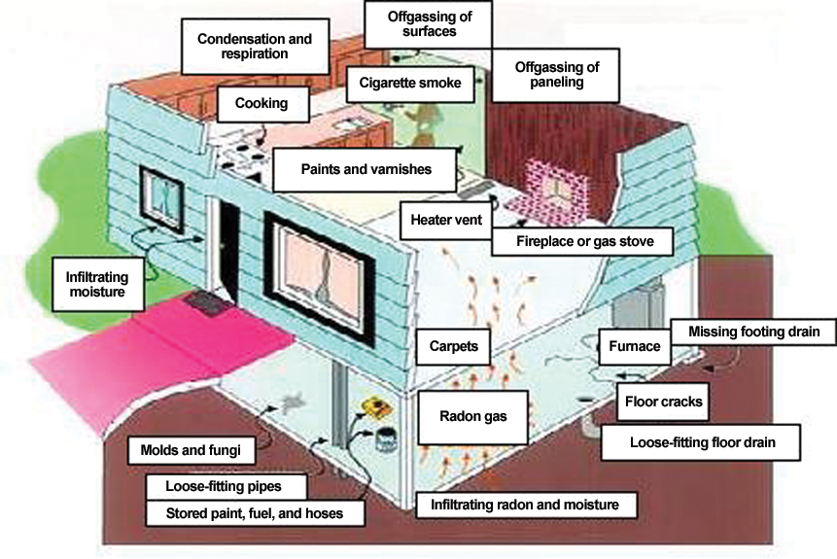
Why do we care about indoor air quality?
Poor air quality harms health.
More exposure leads to health concerns.
Routes of exposure are through:
Inhalation
Ingestion
Skin absorption
Injection

Slide 3
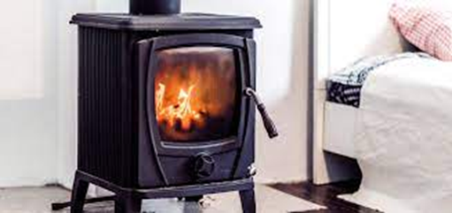
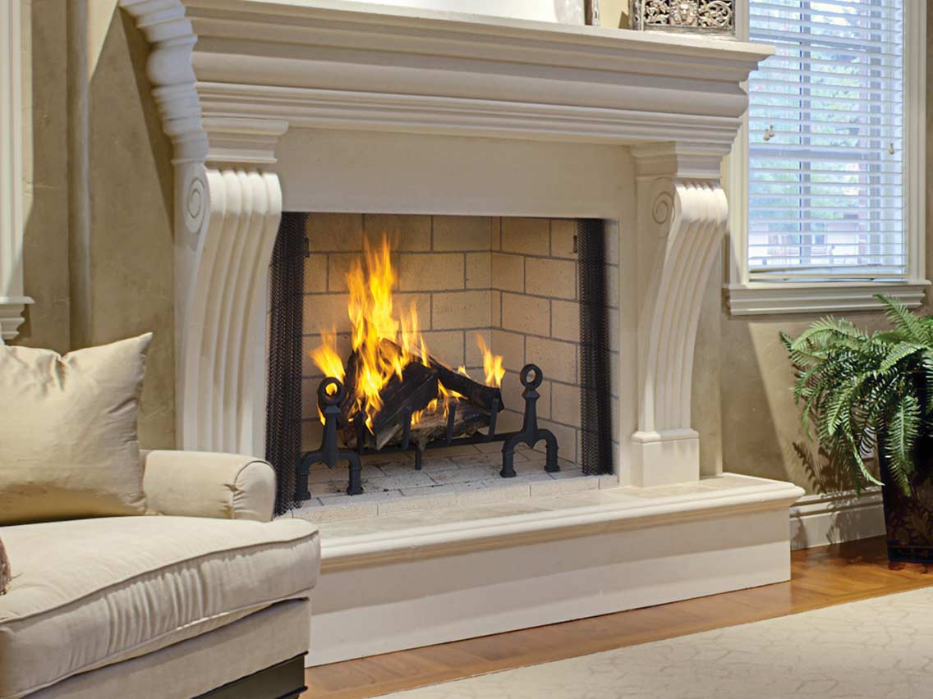
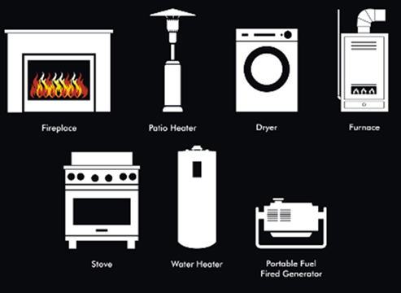
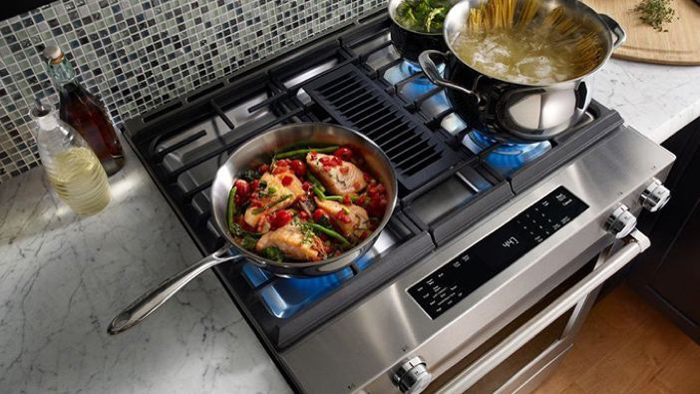
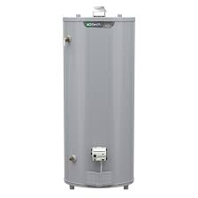
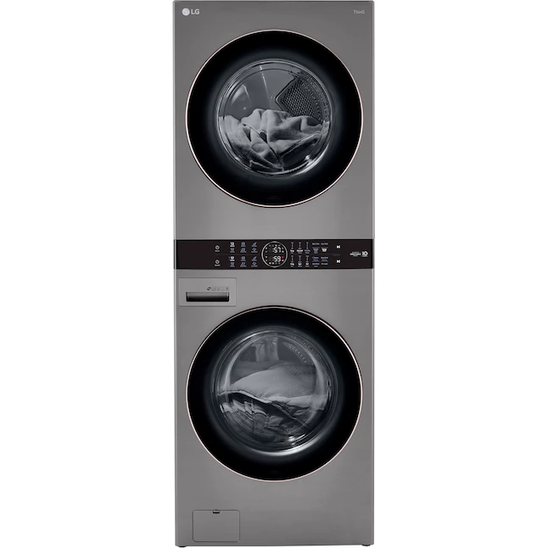
Focus on Combustion in the Home
A combustion appliance burns fuels for heating, cooking, or decorative purposes within the walls of the home.
Notes:
We’re going to focus on combustion appliances as a source of air pollution. Gas stoves has been getting some press lately, but there are other sources of combustion, which includes anything that uses fire to make heat directly in the home. Some examples are shown here.
We’ve long assumed that burning stuff directly in the home was not a good idea, particularly when the fuel is wood. But we weren’t sure exactly what was going on. So Last year, the American lung association set out to investigate exactly what these appliances are doing to our health.

Slide 4
Existing Literature Review Report
A systematic literature search was implemented to examine combustion appliances and their impact on our lives.
Expert consultants reviewed 70,865 articles from the bibliographic database searches. They used a combination of automated screening methods (e.g., natural language processing) and manual screening methods. Additionally, they retrieved numerous technical reports and other information from government agencies and organizations.
Notes:
Methodical and thorough- a lot of sources.
Might have missed some things- we acknowledge that

Slide 5
Existing Literature Review Report
We asked:
The number and types of appliances in homes, the fuel they use and their:
Emissions profile
Contribution to indoor air quality + impact of mitigations
Contribution to outdoor air pollution
Health impact of exposure to appliance emissions both in and out of doors
Notes:
Mitigations such as ventilation etc

Slide 6
Key Findings

Slide 7
Scope of the Issue
There are no indoor air quality standards in the United States
People spend most of their time inside (90+%)
Two-thirds of the approximately 118.2 million housing units in the United States use combustion-based appliances to cook, heat their homes, dry their clothes, and other chores
These households burn methane (commonly referred to as “natural gas”), wood, propane, heating oil or other fuel.
Roughly 60% use gas, 15% use other fossil fuels including propane, fuel oil, and kerosene and 9% use wood.
Notes:
This is what we found- key findings
Fossil fuels- manufactured in different ways and wood

Slide 8
Fuel Use in Kentucky
State Overview
Population: 4.40 million (1% total U.S.)
Housing Units: 1.94 million (1% total U.S.)
Annual Energy Consumption
Electric Power: 89.1 TWh (2% total U.S.)
Coal: 40,100 MSTN (5% total U.S.)
Natural Gas: 211 Bcf (1% total U.S.)
84% of Kentucky homes have an electric cooking appliance
20% of Kentucky homes have a natural gas powered cooking appliance
Notes:
Kentucky has slightly less than average of 1/3 gas. This doesn’t add up because of rounding and people with both.

Slide 9
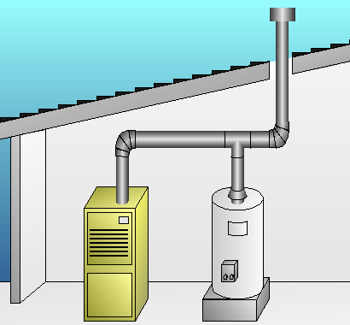
What do appliances emit?
All combustion produces by-products that are released as emissions, or air pollutants.
Gas-burning appliances can emit substantial amounts of CO and NOx as well as some of PM and air toxics
Gas appliances such as gas furnaces and water heaters are vented to the outside, though pollutants may get back-drafted into the home is certain circumstances
Gas kitchen appliances such as stoves emit directly into the living space, especially when vent hood is not used
Appliances using propane and kerosene emit at higher rates than those using natural gas
Notes:
The make-up and amount of emissions varies with the fuel type and the appliance.

Slide 10
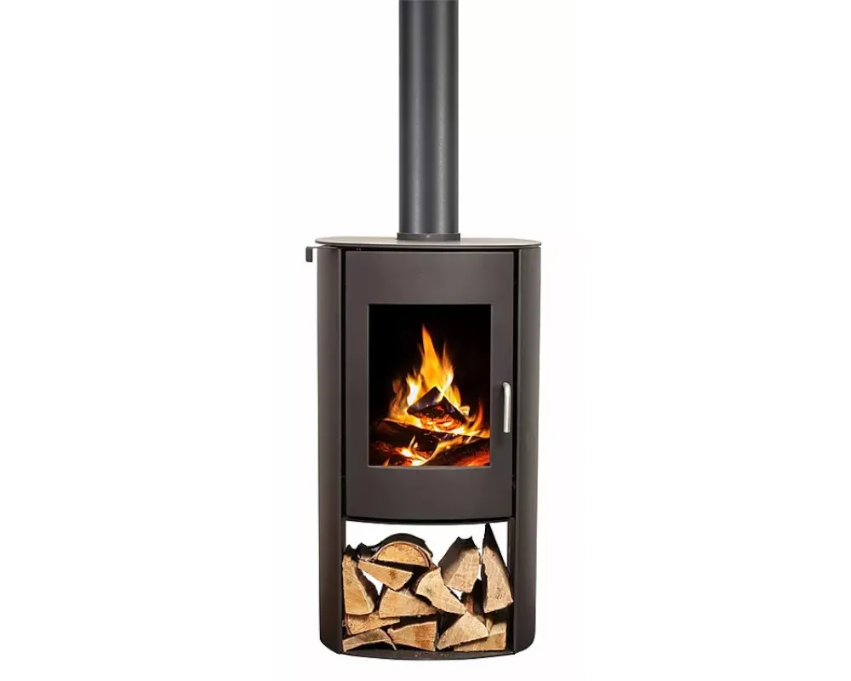
What do appliances emit?
Wood burning appliances include woodstoves and fireplaces
Residential wood combustion can greatly increase indoor levels of CO, NOx, particulate matter and air toxics including PAHs, benzene and chromium
Pelletized fuels generally emit at lower levels than cord wood, but the type of wood used for both makes a difference
For all combustion appliances, rates of emissions and their contribution to indoor air pollution depend on housing type, appliance age, maintenance status and usage practices
Notes:
Katherine

Slide 11
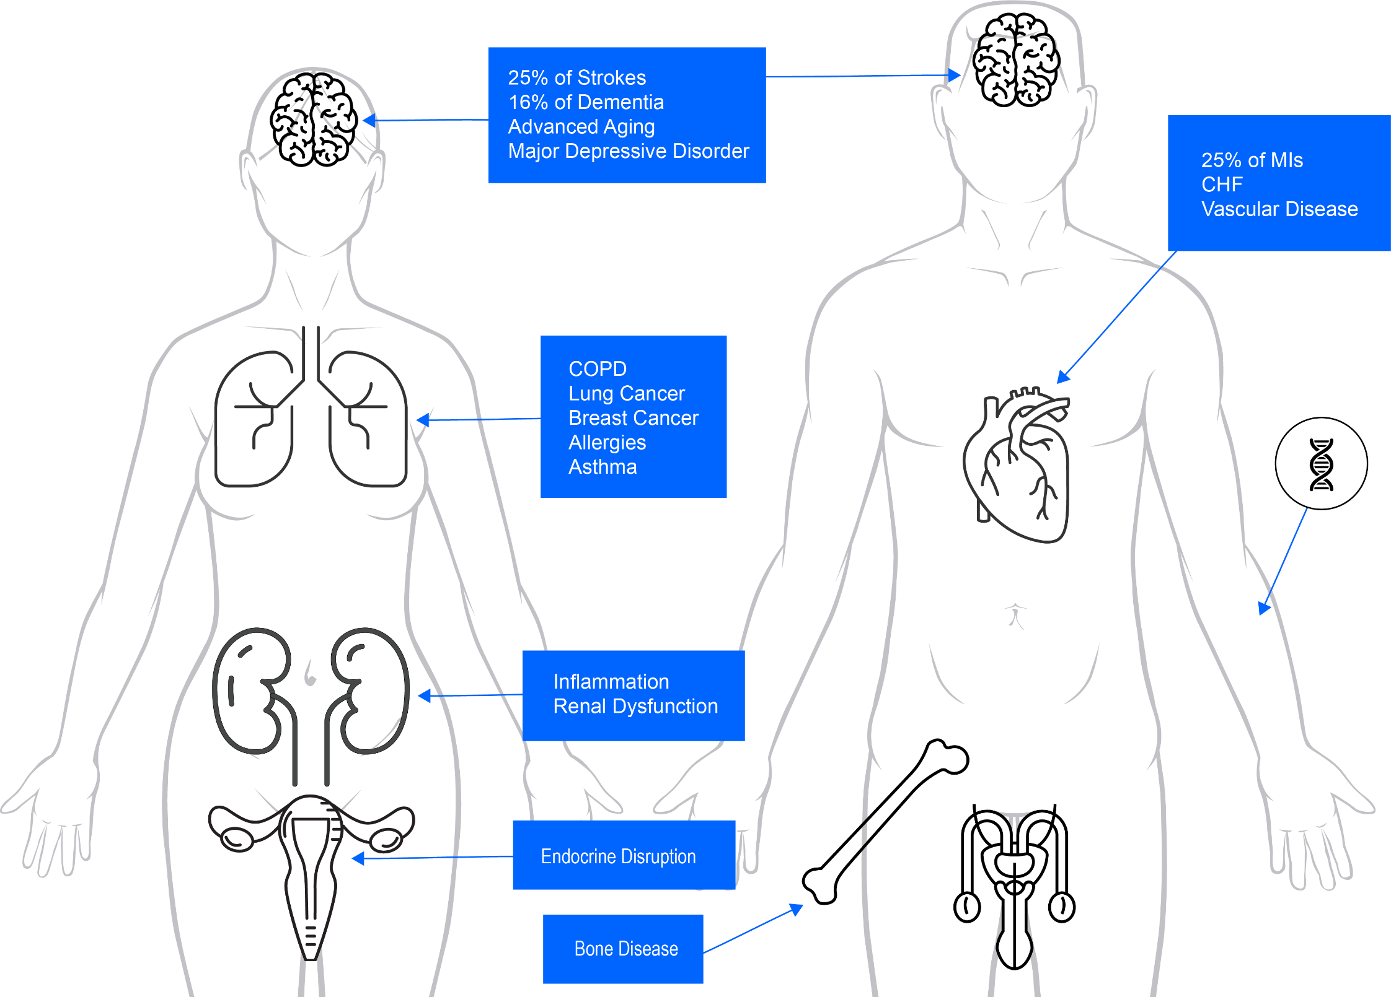
Hazards: Air Pollution

Slide 12
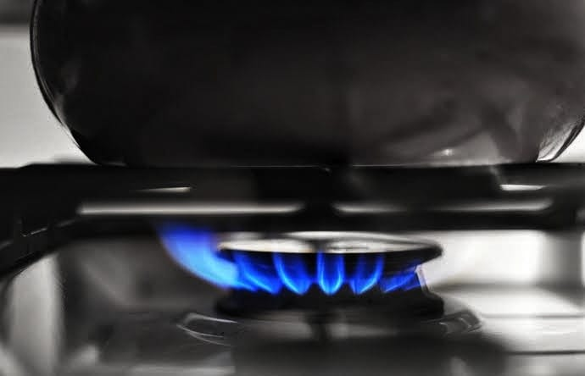
Health impacts of emitted pollutants
Combustion pollutants of primary concern:
Carbon monoxide (CO), a dangerous gas that when inhaled can interfere with the ability of blood to carry oxygen from the lungs to the rest of the body
Nitrogen oxides (NOx), a respiratory irritant that causes airway inflammation, coughing, wheezing and increased asthma attacks
Notes:
Katherine The body of knowledge on the health effects of these pollutants has been gathered over decades of research on outdoor and indoor air pollution generally – not specific to combustion appliances
NO_{x} is the term for the nitrogen oxides that are most relevant for air pollution, namely nitric oxide (NO) and nitrogen dioxide (NO₂)

Slide 13
Health impacts of emitted pollutants
Combustion pollutants of primary concern:
Particulate matter (PM), a mixture of microscopic solids and liquids that affects multiple body systems and can increase the risk of premature death
Air toxics, including ammonia, polycyclic aromatic hydrocarbons (PAHs), benzene and formaldehyde that can cause cancer, birth defects and other serious health harms
Notes:
Katherine

Slide 14
Health impacts of appliances in the home
Burning natural gas in homes releases nitrogen dioxide (NO2).
Homes that have gas burning appliances can make children sick, especially those with asthma and allergies. It worsens asthma symptoms and wheeze and may also increase lower respiratory tract infections and reduce lung function.
Evidence of health effects among adults is limited and inconsistent.
Notes:
This is from the report looking specifically at appliance exposure and their impacts
Lower respiratory tract infections
Rates of pneumonia

Slide 15
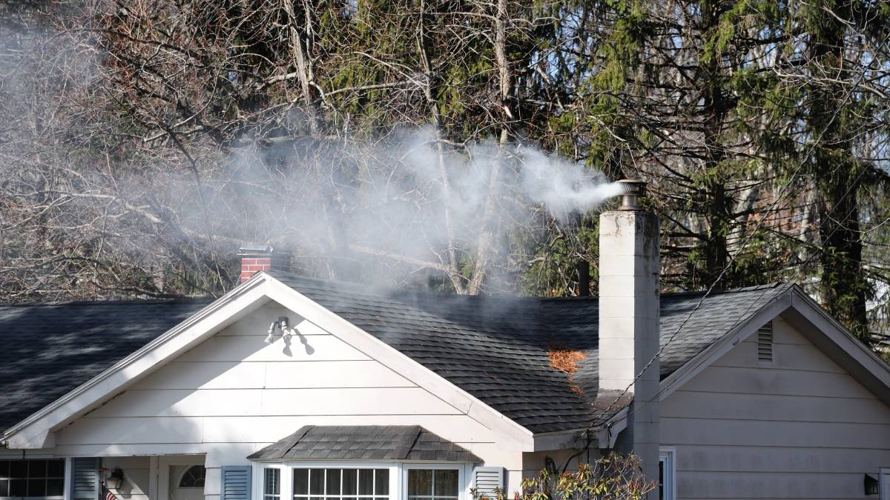
Health impacts of appliances in the home
Indoor exposure to air pollutants from wood combustion is linked with increased lower respiratory infections in children, and may be associated with upper respiratory infections, wheeze and cough.
The particulate matter from wood burning has a detrimental effect on children’s immune system, leaving them more susceptible to infections.
Smoke from indoor wood stoves is released to the outside and impacts the community. High levels of wood smoke related pollutants causes detrimental impacts for the area’s residents including irritation of the eyes, nose and throat, and respiratory effects in children.
Notes:
90% of local pollution is caused by wood burning in small rural towns

Slide 16
Indoor combustion impacts on outside air quality
The planet is a (relatively) closed system and while venting appliances to the outdoors reduces resident’s direct exposure to unhealthy emissions, their emissions contribute to local and regional outdoor pollution.
They also drive climate change across the planet.
Residential and commercial emissions made up 13% of total U.S. global warming emissions in 2020, mostly from burning natural gas and heating oil.

Slide 17
Limitations from the body of research
We limited our search to the United States
Most of the studies done are on solid fuels in other countries
No studies linking health impacts of indoor combustion of propane or kerosene to human health
Hard to accurately quantify what’s being used and level of maintenance
Notes:
We were surprised by the overall incompleteness of the overall picture on these questions. We were surprised by how little we know about the contribution of these appliances to indoor air quality and their health impacts in the united states.
Developing countries

Slide 18
Limitations from the body of research
Not many studies on the impacts of mitigation measures (beyond swap out programs for wood stoves)
Conflated variables- contribution of combustion pollutants vs other sources of common indoor pollutants and housing differences
Studies on outdoor pollution can’t definitively isolate the health impacts from indoor sources only
Notes:
Most studies look at the pollutant not the sources
VOCs come from paint, and markers

Slide 19
Suggested Mitigations
Notes:
Katherine

Slide 20
Suggested mitigations
ALA recommends a three-pronged approach: research, personal protection and source reduction
Additional research
Quantify the number and use of combustion appliances in the U.S.
Measure the impact of combustion pollutants on indoor air quality
Study the health effects “in real world settings” with an emphasis on sensitive populations
Notes:
Katherine As you will see in the review draft of the issue brief, we have made some recommendations for reducing the health impact of combustion in homes, in 3 different areas – research, personal protection and source reduction. these recommendations are very basic high level at this point, as we gather stakeholder input on specifics

Slide 21
Suggested mitigations
Personal protection
Ensure appliances are in good working order
Install carbon monoxide monitors
Use ventilation
Consider using HEPA air cleaners as needed
Source reduction
Reduce unnecessary wood burning, replace combustion appliances
Take advantage of incentive programs to purchase cleaner heating systems, water heaters, clothes dryers, and stoves
Notes:
Katherine

