Slide 1

Osteopathic Manipulation and Breathing
Michael Carnes, DO, FAAO
Jessica Jurak, NUFA, & Cayla Lyle, NUFA

Slide 2

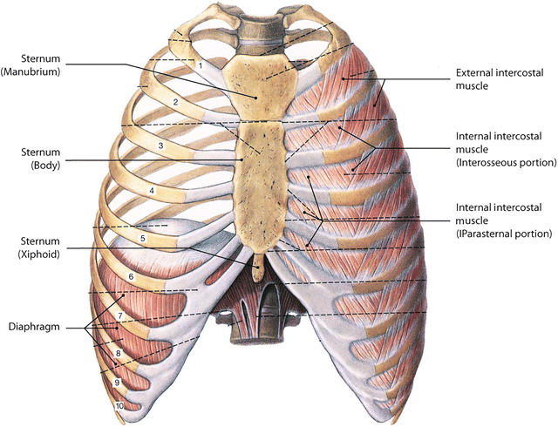
From: 9 Anatomy, Mechanics, and Physiology of Pulmonary Respiration
Foundations of Osteopathic Medicine: Philosophy, Science, Clinical Applications, and Research, 4e, 2018
Legend:
The intercostal muscles.

Slide 3
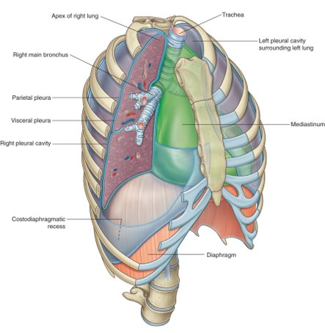
From: 3 Thorax
Gray's Anatomy for Students, 4e, 2020
Legend:
Pleural cavities.

Slide 4
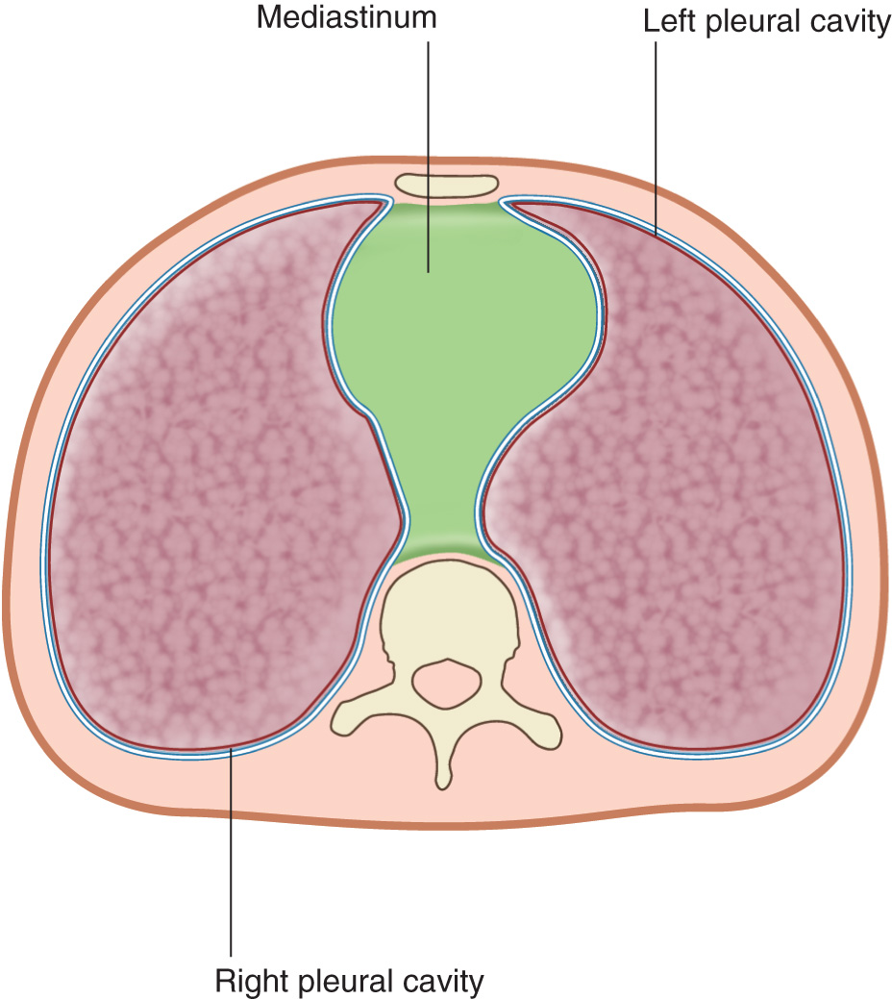
From: 3 Thorax
Gray's Anatomy for Students, 4e, 2020
Legend:
Cross-section of the thorax showing the position of the mediastinum.

Slide 5
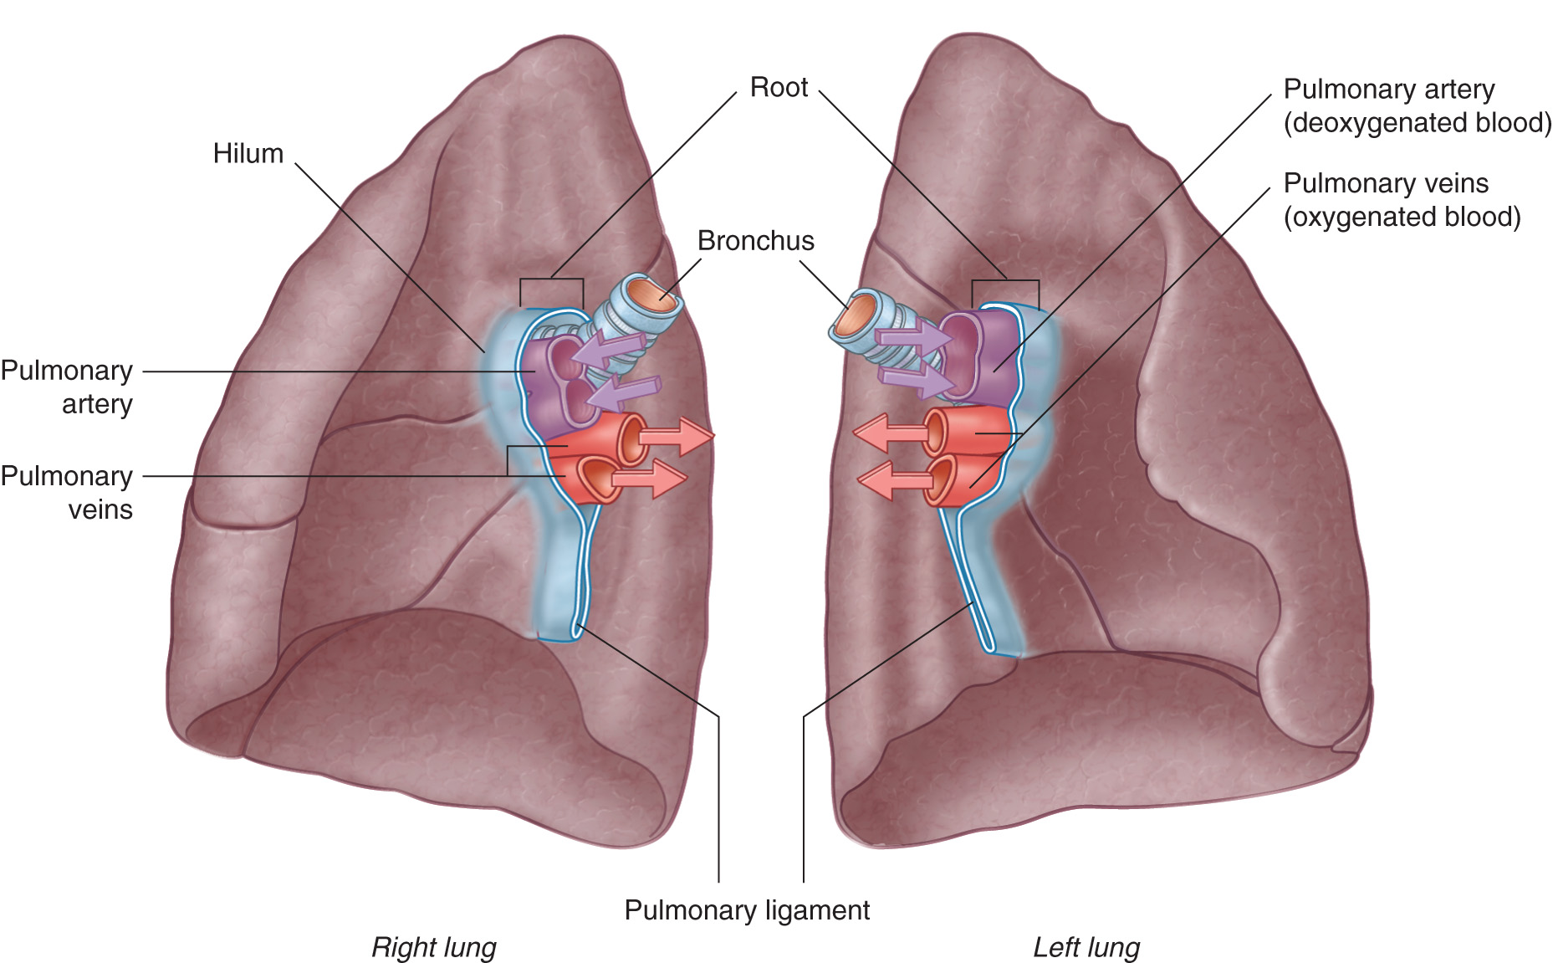
From: 3 Thorax
Gray's Anatomy for Students, 4e, 2020
Legend:
Roots and hila of the lungs.

Slide 6
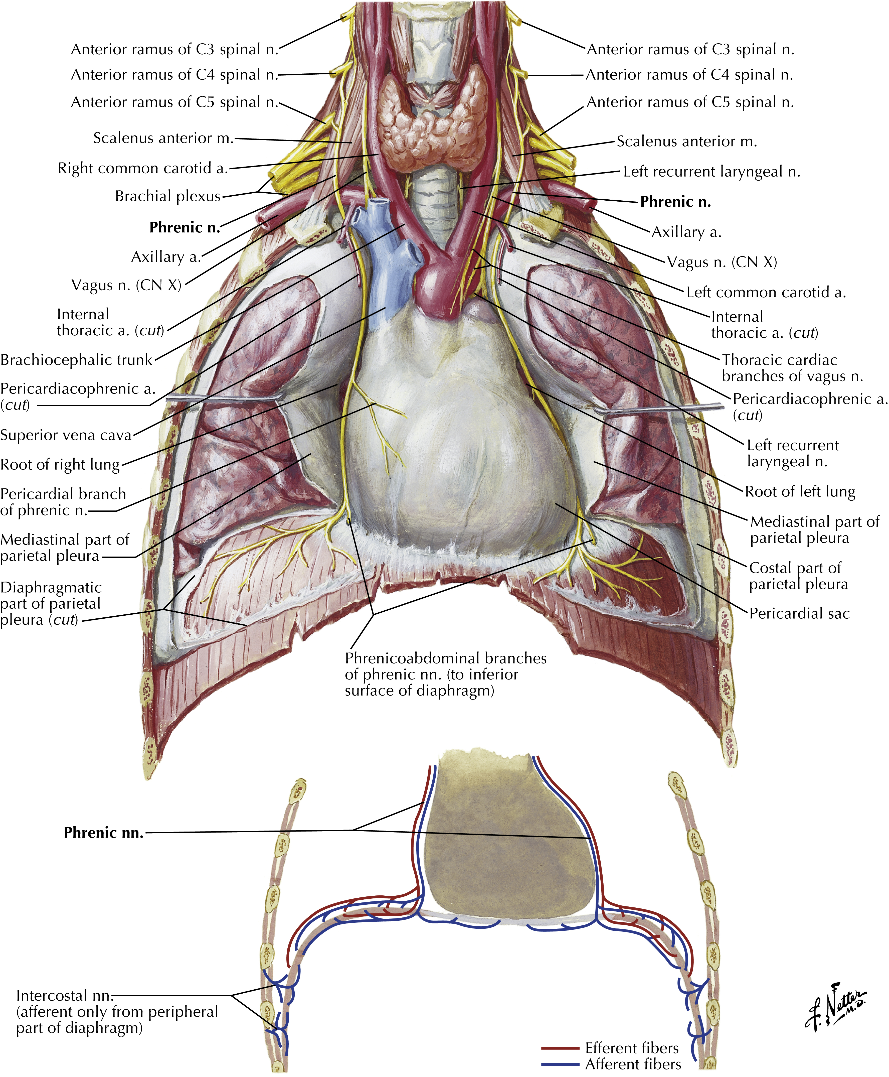
From: Thorax
Netter Atlas of Human Anatomy: Classic Regional Anatomy Approach, 8e, 2022
Legend:
Plate 214: Phrenic Nerve and Relationship to Pericardium

Slide 7
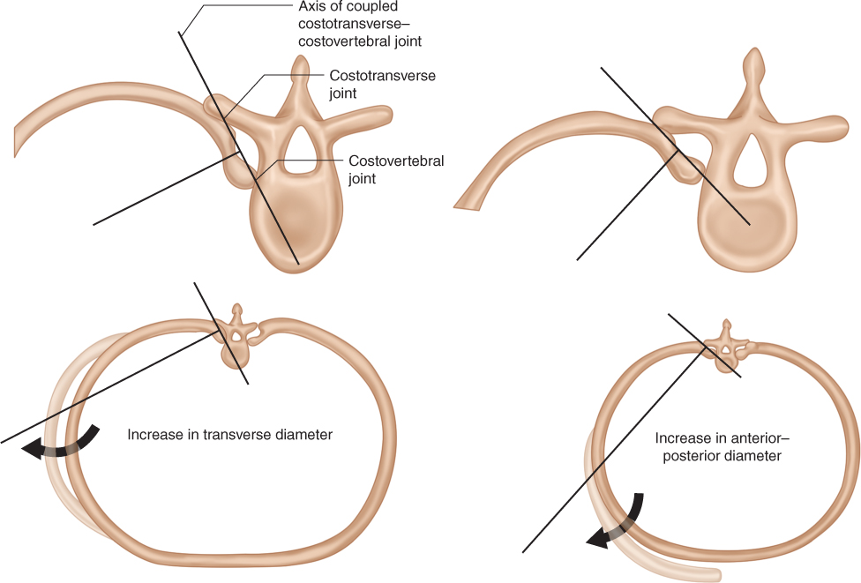
From: Chapter 69 Anatomic Considerations of the Thoracic Cage
An Osteopathic Approach to Diagnosis and Treatment, 4e, 2021
Legend:
Axes of the costotransverse–costovertebral joints.

Slide 8
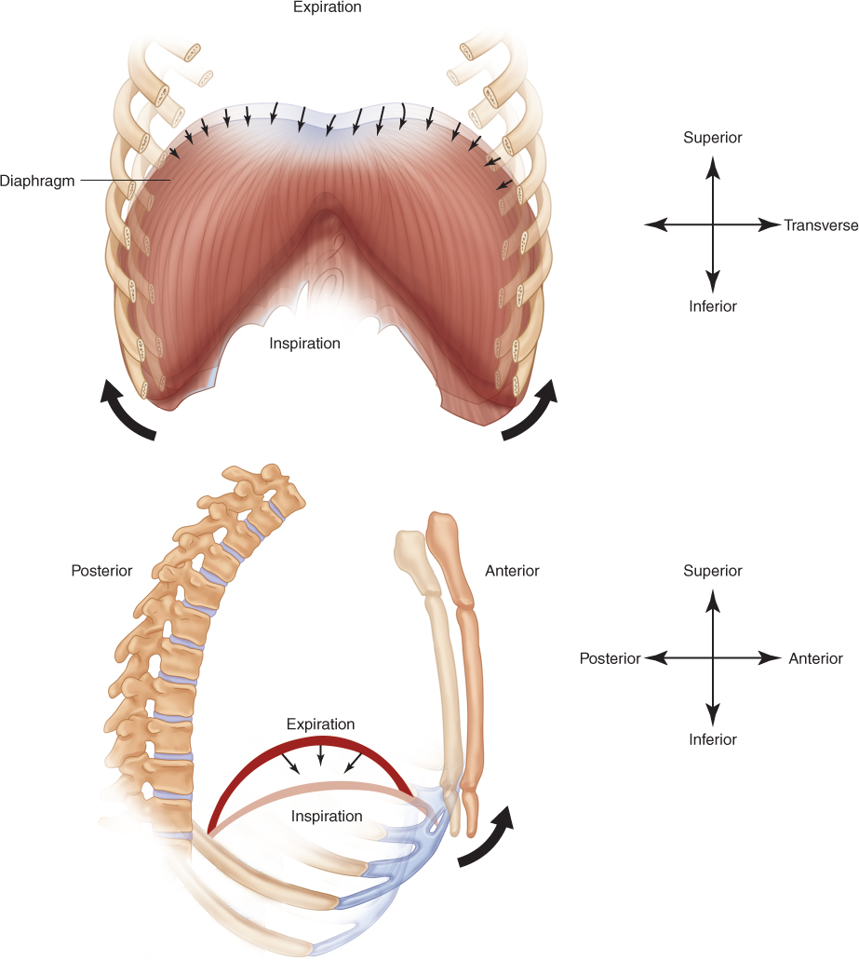
From: Chapter 69 Anatomic Considerations of the Thoracic Cage
An Osteopathic Approach to Diagnosis and Treatment, 4e, 2021
Legend:
Diameter changes that occur during diaphragmatic motion.

Slide 9
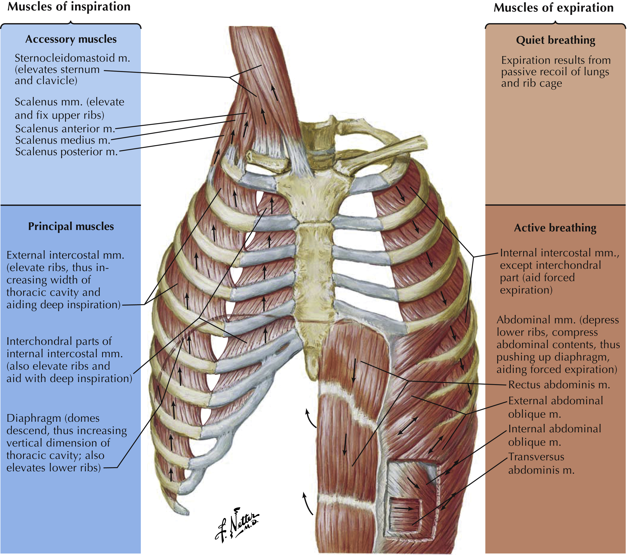
From: Thorax
Netter Atlas of Human Anatomy: Classic Regional Anatomy Approach, 8e, 2022
Legend:
Plate BP 43: Muscles of Respiration

Slide 10
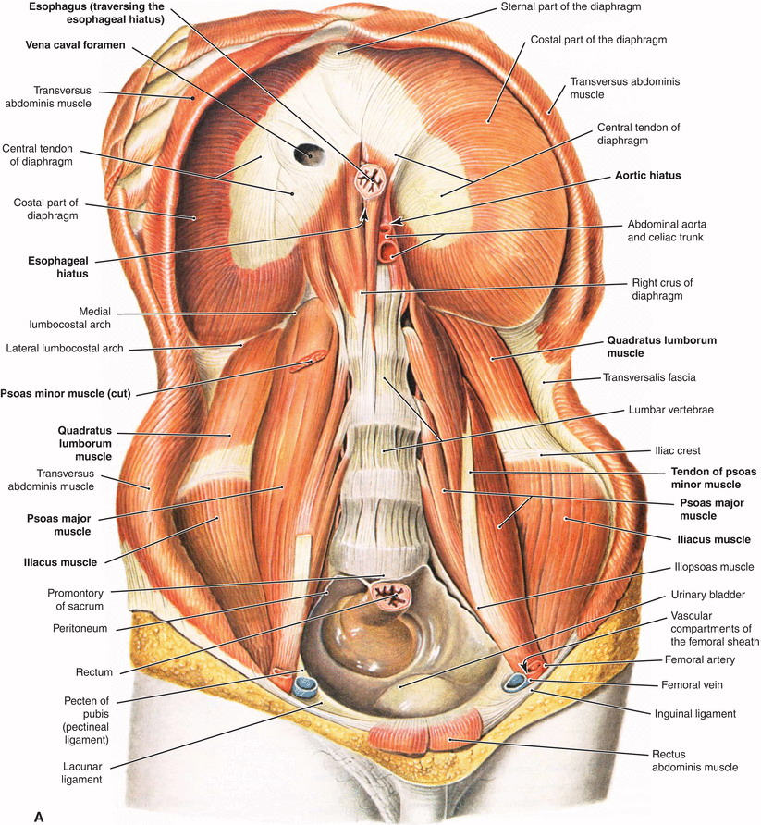
From: 9 Anatomy, Mechanics, and Physiology of Pulmonary Respiration
Foundations of Osteopathic Medicine: Philosophy, Science, Clinical Applications, and Research, 4e, 2018
Legend:
The inferior surface of the thoracoabdominal diaphragm.

Slide 11
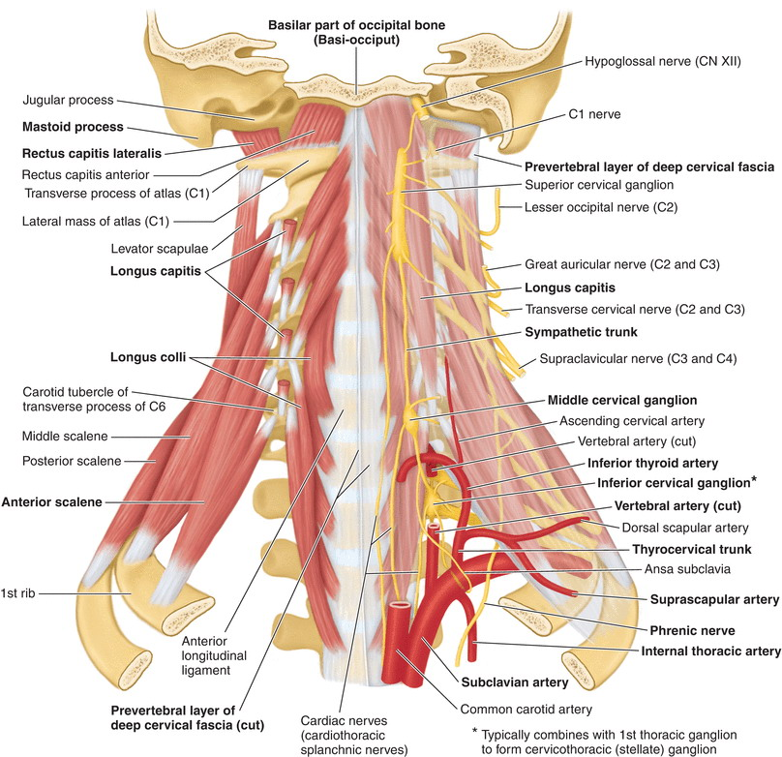
From: 28B Cervical Region
Foundations of Osteopathic Medicine: Philosophy, Science, Clinical Applications, and Research, 4e, 2018
Legend:
The cervical prevertebral region.

Slide 12
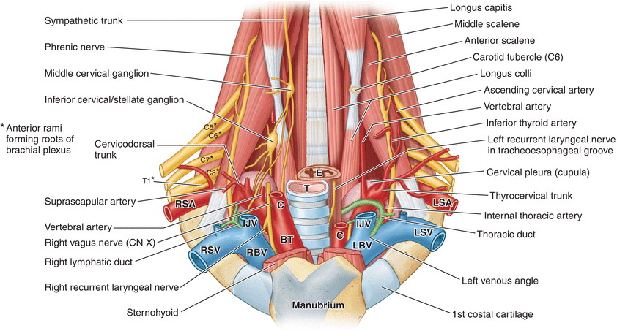
From: 28B Cervical Region
Foundations of Osteopathic Medicine: Philosophy, Science, Clinical Applications, and Research, 4e, 2018
Legend:
The root of the neck.

Slide 13
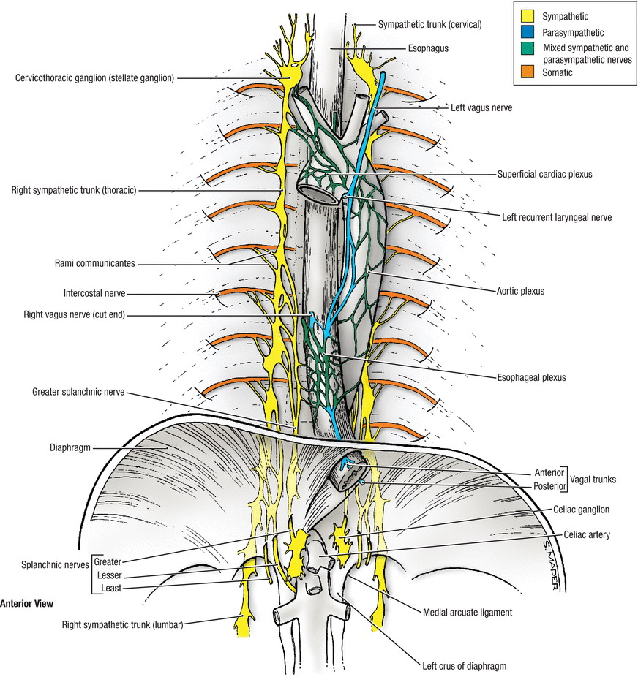
From: Chapter 10 Autonomic Nervous System
Foundations of Osteopathic Medicine: Philosophy, Science, Clinical Applications, and Research, 4e, 2018
Legend:
An anterior view of the thoracic plexus.

Slide 14
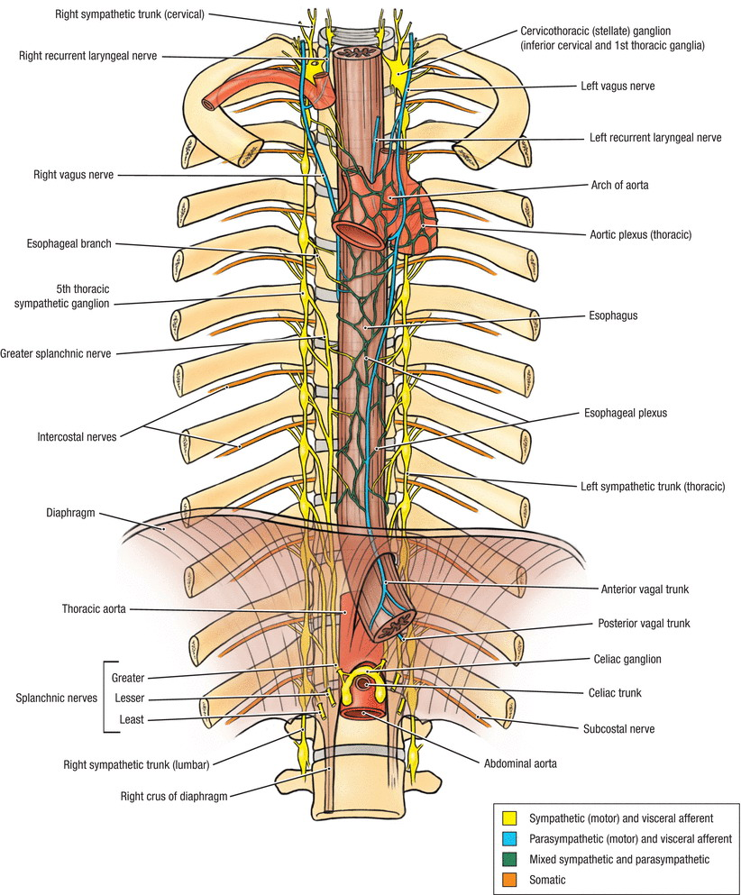
From: Chapter 10 Autonomic Nervous System
Foundations of Osteopathic Medicine: Philosophy, Science, Clinical Applications, and Research, 4e, 2018
Legend:
The esophageal plexus.

Slide 15
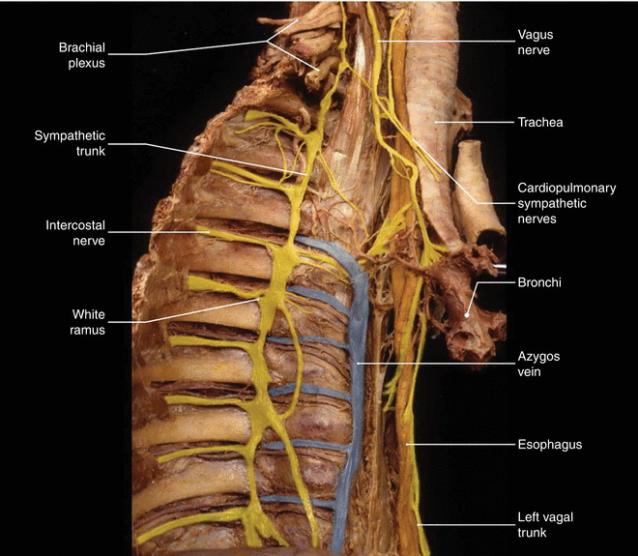
From: Chapter 10 Autonomic Nervous System
Foundations of Osteopathic Medicine: Philosophy, Science, Clinical Applications, and Research, 4e, 2018
Legend:
Sympathetic trunk in the upper thoracic region.

Slide 16
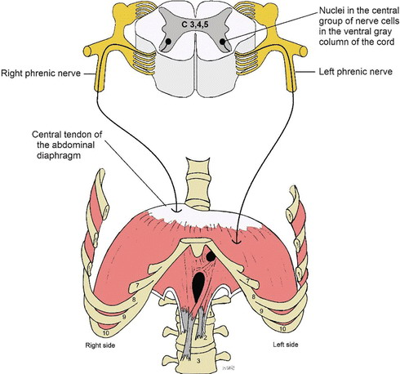
From: 28D Rib Cage
Foundations of Osteopathic Medicine: Philosophy, Science, Clinical Applications, and Research, 4e, 2018
Legend:
Phrenic nerve innervation to the thoracoabdominal diaphragm.

Slide 17
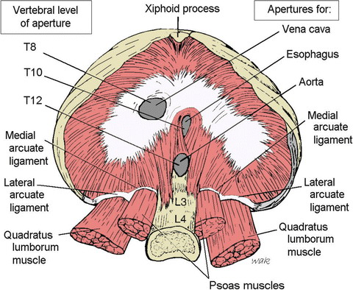
From: 28D Rib Cage
Foundations of Osteopathic Medicine: Philosophy, Science, Clinical Applications, and Research, 4e, 2018
Legend:
Apertures of the thoracoabdominal diaphragm.

Slide 18
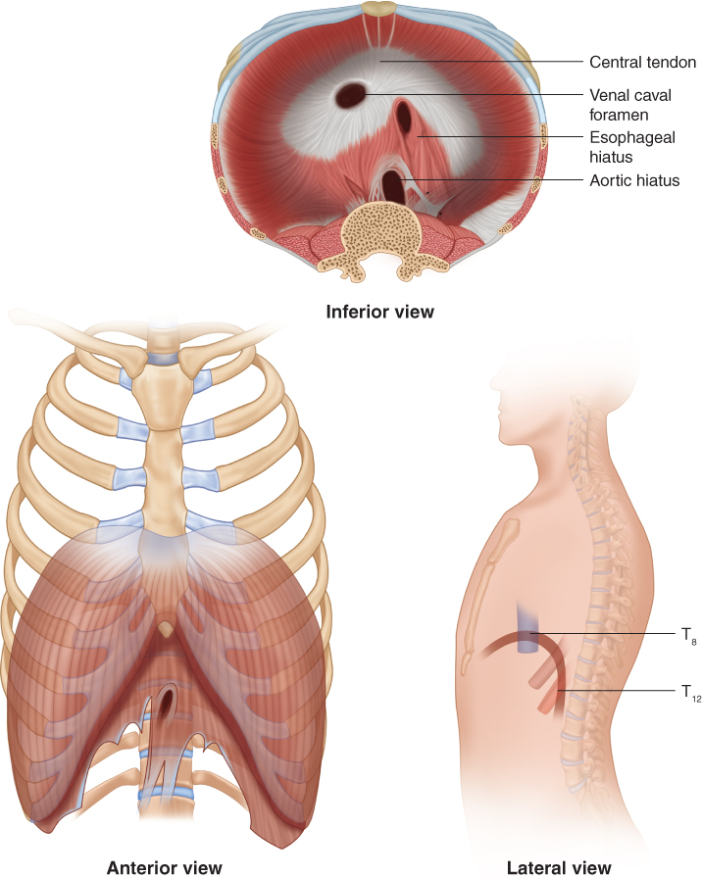
From: Chapter 69 Anatomic Considerations of the Thoracic Cage
An Osteopathic Approach to Diagnosis and Treatment, 4e, 2021
Legend:
(A) The thoracic diaphragm. (B) The thoracic inlet.

Slide 19
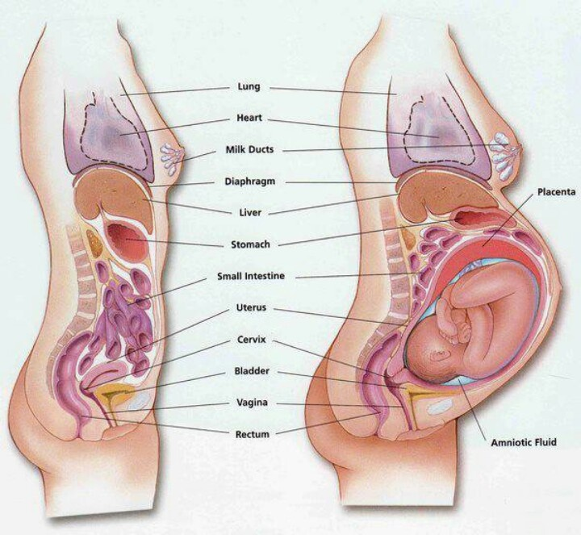
Pregnancy's Effect on Respiratory Function

Slide 20
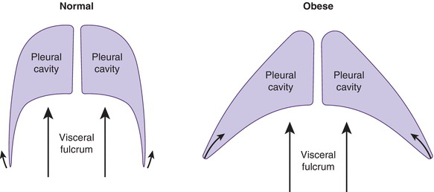
From: 9 Anatomy, Mechanics, and Physiology of Pulmonary Respiration
Foundations of Osteopathic Medicine: Philosophy, Science, Clinical Applications, and Research, 4e, 2018
Legend:
Change in pleural space configuration with abdominal obesity.

