Slide 1
Asthma Disparities
Douglas R. Lotz, MD
Chair, Kentucky Asthma Partnership

Slide 2
Health Disparities
Differences in health and health care between groups that stem from broader inequities

Slide 3
Health Disparities
Per the CDC:
Preventable differences in the burden of disease, injury, violence, or opportunities to achieve optimal health that are experienced by socially disadvantaged populations
Populations defined by factors such as:
Race or ethnicity
Gender
Education or income
Disability
Geographic location (e.g., rural or urban)
Sexual orientation
CDC. Community Health and Program Services (CHAPS): Health Disparities Among Racial/Ethnic Populations. Atlanta: U.S. Department of Health and Human Services; 2008

Slide 4
Health Disparities
Directly related to the historical and current unequal distribution of social, political, economic, and environmental resources

Slide 5
Inequality
Unequal and/or unjust distribution of resources and opportunities among members of a given society
“Addressing Imbalance,” by Tony Ruth for the 2019 Design in Tech Report

Slide 6
Equality
Each individual or group of people is given the same resources or opportunities
“Addressing Imbalance,” by Tony Ruth for the 2019 Design in Tech Report

Slide 7
Equity
Equity recognizes that each person has different circumstances and allocates the exact resources and opportunities needed to reach an equal outcome
“Addressing Imbalance,” by Tony Ruth for the 2019 Design in Tech Report

Slide 8
Equity
Per the World Health Organization (WHO):
“The absence of avoidable or remediable differences among groups of people, whether those groups are defined socially, economically, demographically or geographically”
Per the CDC:
“When everyone has the opportunity to be as healthy as possible”
Equity accounts for disparities. Equality does not.

Slide 9
Justice
Justice can take equity one step further by fixing the systems in a way that leads to long-term, sustainable, equitable access for generations to come
“Addressing Imbalance,” by Tony Ruth for the 2019 Design in Tech Report

Slide 10
Why Address Health Disparities?
Strive to achieve health equity
Improve overall health and economic prosperity
As population becomes more diverse, inequalities continue to grow
Health disparities disproportionately affect racial and ethnic minorities

Slide 11
Cost of Health Disparities
$93 Billion
Excess Medical Costs
+
$42 Billion
Untapped Productivity
=
$135 Billion
Cost of all Health Disparities in US
Source: W.K. Kellogg Foundation, The Business Case for Racial Equity, 2018

Slide 12
Cost of Health Disparities
US Census Bureau projects that minority populations (non-white) will account for > 50% of population by 2060

Slide 13
Asthma By The Numbers
Approx. 1 in 13
21 million adults
Asthma and Allergy Foundation of America, (2020). [Asthma Disparities in America: A Roadmap to Reducing Burden on Racial and Ethnic Minorities].

Slide 14
Asthma By The Numbers
~4.9 million outpatient office visits
~1.5 million ED visits
~170,000 hospitalizations
~3500 deaths/year (10 per day)
National Center for Health Statistics. (2022). National Ambulatory Medical Care Survey: 2019 National Summary Tables. U.S. Department of Health and Human Services, Centers for Disease Control and Prevention

Slide 15
Asthma By The Numbers - Costs
82 Billion Annually
> $50 Billion in direct medical costs
$29 Billion in asthma-related mortality
$3 Billion in losses due to missed work/school
Nurmagambetov, T., Kuwahara, R., & Garbe, P. (2018). The Economic Burden of Asthma in the United States, 2008–2013. Annals of the American Thoracic Society, 15(3), 348–356.

Slide 16
Asthma Disparities
Decades of research and public health surveillance data have identified disparities in asthma prevalence, mortality, and healthcare utilization along racial and ethnic lines

Slide 17
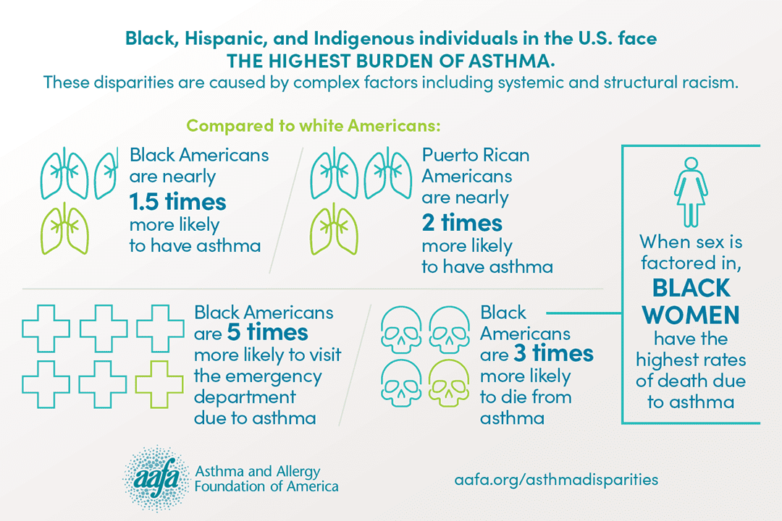
Asthma Disparities

Slide 18
Asthma Disparities - Determinants
Biological
Structural
Behavioral
Social
Asthma and Allergy Foundation of America, (2020). [Asthma Disparities in America: A Roadmap to Reducing Burden on Racial and Ethnic Minorities].

Slide 19
Social Determinants
The conditions in which people are born, grow, live, work, and age¹
Key Domains²:
Economic stability (e.g., poverty, employment)
Education (e.g., early childhood education, higher education)
Physical environment (e.g., environmental conditions, quality of housing)
Social environment (e.g., social class, social cohesion)
Health care (e.g., access to care, quality of care, health literacy)
1. World Health Organization. (2010). A conceptual framework for action on the social determinants of health.
2. Asthma and Allergy Foundation of America, (2020). [Asthma Disparities in America: A Roadmap to Reducing Burden on Racial and Ethnic Minorities].

Slide 20
Social Determinants
Socioeconomic Status
Asthma and Allergy Foundation of America, (2020). [Asthma Disparities in America: A Roadmap to Reducing Burden on Racial and Ethnic Minorities].

Slide 21
Social Determinants
Economic Stability
In the US, 1 in 10 people live in poverty
Can’t afford healthy food, health care, housing

Slide 22
Social Determinants
Educational Attainment
Higher levels of education = healthier and longer life
Lack of education linked to increased rate of chronic health conditions
Increased poverty
Increased stress

Slide 23
Social Determinants
Social Environment
Society, institutions, cultures, etc
Relationships and interactions with family, friends, co-workers, and community members can have a major impact on their health and well-being
Psychosocial stressors

Slide 24
Social Determinants
Physical Environment
External surroundings/conditions
Crime/Safety
Air Quality (indoor/outdoor)
Inadequacies
Location
Access to food, transportation, etc

Slide 25
Social Determinants
Known Asthma triggers associated with poor outcomes

Slide 26
Social Determinants
Environmental Disparities
According to the Environmental Protection Agency, millions of people nationwide live in areas with pollutant concentrations above air quality standards
Marked disparities in air pollution exposure among people of color (ie, non-White individuals)
Cook Q, Argenio K, Lovinsky-Desir S. The impact of environmental injustice and social determinants of health on the role of air pollution in asthma and allergic disease in the United States. J Allergy Clin Immunol 2021;148:1089-101

Slide 27
Social Determinants
Cook Q, Argenio K, Lovinsky-Desir S. The impact of environmental injustice and social determinants of health on the role of air pollution in asthma and allergic disease in the United States. J Allergy Clin Immunol 2021;148:1089-101

Slide 28
Social Determinants
Enivronmental Exposures
Studies suggest that prenatal exposure to air pollutants, such as fine particulate matter (PM2.5) or nitrogen dioxide (marker of traffic-related air pollution), influences the risk of developing early childhood asthma^{1,2}
1. Vieira, S. (2015). The health burden of pollution: the impact of prenatal exposure to air pollutants. International Journal of Chronic Obstructive Pulmonary Disease, 1111.
2. Lavigne, .., B.lair, M.-A., Rodriguez Duque, D., Do, M. T., Stieb, D. M., Hystad, P., van Donkelaar, A., Martin, R. V., Crouse, D. L., Crighton, E., Chen, H., Burnett, R. T., Weichenthal, S., Villeneuve, P. J., To, T., Brook, J. R., Johnson, M., Cakmak, S., Yasseen, A. S., & Walker, M. (2018). Effect modification of perinatal exposure to air pollution and childhood asthma incidence. The European Respiratory Journal, 51(3).

Slide 29
Social Determinants
Health Care
1 in 10 don’t have health insurance
Uninsured are less likely to have primary care
Lack of screenings/health maintenance
Location – live too far from places offering access
Doctor’s office/Hospital
Pharmacy
Poverty – can’t afford services/medications

Slide 30
Social Determinants
When social determinants are statistically balanced disparities in asthma burden between black and white populations are reduced
CCHMC – Pediatric Asthma Hospital Readmission Rates
53% reduction in disparity between black and white children when balancing social and physical environments¹
NHLBI Severe Asthma Research Program (SARP) – 1 year rate of pediatric asthma-related ED
Black children had 2-fold risk compared to white children
Disparity disappeared after statistical adjustment for socioeconomic and environmental variables²
1. Beck, A. F., Huang, B., Auger, K. A., Ryan, P. H., Chen, C., & Kahn, R. S. (2016). Explaining racial disparities in child asthma readmission using a causal inference approach. JAMA Pediatrics, 170(7), 695–703.
2. Fitzpatrick, A. M., Gillespie, S. E., Mauger, D. T., Phillips, B. R., Bleecker, E. R., Israel, E., Meyers, D. A., Moore, W. C., Sorkness, R. L., Wenzel, S. E., Bacharier, L. B., Castro, M., Denlinger, L. C., Erzurum, S. C., Fahy, J. V., Gaston, B. M., Jarjour, N. N., Larkin, A., Levy, B. D., … Teague, W. G. (2019). Racial disparities in asthma-related health care use in the National Heart, Lung, and Blood Institute’s Severe Asthma Research Program. The Journal of Allergy and Clinical Immunology, 143(6), 2052–2061

Slide 31
Structural Determinants
The wider set of forces and systems shaping the conditions of daily life¹
Examples²:
Systemic racism and discrimination
Residential segregation and discriminatory housing policies
Discriminatory hiring and promotion practices
Stereotyping and stigmatization
Explicit and implicit bias
Environmental injustice
1. World Health Organization. (2010). A conceptual framework for action on the social determinants of health.
2. Asthma and Allergy Foundation of America, (2020). [Asthma Disparities in America: A Roadmap to Reducing Burden on Racial and Ethnic Minorities].

Slide 32
Structural Determinants
Structural racism refers to the totality of ways in which societies foster racial discrimination through mutually reinforcing systems of housing, education, employment, earnings, benefits, credit, media, health care and criminal justice
Perpetuates the social stratification of minority populations by shaping economic and public policies
Racial and ethnic minorities are routinely disadvantaged in socioeconomic position, physical environment, and health care

Slide 33
Structural Determinants
Asthma and Allergy Foundation of America, (2020). [Asthma Disparities in America: A Roadmap to Reducing Burden on Racial and Ethnic Minorities].

Slide 34
Structural Determinants
Segregation
Racial segregation
Historical policies that resulted in the racial segregation of neighborhoods, workplaces, schools, and health care facilities continue to exacerbate asthma disparities today
Residential segregation
Discriminatory housing policies resulted in current residential segregation, restricting many families of color to undesirable neighborhoods where poverty rates are high, and economic and educational opportunities are low
Occupational segregation
Black individuals and ethnic minorities face more vulnerability in the labor market than white individuals, and disproportionately experience lower employment rates, wages, access to quality jobs, and job stability
Asthma and Allergy Foundation of America, (2020). [Asthma Disparities in America: A Roadmap to Reducing Burden on Racial and Ethnic Minorities].

Slide 35
Structural Determinants
ED visits for asthma are 2.4 times higher for residents of areas that were more likely to be “redlined”
“Redlining”
Denying mortgages to neighborhoods deemed “hazardous” based largely on racial composition
Nardone A, Casey JA, Morello-Frosch R, Mujahid M, Balmes JR, Thakur N. Associations between historical residential redlining and current age-adjusted rates of emergency
department visits due to asthma across eight cities in California: an ecological study. Lancet Planet Health. 2020 Jan;4(1):e24–31

Slide 36
Structural Determinants
Healthcare segregation
“Separate but equal” legitimized “white-only” patient care
Fewer resources, fewer doctors, and lower quality care overall for communities of color
Systematic disinvestment in predominantly minority neighborhoods results in a substandard health care infrastructure and scarcity of primary care providers and specialists in underserved communities
Asthma and Allergy Foundation of America, (2020). [Asthma Disparities in America: A Roadmap to Reducing Burden on Racial and Ethnic Minorities].

Slide 37
Biological Determinants
Various genes found to influence:
Susceptibility of asthma (heritability)¹
Progression of Asthma (severity)²
Response to treatment³
Environmental factors (such as tobacco smoke and pollution) may also increase risk of asthma in individuals with certain genetic variants
Asthma and Allergy Foundation of America, (2020). [Asthma Disparities in America: A Roadmap to Reducing Burden on Racial and Ethnic Minorities].

Slide 38
Biological Determinants
Heritability
Evidence points to a family history of asthma as a leading risk factor for developing asthma
Maternal asthma serves as a stronger risk factor for asthma in children, compared to paternal asthma¹
Studies of twins and families show heritability estimates of 35-95%
Certain components of asthma are hereditary²
1. Lim, R. H., Kobzik, L., & Dahl, M. (2010). Risk for asthma in offspring of asthmatic mothers versus fathers: a meta-analysis. PloS one, 5(4), e10134.
2. Ober, C., & Yao, T. C. (2011). The genetics of asthma and allergic disease: a 21st century perspective. Immunological Reviews, 242(1), 10–30

Slide 39
Biological Determinants
African ancestry may partially explain the disproportionate burden of asthma in Puerto Ricans compared to other Hispanic subgroups¹
Additonally, Black and Puerto Rican individuals with moderate-to-severe asthma demonstrated the lowest level of bronchodilator (albuterol) responsiveness²
1. Asthma and Allergy Foundation of America, (2020). [Asthma Disparities in America: A Roadmap to Reducing Burden on Racial and Ethnic Minorities].
2. Naqvi, M., Thyne, S., Choudhry, S., Tsai, H. J., Navarro, D., Castro, R. A., Nazario, S., Rodriguez-Santana, J. R., Casal, J., Torres, A., Chapela, R., Watson, H. G., Meade, K., LeNoir, M., Avila, P. C., Rodriguez-Cintron, W., & Burchard, E. G. (2007). Ethnic-specific differences in bronchodilator responsiveness among African Americans, Puerto Ricans, and Mexicans with asthma. The Journal of Asthma: Official Journal of the Association for the Care of Asthma, 44(8), 639–648

Slide 40
Biologic Determinants
Asthma Phenotypes
Large cohort studies indicate at least four clusters of asthmatics based on clinical and biological traits¹:
Early-onset mild allergic asthma
Early-onset allergic moderate-to-severe remodeled asthma
Late-onset non-allergic eosinophilic asthma
Late-onset non-eosinophilic non-allergic asthma
Phenotypic differences may also be based on race/ethnicity²
Higher level of eosinophils and/or neutrophils in the airway
Both associated with more severe asthma
1. Kaur R, Chupp G. Phenotypes and endotypes of adult asthma: moving toward precision medicine. J Allergy Clin Immunol. 2019 Jul;144(1):1–12.
2. Nyenhuis SM, Krishnan JA, Berry A, Calhoun WJ, Chinchilli VM, Engle L, et al. Race is associated with differences in airway inflammation in patients with asthma. J Allergy Clin Immunol. 2017 Jul;140(1):257–265.e11

Slide 41
Behavioral Determinants
Factors influencing disparities:
Non-adherence to treatment
Negative beliefs about medication and health care system
Distrust of the medical establishment
Misperceptions about illness and asthma severity
Tobacco use

Slide 42
Behavioral Determinants
Medication non-adherence:
Medication beliefs
Fear
Misconception
Preference for complementary and alternative medicines
Patient-provider interaction factors
Language barriers and racial concordance
Healthcare system factors
Insurance coverage
Pharmacy availability [60-63]

Slide 43
Behavioral Determinants
Tobacco Use/Exposure
Secondhand smoke (SHS) is linked to negative outcomes in people with asthma
Tobacco smoke can trigger epigenetic modifications in certain genes that correlate with the development of childhood asthma, which can persist into adulthood
Exposure to SHS is associated with increased need for inhaled corticosteroids in children with asthma, higher odds of asthma exacerbations, and poor asthma control among Black and Hispanic children
In-utero smoke exposure has been shown to reduce age-related improvements in airway responsiveness among asthmatic children

Slide 44
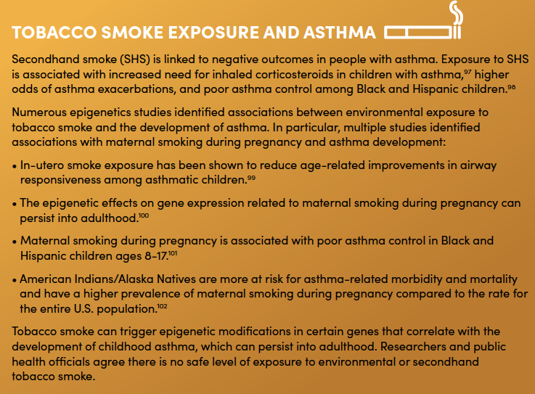
There is NO safe level of exposure to environmental or secondhand tobacco smoke
Asthma and Allergy Foundation of America, (2020). [Asthma Disparities in America: A Roadmap to Reducing Burden on Racial and Ethnic Minorities].

Slide 45
Addressing Asthma Disparities
Asthma and Allergy Foundation of America (AAFA) Roadmap
Public policy reform
Direct interventions to improve asthma self-management
Advancement in research and science
Community-based programs/partnerships

Slide 46
Public Policy Reform

Slide 47
Policy Outcomes
Asthma and Allergy Foundation of America, (2020). [Asthma Disparities in America: A Roadmap to Reducing Burden on Racial and Ethnic Minorities].

Slide 48
Policy Outcomes
Asthma and Allergy Foundation of America, (2020). [Asthma Disparities in America: A Roadmap to Reducing Burden on Racial and Ethnic Minorities].

Slide 49
Policy Outcomes
Asthma and Allergy Foundation of America, (2020). [Asthma Disparities in America: A Roadmap to Reducing Burden on Racial and Ethnic Minorities].

Slide 50
Public Policy Reform

Slide 51
Public Policy Reform

Slide 52
Interventions

Slide 53
Interventions

Slide 54
Interventions

Slide 55
Research

Slide 56
Research

Slide 57
Research

Slide 58
Research

Slide 59
Research

Slide 60
Partnerships

Slide 61
Partnerships

Slide 62
Partnerships

Slide 63
Conclusions
Asthma disparities are complex
Upstream injustices lead to downstream medical and non-medical factors
Racial and ethnic minorities remain at greater risk for:
Severe/difficult-to-control asthma
ED visits/hospitalizations
Asthma-related death
By understanding and bridging gaps, we advance care for everyone

Slide 64
Thank You!

