Slide 1
OCCUPATIONAL LUNG DISEASE
Dr. Brandon Crum, United Medical Group, Pikeville Ky

Slide 2

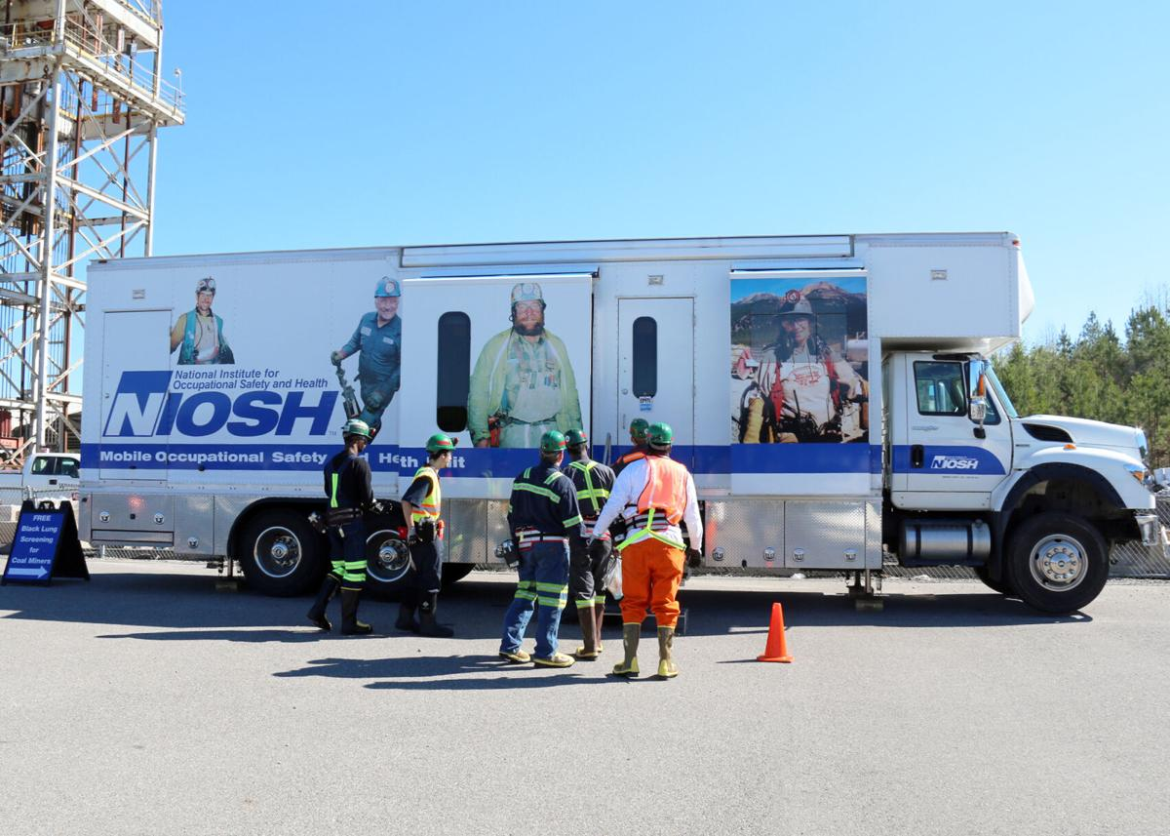
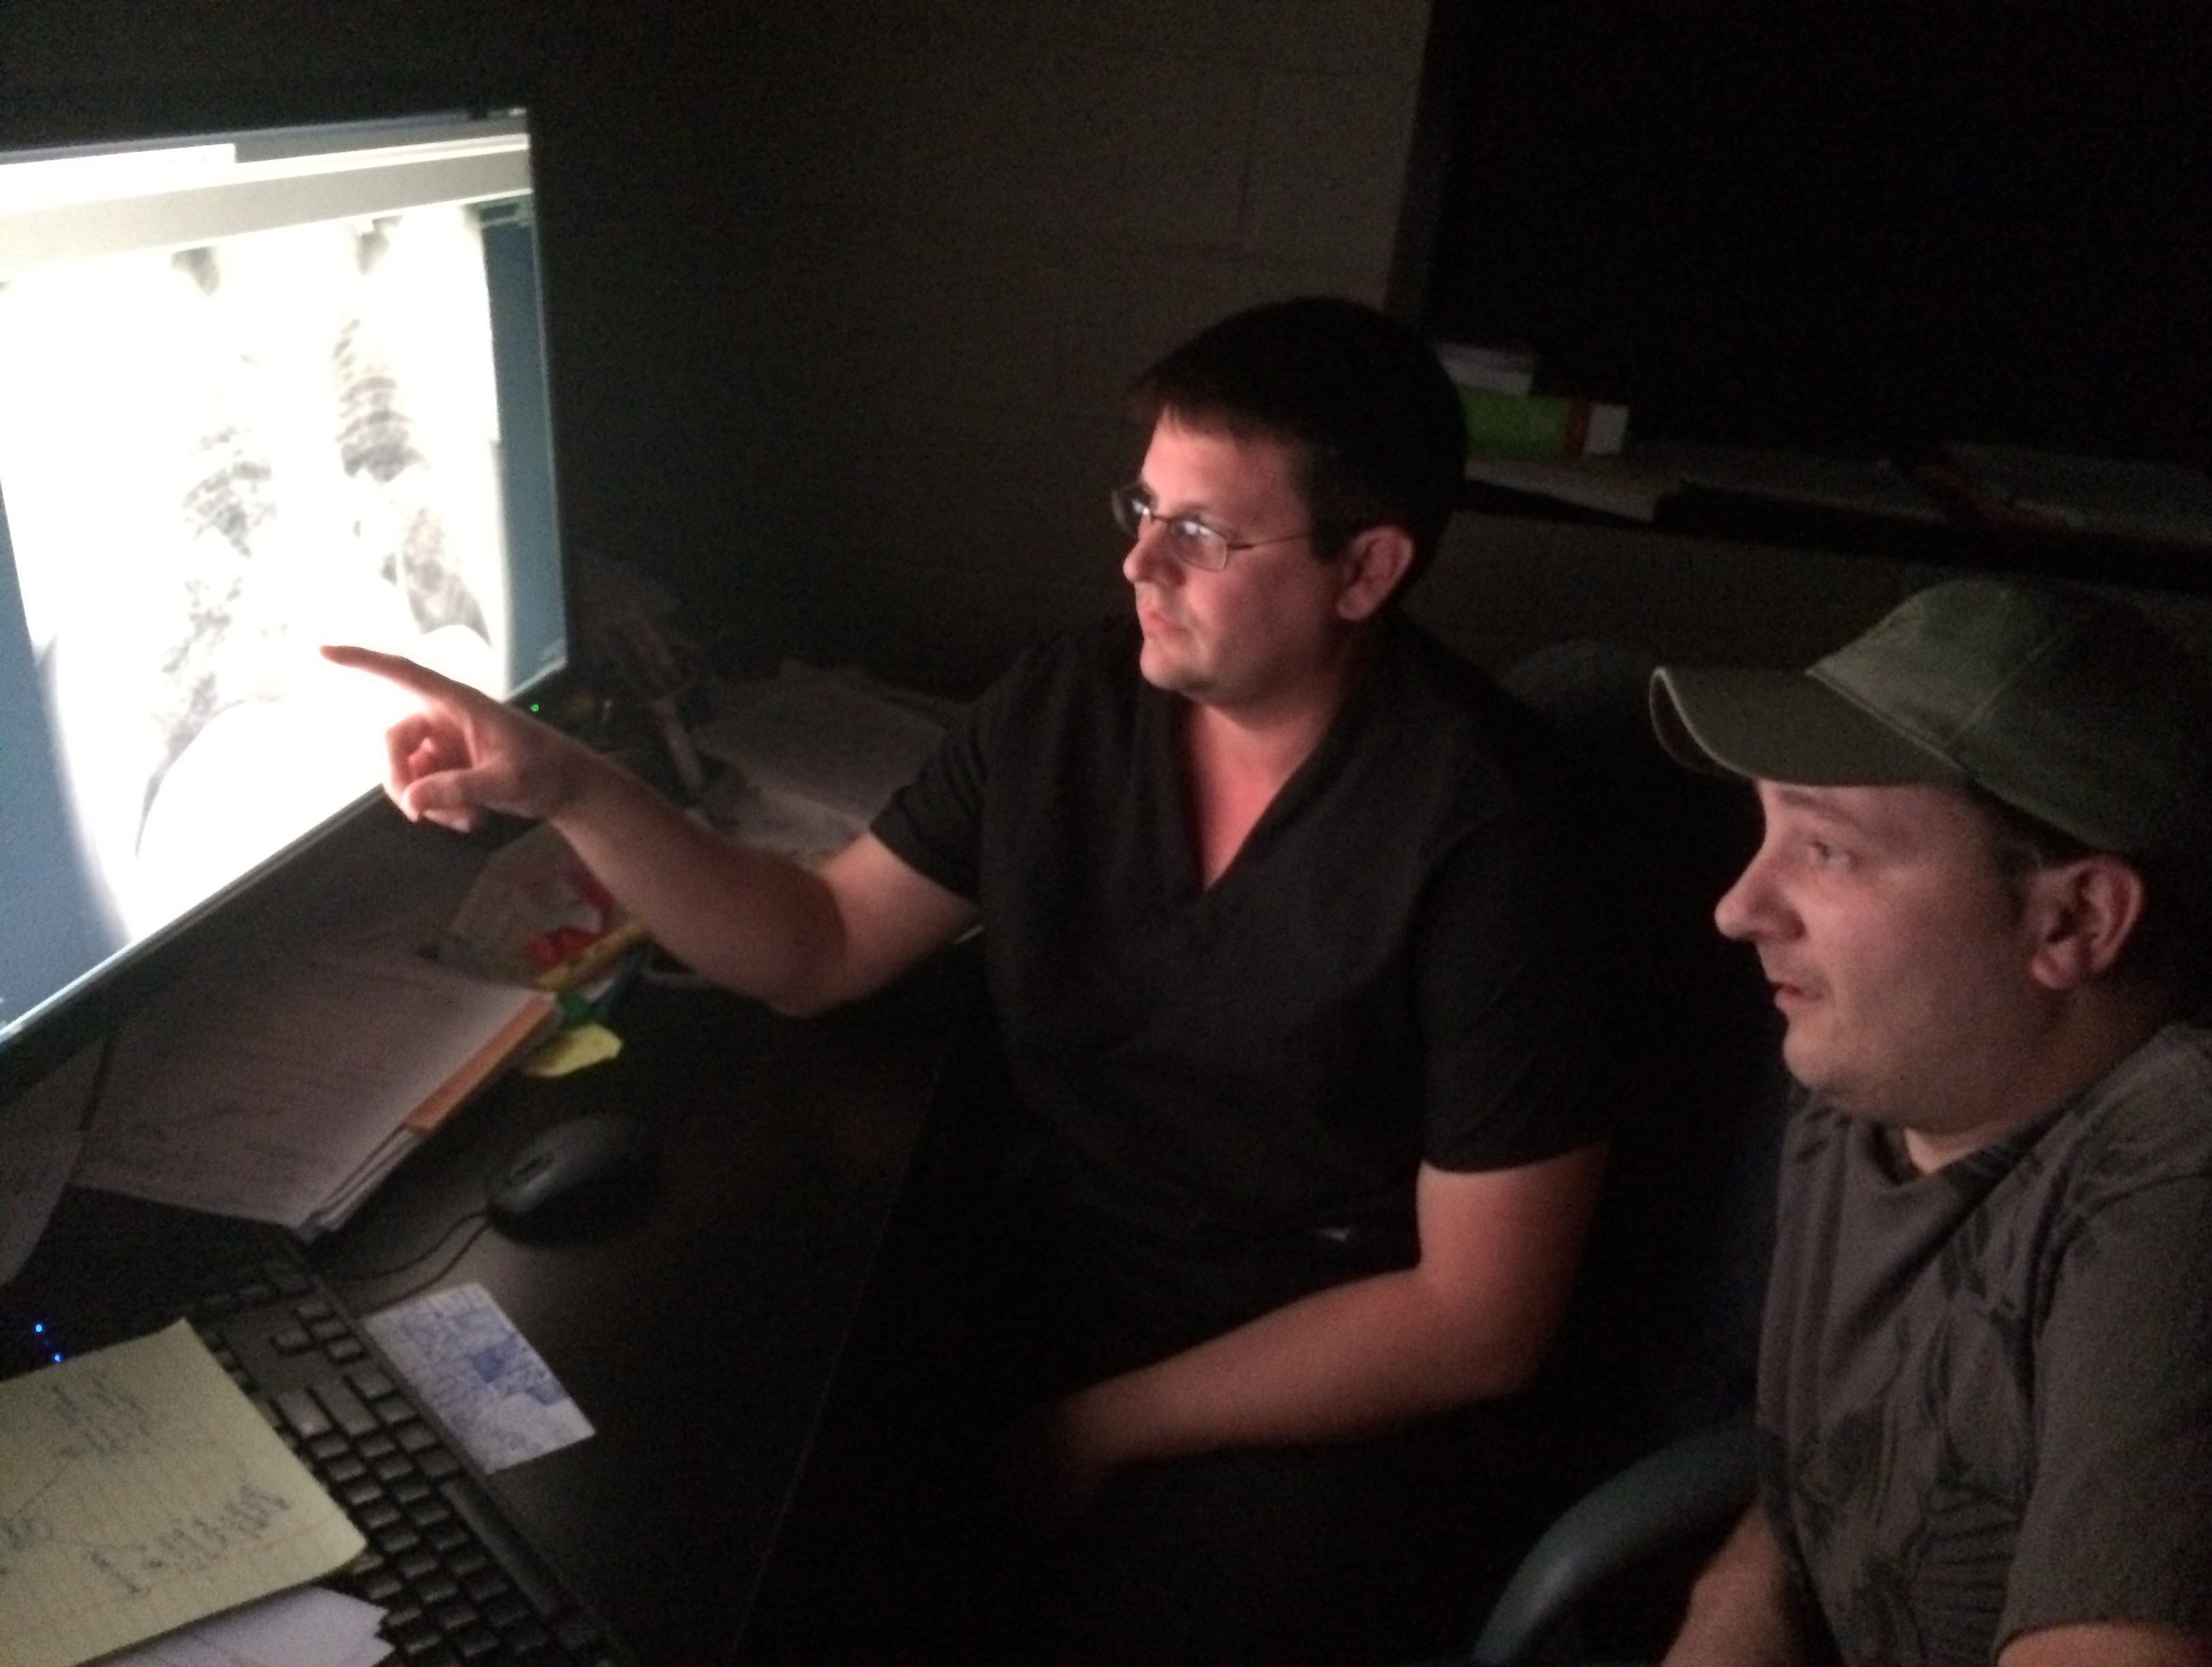

Slide 3
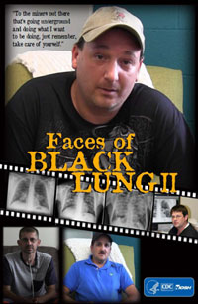
RESEARCH AND PUBLICATIONS
-Resurgence of Progressive Massive Fibrosis in Coal Miners —
Eastern Kentucky, 2016
Weekly / December 16, 2016 / 65(49);1385–1389
David J. Blackley, DrPH1; James B. Crum, DO2; Cara N. Halldin, PhD1; Eileen Storey, MD1; A. Scott Laney, PhD1
-Post Exposure Progression of Pneumoconiosis Among Former Appalachian Coal Miners
Am J Ind Med.2022 Dec;65(12):953-958.doi: 10.1002/ajim.23431.Epub 2022 Sep 26.

Slide 4
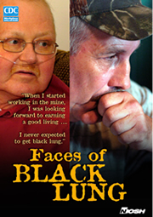

Slide 5
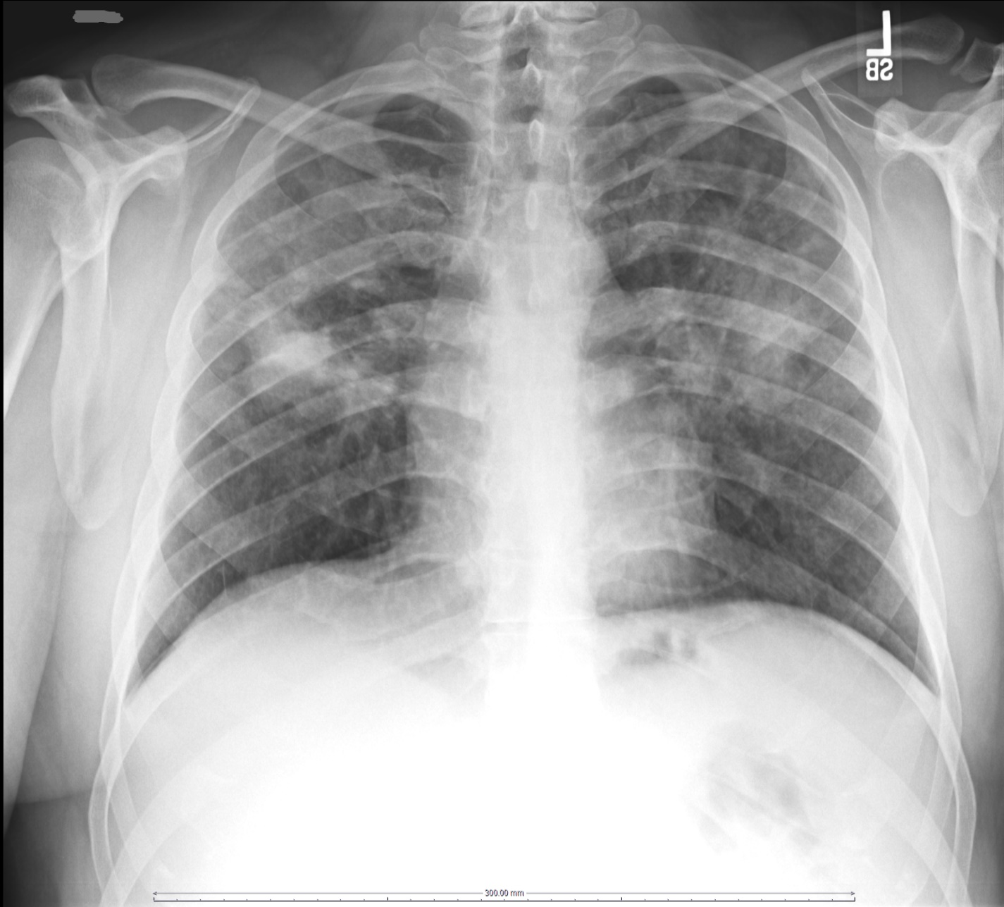
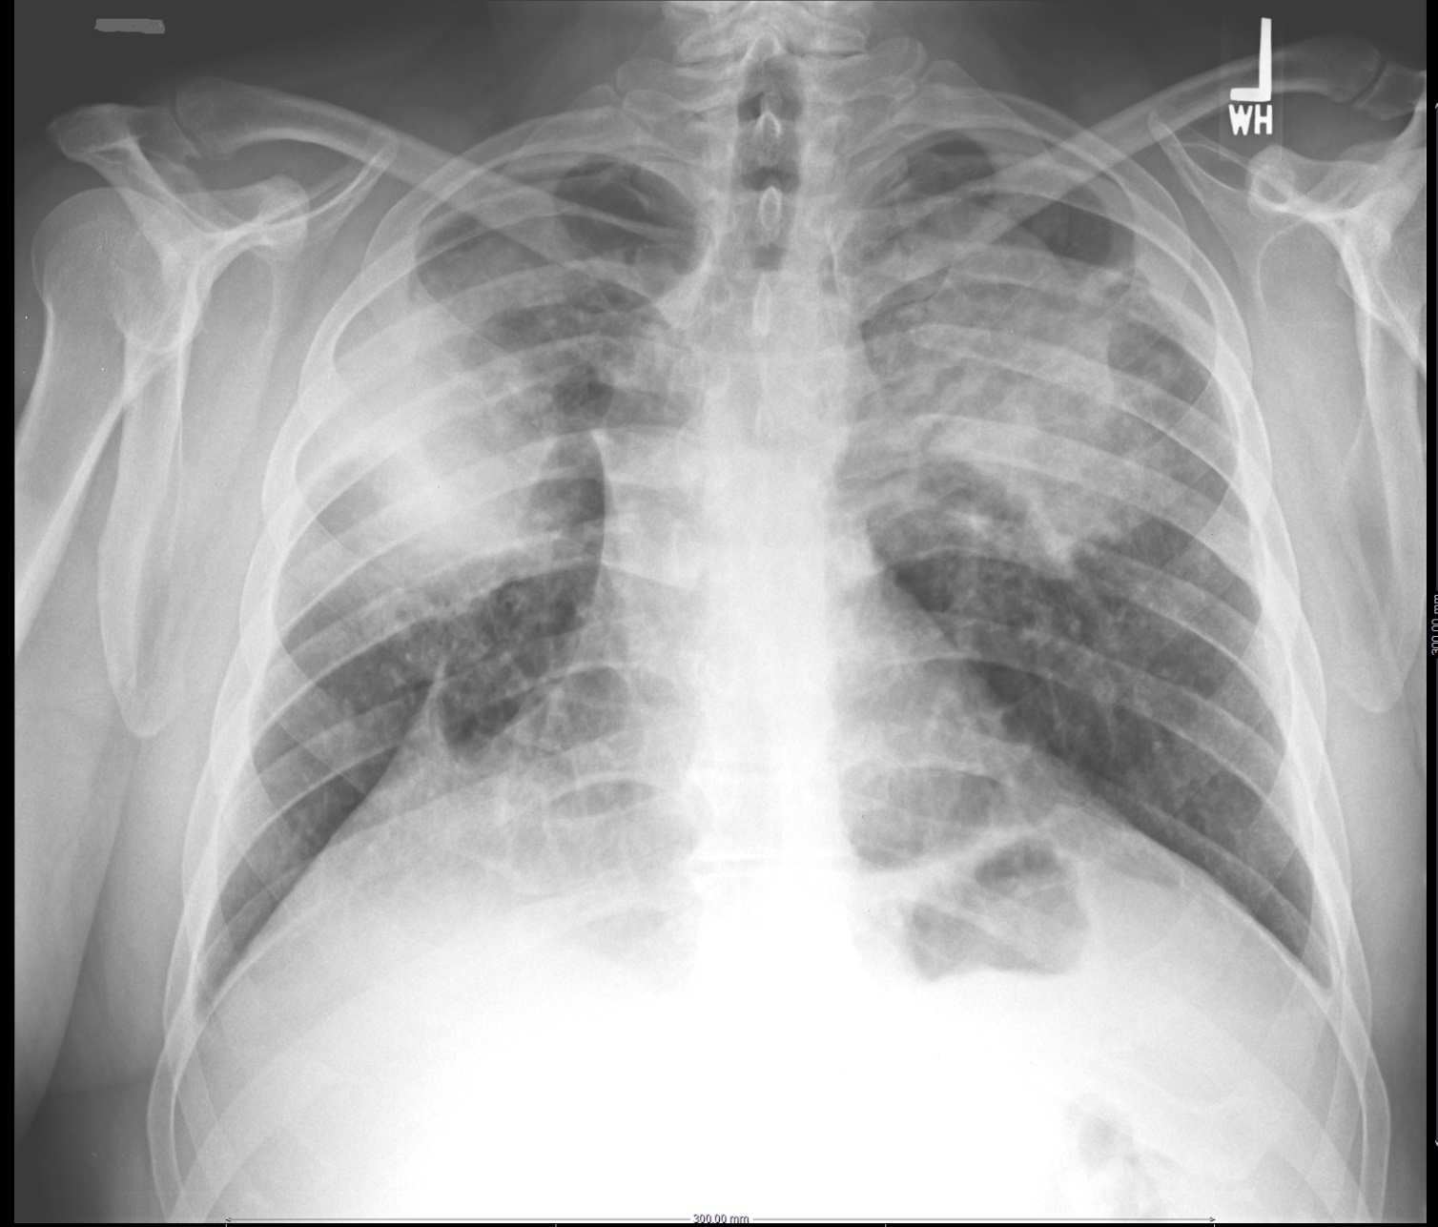

Slide 6
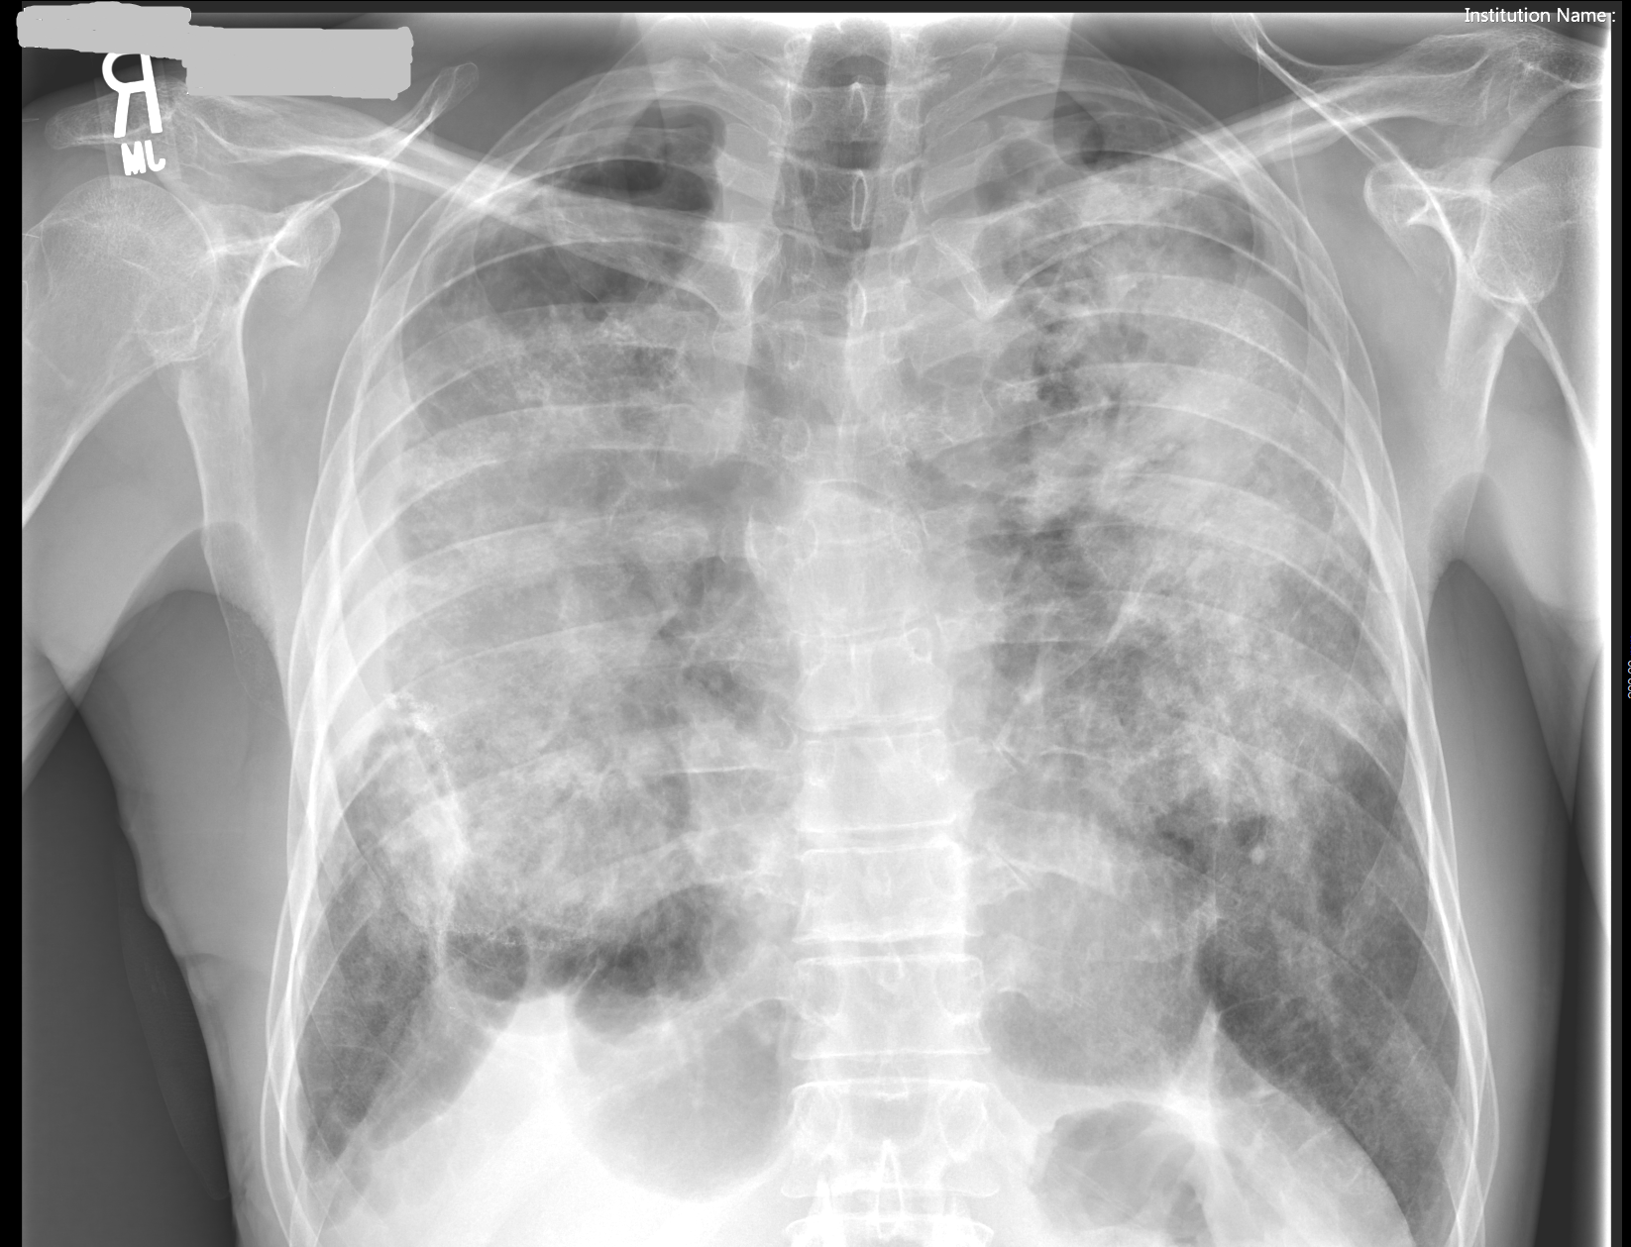

Slide 7
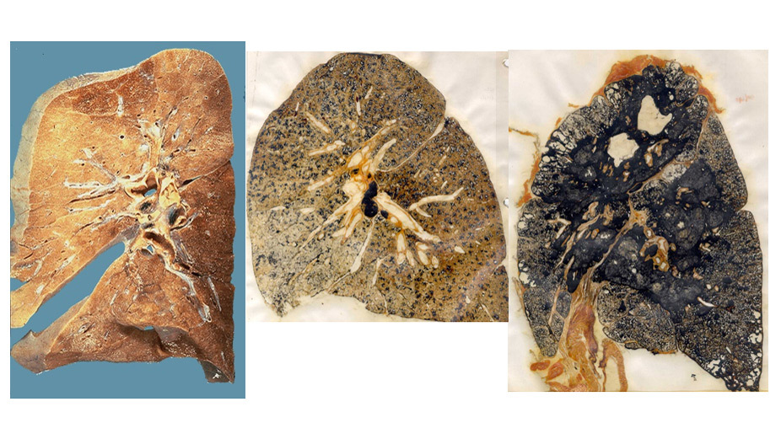

Slide 9
MANIFESTATIONS OF BLACK LUNG (CMDLD)
SIMPLE BLACK LUNG
COMPLICATED BLACK LUNG
DIFFUSE DUST FIBROSIS (DDF)
COPD (EMPHYSEMA/CHRONIC BRONCHITIS)
REACTIVE AIRWAY DISEASE

Slide 10
Simple Pneumoconiosis
Definition – Presence of small opacities (nodules) within some or all lung zones which are consistent with black lung and with appropriate work history.
The small opacities or nodules measure less than 10mm or 1cm in size and are round or irregular in shape.

Slide 11
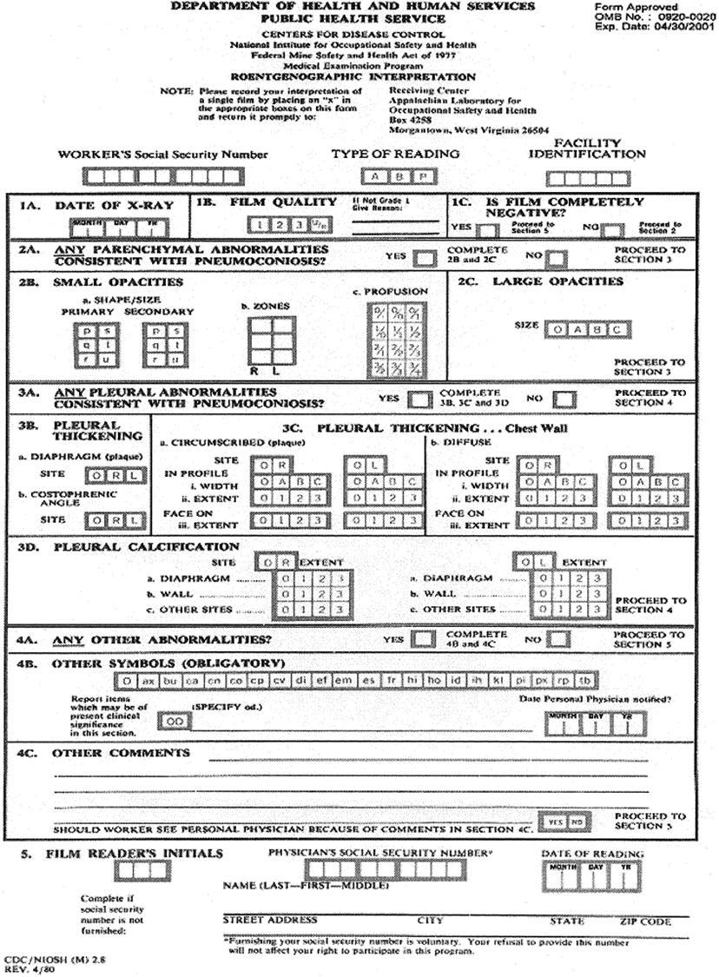

Slide 12
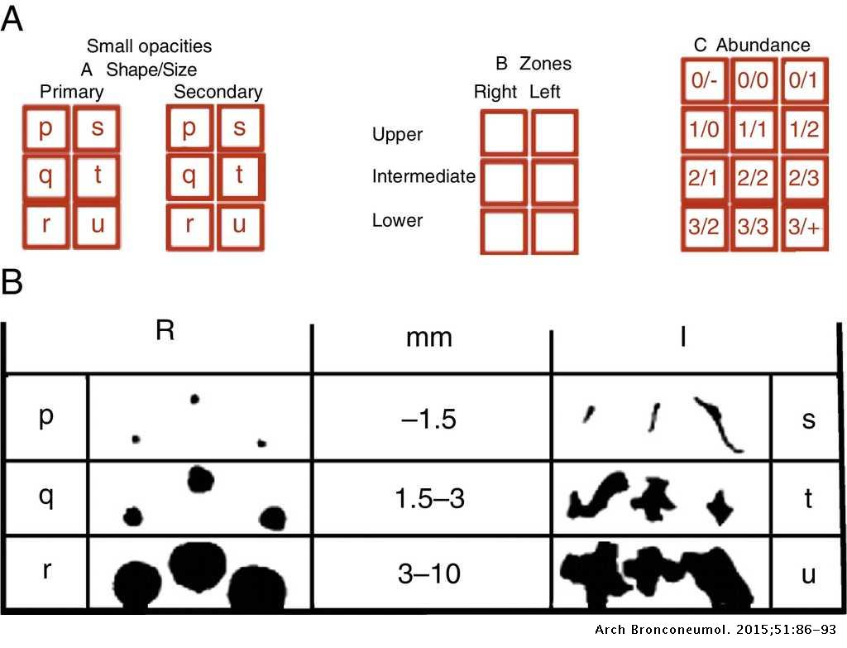
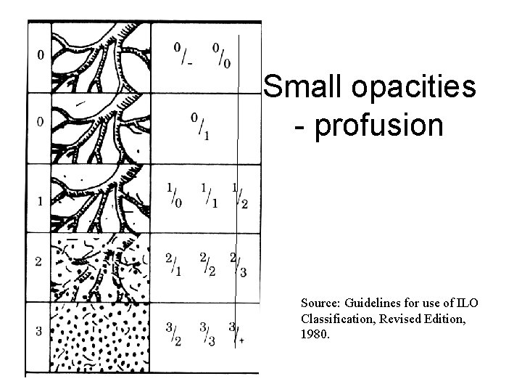

Slide 13
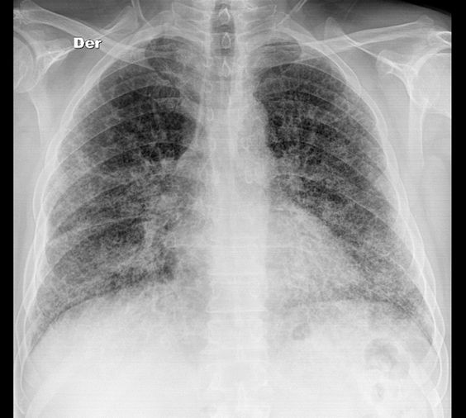
SIMPLE cwP

Slide 14
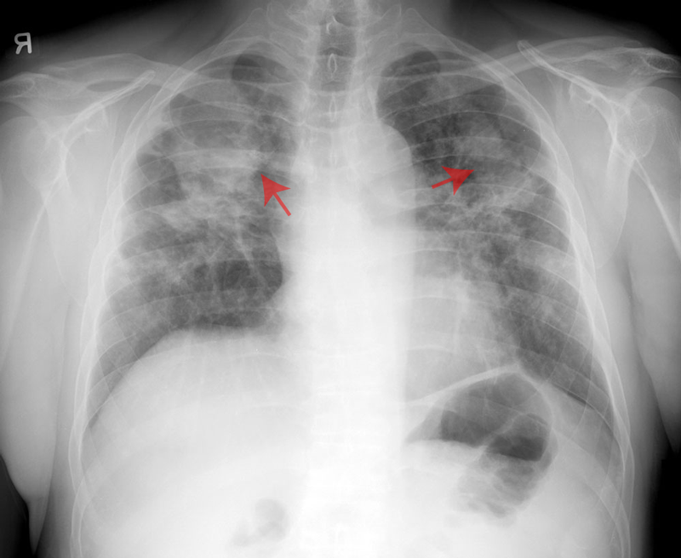
Complicated Pneumoconiosis
Definition – Black lung findings in which there is an opacity with greatest dimension GREATER THAN 1OMM OR 1CM

Slide 15
COMPLICATED CWP

Slide 16
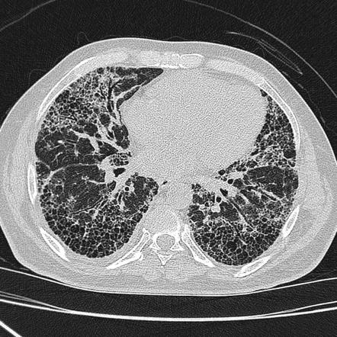
DIFFUSE DUST FIBROSIS (DDF) CT SCAN

Slide 17
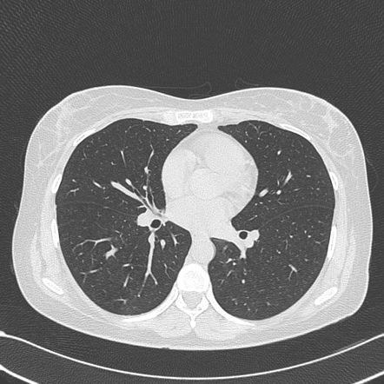
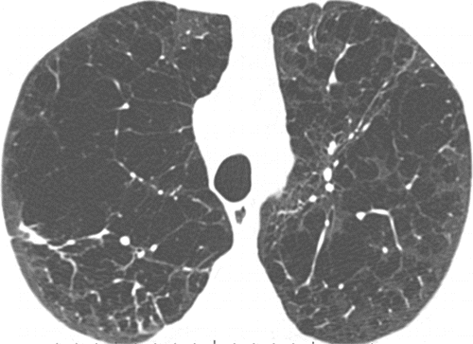
COPD (EMPHYSEMA/COPD) CT SCAN

Slide 18
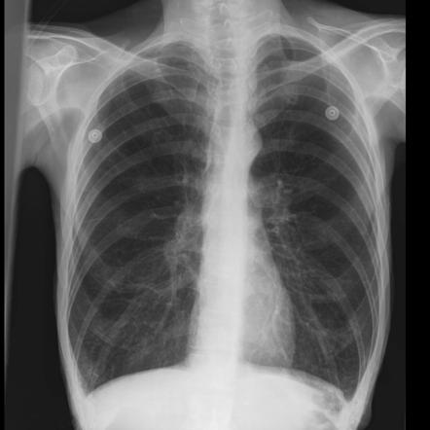
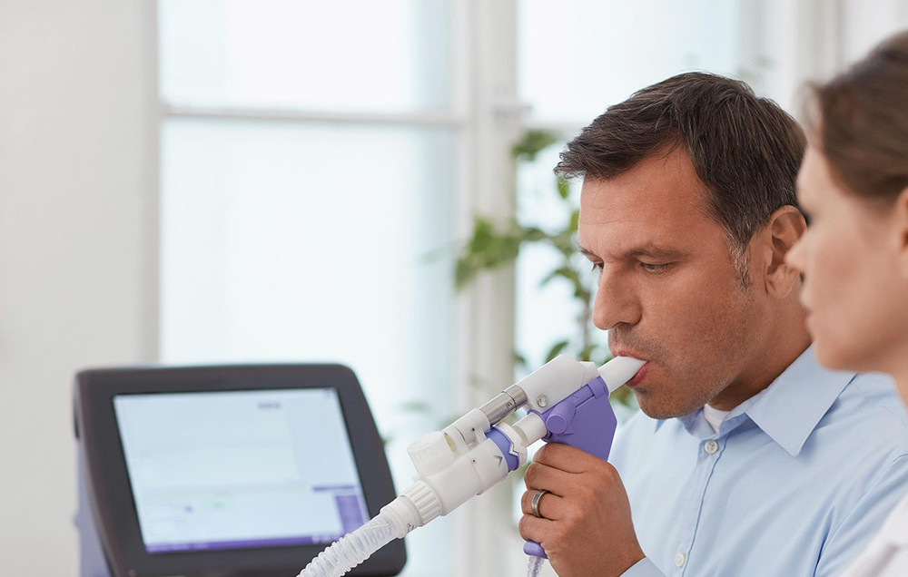
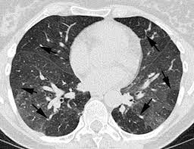
Reactive airway disease (occupational asthma)

Slide 19
SUMMARY (THE WORST ITS EVER BEEN)
INCREASED MORBIDITY AND MORTALITY (PHYSICALLY AND MENTALLY)
INCREASED TRANSPLANTS AND EVALUATIONS
INCREASED RATES OF ALL FORMS OF BLACK LUNG
INCREASED SEVERITY WITH SHORTER EXPOSURES (YOUNG MINERS)
INCREASED SEVERITY WITH PROGRESSION (OLDER OR RETIRED MINERS)

Slide 20
