Slide 1


Too Good For Drugs
Elementary • Middle School • High School
Program Overview Session
February 27, 2017
Wanda Absher, Psy. S.
Safe Schools Coordinator
Pulaski County Schools

Slide 2


Slide 3
Too Good For Drugs
Grades for which it is designed
All grades Kindergarten through High School for students ages 6 through 17. Separate volumes available at each grade level

Slide 4
Too Good For Drugs
Evidence-Based
Skill-Building Programs
Mitigate Risk Factors
Promote Protective Factors
Interactive Lesson Design
Engaging, Thought-Provoking Activities

Slide 5
Too Good for Drugs
Theoretical Framework
Risk & Protective Factors
Behavioral Change Theory
Emotional Intelligence
Social Intelligence

Slide 6

Too Good For Drugs
How the program is incorporated into the curricula?
Too Good for Drugs has been aligned with:
-American School Counselors Association Competencies and Indicators
-The American Cancer Society's Content Standards and Benchmarks
-Kentucky and National Health Standards and Performance Indicators 2, 3, 4, 5, 6, 7
-PBIS - Positive Behavioral Supports and Intervention framework
-RTI - Response to Intervention
The program is well suited to implementation in Health, Social Studies, Science and other related classrooms.
Notes:
The evidence-based Too Good for Drugs program is designed to empower students grades K-12 with the skills they need to make healthy choices, build positive friendships, resist negative peer pressure, and ultimately avoid drug use. More specifically, lessons on understanding the negative health effects related to prescription drug misuse are available in the following grades 4th thru HS.
Too Good for Drugs K-5
Skill development is at the core of Too Good for Drugs K–5, a universal prevention program designed to mitigate the risk factors and enhance protective factors related to alcohol, tobacco, and other drug (ATOD) use. The program introduces and develops social and emotional skills for making healthy choices, building positive friendships, communicating effectively, and resisting peer pressure.
Too Good for Drugs teaches five essential social and emotional learning skills, which research has linked with healthy development and academic success:
Goal Setting
Decision Making
Bonding with pro-social others
Identifying and managing emotions
Communicating effectively
How does Too Good work?
Too Good offers developmentally appropriate curricula for each grade level in kindergarten through grade 5. Each grade level builds on previous levels, developing the skills sequentially with engaging, age-appropriate lessons and activities.
Mitigates risk factors and builds protective factors
Too Good focuses on the risk factors that can be positively affected in the classroom: favorable attitudes toward drugs, violence, and other problem behaviors; and friends who engage in problem behavior.
Too Good builds protection within the student by:
Providing opportunities for pro-social involvement
Establishing positive norms including healthy beliefs and clear standards
Promoting bonding to pro-social peers
Increasing personal and social skills

Slide 7
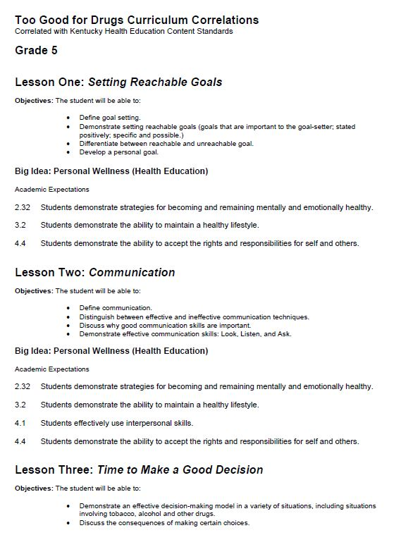
Too Good for Drugs

Slide 8

Too Good for Drugs

Slide 9
Too Good for Drugs
Logic Model
Target Group
►Program Goals
► Strategies
► Theory of Change
► Short Term Outcomes
► Long Term Outcomes

Slide 10
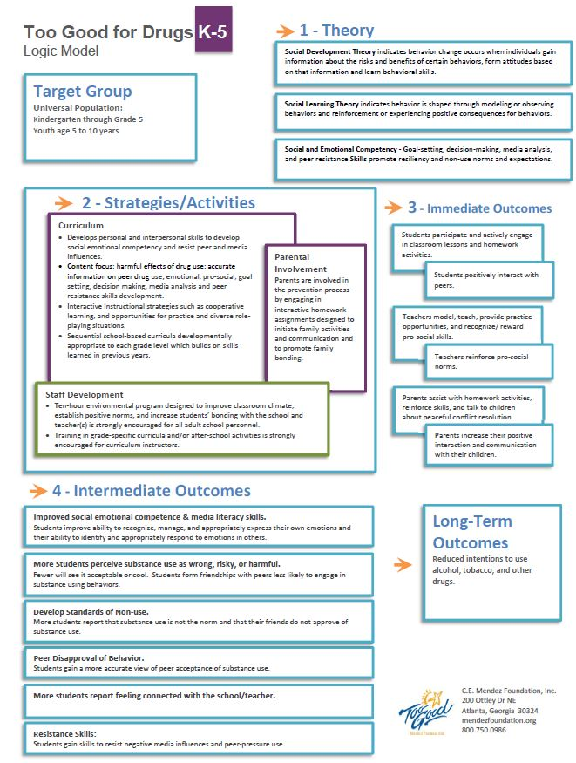
Too Good for Drugs

Slide 11
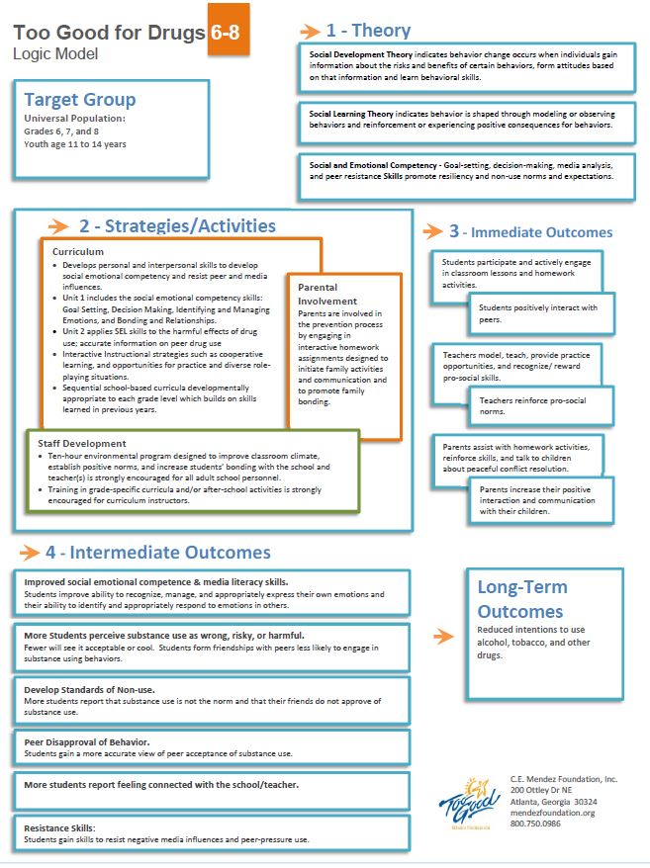
Too Good for Drugs

Slide 12
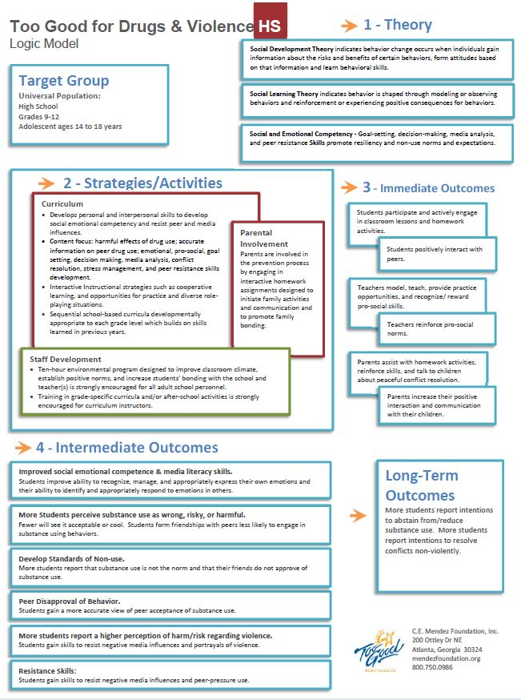
Too Good for Drugs

Slide 13
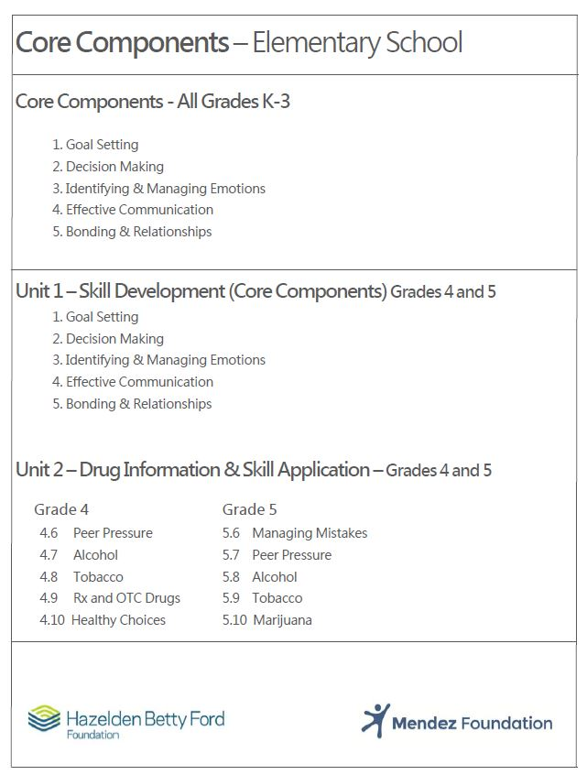
Too Good for Drugs

Slide 14
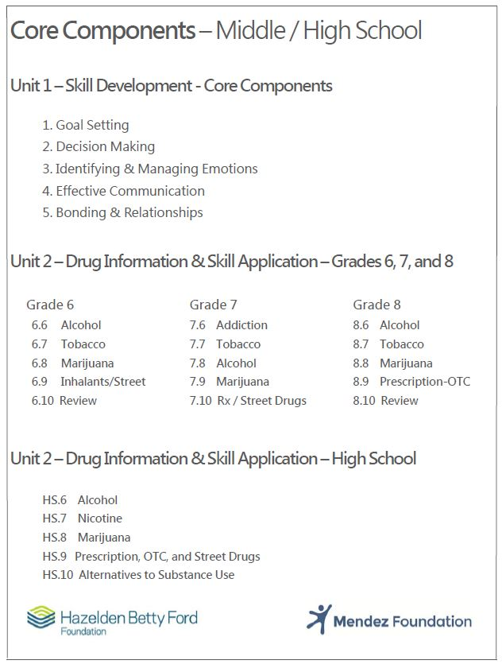
Too Good for Drugs

Slide 15
Too Good for Drugs
Looking for More?
Journal Assignments
Language Arts Extender
Art Extender
Technology
Recommended Books
Recommended Audio and Video
ETC…..

Slide 16
Too Good For Drugs
How much time is required to present the curricula?
30 – Minutes Grades K-3
45 – Minutes Grades 4 and 5
50 – Minutes Grades 6-8 and High School

Slide 17
Too Good for Drugs
ills
TEACHING SOCIAL SKILLS
10 Fully Scripted Lessons
30-50 Minutes
Guided Lesson Planning
Interactive Design
Minimal Preparation
Active Experiential Learning

Slide 18
Too Good For Drugs
Frequency of the Program (daily, weekly or monthly)
Once per week

Slide 19
Too Good For Drugs
Duration of the program
Each grade level curriculum of Too Good for Drugs is a ten session curriculum intended to be delivered once per week for 30-50 minutes depending on grade level. Additional optional activities and lesson extenders are included with each Teacher’s Manual.

Slide 20
Too Good For Drugs
How parents are engaged in the curricula?
Each grade level program of Too Good for Drugs includes a Home Workout activity for each lesson. These take home activities are intended to provide parents and caregivers an opportunity to work with their child to develop the concepts they learned in class as well as to provide the parent/ caregiver with guidance and information to help them practice and reinforce the learning at home.
Additional parent newsletters are included in the High School curriculum. These newsletters provide additional parent resources to help them observe and guide their teens through the challenges of high school socializing.
Too Good for Drugs also includes strategies and planning guides for schools to engage parents and their communities in their prevention education programs so that parents can support and reinforce the prevention message and skill development outside of school

Slide 21
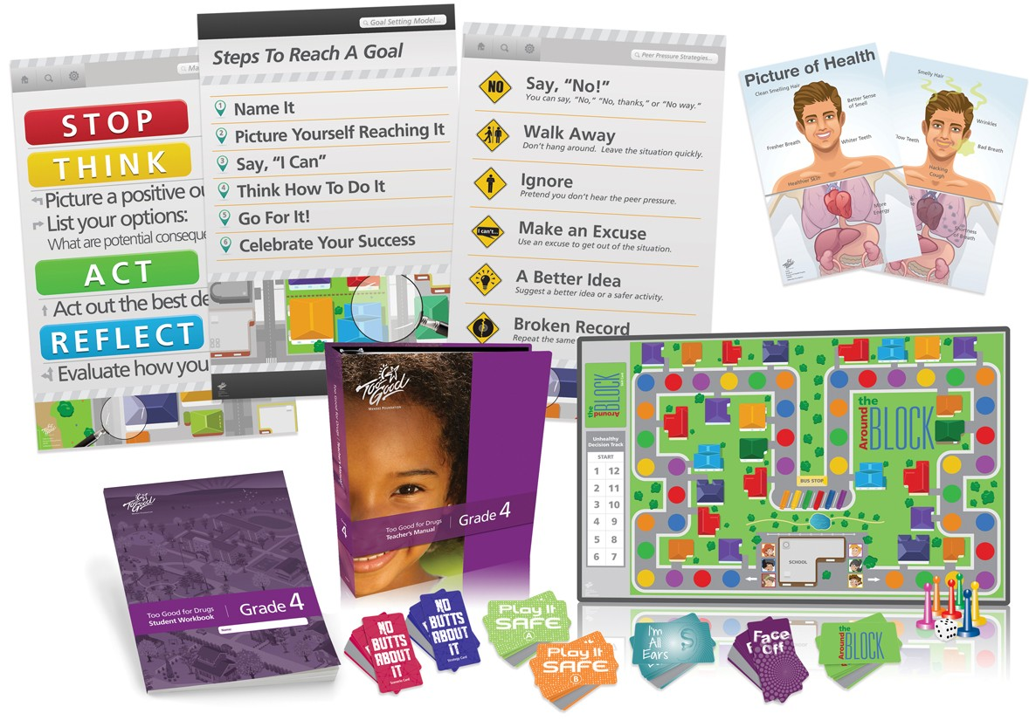
Hands-on Learning
Paired, Group, and Individual Learning
Card Games
Board Games
Skits
Role Play
Posters
Discussion

Slide 22
Too Good for Drugs
Fidelity of Implementation
One lesson per week for 10 weeks
Teach the lessons in order
Teach every activity in each lesson
Teach the entire lesson time
Use all materials
Each student has his/her own workbook

Slide 23
Too Good For Drugs
Who teaches the curricula?
The Curricula can be taught by Teachers, Counselors, School Psychologists, law enforcement officers, behavioral health specialists, parents, volunteers and any other related professional.

Slide 24
Too Good For Drugs
The amount of professional development required to train personnel
Training and professional Development is not required to implement the program, but the program developers strongly recommend at least one 6-hr training session

Slide 25
Too Good For Drugs
The cost of the program
K-3rd $179.95 Teacher Kit*
$39.95 (25 workbooks)
4th-8th $265.96 Teacher Kit*
$49.94 (25 workbooks)
HS - $395.95 Teacher Kit*
$49.95 pack of 25
*Teacher Kits (includes 25 workbooks)

Slide 26
Too Good For Drugs
The cost of the program
Program kits range from $179.95 to $395.95 depending on the grade level. Each kit includes everything the instructor needs to implement the program to a classroom of students. Kit contents include: Teacher’s Manual, Student Workbooks, Activity Materials, Posters, Multi-media, Puppets, and other materials. Kit content depends on the grade level.
Additional Student Workbooks cost $1.99 per student.

Slide 27
Too Good For Drugs
The intended outcomes and how they are measured
Evaluation Instruments
Fidelity of Implementation
Teacher Implementation Survey
Classroom Observation Checklist
    Evaluation Tools
    Student Behavior Checklist - Grades K - 5
Student Knowledge Test - Grades 3 - 12
    Student Risk & Protective Factors Survey - Grades 3 - 12

Slide 28
Too Good For Drugs
The intended outcomes and how they are measured
1: Intentions to use alcohol, tobacco, and
other drugs
2: Risk and protective factors for substance
use
3: Personal and prosocial behaviors

Slide 29
Too Good for Drugs
Too Good for Drugs
Elementary • Middle School • High School
Cindy Swartzwelder
Blake Christy
C.E. Mendez Foundation, Inc.
Wanda Absher, Psy. S.
Safe Schools Coordinator
Pulaski County Schools

