Slide 1

Perspectives of a Treatment Center
Priscilla McIntosh, CEO
The Morton Center

Slide 2

Why do Kids try drugs?
To feel good
Because they want to fit in
Because they want to escape or relax
Because they are bored
Because the media says it’s cool
Because they think it makes them seem grown-up
Because they want to rebel
Because they want to experiment

Slide 3
Definition of Abuse
Using any substance differently than it was intended to be used is considered “Abuse”
EXAMPLES:
  A student who does NOT have ADHD takes a friend’s ADHD medications to pull an all-nighter.
  A man who is prescribed pain medication after surgery begins taking more medication than prescribed or advised by his physician.

Slide 4

Definition of Dependency
Dependency is continued use of drugs or alcohol, even when significant problems related to their use have developed.
Simply stated: Abuse has gotten to the point where it disrupts healthy functioning.
    Losing ability to make my own choices
    Feeling sick when I don’t use
    Using in a way that keeps me from my loved ones, favorite activities etc.

Slide 5
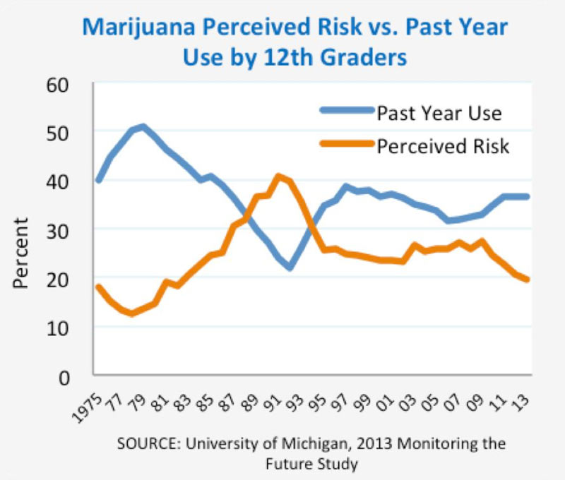
The trend – Marijuana is, once again, popular

Slide 6

Is Marijuana Addictive?
All evidence points to YES, marijuana CAN be addictive.
9% of users will become addicted. However….
This number jumps to 17% (or 1 in 6) for those who start before the age of 18 and to 25% to 50% for those who use daily.
Because marijuana bonds to fat cells, it took researchers a while to identify it as addictive, because the withdrawal symptoms were harder to pick up on.
However, withdrawal symptoms are mostly mood-based – irritability, depression, restlessness, sleep changes.

Slide 7
Alcohol 101
Research has also shown that youth who use alcohol before age 15 are five times more likely to become alcohol dependent than adults who begin drinking at age 21.
Other consequences of youth alcohol use include increased risky sexual behaviors, poor school performance, and increased risk of suicide and homicide.

Slide 8
Why is the drinking age 21?
Physical development/body composition make it risky
2. Brains are still undergoing critical development
- full brain development is at – age 25
3. Combination of body & brain development create faster intoxication & to a greater degree

Slide 9
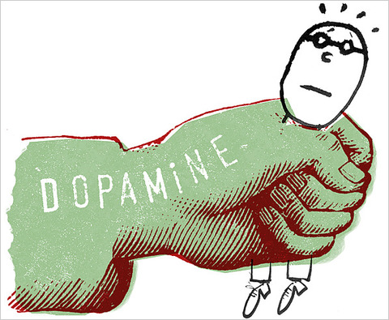
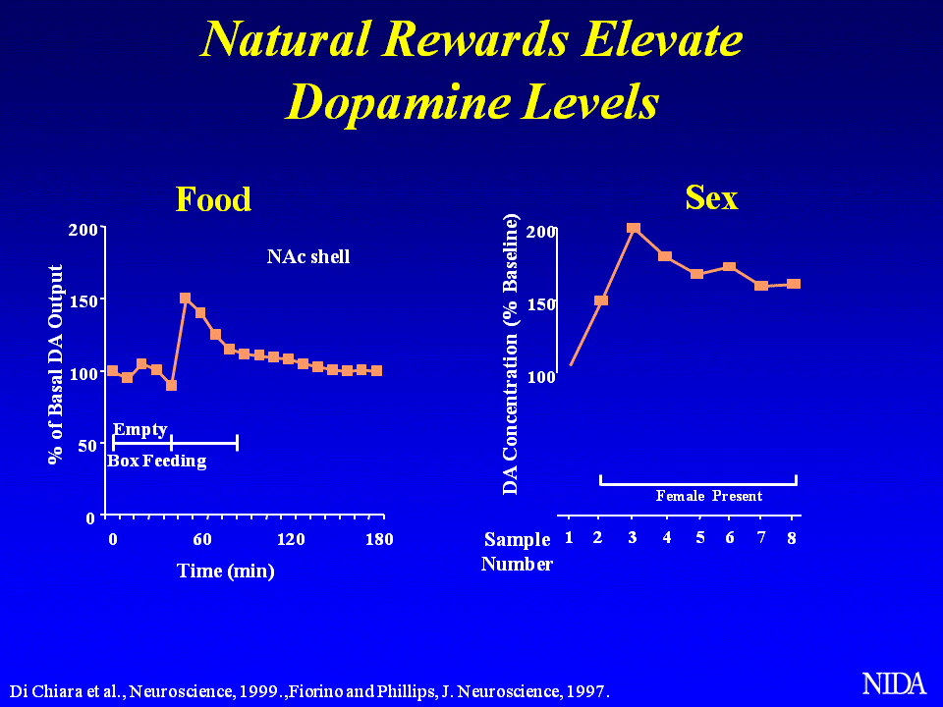
How strong is the release of dopamine?
If we say our dopamine levels are at 100 in a "normal state:“
Favorite food – 150 units
Cocaine – 350 units
Meth – 1,250 units
That's why it's sometimes said meth is "instantly addictive:" The high from it is so extreme.

Slide 10
Tips for Making Smart Choices
What do you do when you are faced with an important decision? Here are some tips for making smart choices:
  Pause. Take a moment to think through your decision.
  What do you know? Ask yourself: What are the facts involved in the situation? For instance, if someone has offered you drugs, what facts do you know about how the drugs may affect your brain and body?
  Do you know enough to make a decision? If you don’t know all the facts, remove yourself from the situation and find out more. Make sure to use reliable sources.

Slide 11
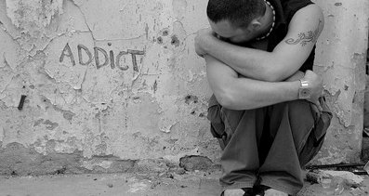
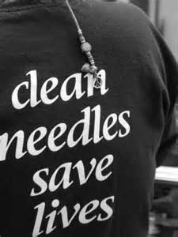
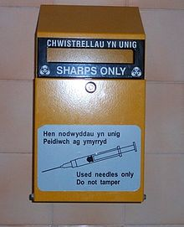
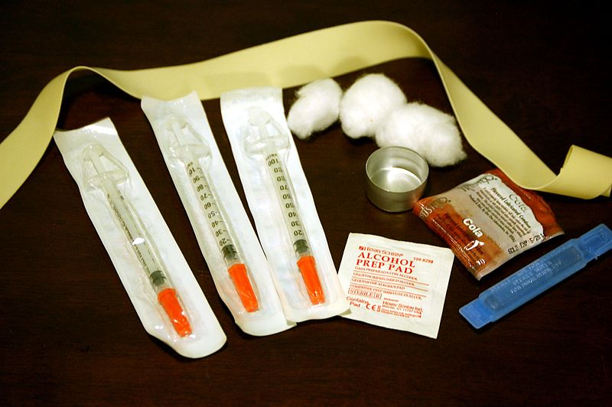
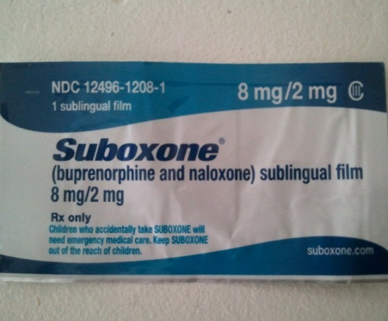
Treatment often involves harm reduction
- Meeting person where they are
Helping person avoid danger
Providing resources (education)
Sometimes disease model is incorporated & harm reduction is adjunctive
“Keeping them alive for the day they do decide to be sober”

Slide 12
The bottom line -
No single factor determines whether a person will become addicted to drugs vs. experimentation/using. The overall risk for developing an addiction is impacted by:
*- Biological makeup of the individual
*- The developmental stage of the individual when they start
using (adolescents are at a higher risk)
*- The surrounding social environment (conditions at home, at school, and in the neighborhood.)

Slide 13
The Morton Center
1028 Barret Avenue
Louisville, KY 40204
502-451-1221
www.themortoncenter.org

