Slide 1
Jamie Irwin
Community Manager Lead
Phone: (615) 975-4991
Email: jamie.irwin@gonoodle.com
Twitter Handle: @GoNoodleJamie
Ashley Shults
Regional Community Manager, KY
Phone: (615) 513-5419
Email: ashley.shults@gonoodle.com
Twitter Handle: @GoNoodleAshley

Slide 2
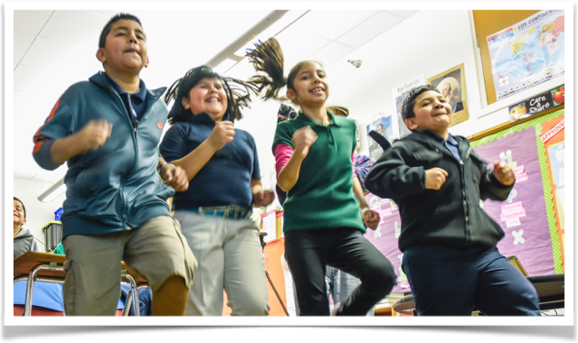
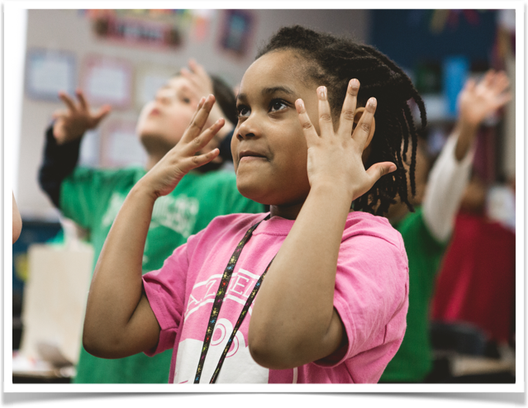
Erin Beach | October 16 at 8:44pm
My kids are So0o0o0o excited to create their own champ!! We had 3 the next day and we are up to 8!
Therese McGee October 12 at 1:16pm
Changing weather = Maximo morning!
Lisa Mayhugh | October 17 at 5:46am
Champ Chat Time! I hope you are all gearing up for an amazing Monday! Our question today is: Which GoNoodle videos do you find most engaging for primary students? Share your questions and suggestions and let's chat!
Kentucky Impact
Kentucky kids generated nearly 42 million minutes of movement and mindfulness through GoNoodle in the 2015-16 school year and are on pace to increase movement by 50% this school year.
Kentucky ranked #3 in state rankings & Louisville ranked #2 for large-size cities on the Kids Movement Index.*
99% of partner area survey respondents who have played GoNoodle Plus activities said that GoNoodle Plus is a valuable resource in helping their students succeed in core subjects.

Slide 3
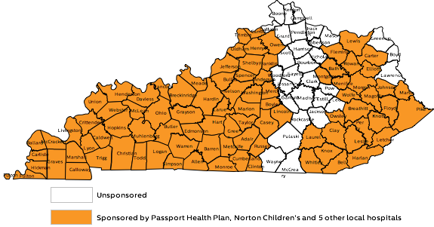
Engaging Kentucky kids in movement
In January 2017, GoNoodle sponsorships reached 157,537 kids, 6,292 teachers in 696 schools. Kids earned over 9.5 million minutes of movement.

Slide 4
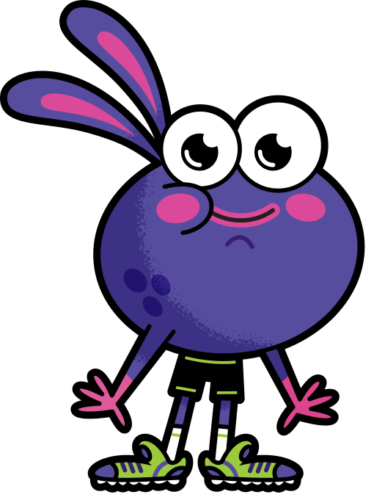
Erin Beach | October 16 at 8:44pm
My kids are So0o0o0o excited to create their own champ!! We had 3 the next day and we are up to 8!
Therese McGee October 12 at 1:16pm
Changing weather = Maximo morning!
Lisa Mayhugh | October 17 at 5:46am
Champ Chat Time! I hope you are all gearing up for an amazing Monday! Our question today is: Which GoNoodle videos do you find most engaging for primary students? Share your questions and suggestions and let's chat!
Kentucky Impact
Kentucky kids generated nearly 42 million minutes of movement and mindfulness through GoNoodle in the 2015-16 school year and are on pace to increase movement by 50% this school year.
Kentucky ranked #3 in state rankings & Louisville ranked #2 for large-size cities on the Kids Movement Index.*
99% of partner area survey respondents who have played GoNoodle Plus activities said that GoNoodle Plus is a valuable resource in helping their students succeed in core subjects.
**The Kids Movement Index is a physical activity measurement index using minutes and the elementary-age kid population to rank the top U.S. cities and states where kids are most physically active through the use of GoNoodle.

Slide 5
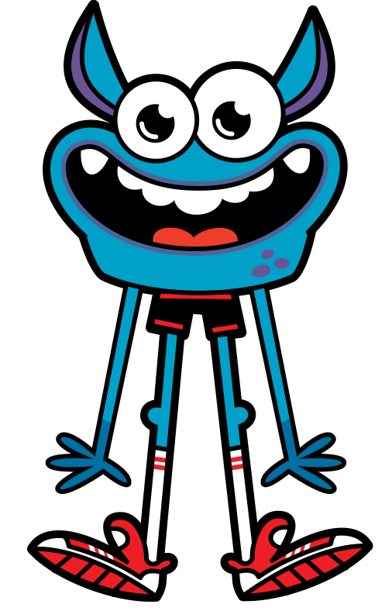
Kids, Parents and Teachers Love GoNoodle
“Amazing & useful technology that is super easy to use, beautifully designed & engaging. I love it, my students love it, my kids love it, and my principal loves it. A must tool for any classroom or living room!”
— Koda L., Elementary School Teacher
“My kid used to be a little girl who sat and played video games and now she can exercise at the same time so I thank you and your company. This is just amazing, you turned my child's life around.”
— Hailey B., Parent

