Slide 1
Developing capable young people
As implemented by Anchorage Public School

Slide 2
Developing capable young people
Developing Capable Young People® is based on the assumption that everyone can learn to be more effective in relationships that touch their lives. Our world is changing; therefore, individuals and the institutions of school and family must adapt to these changes.
Notes:
Kelley

Slide 3
Developing capable young people
Program developed by H. Stephen Glenn
Aims to guide adults who work with youth to develop the three perceptions and four skills which will determine how effectively youth can make adaptations and deal with life
Notes:
Sara – 3rd year program has been implemented at Anchorage, prior to implementation we took a year to research the program and train a core team of teachers who could then help to facilitate school wide implementation. Our program focuses on both school staff and the parents/families of our students. Continued staff training as well as Parent Academies.

Slide 4
The Significant seven
PERCEPTIONS OF CAPABILITIES “I am capable of facing problems and challenges and gaining strength and wisdom through experience.”
PERCEPTIONS OF SIGNIFICANCE “My life has meaning and purpose — who I am and what I have to offer is of value in the scheme of things.”
PERCEPTIONS OF INFLUENCE “My actions and choices influence what happens.”
INTRAPERSONAL SKILLS The tools to respond to feelings effectively—self-assessment, self-control and self-discipline.
INTERPERSONAL SKILLS The tools to communicate, cooperate, negotiate, share, empathize, resolve conflicts, and listen effectively when dealing with people.
SYSTEMIC SKILLS The tools of responsibility, adaptability, and flexibility necessary to deal with the environmental family, social, legal, and other systems in which we live.
JUDGMENT SKILLS The tools to set goals and/or make decisions, judgments, and choices based on moral and ethical principles, wisdom, and experience.
Notes:
Parent Academies and Staff trainings focus on these 3 perceptions and 4 skills. For our first year, we invited Dr. Bruce Colston to lead the trainings for staff and families throughout the year. Learn and understand how perceptions influence behaviors. Participants watch the videos by H. Stephen Glenn and take part in lively discussions related to experiences in the classroom and at home.
Use the Significant 7 to guide EIAG (experience, identify, analyze, and generalize) principle when talking with young people

Slide 5
Builders and Barriers
Barriers
Assuming - Thinking you know what other people think, what they will do and how they will respond.
Rescuing/Explaining - Stepping in to explain what happened rather than asking the kind of questions that will help a person discover what happened; or rescuing a person so he/she can’t learn from the consequences of his/her own choices.
Directing - Giving instructions on each step to make sure it’s done my way (the right way). Having an attitude of controlling another…pick that up, hand that to me, etc.
Expecting - The art of setting high standards and then pointing out the person’s failure to reach those standards.
Adultisms - The art of setting high standards and then pointing out the person’s failure to reach those standards.
Builders
Checking - Asking other people what they think, what they plan to do; or trying to understand why they chose to respond the way they did.
Exploring - Asking the “What? Why? And How?” questions to help a person become aware of his/her own perceptions and the consequences of his/her own choices.
Encouraging/Inviting - Seeing people as assets rather than objects or recipients. Allowing for mistakes and different ways of doing things.
Celebrating - Recognizing progress and encouraging any step in that direction.
Respecting - Being willing to “get into the world” of another person. The language of respect is, “What is your understanding of ______? Let me be sure I understand what you feel.”
Notes:
These are talked about directly with intermediate and middle school students, as well as with staff and families. Use the builders to guide our conversations with youth and others, and watch for barriers in our interactions.

Slide 6
Five criteria of positive discipline
Helps children feel a sense of connection. (Belonging and significance)
Is mutually respectful and encouraging. (Kind and firm at the same time)
Is effective long-term. (Considers what the child is thinking, feeling, learning, and deciding about himself and his world – and what to do in the future to survive or to thrive)
Teaches important social and life skills. (Respect, concern for others, problem solving, and cooperation as well as the skills to contribute to the home, school or larger community)
Invites children to discover how capable they are. (Encourages the constructive person power and autonomy)
Notes:
Positive Discipline is interwoven with the Developing Capable Young People coursework. This has been the focus of our staff training this year. Discussions take place during faculty meetings and fun yet informative positive discipline cards are emailed to all staff.

Slide 7
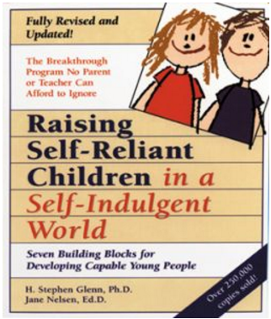
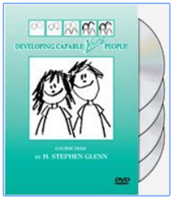
Notes:
Used in trainings for both staff and families

Slide 8
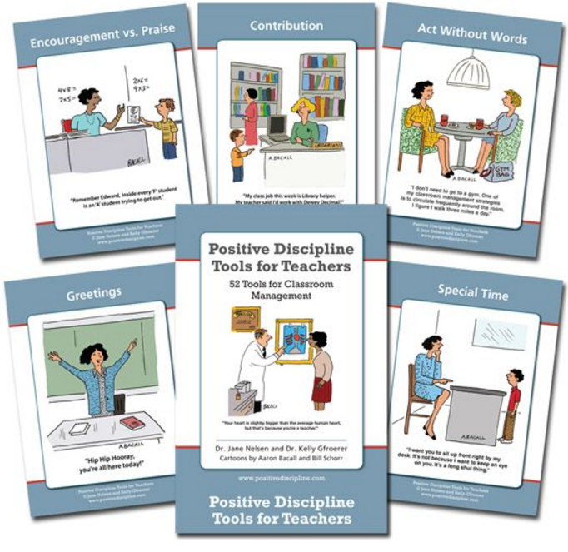
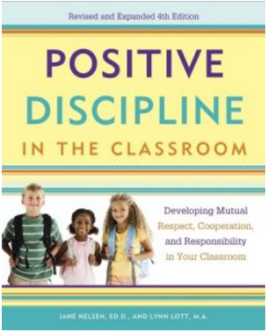
Notes:
Used for trainings with staff

Slide 9
Contact us!
Kelley Ransdell
Superintendent, Anchorage Independent School District
kelley.ransdell@anchorage.kyschools.us
502-245-8927
Sara Wiles
School Counselor, Anchorage Public School
sara.wiles@anchorage.kyschools.us
502-245-2121
Notes:
Kelley

