Slide 1
CoreLife: Build Yourself Strong
Dayton Independent Schools
Lincoln Elementary School
Jay Brewer, Superintendent
Heather Dragan, Principal
Naomi Colliver, Counselor
Notes:
Core-Life is an elementary school program for building student character and enhancing school spirit, culture, and climate. This is the third year of Core-Life at Lincoln Elementary School. In 2016- 2017, Core-Life will be taught in all classrooms. It is our goal to teach our children core character essentials that will help them lead a productive and fulfilling life, without the need to turn to drugs, alcohol and tobacco.
With Core Life lessons, we hope to teach our students how best to interact with one another at school, how to communicate effectively with adults, and how to build a positive reputation for themselves in our community. When children are able to view themselves in a positive light, they are less likely to look to self-destructive coping mechanisms. Core Life builds strong kids who can not only say “no” to the wrong things, but who can also say “yes” to the right things.

Slide 2
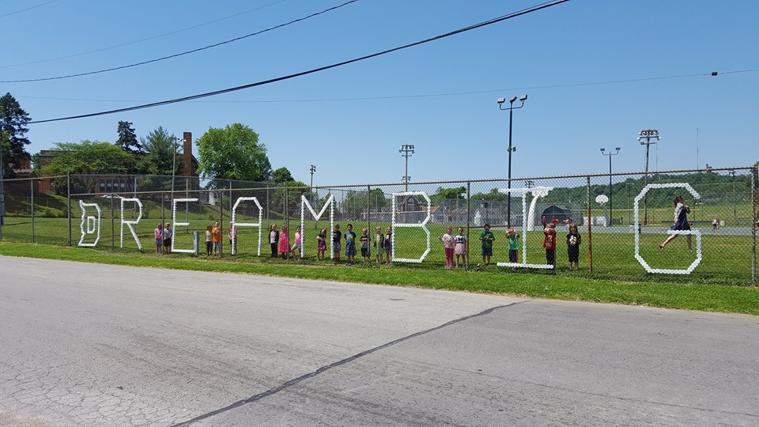
Protective Factors: The Intended Outcome
Family History:
Respect, Empathy, Rules, Responsibility, Tolerance
Mental Health Issues:
Healthy Living, Moderation, Perseverance, Gratitude
Trauma:
Optimism, Honesty, Volunteering
Impulse Control:
Goals, Wisdom, Courtesy
Notes:
I would mention the concept of "layering" - that is, to prevent substance use and other unhealthy behavior, we must start young and then implement subsequent booster shots or new programming that are developmentally appropriate for older students, eg. basic core character/resiliency development at the elementary level, Generation Rx for other programs for middle school students and Drug Free Clubs as an example for high school students - Dayton Independent Schools is doing just that! building developmentally appropriate program for all age levels.
According to the Partnership for Drug- Free Kids,
4 common risk factors associated with teen drug and alcohol use.
- family history
- mental health issues
- trauma
- impulse control problems

Slide 3
CoreLife: Program Details
Which grades are targeted with CoreLife?
Kindergarten-5/6
How is CoreLife incorporated into the curricula?
School Culture, Literature, Experiential Learning
How much time is required to present the curricula?
15- 20 minutes weekly
Notes:
- Grades for which it is designed
- How the program is incorporated into the curricula
- How much time is required to present the curricula
- Frequency of the program (daily, weekly or monthly)

Slide 4
CoreLife: Program Details
What’s the duration of CoreLife?
15- 20 weeks
How are parents engaged in the curricula?
Fridge cards, newsletters per topic
Who teaches CoreLife?
Counselors and teachers deliver lessons
What PD is required?
Determined by each school
Notes:
- Duration of the program
- How parents are engaged in the curricula
- Who teaches the curricula
- The amount of professional development required to train personnel

Slide 5
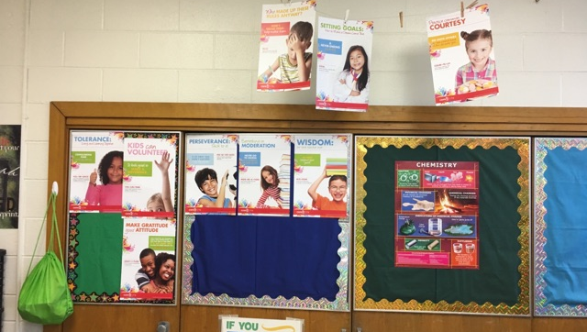
Cost Per Student
K-2: .50 per topic
3-4th grade: $1 per topic
5-6th grade: $10 per book
To implement K-6 for one year it would be about $8,000 which would include all student/parent/teacher materials, implementation manual, training, technical assistance, and evaluation materials.
Potential for a licensing fee for printing materials at schools– all in an effort to make CoreLife as cost effective for schools as possible.
Notes:
- The cost of the program

Slide 6
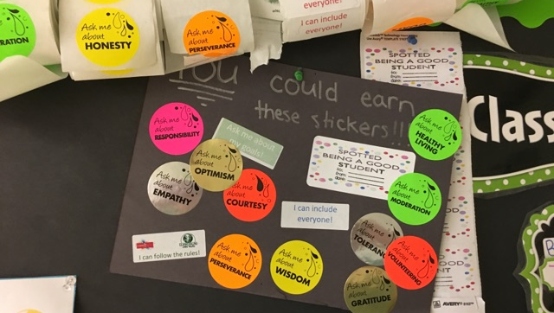
CoreLife: Measured Outcomes
Students' Academic Motivation
Students' School Connectedness
Bullying
Diversity
Teachers' perceptions of school climate
Teacher/staff commitment
Students' strengths and difficulties in the classroom and with peers
How do students feel, think, or act at school, especially with other students
Notes:
- The intended outcomes and how they are measured

Slide 7
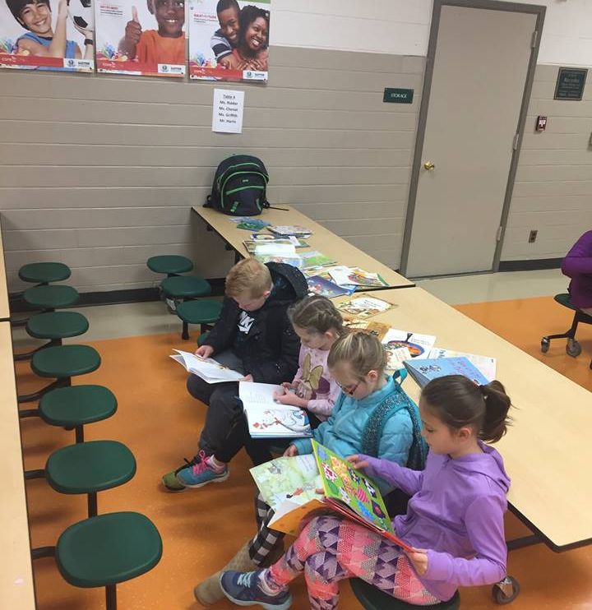
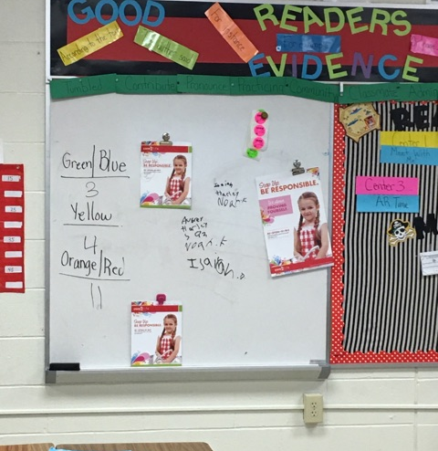
CoreLife at Lincoln: School wide implementation
Notes:
School wide expansion: age appropriate at each grade level.
Integrated in the student daily work
Showcased on announcements, in the halls, in the student agenda
Parent Component Expansion- document sent quarterly to gather parent feedback as well as ways to integrate at home
Immediate rewards: stickers and recognition
Student leadership through announcements and project based learning
Foundational to PBIS in 2017- 2018

Slide 8
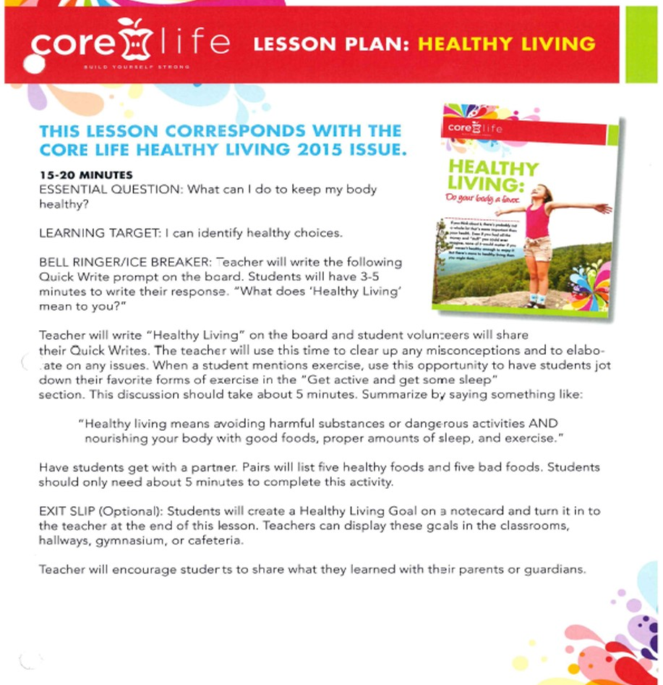
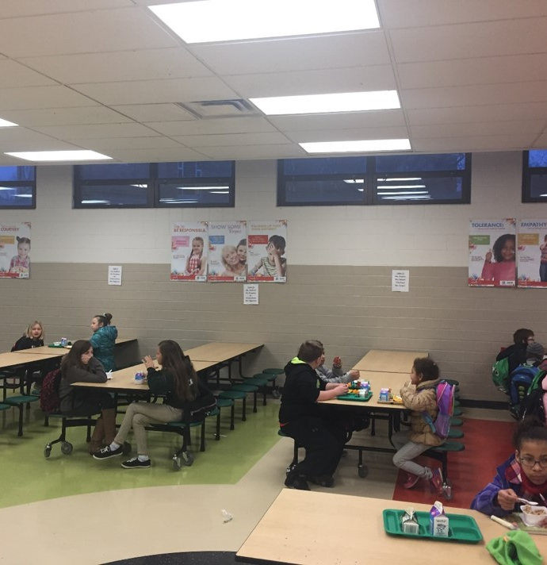
Lesson Plan for Counselor/ Teacher
Vinyl Banners in the Cafeteria
Notes:
Each classroom will spend at least 15 minutes per week examining a character trait. The whole school will examine the same trait, at the same time. Traits will be delivered through a series of “We can…” statements, in which classroom teachers creatively present opportunities for students to learn the weekly trait. These lessons and opportunities will be presented and created in ways comfortable for each teacher and appropriate for each student. Examples for each topic are available on the CoreLife One Note Drive, where the counselor and teachers will share resources specific for every character trait. Each “We can…” statement is linked to a character trait, as outlined.
Tier 1: Universal Intervention for all students to build character traits.
Tier 2: Small groups of students meet for remediation on any topic or trait that they are not mastering. Counselor provides additional education and then works in the classroom with these remediated students and all others in order to reinforce the material and watch the traits in action. Bibliotherapy is being used with intermediate student. 5th grade girls are learning about peer relationship, relational aggression, and importance of appropriate social connections by reading Charlotte’s Web.
Tier 3: Students are referred for school based mental therapy to address barriers in their personal lives that lead to destructive decisions. Students with negative coping skills in Kindergarten, who never learn individualized healthy coping skills, seem more inclined to turn to negative coping as adults (i.e. self medication and destructive behaviors).

Slide 9
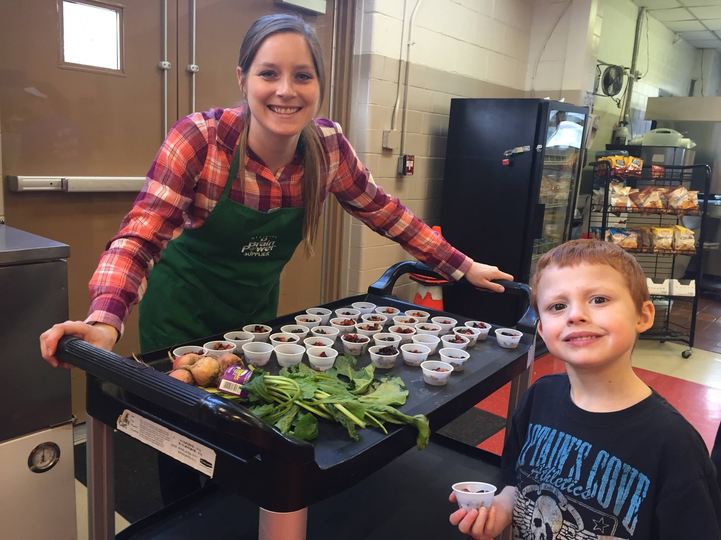
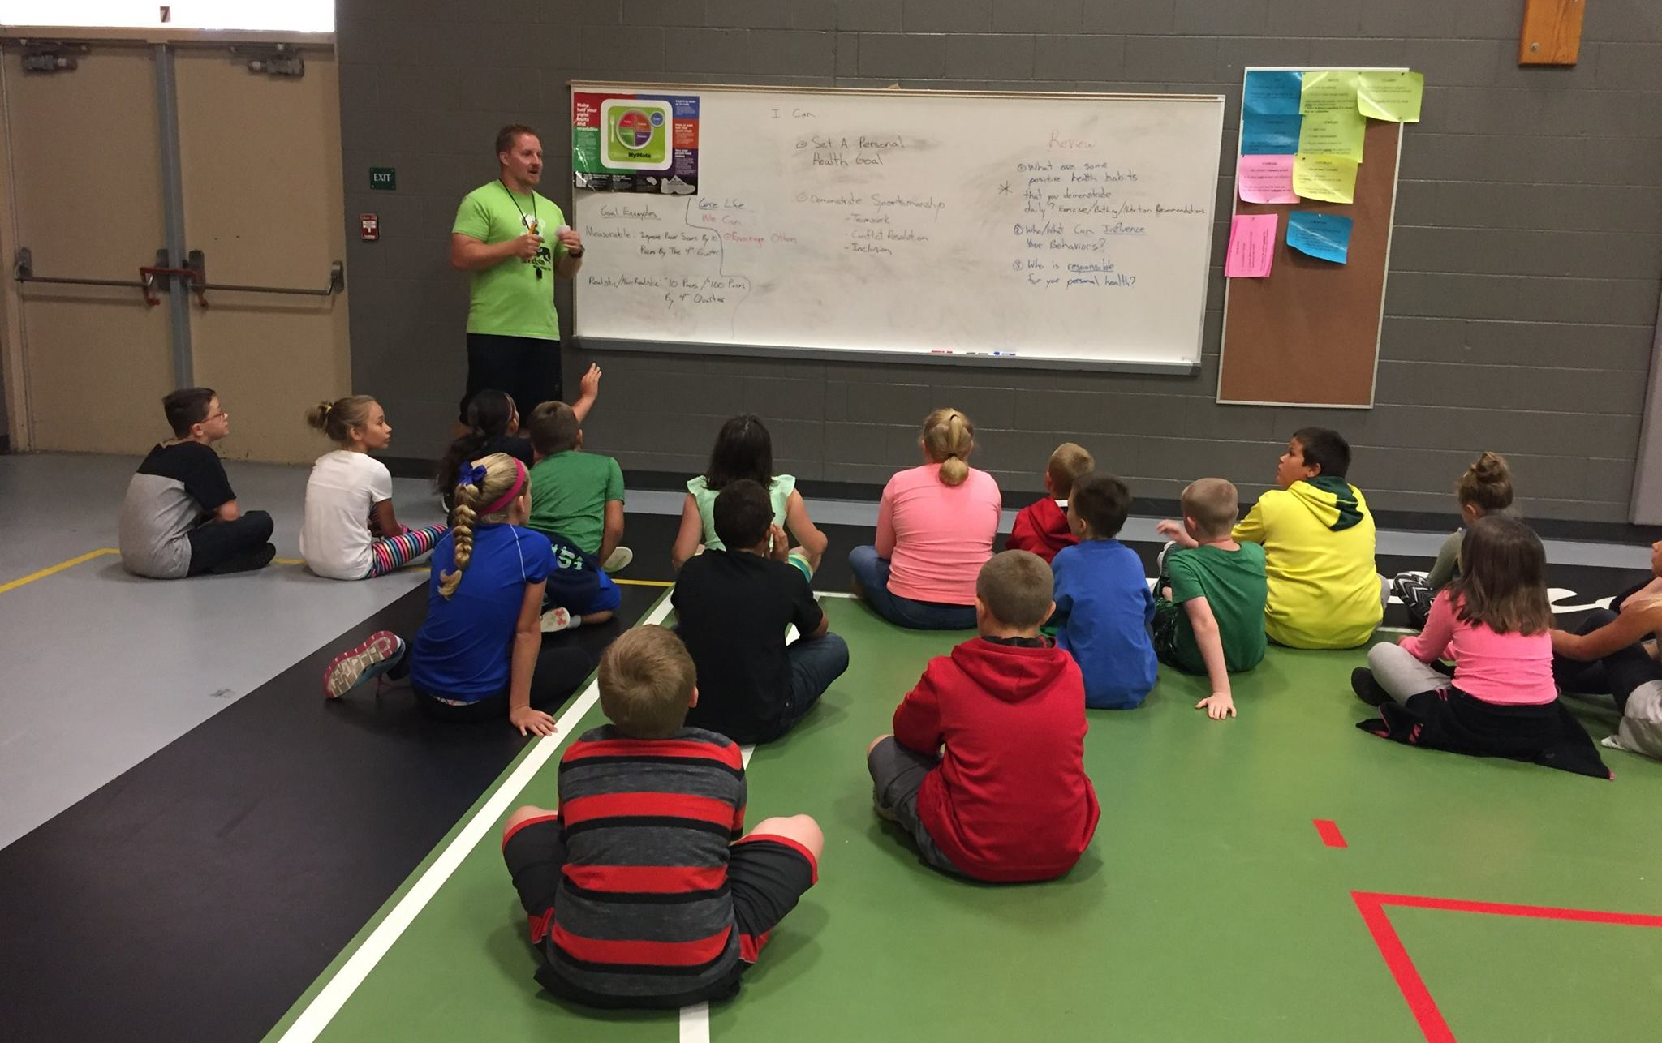
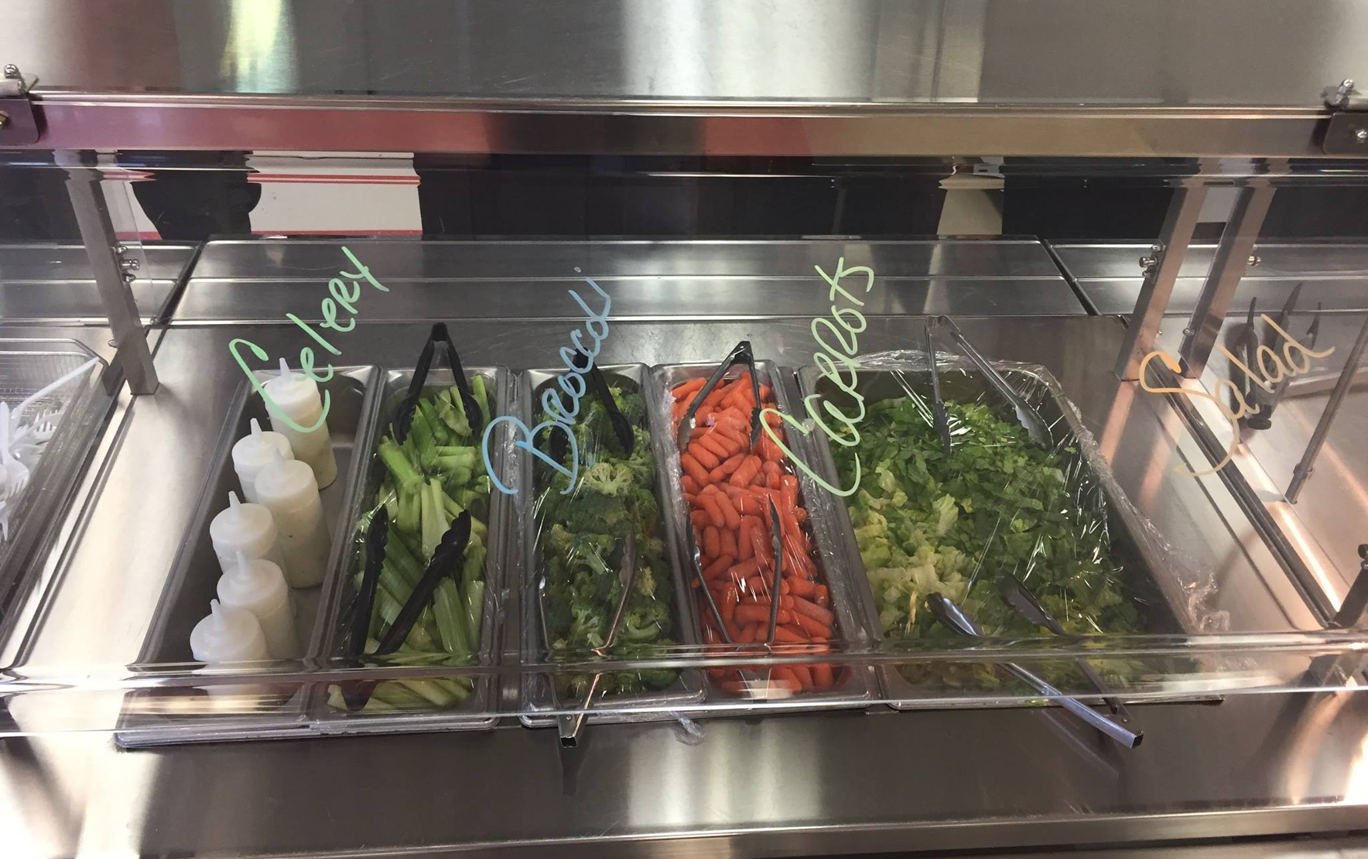
Core Life builds strong kids who can not only say “no” to the wrong things,
but who can also say “yes” to the right things.
Notes:
Core Life builds strong kids who can not only say “no” to the wrong things,
but who can also say “yes” to the right things.

Slide 10
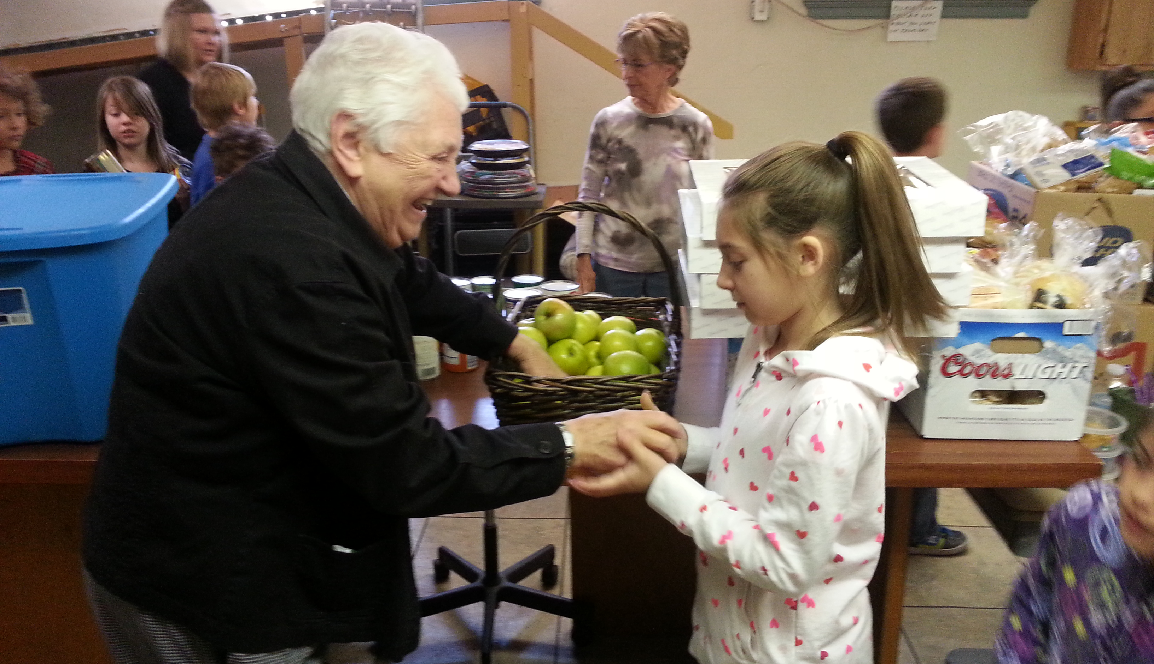
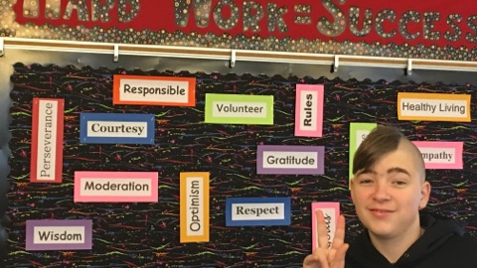
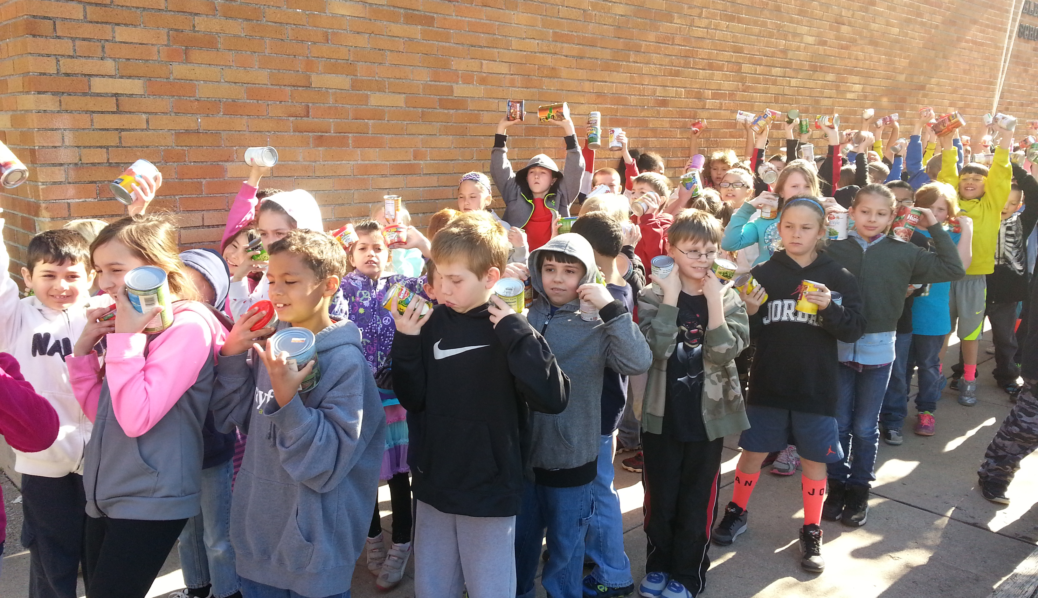
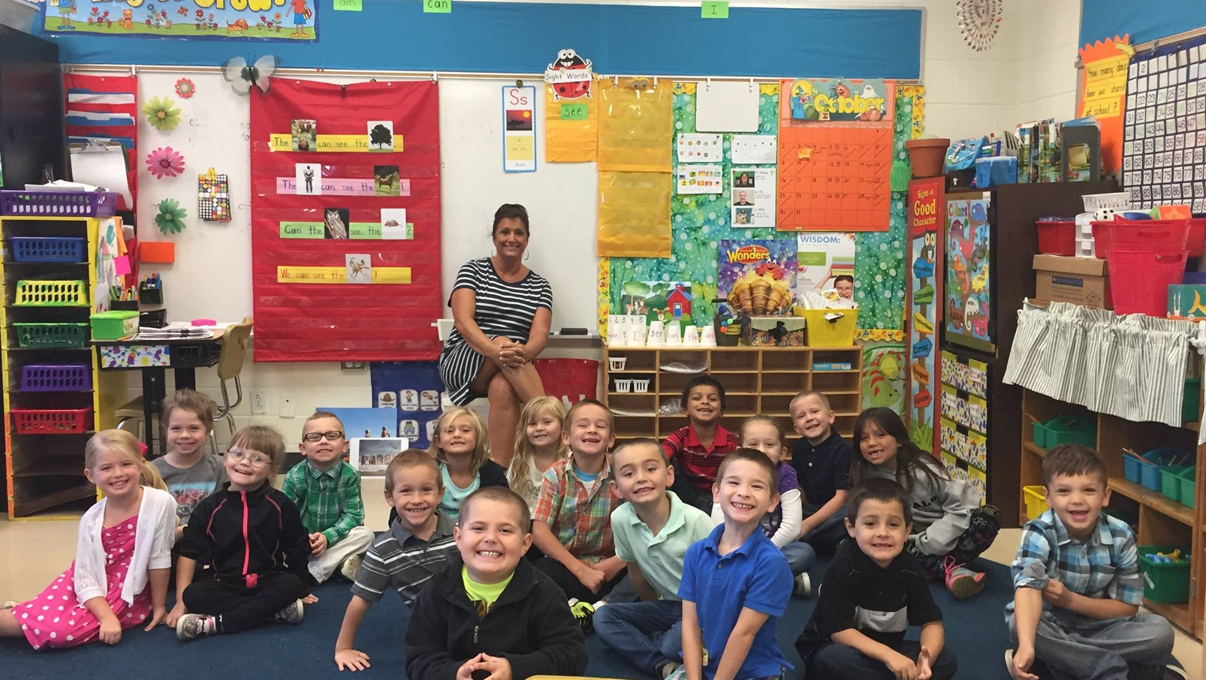
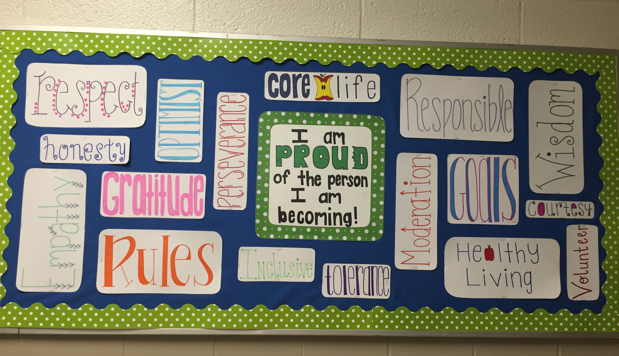
Notes:
From the classroom into the community
Results experienced at LES-
Greater growth increases in reading MAP scores in students who performed below grade level.
Students with previously higher numbers of maladaptive behaviors, had significantly lower numbers of maladaptive behaviors after CoreLife.
Teachers who are “all in” and teaching CoreLife weekly are more flexible, tolerant, and exhibit the traits more regularly than those who only teach to fulfill the requirement.
Behavior referrals are concrete teachable moments when students visit the office.

