Slide 1
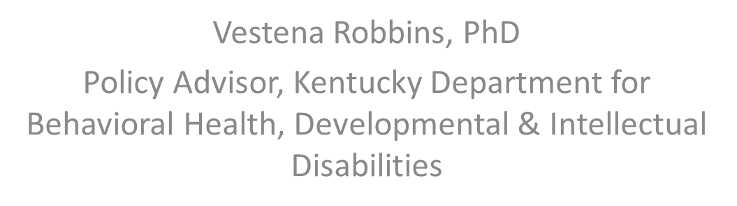
Early Childhood Healthy Living Curricula:
A Behavioral Health Perspective

Slide 2
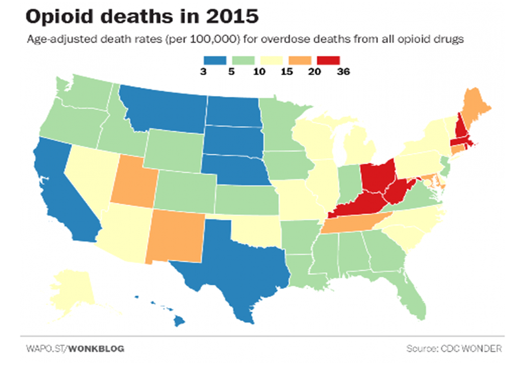
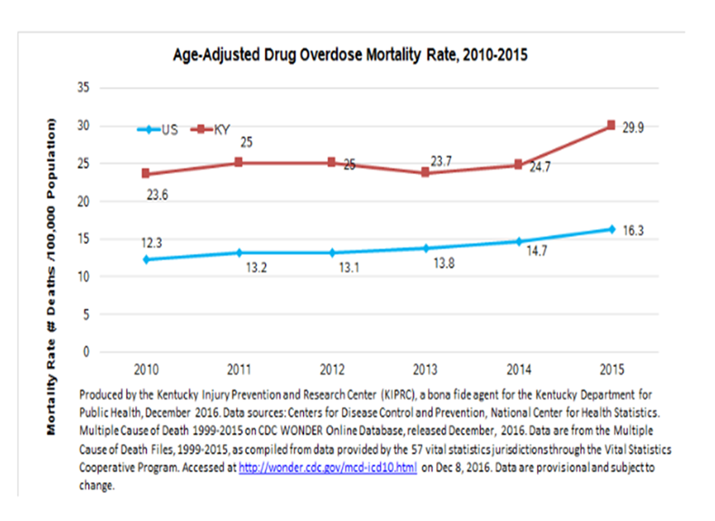
In the Grip of an Unprecedented
Epidemic of Drug Addiction

Slide 3








Dire Consequences

Slide 4
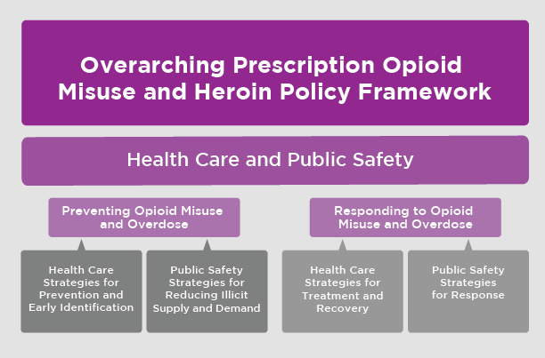
A Comprehensive Response
K.Murphy, M.Becker, J.Locke, C.Kelleher, J.McLeod, and F.Isasi, Finding Solutions to the Prescription Opioid and Heroin Crisis: A Road Map for States (Washington, D.C.: National Governors Association Center for Best Practices, July 2016).

Slide 5

Investing in Prevention

Slide 6
Why the First 8 Years Matter
Substance use, misuse, and addiction are preventable disorders that interfere with healthy functioning
  physical and behavioral health problems
  injuries
  lost income and productivity
  family problems
While most substance use begins in the teen years, there are known biological, psychological, social, and environmental factors that contribute to the risk, starting even before birth.
This creates opportunities to intervene very early in a child’s life to prevent substance use disorders and, along with them, a range of other related problems.

Slide 7


Why it Matters to Me…
Personal Anecdote

Slide 8
Principle 1
Intervening early in childhood can alter the life course trajectory in a positive direction

Slide 10
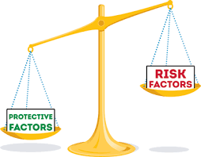
Principle 2
Intervening early in childhood can both increase protective factors and reduce risk factors
Risk factors are qualities of a child or his or her environment that can adversely affect the child’s developmental trajectory and put the child at risk for later substance abuse or other behavioral problems.
Protective factors are qualities of children and their environments that promote successful coping and adaptation to life situations and change. Protective factors are not simply the absence of risk factors; rather, they may reduce or lessen the negative impact of risk factors.

Slide 11
Risk Factors
Protective Factors
Prenatal Period: Maternal substance use
Infancy and Toddlerhood: Difficult temperament, insecure attachment, and uncontrolled aggression
Preschool: lack of school readiness skills
Transition to School: poor self-regulation; lack of classroom structure
Across periods:
  chronic stressors (e.g., family poverty, parental illness)
  neglect and maltreatment
  parental substance use and/or mental illness
  emergent mental illness
Prenatal Period: Good maternal nutrition
Infancy and Toddlerhood: Parents who are highly responsive to their infant
Preschool: Increasing behavioral control in the preschool years improves social competence across the transition to elementary school.
Transition to School: School readiness supports mastery of basic concepts during kindergarten, setting the stage for academic success throughout the school years.
Across periods:
  intelligence and easy temperament
  warmth, consistency, age-appropriate expectations, praise for accomplishments and consistent routines and rules
  opportunities for social interaction with peers
  opportunities for physical exercise

Slide 12
Kentucky Strengthening Families
Protective Factor Framework
http://kidsnow.ky.gov/Improving-Early-Care/Pages/-Kentucky-Strengthening-Families.aspx

Slide 13
Principles 3 - 5
Intervening early in childhood can have positive long-term effects
Intervening in early childhood can have effects on a wide array of behaviors
Early childhood interventions can positively affect children’s biological functioning

Slide 15
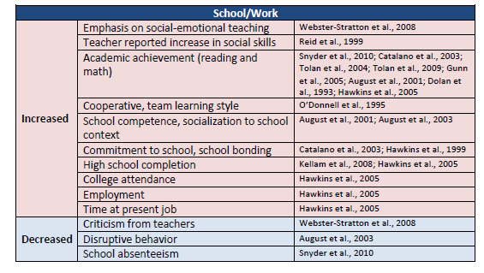
Impact of Early Intervention on School/Work

Slide 16
Principles 6
Early childhood prevention interventions should target the proximal environments of the child

Slide 17

During the preschool and elementary school years, schools and classrooms become primary proximal environments
  improving school climate, resources, and policies
  enhancing teachers’ skills and parent-teacher communication
  changing classroom environments from those that react to problem behavior to those that encourage pro-social behavior
Core elements of a school-based early childhood intervention include
  training teachers to establish clear behavioral expectations
  teach interactively (e.g., role playing, guided play)
  promote cooperative learning in small groups

Slide 18
Principle 7
Positively affecting a child’s behavior through early intervention can elicit positive behaviors in adult caregivers and in other children, improving the overall social environment

Slide 19

Some interventions address multiple contexts such as family and school, with emphasis on communication and collaboration between the two
Program activities often reinforce those of another (e.g., a program to reduce aggressive behavior in children entering school could include activities and training in classroom management for teachers and instruction in supportive, consistent, contingent-responsive parenting strategies for parents and other caregivers)
Behavioral changes in children and the adults who interact with them can be mutually reinforcing. By positively influencing the child’s family or school environment, child behavior can, over time, become more pro-social; this, in turn, can elicit more positive interactions with caregivers and peers, and thereby improve the social environment.

Slide 20
Thank you for Investing in Prevention

Slide 21
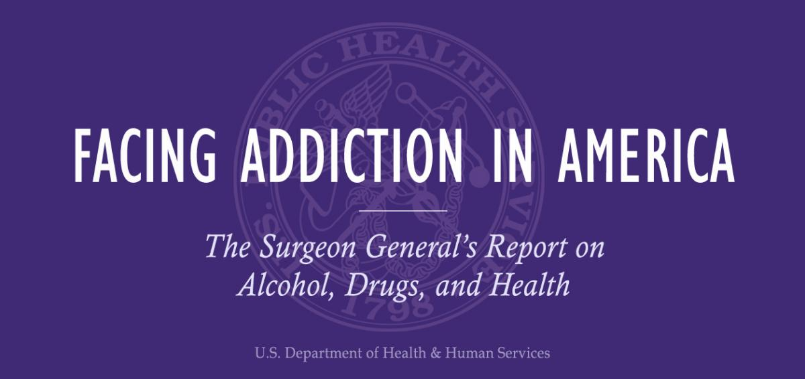

Resources
https://www.drugabuse.gov/publications/principles-substance-abuse-prevention-early-childhood/index
https://addiction.surgeongeneral.gov/

Slide 22
Contact Information
Vestena Robbins, PhD Policy Advisor, Commissioner’s Office Kentucky Department for Behavioral Health, Developmental and Intellectual Disabilities vestena.robbins@ky.gov
Phyllis Millspaugh Branch Manager, Behavioral Health Prevention and Promotion Division of Behavioral Health Kentucky Department for Behavioral Health, Developmental and Intellectual Disabilities phyllis.millspaugh@ky.gov
Michelle Kilgore Adolescent Treatment Coordinator, Children’s Behavioral Health & Recovery Services Division of Behavioral Health Kentucky Department for Behavioral Health, Developmental and Intellectual Disabilities michelle.kilgore@ky.gov
Beth Jordan Branch Manager & EC Mental Health, Children’s Behavioral Health & Recovery Services Division of Behavioral Health Kentucky Department for Behavioral Health, Developmental and Intellectual Disabilities beth.jordan@ky.gov

