Slide 1
Hepatitis A Outbreak Environmental Health Resources, Recommendations and Special Considerations
Summer/Fall 2018

Slide 2
Purpose-To Provide Environmentalists:
General information about Hepatitis A Virus (HAV)
Overview of contact investigation done by Epidemiologist/Communicable Disease
Overview of investigation of cases in congregate care and food service facilities
Overview of State Response
Special Considerations for HAV Outbreak
Suggested Community Partnerships
Resources Available for Environmental Health

Slide 3
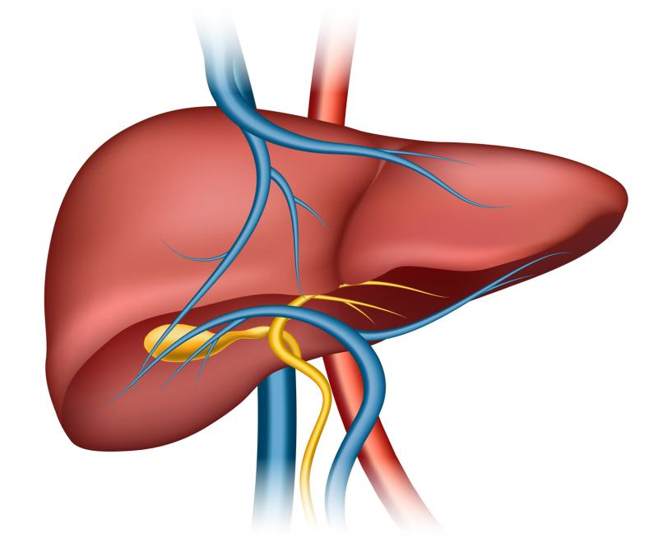
Hepatitis A
Vaccine preventable, communicable disease of the liver
Caused by hepatitis A virus (HAV)
Fecal-oral transmission
No chronic infection
Usually resolves within 2 months of infection

Slide 4
Hepatitis A Virus
A transmission electron micrograph of a small cluster of hepatitis A virus ribonucleic acid (RNA).
Adapted from CDC/Betty Partin, 1976, retrieved from
https://phil.cdc.gov

Slide 5
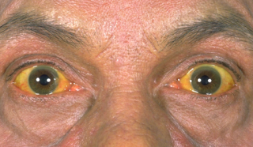
Signs and Symptoms
Discrete onset of:
Fatigue/Malaise
Decreased appetite
Nausea/Vomiting
Abdominal Pain
Jaundice
Dark urine *May have several
Pale stools symptoms or
Fever very few.
Not all people infected with hepatitis A experience illness. Most hepatitis A infections in children younger than age 6 are not accompanied by symptoms. Older children and adults are at risk for severe hepatitis A disease.

Slide 6
Preventing Hepatitis A

Slide 7
Encourage vaccination
Thorough handwashing with soap and water (after using the bathroom or diapering an incontinent person, and before eating or preparing food)
Avoid waters that may be contaminated with sewage
Avoid raw or undercooked oysters or shellfish
Practice safe sex

Slide 8
Diagnosis and Treatment

Slide 9
Diagnosis of Hepatitis A
› Based on symptoms and lab results
› IgM antibody to hepatitis A virus
(IgM anti-HAV)
› Total antibody to HAV not acceptable for
diagnosis and determining a case
› Providers should consider forwarding
reactive specimens to the state lab for
confirmation during the current outbreak
›Hepatitis A does not become chronic

Slide 10
Treatment of Hepatitis A
› No specific treatment for hepatitis A
› Rest, adequate nutrition, fluids
› Avoid alcohol and medications or
supplements that may damage
the liver
› Some people may require
hospitalization
› Antibodies are developed and offer life-
long protection against the disease

Slide 11
How is HAV Transmitted?

Slide 12
HAV Transmission
Transmission Ingestion of fecal matter, even in microscopic amounts, from:
Close, person-to-person contact with a person who is infected
Touching objects or eating food that someone with hepatitis A infection handled
Use of recreational drugs, whether injected or not
Sexual contact with someone who has a hepatitis A infection

Slide 13
Person-to-person transmission through the fecal-oral route
› Primary means of transmission in the US
› Usually from close contact with an infected household member or sex partner
› Lack of thorough handwashing after using the bathroom or changing a diaper
› Accidental ingestion of fecal bacteria

Slide 14
Contaminated food or water
More likely to occur in countries where HAV is endemic
Due to poor sanitary conditions or poor personal hygiene
Fruits, vegetables, shellfish, water, ice
Cooked foods can also transmit HAV if
not heated to >185 °F for one minute
Waterborne outbreaks are infrequent in countries with well-maintained sanitation systems and water supplies

Slide 15
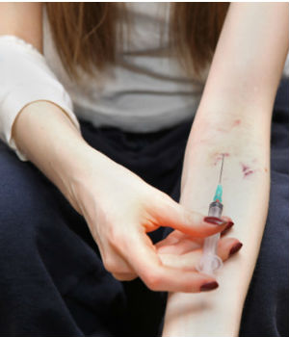
Transmission Through Blood Exposure
› Very rare but can occur
• Injection drug use
• Blood transfusion

Slide 16
Who Is at Risk?
Persons who use illicit drugs*
Persons who do not have access to adequate
hygiene facilities (i.e.: homelessness)*
Men who have sex with men (MSM)*
Persons with chronic liver disease
Travelers to countries with high or
intermediate endemicity of HAV infection
Persons with close contact with an international
adoptee during first 60 days of arrival to US
*risk groups identified in hepatitis A outbreaks

Slide 17
Infectious Period
Average incubation is 28 days (range:15-50 days)
Virus present in blood and feces 10-12 days after infection
Infected individuals can transmit the virus to others for up to two weeks before jaundice onset*
Virus excretion may continue for up to 3 weeks after onset of symptoms
Cases remain contagious until 7 days after jaundice onset*
Likelihood of symptomatic illness directly related to age
Children generally asymptomatic, adults
symptomatic
*use symptom onset date if jaundice is not present

Slide 18
Case Definitions Requirements
NNDSS Definition
Classification: Confirmed
Clinical criteria: Acute onset of sign or symptom consistent with hepatitis and jaundice or elevated ALT or AST
Laboratory Criteria: Positive IgM anti-HAV
KY17-089 Case Definition
Classifications: Confirmed, Probable, and Suspect
Clinical Criteria: same
Laboratory criteria: positive IgM anti-HAV, viral sequencing, genotyping
Exclusions added
Notes:
Case Definition for the 2017 Outbreak of Acute Hepatitis A in Kentucky
The following definition is to be used for cases associated with the KY 17-089 outbreak only. It does not replace the definition used for routine surveillance of hepatitis A. Outbreak statistics may vary from routine surveillance statistics due to this change.
Clinical Criteria
On or after August 1, an acute illness in a Kentucky resident with a discrete onset of any sign or symptom consistent with acute viral hepatitis (e.g., fever, headache, malaise, anorexia, nausea, vomiting, diarrhea, and abdominal pain), and either: a) jaundice; or b) elevated serum alanine aminotransferase (ALT) or aspartate aminotransferase (AST) levels.
Laboratory Criteria for Diagnosis of a Kentucky Outbreak Case
Supportive
Immunoglobulin M (IgM) antibody to hepatitis A virus (anti-HAV) positive
Confirmatory
Hepatitis A RNA positive
Genotype match to outbreak strain 1B
Case Classification for Kentucky Outbreak Case
Confirmed
A clinically compatible case with confirmatory laboratory evidence, OR
• A clinically compatible case with supportive laboratory evidence, and occurs in a person who has an epidemiologic link (i.e., household or sexual contact with an infected person during the 15-50 days before the onset of symptoms) with a person who meets the above confirmed case classification for the outbreak.
Probable
A clinically compatible case with supportive laboratory evidence, and occurs in a person who has one of the primary risk factors associated with this outbreak (i.e., homelessness, illicit drug use, or MSM), OR
A clinically compatible case with supportive laboratory evidence, and occurs in a person who has an epidemiologic link (i.e., household or sexual contact with an infected person during the 15-50 days before the onset of symptoms) with a person who meets the above probable case classification for the outbreak.
Suspect
A case that meets the clinical case definition, with supportive laboratory evidence, and has no other known risk factors
Cases will be excluded from the Kentucky outbreak, if:
Persons are known to have traveled to or worked in a country that has high or intermediate endemicity for hepatitis A virus infections in the 15-50 days before the onset of symptoms (i.e., all countries outside the US other than Canada, Australia, New Zealand, Japan, and Western Europe).
Persons are infected with a genotype of HAV other than genotype 1B.
Persons who have a specimen, drawn within 4 weeks of symptom onset, tested that is found to be HAV RNA negative

Slide 20
Epidemiological Contact Investigation

Slide 21
Communicate with the case as soon as possible
› Attempt by phone first, if possible
› Mail certified letter if unable to contact via
phone
› Inform the case of the infectious period
› If the case is a food handler, daycare worker, or
healthcare worker, notify her/him of work
exclusion recommendations
* Case should not return to work until 7 days after symptom onset (May return on day 8 if asymptomatic.)

Slide 22
Determine Close Contacts
› Household contacts
› Sexual contacts
› Persons who may have shared drugs,
injection or non-injection, with the case

Slide 23
Encourage Post-exposure Prophylaxis (PEP)
› Persons recently exposed to HAV should
receive PEP within 2 weeks after exposure,
unless previously vaccinated
› PEP consists of a single dose of HAV
vaccine or IG (Immunoglobulin)
› Guidelines vary by age and health status
› Encourage contacts to seek PEP as soon
as possible

Slide 24
PEP continued…
› Use PEP calculator to determine dates for vaccine and last day in incubation period
› If you have questions, contact KDPH
› If outside of PEP window, recommend vaccination
for susceptible persons
› Involve clinical staff for questions about vaccine
Date of diagnosis of acute hepatitis A disease or Date of last exposure to an acute case | Last date to give hepatitis A vaccine and / or IG (14 days after exposure) | First date in incubation period (15 days after exposure) | Last date in incubation period (50 days after exposure)
10/1/2017 | 10/15/17 | 10/16/17 | 11/20/17

Slide 25
Educate case and contacts about handwashing and disinfection
Always wash hands with soap and water after using the bathroom or changing a diaper, and before eating or preparing food
Instruct case and contacts on proper handwashing technique
Hand sanitizer is not as effective against hepatitis A virus as soap and water.
If soap and water aren’t available, clean your hands with hand sanitizer containing at least 60% alcohol. (See https://wwwnc.cdc.gov/travel/diseases/hepatitis-a )

Slide 26
Surfaces should be cleaned with freshly prepared solution of 5,000 ppm bleach (1 2/3 cups of bleach in 1 gallon of water).
Allow 1 minute of contact time and then rinse with water.
If bleach cannot be used, use a product that states that it is effective against hepatitis A and refer to product label

Slide 27
KY National Electronic Disease Surveillance System (NEDSS)
Create an investigation and notification in NEDSS within 24 hours
Include preliminary information including:
Signs and symptoms
All applicable laboratory results
Risk factors
Presence in high-risk occupation (food handler, daycare worker, etc.)

Slide 28
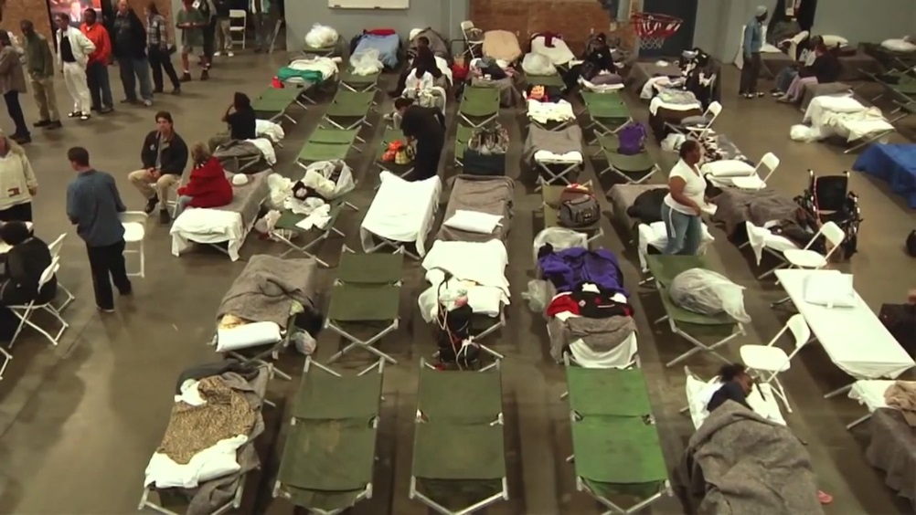
Investigating in a Congregate Setting

Slide 29
Congregate Settings
Detention facilities
Substance abuse facilities
Shelters
Increased vulnerability due to shared spaces
May require special arrangements to interview
Work with facility to obtain list of potential contacts during infectious period
Can be challenging due to quick turn-over and limited access to facility records

Slide 30
Obtain contact information for persons who have had potential contact with case
› Include persons in facility and those released
›Provide line list of contacts to DPH
›DPH will distribute information to county of residence and county of employment for notification purposes
›Each county will be responsible for notifying contacts in their jurisdiction
›Encourage PEP/vaccination as indicated
›Provide facility with dates from PEP calculator

Slide 31
Congregate Settings
Isolate case until jaundice is resolved
Monitor other residents for symptoms
Create a plan to vaccinate exposed and susceptible persons
Educate staff and residents about
proper handwashing and hygiene
Educate staff about disinfection
Surfaces should be cleaned with 5,000 ppm bleach (1 2/3 cups of bleach in 1 gallon of water)

Slide 32
Investigating Case in Food Worker
See Hepatitis A Foodservice Worker Case Investigation
Pursuant to KAR 45:005 and KRS 217.005-217.215
Ordered to: Immediately exclude (employee name) from work due to an excludable illness until such time that they can produce documentation from a healthcare provider they are cleared to return to work.

Slide 33
How Do We Stop this Train?

Slide 34
KY17-089
Large uptick in cases noticed in October 2017
Retroactive case finding back to August 1, 2017
Statewide outbreak declared November 2017
Genotype IB
Strains linked to CA and MI
Cases primarily among illicit drug users or homeless

Slide 35
State Response Activities
Produce and disseminate guidance, data
Call for testing and cases
Weekly report
State Health Operations Center (SHOC) activated
Surveillance and case investigation coordination
Daily response meetings
Coordination with Louisville, other counties
Allocation and acquisition of vaccines
Personnel assistance
Monetary resources
Epi-Aid from CDC

Slide 36
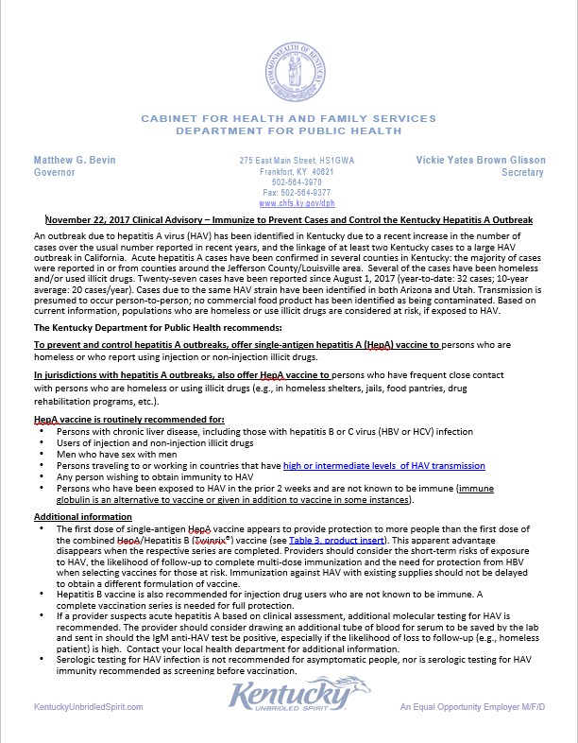
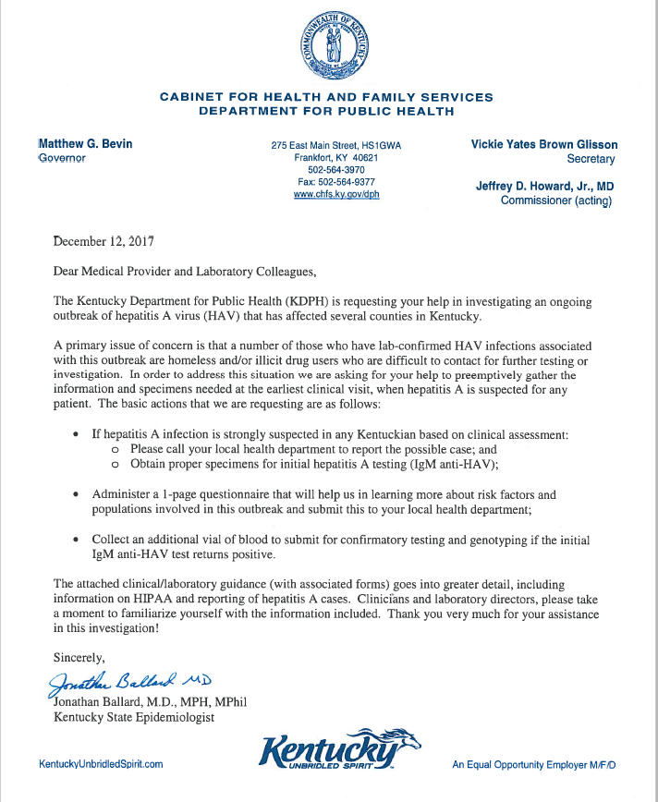
State Response Activities

Slide 37
Special Populations for Response
Illicit drug users
Homeless
Food Service Workers
Corrections
Community
Healthcare Workers

Slide 38
Targeting At-Risk Populations I
Drug Users
Syringe exchange programs
Jails/prisons
Vaccinate at intake most efficient approach
Corrections staff trained to administer HAV vaccine
Hospital ED’s
Need a champion for each facility
Halfway houses
Substance abuse treatment centers

Slide 39
Targeting At-Risk Populations II
Homeless
Street outreach
Homeless camps
Homeless shelters
Food service workers (FSW)
Preventive vaccination not recommended by CDC
Each positive case wreaks mayhem
SAMHSA study: 19% of FSW use illicit drugs*
Target restaurants in high-risk areas
*https://www.samhsa.gov/data/sites/default/files/report_1959/ShortReport-1959.html)

Slide 40
Special Considerations in this Outbreak
In areas with local transmission, KY is recommending food service workers get vaccinated
In counties with local transmission, KY is recommending all people consider vaccination
Private providers are best route
Public health vaccine stocks are subject to limitations – uninsured, persons with risk factors
Should be no co-pay with ACA-compliant providers
Preventive services are exempt from co-pay
Getting into prisons – big job, start early
Notes:
Utilization of syringe exchange programs
Collaboration with community partners

Slide 41
Special Considerations – Epi & Environmental
Whenever possible, it may be helpful to pair an Epidemiologist/Communicable Disease Investigator and an Environmental Field Investigator when investigating congregate facilities and food service facilities
PEP/Vaccination Issues
Infectious period
Low or high risk work activities

Slide 42
Special Considerations - Staffing
Need for additional personnel
Nurses to vaccinate
PH nurses – may not be available or for duration
Contract nursing
Must fund either
Staff to back-fill other positions during response
Data entry, greeters, clerical, drivers
Student volunteers
Liability coverage
Training

Slide 43
Special Considerations - Before 1st Case
Visit Shelters/Feeding sites
Inquire about how is foodservice done
Distribute flyers/education
Mass email/mail to food service facilities
Disinfection guidelines
Hotels
Gloves for handling sheets/cleaning bathrooms
Distribute flyers/education
Truck Stops
Distribute flyers

Slide 44
Special Considerations- Vaccine
Identify money to buy vaccine
CDC vaccine is restricted:
Section 317 PHSA – uninsured/at risk adults
VFC – Any VFC child
Can negotiate directly with manufacturer
Recording vaccinations from the field or mass events
Training as vaccine transporter required
Special requirements associated with equipment/supplies (cooler thermometers, etc.)
Vaccination efforts should focus on uninsured or under-insured at-risk individuals

Slide 45
Choosing a Vaccine
Single Antigen Hep A vaccine
Much less expensive
Better coverage on first dose
Only two doses needed to fully immunize
Twinrix ®
About double the cost
2nd dose needed to assure fuller initial coverage
3rd dose needed
Covers hepatitis B as well as A
Consider ability of individual to return for additional doses
Not recommended for PEP (https://www.cdc.gov/hepatitis/HAV/HAVfaq.htm#B3 )

Slide 46
Community Partnerships
Community partners should be encouraged to seek out vaccination for staff
Community Festivals – handwashing stations
Inquire with local sanitation suppliers
Convention/Visitors Bureau – esp. in metro areas
First responders – encourage vaccination (insurance covers 100% most of time)
Hospital/Medical Community – may be willing to provide nursing staff to help with vaccinations
Should encourage vaccination of at-risk patients
Community College/University – may be willing to help vaccinate

Slide 47
Community Partnerships
Restaurants - may be willing to help cover the costs of employee vaccinations
Hotel Association – may be willing to help get information to hotels
Syringe Exchange Programs – may be willing to help encourage vaccination of clients
Correction Facilities – may be willing to vaccinate inmate population
Pharmacy Chains – may be willing to help vaccinate in multiple counties/areas of state

Slide 48
Public Alert for Foodservice Worker
Unless there is an unusually high level of risk (e.g., a worker who has poor hand hygiene, was involved in bare-handed food preparation, and was contagious during the same period), a detailed level of public alert is not recommended.
CHFS/DPH urges all LHDs to utilize CDC templates for high and low-risk exposure situations in food handling establishments (see DPH Hep A Resources at https://chfs.ky.gov/agencies/dph/dehp/idb/Pages/hepatitis.aspx or contact DPH for templates)
Notes:
See email sent from Danielle Jones to LHD Directors and PIOS on June 21, 2018

Slide 49
HAV and Swimming Pools
Kentucky regulations require 1 to 2.5 ppm free chlorine in public swimming pools and bathing facilities.
It takes 16 minutes to kill Hep A at 1 ppm free chlorine with a pH of 7.5 (takes longer in the presence of cyanuric acid)
CDC says it would be highly unlikely for individuals to be infected from swimming in a properly chlorinated pool.
Pool safety guidelines such as showering before entering pool and avoiding the pool during episodes of diarrhea should continue to be encouraged
https://www.cdc.gov/healthywater/swimming/residential/disinfection-testing.html

Slide 50
Helpful Resources
https://chfs.ky.gov/agencies/dph/dehp/idb/Pages/hepatitis.aspx
https://www.cdc.gov/hepatitis/hav/index.htm
https://healthalerts.ky.gov/Pages/default.aspx
https://www.cdc.gov/vaccines/pubs/pinkbook/downloads/table-of-contents.pdf

Slide 52
Kentucky Department for Public Health
Division of Epidemiology and Health Planning
Infectious Disease Branch
275 East Main Street HS2E-A
Frankfort, KY 40621
Telephone: 502-564-3261
Secure Fax: 502-696-3803
Amanda Hunt, RN, BSN
Ext: 4242
Jennifer Khoury, MPH
Ext: 4239
Katie Myatt, MS
Ext: 4244

Slide 53
Public Health Protection and Safety
Rebecca Gillis, MPH, CHES
Director
275 E. Main St, HS1E-B
Frankfort, KY 40621
RebeccaL.Gillis@ky.gov
502-564-7398ext. 4153
502-382-7374 work cell
Curt Pendergrass, PhD
Assistant Director
275 E. Main St, HS1E-B
Frankfort, KY 40621
Curt.Pendergrass@ky.gov
502-564-7398 ext. 4151
Pam Hendren
Branch Manager
Kentucky Food Safety Branch
275 East Main Street
HS1C-F
Frankfort, KY 40621
PamelaM.Hendren@ky.gov
502/564-7181 ext. 4208

