Slide 1
Kentucky Women’s Cancer Screening Program (KWCSP) Contract Training
Ellen Barnard, Director
03.2019

Slide 2
The KWCSP sincerely appreciates the LHDs that provide breast and cervical care and that serve as the medical home for many women throughout the Commonwealth.
KWCSP
The KWCSP is 100% federally funded by a grant from the CDC’s National Breast and Cervical Cancer Early Detection Program (NBCCEDP)
Grant award funds are allocated to LHDs for:
Clinical service reimbursements
Case management
Outreach, education and recruitment activities for all women and potential/contracted providers
Notes:
The KWCSP is a statewide safety net program that ensures that age-appropriate, underserved, low-income women have access to lifesaving breast and cervical cancer screenings, diagnostics and treatment if needed.
The program is 100% federally funded by the CDC's National Breast and Cervical Cancer Early Detection Program (NBCCEDP) and the grant award funds are allocated to participating LHDs and contract providers. The KWCSP also supports the LHDs in case management, outreach, education and recruitment activities for eligible women.
The KWCSP sincerely appreciates the LHDs that provide breast and cervical care and that serve as the medical home for many women throughout the Commonwealth.

Slide 3
KWCSP Approved CPT Codes and Reimbursement Rates
The KWCSP reimburses contracted providers via the LHDs for breast and cervical cancer screening services to program eligible women
KWCSP reimburses at the highest allowable Medicare Part B rate
Every fiscal year the KWCSP provides LHDs with the newly approved CPT codes and reimbursement rates
Notes:
The KWCSP reimburses for clinical services via the LHDs contracts with clinical service providers for breast and cervical cancer screenings and diagnostics for program eligible women.
The KWCSP reimburses at the highest allowable Medicare Part B rate.
Every year, prior to the contract season, an email is sent to all LHDs and their directors, providing the newly approved KWCSP CPT codes and reimbursement rates for that fiscal year.

Slide 4
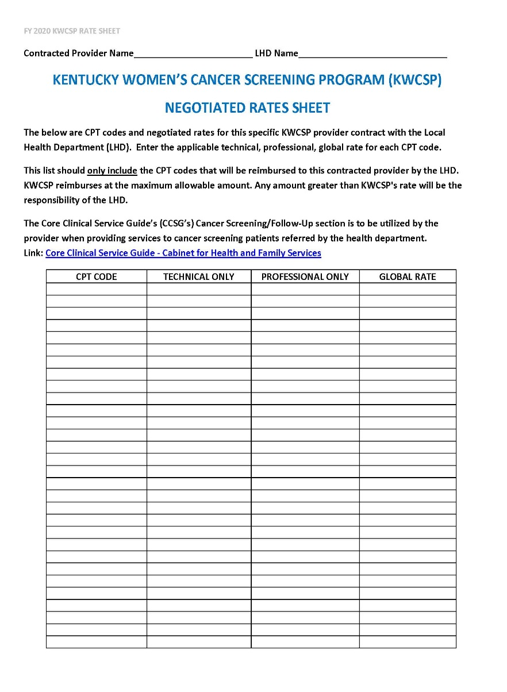
KWCSP Negotiated Rates Sheet
This form is known as the ‘KWCSP rate sheet’
A KWCSP rate sheet must be included in all LHD/KWCSP contracts
The KWCSP rate sheet should only list the CPT codes that will be reimbursed to the contracted provider by the LHD for KWCSP services
Notes:
This form is known as the ‘KWCSP rate sheet.’
A KWCSP rate sheet should be included in all LHD/KWCSP contracts.
The KWCSP rate sheet should only list the CPT codes that will be reimbursed to the contracted clinical service provider by the LHD for KWCSP services.

Slide 5
LHD/KWCSP Provider Contract Language
Contractors will:
Perform KWCSP services in lieu of the LHDs providing direct clinical services for a KWCSP patient
Comply with the Core Clinical Service Guide’s (CCSG’s) Cancer Screening/Follow-Up sections
The CCSG is located on the KDPH LHD home page
Will never bill the KWCSP-eligible patient
Include approved CPT codes via the KWCSP rate sheet
Notes:
LHD / KWCSP contract language states that contractors will:
Perform KWCSP services in lieu of the LHDs providing direct clinical services for a KWCSP patient.
Comply with the KDPH’s Core Clinical Service Guide’s (CCSG’s) Cancer Screening/Follow-Up sections.
Will never bill the KWCSP-eligible patient
Include approved CPT codes in the contract, utilizing the KWCSP rate sheet shown on the previous slide.

Slide 6
Negotiated Rates for KWCSP Services
LHDs may negotiate lower reimbursement rates with contract providers, but know:
No matter the negotiated rate, KWCSP reimburses at the maximum allowable amount, no more, no less
In other words: KWCSP will not reimburse over the amount listed on the KWCSP’s Approved CPT Codes and Reimbursement Rate sheet
Any negotiated rate greater than KWCSP's rate will be the responsibility of the LHD
Notes:
LHDs may negotiate lower reimbursement rates with contract providers, but know:
No matter the negotiated rate, KWCSP reimburses at the maximum allowable amount per Medicare Part B.
We have found that during our contract review/approval process that the most common comment to the LHDs pertained to contracts submitted with rates greater than KWCSP approved rates.
So ensure that your contracted providers know that KWCSP will not reimburse over the amount listed on the KWCSP’s Approved CPT Codes and Reimbursement Rate sheet.
Any negotiated rate greater than KWCSP's rate will be the responsibility of the LHD.

Slide 7
Provider Education to Enhance Opportunities for Fiscal Efficiency
Educate contracted providers to ensure they:
Identify KWCSP-eligibles, provide screening and make referrals to LHDs for treatment, if needed
Bill LHDs for KWCSP services
Assist the KWCSP in reaching screening goals to secure future CDC funding to decrease the breast and cervical cancer burden for women in the Commonwealth
Utilize the Quick Reference Guide for Healthcare Providers: Breast and Cervical Cancer Screening and Treatment in KY. Link below:
www.kycancerprogram.org/professional-education-and-training
Notes:
Ensuring your contracted providers are educated on the KWCSP eligibility and services can result in increased LHD revenue.
Ways the LHDs can do this is by ensuring their providers:
Evaluate, identify women who may be eligible, provide services to KWCSP-eligibles and then make referrals back to LHD for assistance with receiving treatment through Medicaid’s Breast and Cervical Cancer Treatment Program.
Bill LHDs for KWCSP-eligible services provided.
Encourage providers to promote access to care and assist the KWCSP in reaching screening goals that will help secure future CDC funding in order to continue our efforts to decrease the breast and cervical cancer burden for women in the Commonwealth.
And lastly, consider providing contractors with the Quick Reference Guide for Healthcare providers: Breast and Cervical Cancer Screening and Treatment in Kentucky. Go to kycancerprogram.org, professional education and training.

Slide 8
Ellen Barnard
Director
Ellen.Barnard@ky.gov
502-564-3236 x 4157
Sivaram ‘Ram’ Maratha Data Manager
SivaramR.Maratha@ky.gov
502-564-3236 x 4161
Colleen Toftness
Clinical Coordinator
Colleen.Toftness@ky.gov
502-564-3236 x 4159

