Slide 1
Third Party Billing
Rebilling Steps for PEFs entered on CMS Portal

Slide 2
Slide # | Scenario
3 | PEF billed to the wrong Medicaid MCO
18 | PEF billed to Regular Medicaid and needs to bill to a Medicaid MCO
29 | PEF went to Private pay and needs to bill to Medicaid/MCO
40 | PEF billed to Medicaid/MCO but denied
53 | PEF went to Private pay and needs to bill to Private Insurance
64 | PEF billed to Private Insurance but denied
78 | Medicaid/MCO Information

Slide 3
The PEF billed to the wrong Medicaid MCO
Scenario #1

Slide 4
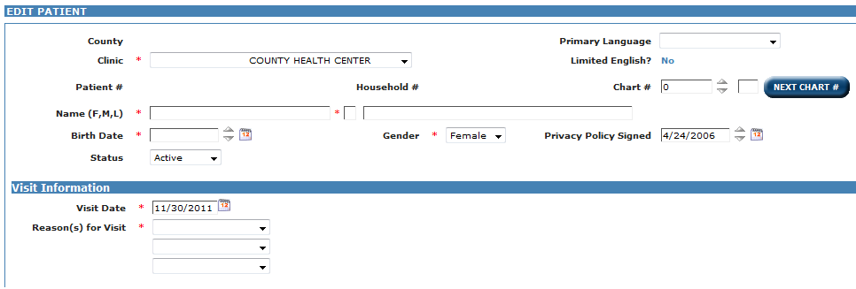
On Patient Registration, set the Visit Date to the date the patient was originally seen.

Slide 5
Set the Reason for Visit.

Slide 6
Correct the Medicaid MCO and the MCO Member #.

Slide 7
Request a PEF label. DO NOT check Additional PEF?.

Slide 8
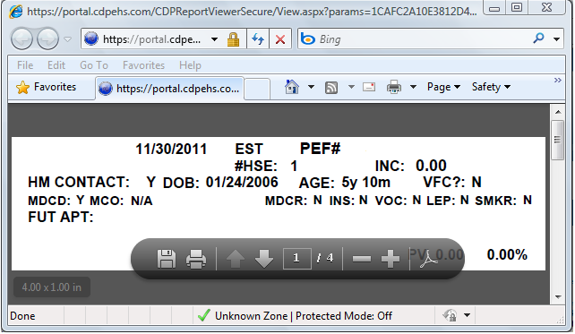
Only print the label if needed. Corrections may be hand-written on the CH-5 with the effective date and initial and date.

Slide 9
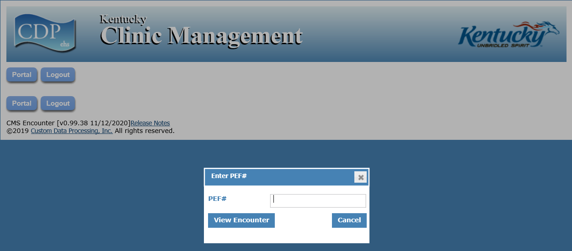
Enter the PEF # and click View Encounter.

Slide 10
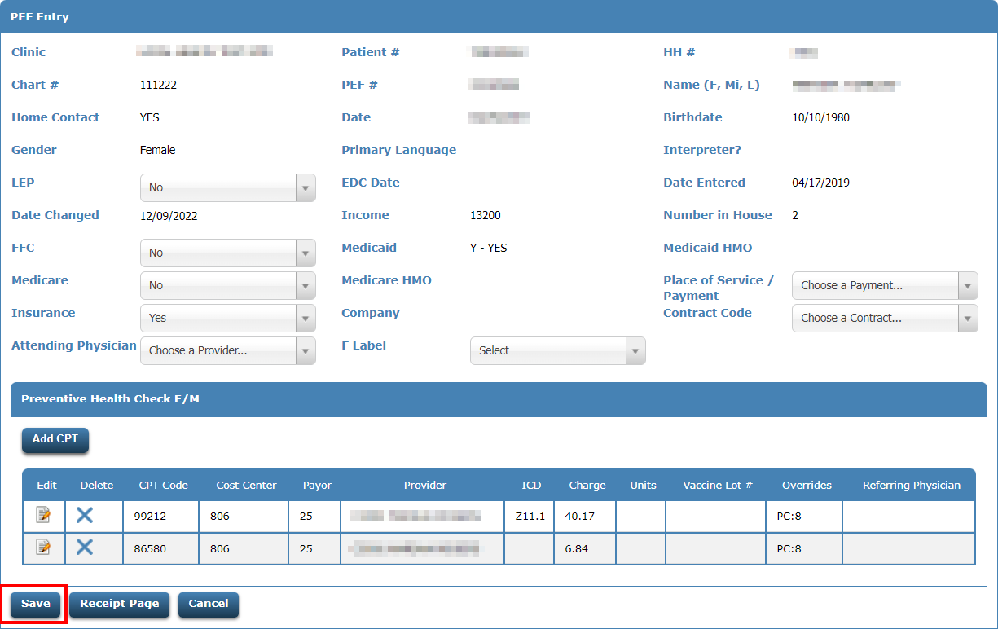
Click the Save button.

Slide 11
Review the PEF and verify the services are going to the correct payor code.

Slide 12
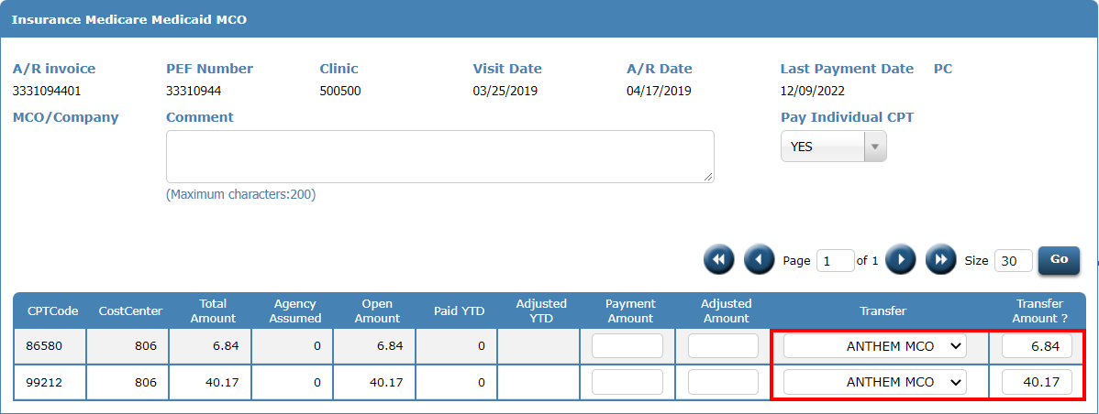
Call up the AR invoice and transfer the charges to the new MCO payor code.

Slide 13
Transferring AR
When you transfer an AR invoice to a different payor code, the system WILL NOT automatically adjust off the AR invoice that was set up for the wrong MCO.
The AR invoice set up for the wrong MCO can be manually adjusted off at your agency’s discretion.

Slide 14
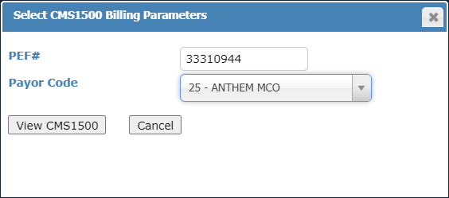
Call up the CMS1500 using the PEF # to rebill and the payor code we want to bill to.

Slide 15
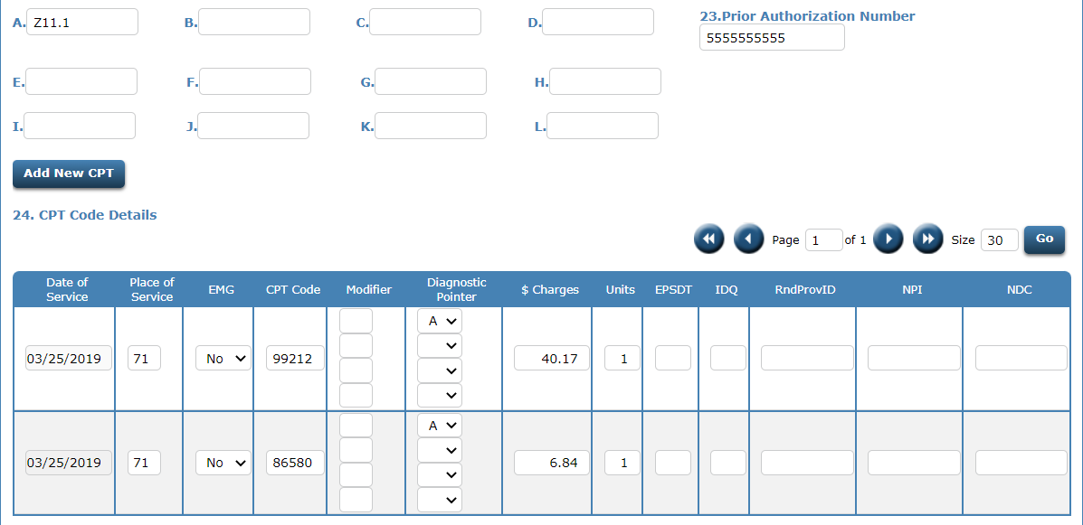
Review the information on the CMS1500.

Slide 16
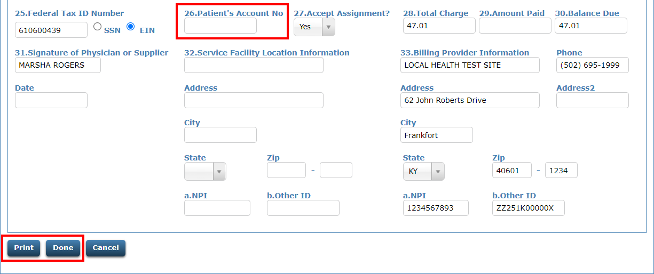
Enter the AR invoice number in the 26.Patient’s Account No field. Then click Print for a hard copy or Done to bill the claim electronically.

Slide 17
If the claim is re-billed electronically, verify that the PEF shows on the next Medicaid MCO Rebill Invoice Register.
3090 – Molina Rebill Invoice Register
3091 – United Rebill Invoice Register
3095 – Anthem Rebill Invoice Register
3096 – Aetna Rebill Invoice Register
3098 – WellCare Rebill Invoice Register
3099 – Humana CareSource Rebill Invoice Register

Slide 18
The PEF billed to regular Medicaid and needs to bill to a Medicaid MCO
Scenario #2

Slide 19
On Patient Registration, set the Visit Date to the date the patient was originally seen.

Slide 20
Set the Reason for Visit.

Slide 21
Enter the Medicaid MCO and the MCO Member #.

Slide 22
Request a PEF Label. DO NOT check Additional PEF?.

Slide 23
Only print the label if needed. Corrections may be hand-written on the CH-5 with the effective date and initial and date.

Slide 24
Enter the PEF # and click View Encounter.

Slide 25
Click the Save button.

Slide 26
Review the PEF and verify the services are going to the Medicaid MCO payor code.

Slide 27
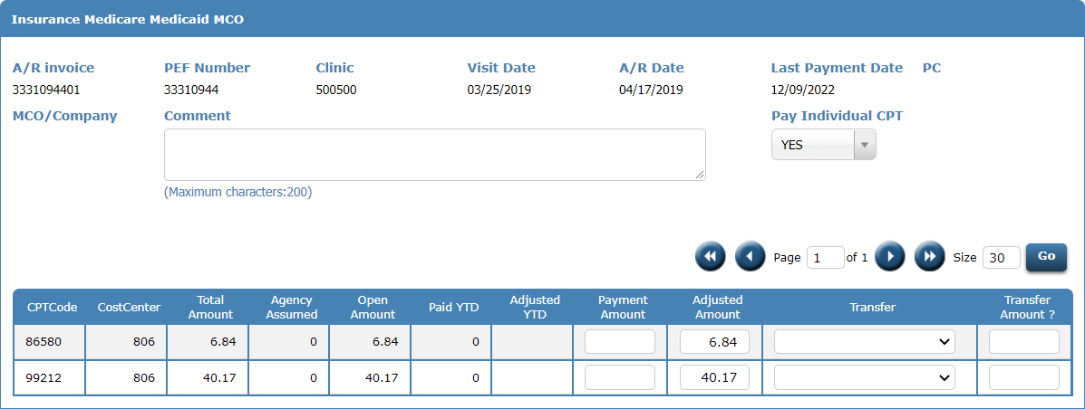
Call up the AR invoice created for regular Medicaid and adjust off the balance.

Slide 28
This claim will bill off on the next Medicaid MCO billing cycle. An AR invoice will also be created. Verify that the PEF shows on the appropriate MCO Invoice Register.
3080 – Molina (MCO) Invoice Register
3081 – United Healthcare (MCO) Invoice Register
3085 – Anthem (MCO) Invoice Register
3086 – Aetna (MCO) Invoice Register
3088 – WellCare (MCO) Invoice Register
3089 – Humana CareSource (MCO) Invoice Register

Slide 29
The PEF went to private pay and needs to bill to Medicaid/MCO
Scenario #3

Slide 30
On Patient Registration, set the Visit Date to the date the patient was originally seen.

Slide 31
Set the Reason for Visit.

Slide 32
Enter the Medicaid MCO and the MCO Member #.

Slide 33
Request a PEF Label. DO NOT check Additional PEF?.

Slide 34
Only print the label if you need to. Corrections may be hand-written on the CH-5 with the effective date and initial and date.

Slide 35
Enter the PEF # and click View Encounter.

Slide 36
Click the Save button.

Slide 37
Review the PEF and verify the services are going to the correct Medicaid MCO payor code.

Slide 38
Call up the AR invoice created for private pay and adjust off the balance.

Slide 39
This claim will bill off on the next Medicaid MCO billing cycle. Verify that the PEF shows on the appropriate MCO Invoice Register.
3080 – Molina (MCO) Invoice Register
3081 – United Healthcare (MCO) Invoice Register
3085 – Anthem (MCO) Invoice Register
3086 – Aetna (MCO) Invoice Register
3088 – WellCare (MCO) Invoice Register
3089 – Humana CareSource (MCO) Invoice Register

Slide 40
The PEF billed to Medicaid/MCO but denied
Scenario #4

Slide 41
On Patient Registration, set the Visit Date to the date the patient was originally seen.

Slide 42
Set the Reason for Visit.

Slide 43
Review the information on Registration and make corrections if necessary.

Slide 44
If any corrections are made, request a PEF label. DO NOT check Additional PEF?.

Slide 45
Only print the label if you need to. The corrections may be hand-written on the CH-5 with the effective date and initial and date.

Slide 46
Enter the PEF # and click View Encounter.

Slide 47
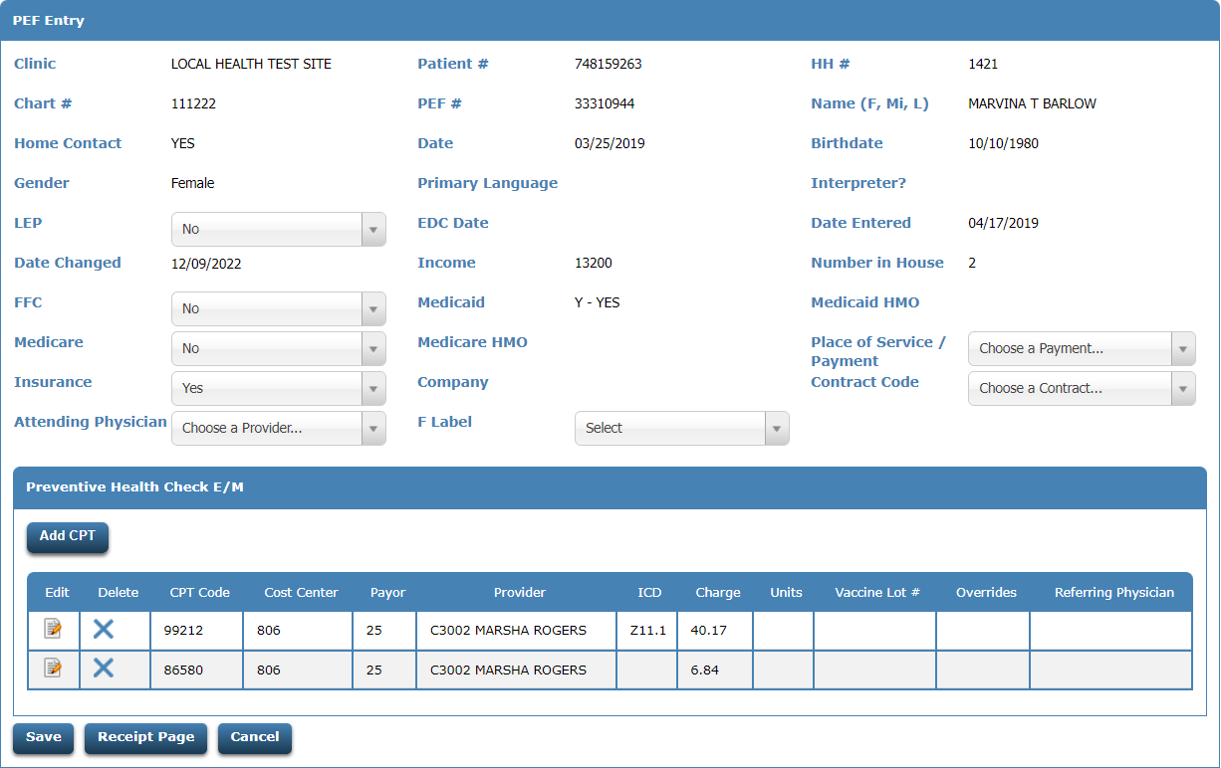
Make any corrections to the PEF.

Slide 48
Click the Save button.

Slide 49
Call up the CMS1500 using the PEF # to rebill and the payor code you want to bill to.

Slide 50
Review the information on the CMS1500.

Slide 51
Enter the AR invoice number for this claim in the 26.Patient’s Account No field. Click Print for a hard copy or Done to bill the claim electronically.

Slide 52
If the claim is re-billed electronically, verify that the PEF shows on the next Medicaid MCO Rebill Invoice Register.
3090 – Molina Rebill Invoice Register
3091 – United Rebill Invoice Register
3095 – Anthem Rebill Invoice Register
3096 – Aetna Rebill Invoice Register
3098 – WellCare Rebill Invoice Register
3099 – Humana CareSource Rebill Invoice Register

Slide 53
The PEF went to private pay and needs to bill to private insurance
Scenario #5

Slide 54
On Patient Registration, set the Visit Date to the date the patient was originally seen.

Slide 55
Set the Reason for Visit.

Slide 56
Enter the Insurance information if not previously captured.
If the patient is in a household, the insurance information will need to be collected via the household pages.

Slide 57
Request a PEF Label. DO NOT check Additional PEF?.

Slide 58
Only print the label if needed. Corrections may be hand-written on the CH-5 with the effective date and initial and date.

Slide 59
Enter the PEF # and click View Encounter.

Slide 60
Click the Save button.

Slide 61
Review the PEF and verify the services are going to the Medicaid MCO payor code.

Slide 62
Call up the AR invoice created for private pay and adjust off the balance.

Slide 63
This claim will bill off on the next private insurance billing cycle. Verify that the PEF shows on the appropriate insurance invoice register.
729 – Pre-bill Invoice Register (Paper Claims)
2729 – Pre-bill Invoice Register (Electronic Claims)
730 – Insurance Invoice Register (Paper Claims)
2730 – Insurance Invoice Register (Electronic Claims)

Slide 64
The PEF billed to private insurance but denied
Scenario #6

Slide 65
On Patient Registration, set the visit date to the date the patient was originally seen.

Slide 66
Set the Reason for Visit.

Slide 67
Review the information on Registration and make corrections if necessary.

Slide 68
If any corrections are made, request a PEF label. DO NOT check Additional PEF?.

Slide 69
Only print the label if needed. Corrections may be hand-written on the CH-5 with the effective date and initial and date.

Slide 70
Enter the PEF # and click View Encounter.

Slide 71
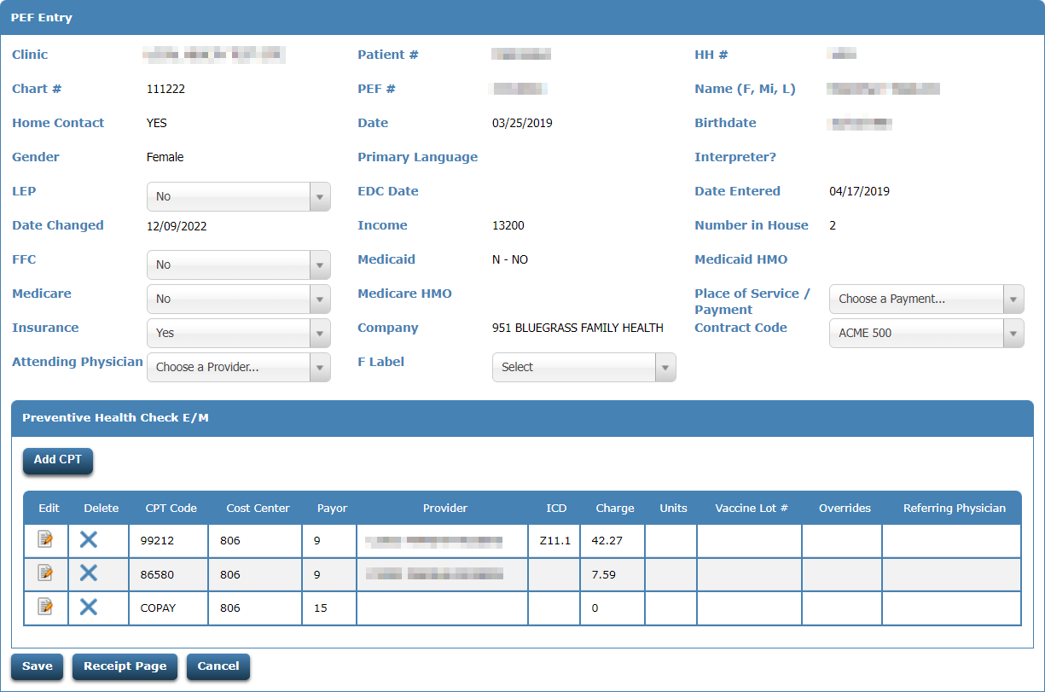
Make any corrections to the PEF.

Slide 72
Click the Save button.

Slide 73
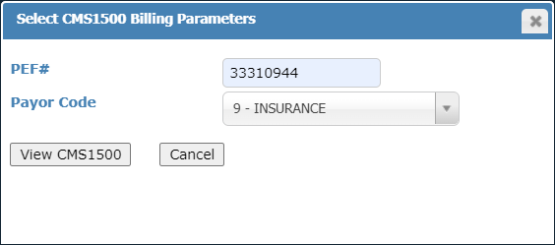
Call up the CMS1500 using the PEF # to rebill and the payor code to bill.

Slide 74
Review the information on the CMS1500.

Slide 75
Enter the AR invoice number for this claim in the Patient’s Account No field. Click Print for a hard copy or Done to bill the claim electronically.

Slide 76
If the claim is re-billed electronically, verify that the PEF shows on the next Insurance Rebill Invoice Register.
2734 – Insurance Re-bill Invoice Register

Slide 77
Medicaid MCO Information
MCO #s
Medicaid & MCO Payor Codes
1 – Molina (Passport)
2 – United Healthcare
5 – Anthem
6 – Aetna
8 - WellCare
9 – Humana CareSource
2 – Preventive Medicaid
21 – Molina
22 – United Healthcare
25 – Anthem
26 – Aetna
28 – WellCare
29 – Humana CareSource

Slide 78
Questions?
Call 1-866-237-4814
Email – customersupport@cdpehs.com

