Slide 1
CDP Report Presentation 2022
Reports

Slide 2
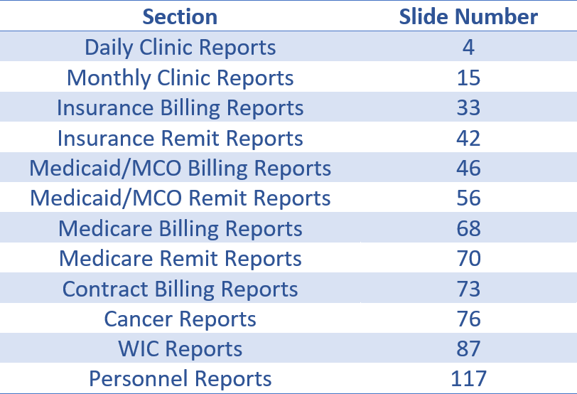
Table of Contents

Slide 3
Clinical
Reports

Slide 4
Daily Clinic Reports
CDP Report Presentation 2022

Slide 5
319 – Patient Encounters entered
Listing of encounters entered in a clinic for the previous business day
Summary of CPT codes & RBRV’s
Summary by provider
Summary by operator
Rejected A/R

Slide 6
352 – Daily Invoices
Report shows invoices set up for previous day by pay code

Slide 7
358 – Daily receipts
Report shows any money collected or adjusted for the previous day by pay code
Also shows money that was electronically posted

Slide 8
419 Daily Encounter summary
This report is a summary of the 319 Patient Encounters Entered
This report is by county
Summary of CPT codes & RBRV’s
Summary by provider
Summary by operator

Slide 9
519 Daily Encounter summary
This is a summary of the 319 Patient Encounters Entered
This report is by district
Summary of CPT codes & RBRV’s
Summary by provider
Summary by operator

Slide 10
601 – Supplemental Encounter List
List of Supplemental encounters entered the previous day.

Slide 11
615 – Community Health Service List
List of Community Health Services entered the previous day.

Slide 12
773 – PEFs updated
Listing of PEF’s that had changes made the previous day
If the encounter was changed 5 times, it will show on the report 5 times.

Slide 13
850 – Outstanding PEF’s
Listing of PEF #’s assigned but did not get entered
This report is cumulative

Slide 14
902 – PEF’s Assigned
Listing of patient who had a PEF # assigned
Shows Sex, Race, Income, Medicaid and Medicare Status

Slide 15
Monthly Clinic Reports
CDP Report Presentation 2022

Slide 16
108 – Supplemental Activity by Type, Discipline, and Age
Breakdown of Supplemental encounters by type, discipline and age
This report is cumulative from the beginning of the fiscal year
Report runs the second weekend of the month

Slide 17
135 – Unduplicated Patient Counts
Report is broken out by Cost Center, race, and sex
Report is cumulative from the beginning of the Fiscal year

Slide 18
138 – Unduplicated Patient Counts
Report is broken out by Cost Center, race, and sex
Report is for only one month

Slide 19
219 – FYTD Encounter Summary
This is a fiscal year to date summary of the 319 Patient Encounters Entered
This report is by site
Summaries by CPT code, provider and Operator

Slide 20
353 – Number of Services by cost center
Report is broken out by Cost Center and pay codes
Report is cumulative from the beginning of the Fiscal year
This report is in a .CSV format and must be opened with Excel
A clinic, county, and District version will be created
Report will be named –
Site-XXXX_Rpt-0353_Clinic_MM-DD-YYYY

Slide 21
359 – Monthly Aging Report
Listing of all A/R invoices with an open balance and # of days past due
Report runs first weekend of the month or last day of the month if it falls on a weekend

Slide 22
360 – Monthly Invoice listing
List all invoices set up for the previous month by pay code
Runs the last day of the month

Slide 23
361 – Monthly receipt listing
Report shows any money collected or adjusted for the previous month by pay code
Also shows money that was electronically posted
Report runs last day of the month

Slide 24
375 – Medicaid encounters with MDCD Status of A, P, or M
This report list those Medicaid encounters that have a Medicaid status of A, P, or M
The encounters with these status will NOT bill out until the status has changed
This report is available in EXCEL format

Slide 25
439 – Positive Pregnancy Log
Listing of patients who tested positive for pregnancy
Runs first weekend of the month

Slide 26
597 – Private Pay Statements
Statement that can be sent to the patient showing balance due for Pay code 1 and 15
Available for plain paper or mailers
Statement amounts are determined by the agency

Slide 27
598 – Private Pay Statement labels
Labels for the private pay statements
Only receive if your statements are printed on plain paper

Slide 28
617 – Supplemental Encounter List
Listing of supplemental encounters entered for during the previous month
This report runs on the night of the 15th of the month

Slide 29
700 – FYTD Encounter Summary
This is a fiscal year to date summary of the 319 Patient Encounters Entered
This is a district version of the 219 report
Summaries by CPT code, provider and Operator

Slide 30
701 – FYTD Encounter Summary
This is a fiscal year to date summary of the 319 Patient Encounters Entered
This is a county version of the 219 report
Summaries by CPT code, provider and Operator

Slide 31
758 – Number of Services by cost center
Report is for Radiology/Laboratory/Pathology services
Report is broken out by Cost Center and pay codes
Report is cumulative from the beginning of the Fiscal year
This report is in a .CSV format and must be opened with Excel
A clinic, county, and District version will be created
Report will be named –
Site-XXXX_Rpt-0758_Clinic_MM-DD-YYYY

Slide 32
2898 – Private Pay Statement labels
Same labels as the 598 only they are for printing on the Zebra printers

Slide 33
Insurance Billing Reports
CDP Report Presentation 2022

Slide 34
Pre-Billing Reports
729 – Pre-bill Invoice Register (Paper)
733 – Pre-bill Reject Report (electronic/paper)
2729 – Pre-bill Invoice Register (electronic)

Slide 35
729 – Insurance Pre-bill Register
This report runs on the 1st and 3rd Sunday of the month.
This report is for reviewing the claims before they bill out.
This report will only show those claims that will be billed out on paper (CMS1500)

Slide 36
733 – Insurance Rejects
This report is created when the 729, 730, 2729, and 2730 are created
This report shows the claims that are missing information that keeps CDP from being able to bill
This report is for both paper and electronic claims
This report is in a .CSV format and must be opened with Excel
Report will be named –
Site-XXXX_Rpt-0733_Insurance_Rejects_MM-DD-YYYY

Slide 37
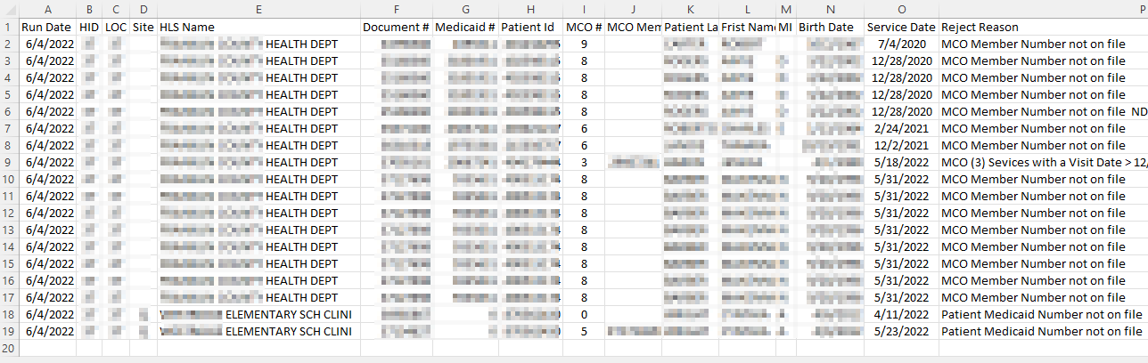
733 – Insurance Reject Report

Slide 38
2729 – Insurance Pre-bill Register
Electronic claims only
This report runs on the 1st and 3rd Sunday of the month
This report is for reviewing the claims before they bill out
This report will only show those claims that will be billed out electronically (not on CMS1500)

Slide 39
Live Billing Reports
These reports are created the 2nd and 4th weekend of the month
730 – Invoice Register (Paper)
731 – CMS 1500 forms (HCFA’s)
732 – Labels for CMS 1500 forms
733 – Reject Report (paper & electronic)
2730 – Invoice Register (electronic)
2734 – Re-bill Invoice Register

Slide 40
1830 - Insurance Acknowledgment
Report is created when CDP receives a file.
This report shows the status of the claims received by the insurance clearinghouse
Claim Status P = Processed (not paid)
Claim Status R = REJECTED

Slide 41
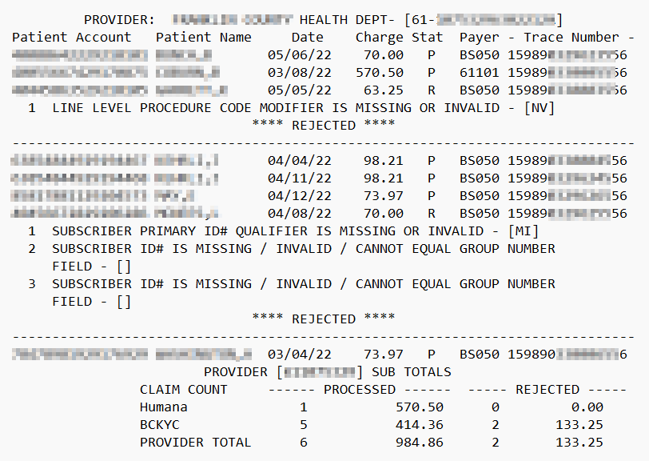
1830 – Insurance Acknowledgement

Slide 42
Insurance Remit Reports
CDP Report Presentation 2022

Slide 43
3150 - Anthem Private Insurance Paid Claims
This report list the Anthem Private Insurance claims that have been paid
This report is created when CDP receives a paid claims file from Anthem

Slide 44
3151 - Anthem Private Insurance Denied Claims
This report list the Anthem Private Insurance claims that have been denied
This report is created when CDP receives a denied claims file from Anthem

Slide 45
977 – Insurance company listing
Listing of the insurance companies for your district
User can request report when they need it
Reach out to CustomerSupport@cdpehs.com to request this report

Slide 46
Medicaid/MCO Billing Reports
CDP Report Presentation 2022

Slide 47
Preventive Medicaid Billing Reports
3062 – Preventive Medicaid Rejects
3082 – KY Medicaid Invoice Register
3092 – KY Medicaid Rebill Invoice Register

Slide 48
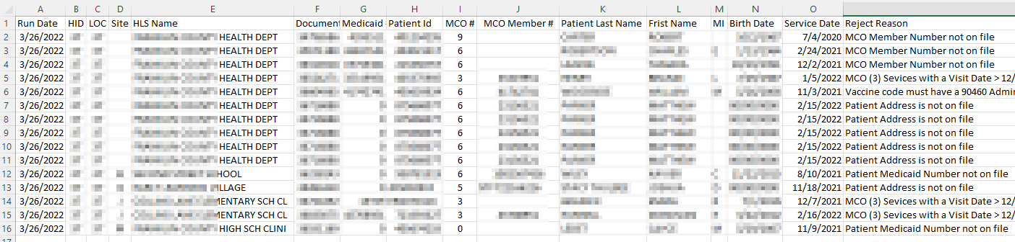
3062 – Medicaid/MCO Reject Report
This report list the PEFs that could not be billed due to missing data
This report is in a .CSV format and must be opened with Excel
Report will be named –
Site-XXXX_Rpt-3062_Medicaid_Rejects_MM-DD-YYYY

Slide 49
Molina (MCO) Billing Reports
3062 – Molina Claim Rejects
3080 – Molina Medicaid Invoice Register
3090 – Molina Medicaid Re-bill Invoice Register

Slide 50
United Healthcare (MCO) Billing Reports
3062 – United Healthcare Claim Rejects
3081 – United Healthcare Invoice Register
3091 – United Healthcare Re-bill Invoice Register

Slide 51
Passport (MCO) Billing Reports
3062 – Passport Claim Rejects
3083 – Passport (MCO) Invoice Register
3093 – Passport (MCO) Re-bill Invoice Register

Slide 52
Anthem (MCO) Billing Reports
3062 – Anthem Claim Rejects
3085 – Anthem (MCO) Invoice Register
3095 – Anthem (MCO) Re-bill Invoice Register

Slide 53
Aetna (MCO) Billing Reports
3062 – Aetna Claim Rejects
3086 – Aetna (MCO) Invoice Register
3096 – Aetna (MCO) Re-bill Invoice Register

Slide 54
WellCare (MCO) Billing Reports
3062 – WellCare Claim Rejects
3088 – WellCare (MCO) Invoice Register
3098 – WellCare (MCO) Re-bill Invoice Register

Slide 55
Humana CareSource (MCO) Billing Reports
3062 – Humana CareSource Claim Rejects
3089 – Humana CareSource (MCO) Invoice Register
3099 – Humana CareSource (MCO) Re-bill Invoice Register

Slide 56
Medicaid/MCO Remit Reports
CDP Report Presentation 2022

Slide 57
Preventive Medicaid Remit Reports
432 – Paid Medicaid claims report
578 – Denied Medicaid claims report
579 – Medicaid claims in suspense
580 – Medicaid A/R rejects
581 – Medicaid Summary by Service and Cost Center – FYTD
582 – Medicaid District Summary by Service and Cost Center – FYTD
794 – Medicaid Payment Summary by Service and Cost Center - FYTD
795 – Medicaid District Payment Summary by Service and Cost Center - FYTD

Slide 58
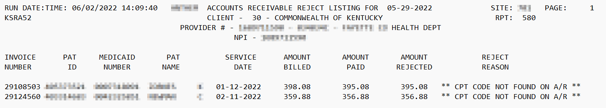
Example of A/R Reject Report

Slide 59
Lead Remit Reports
2532 – Paid Lead claims report
2578 – Denied Lead claims report
2579 – Lead claims in suspense
2580 – Lead A/R rejects
2581 – Lead Summary by Service and Cost Center – FYTD
2582 – Lead District Summary by Service and Cost Center – FYTD
2588 – Adjusted Lead claims report

Slide 60
Passport Remit Reports
532 – Paid Passport claims report
530 – Denied Passport claims report
531 – Passport A/R rejects

Slide 61
Molina MCO Remit Reports
430 – Paid Molina claims report
178 – Denied Molina claims report
580 – A/R rejects
583 – Adjusted claims report
3181 – Summary by Service and Cost Center – FYTD
3182 – District Summary by Service and Cost Center – FYTD
3194 – Payment Summary by Service and Cost Center - FYTD
3195 – District Payment Summary by Service and Cost Center - FYTD

Slide 62
United Healthcare MCO Remit Reports
431 – Paid United Healthcare claims report
578 – Denied claims report
580 – A/R rejects
583 – Adjusted claims report
3281 – Summary by Service and Cost Center – FYTD
3282 – District Summary by Service and Cost Center – FYTD
3294 – Payment Summary by Service and Cost Center - FYTD
3295 – District Payment Summary by Service and Cost Center - FYTD

Slide 63
Anthem MCO Remit Reports
435 – Paid Anthem claims report
578 – Denied Anthem claims report
580 – Anthem A/R rejects
583 – Adjusted Anthem claims report
3581 – Anthem Summary by Service and Cost Center – FYTD
3582 – Anthem District Summary by Service and Cost Center – FYTD
3594 – Anthem Payment Summary by Service and Cost Center - FYTD
3595 – Anthem District Payment Summary by Service and Cost Center - FYTD

Slide 64
Aetna MCO Remit Reports
436 – Paid Aetna claims report
678 – Denied Aetna claims report
580 – Aetna A/R rejects
583 – Adjusted Aetna claims report
3681 – Aetna Summary by Service and Cost Center – FYTD
3682 – Aetna District Summary by Service and Cost Center – FYTD
3694 – Aetna Payment Summary by Service and Cost Center - FYTD
3695 – Aetna District Payment Summary by Service and Cost Center - FYTD

Slide 65
WellCare MCO Remit Reports
438 – Paid WellCare claims report
878 – Denied WellCare claims report
580 – WellCare A/R rejects
583 – Adjusted WellCare claims report
3881 – WellCare Summary by Service and Cost Center – FYTD
3882 – WellCare District Summary by Service and Cost Center – FYTD
3894 – WellCare Payment Summary by Service and Cost Center - FYTD
3895 – WellCare District Payment Summary by Service and Cost Center - FYTD

Slide 66
Humana CareSource MCO Remit Reports
439 – Paid Humana CareSource claims report
879 – Denied Humana CareSource claims report
580 – Humana CareSource A/R rejects
583 – Adjusted Humana CareSource claims report
3981 – Humana CareSource Summary by Service and Cost Center – FYTD
3982 – Humana CareSource District Summary by Service and Cost Center – FYTD
3994 – HC Medicaid Payment Summary by Service and Cost Center - FYTD
3995 – HC Medicaid District Payment Summary by Service and Cost Center - FYTD

Slide 67
277 – Billing Claim File Status Report
This report shows Medicaid MCO and Medicare claim status for the claims that have been submitted electronically.
This report runs each Wednesday and Saturday.
Sites will only receive this report if they had Medicaid MCO or Medicare claims that were submitted electronically.

Slide 68
Medicare Billing Reports
CDP Report Presentation 2022

Slide 69
Billing Reports
533 – Invoice Register – Regular Medicare
534 – Invoice Register – Railroad Medicare
535 – Invoice Register – Passport Advantage
536 - Acknowledgement Report
Ready to print on Thursday after 1st Sunday
537 - Reject Report
Claims CDP could not send due to problems
633 – Re-bill Invoice Register – Regular Medicare
634 – Re-bill Invoice Register – Railroad Medicare

Slide 70
Medicare Remit Reports
CDP Report Presentation 2022

Slide 71
Medicare Remittance Reports
115 – Paid Medicare claims report
116 – Denied Medicare claims report
119 – A/R Reject Report

Slide 72
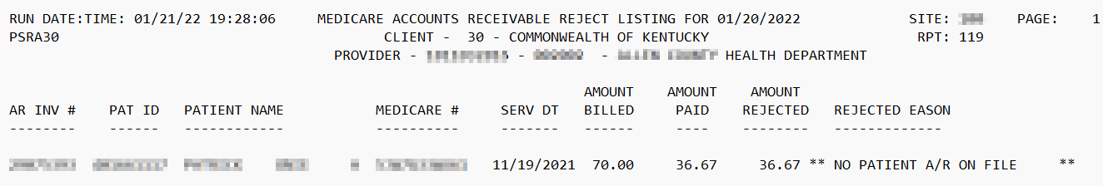
119 – Medicare A/R reject report

Slide 73
Contract Billing Reports
CDP Report Presentation 2022

Slide 74
Billing Reports
736 – Invoice Register
737 – CMS 1500 forms
735 – Mailing Labels for CMS 1500 forms

Slide 75
978 – Contract Payer listing
Listing of the Contract payers for your district
User can request report when they need it
Reach out to CustomerSupport@cdpehs.com to request this report

Slide 76
Cancer Reports
CDP Report Presentation 2022

Slide 77
323 – Cervical Screening Report
This report should be reviewed monthly to assure results are listed for each patient reported through the Patient Encounter Reporting System or the Supplemental Reporting System.
This report runs on the 25th of the month.
Cervical screenings listed with no result; the Patient Results via the Patient Menu will need to be used to enter the result.
As of July 2022, this report is in the process of being redesigned. Watch Portal News for updates.

Slide 78
676 – Mammogram Screening Report
This report should be reviewed monthly to assure results are listed for each patient reported through the Patient Encounter Reporting System or the Supplemental Reporting System.
This report runs on the 25th of the month.
Mammogram screenings listed with no result; the Patient Results via the Patient Menu will need to be used to enter the result.
As of July 2022, this report is in the process of being redesigned. Watch Portal News for updates.

Slide 79
Breast Final Diagnosis Pending Report
This report runs on the first weekend after 3 business days and the 25th of the month.
This report shows a listing of patients that are awaiting a final diagnosis.
You will only receive this report IF you have patients awaiting a final diagnosis or have an abnormal final diagnosis with missing treatment information.
This report is in a .CSV format and must be opened with Excel
Report will be named –
Site-XXXX-Cancer Breast Pending Extract MM-DD-YYYY

Slide 80
Cervical Final Diagnosis Pending Report
This report runs on the first weekend after 3 business days and the 25th of the month.
This report shows a listing of patients that are awaiting a final diagnosis.
You will only receive this report IF you have patients awaiting a final diagnosis or they have an abnormal final diagnosis with missing treatment information.
This report is in a .CSV format and must be opened with Excel
Report will be named –
Site-XXXX-Cancer Cervical Pending Extract MM-DD-YYYY

Slide 81
Cancer Missing Data Report
This report runs on the first weekend after 3 business days and the 25th of the month.
This report shows a listing of patients that are missing either MAM or PAP information.
You will only receive this report IF you have patients missing information.
This report is in a .CSV format and must be opened with Excel
Report will be named –
Site-XXXX-Cancer Missing Data MM-DD-YYYY

Slide 82
2646 – Cervical Lost to Follow-up Report
This report runs on the 25th of the month.
This is a cumulative report.
As of July 2022, this report is in the process of being redesigned. Watch Portal News for updates.

Slide 83
2647 – Breast Lost to Follow-up Report
This report runs on the 25th of the month.
This is a cumulative report.
As of July 2022, this report is in the process of being redesigned. Watch Portal News for updates.

Slide 84
2649 – Duplicate MDE Record Report
This report runs on the 25th of the month.
This is a cumulative report.
Shows patients that may have 2 MDE records for one clinic visit.
As of July 2022, this report is in the process of being redesigned. Watch Portal News for updates.

Slide 85
2653 – Cancer Reimbursement Report
This report runs on the 1st Monday of the month
This is a cumulative report
As of July 2022, this report is in the process of being redesigned. Watch Portal News for updates

Slide 86
2654 – Duplicate CPT Code Report
This report runs on the 1st Monday of the month
This is a cumulative report
Shows patients with duplicate CPT codes on multiple PEFs for the same date of service
As of July 2022, this report is in the process of being redesigned. Watch Portal News for updates

Slide 87
WIC
Reports

Slide 88
110 – 7 Day Late Pickup Labels
This report runs every Wednesday night
Address labels for participants in a clinic that are 7 days late in issuance of benefits, in the last 7 days
The report name will show the clinic HLS in parenthesis
Example – Report 110 – Labels for 7 day late pickup (HidLocS)

Slide 89
111 – 30 Day Late Pickup Labels
This report runs every Wednesday night
Address labels for participants in a clinic that are 30 days late in issuance of benefits, in the last 7 days
The report name will show the clinic HLS in parenthesis
Example – Report 111 – Labels for 30 day late pickup (HidLocS)

Slide 90
274 – 7 Day Late Pickup Report
This report runs every Wednesday night
This report list those participants in a clinic that are 7 days late in issuance of benefits, in the last 7 days.
The report name will show the clinic HLS in parenthesis
Example – Report 274 – Listing for 7 day late pickup (HidLocS)

Slide 91
275 – 30 Day Late Pickup Report
This report runs every Wednesday night
This report list those participants in a clinic that were 30 days late in issuance of benefits, in the last 7 days.
The report name will show the clinic HLS in parenthesis
Example – Report 275 – Listing for 30 day late pickup (HidLocS)

Slide 92
495 – Voter Registration Verification
This report runs on the first day of the month
This report list the adult participants in a clinic that were certified in the last month.
The report name will show the clinic HLS in parenthesis
Example – Report 495 – Voter Registration Verification (HidLocS)

Slide 93
562 – WIC Next Action Due
This report runs every Wednesday night
This report list those participants in a clinic that have a next action due date in the last 7 months or the next 7 days
The report name will show the clinic HLS in parenthesis
Example – Report 562 – WIC Next Action Due (HidLocS)

Slide 94
587 – Auto Termination Listing
This report runs every Wednesday night
This report list those participants in a clinic that have been automatically terminated due to non-participation or categorically ineligible
The report name will show the clinic HLS in parenthesis
Example – Report 587 – Auto Termination Listing (HidLocS)

Slide 95
588 – Auto Termination Labels
This report runs every Wednesday night
Action labels for those participants in a clinic that have been automatically terminated due to non-participation or categorically ineligible on the 587 report
The report name will show the clinic HLS in parenthesis
Example – Report 588 – Auto Termination Labels (HidLocS)

Slide 96
1001 – Possible Dual Participation
This report runs the first weekend of the month
This report list the active participants in your clinic that are possibly participating at another Kentucky WIC clinic
Example – Report 1001 – Possible Dual Participation (HidLocS)

Slide 97
1596 – Breastfeeding Statistics
This report runs the first weekend of the month
This report shows the percentages of enrolled infants that are breastfeeding or have ever breastfed
This report is available in both a clinic and district version
The report name will show in parenthesis the clinic HLS or district number
Example – Report 1596 – Breastfeeding Statistics (HidLocS)
Example – Report 1596 – Breastfeeding Statistics (HID)

Slide 98
1679 – Breastfeeding Details
This report runs the first weekend of the month
This report shows the participant details for infants that are currently breastfeeding or ever breastfed
The report name will show the clinic HLS in parenthesis
Example – Report 1679 – Breastfeeding Details (HidLocS)

Slide 99
1902 – Enrollment by Status and Priority
This report runs the 10th of the month
This report shows the number of participant enrolled the previous month by status and priority
This report is available in both a clinic and district version
The report name will show the clinic HLS or district in parenthesis
Example – Report 1902 – Enrollment by Status and Priority (HidLocS)
Example – Report 1902 – Enrollment by Status and Priority (HID)

Slide 100
1924 – Formula Summary (District)
This report runs the first weekend of the month
This report shows the number of participant enrolled the previous month by status and priority for your district
The report name will show the district in parenthesis
Example – Report 1924 – Formula Summary (District) (037 )

Slide 101
1925 – Infant Formula Detail
This report runs the first weekend of the month
This report shows each of the formula types issued in your clinic along with the number and percentage of infant participants receiving the type of formula.
This report is for the previous month.
Example – Report 1925 – Infant Formula Detail (HidLocS )

Slide 102
1928 – Retailer Volume
This report runs the 15th of each month
This report shows each WIC retailer’s volume of business for the previous month and the Fiscal Year amounts. It shows the number of transaction and dollars spent
This is a district level report
Example – Report 1928 – Retailer Volume (HID)

Slide 103
1930 – Participation Detail (Clinic)
This report runs at the first of each month
This report shows participant details by status and priority
This report is for the month prior to last month
If the report is run in May, it will show March counts
Example – Report 1930 – Participant Detail (Clinic) (HidLocS)

Slide 104
1930 – Participation Summary-Final (Clinic)
This report runs at the first of each month
This report shows the final participant counts by status and priority for a clinic
This report is for the month prior to last month
If the report is run in May, it will show March counts
Example – Report 1930 – Participant Summary-Final (Clinic)(HidLocS)

Slide 105
1930 – Participation Summary-Final (District)
This report runs at the of each month
This report shows the final participant counts by status and priority for the district
This report is for the month prior to last month
If the report is run in May, it will show March counts
Example – Report 1930 – Participant Summary-Final (District)(HID)

Slide 106
1930 – Participation Summary-Provisional (Clinic)
This report runs at the first of each month
This report shows the provisional participant counts by status and priority for a clinic
This report is for the previous month
Example – Report 1930 – Participant Summary-Provisional (Clinic)(HidLocS)

Slide 107
1930 – Participation Summary-Provisional (District)
This report runs at the of each month
This report shows the provisional participant counts by status and priority for the district
This report is for the previous month
Example – Report 1930 – Participant Summary-Provisional(District)(HID)

Slide 108
1932 – Enrollment by Status Detail
This report runs at the 2nd Monday of each month
This report shows the enrollment details by status and priority for the district
This report is for the previous month
Example – Report 1932 – Enrollment by Status Detail (HID)

Slide 109
1932 – Enrollment by Status Detail
This report runs at the 2nd Monday of each month
This report shows the enrollment details by status and priority for the clinic
This report is for the previous month
Example – Report 1932 – Enrollment by Status Detail (HidLocS)

Slide 110
1962 – Medicaid and SNAP Recipients not Enrolled in WIC
This report runs the 10th of each month
List Medicaid and SNAP recipients, for the district, that are not enrolled in WIC
This report is for the previous month
Example – Report 1962 – Medicaid and SNAP recipients not enrolled in WIC (HID)

Slide 111
1964 – Medicaid and SNAP Recipients not on WIC Mailing Labels
This report runs the 10th of each month
Mailing labels for Medicaid and SNAP recipients, for the district, that are not enrolled in WIC
This report is for the previous month
Example – Report 1964 – Medicaid and SNAP recipients not on WIC Mailing Labels(HID)

Slide 112
1986 – Participation by Race (Clinic)
This report runs the first day of each month
This report shows the number of participants in your clinic by race and status
This report show counts for the month prior to last month
If the report is run in May, it will show March counts
Example – Report 1986 – Participation by Race (Clinic)(HidLocS)

Slide 113
1986 – Participation by Race (District)
This report runs the first day of each month
This report shows the number of participants in your district by race and status
This report shows counts for the month prior to last month
If the report is run in May, it will show March counts
Example – Report 1986 – Participation by Race (District)(HID)

Slide 114
1989 – Retailer Listing
This report runs the 10th of each month
List your district’s WIC retailer name, address and phone numbers
Example – Report 1989 – Retailer Listing(HID)

Slide 115
2001 – Breastfeeding Exceptions
This report runs the first weekend of the month
The report list household and participants, in your clinic, where mom and baby’s status are in conflict.
An example, mom is fully breastfeeding, and baby is full formula
Example – Report 2001 – Breastfeeding Exceptions (HidLocS)

Slide 116
2010 – State Issued Benefits Issuance Labels
This report runs every Wednesday
The report is issuance labels for participants that have benefits auto issued by the state
The labels are for issuance that have an issuance date next week.
Example – Report 2010 – State Issued Benefits Issuance Labels (HidLocS)

Slide 117
Personnel
Reports

Slide 118
402 – Certification Report
Listing of registers for district that have not been completed
This report runs daily

Slide 119
403 – Certification Request
Listing of Certification Request for district that have not been completed
This report runs daily

Slide 120
411 – Certification Applicants
Listing of eligible applicants that meet the qualification for a Certification Request
This report runs when a certification request has been completed

Slide 121
817 – Pending Actions
Listing of P2 action waiting to be approved by LHO Personnel
This report runs whenever there are P2 action waiting to be approved for the district

Slide 122
833 – Annual Increment
Listing of employees that will be receiving an annual increments in the next month
This report runs the first day of the month
The report that runs in June will list employees that will receive an annual increment in July

Slide 123
834 – Probationary Increment
Listing of employees that will be receiving a probationary increments in the next month
This report runs the first day of the month
The report that runs in June will list employees that will receive a probationary increment in July

Slide 124
835 – FMLA Employee Listing
Listing of employees that are currently on FMLA
The report shows the date the employees started FMLA and the approximate number of FMLA hours they have used to date
This report runs the first Monday of the month

Slide 125
861 – Actions Accepted/Denied
Listing of P2 action that have been approved or denied by LHO Personnel
This report runs whenever there are P2 action that have been waiting to be approved for the district

Slide 126
889 – Daily Disposition
Listing of applicants that have had a disposition entered on a Certification of Eligibles
This report runs whenever dispositions are entered for the district

Slide 127
921 – Employee Profile Listiing
Listing of all active employees for the district
This report runs the first Monday of the month

Slide 128
If you have any questions
Contact CDP Customer Support
  1-866-237-4814
  customersupport@cdpehs.com

