Slide 1
WIC Certifications &
Food Delivery
Topic #4 – Health Professional

Slide 2
Topics
Food Package Replacement
WIC Certification and Food Delivery/Benefit Issuance
  WIC Inquiry
  Certification - Women
  Certification – Infant and Child
Limited English Proficiency (LEP)

Slide 3
Food Package Replacement
Topic #4 – WIC Certification & Food Delivery - Health Professional

Slide 4
Option #1
Front-End Staff &
Health Professionals

Slide 5
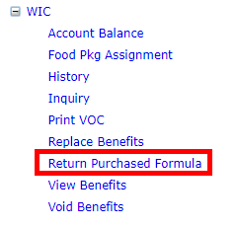
Front-End – On Patient Menu select Return Purchased Formula

Slide 6
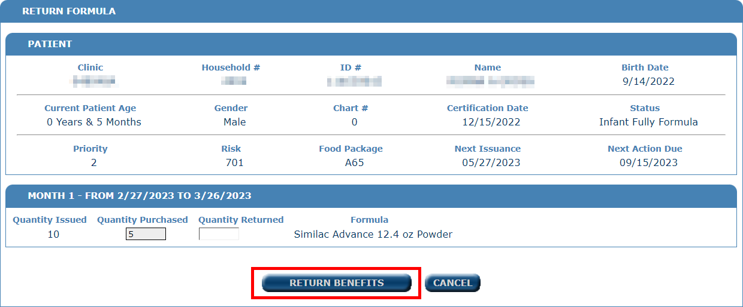
Enter amount returned, click Return Benefits

Slide 7
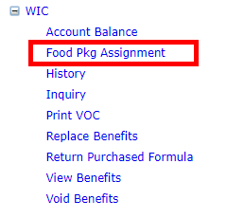
Health Professional – On Patient Menu selects Food Pkg Assignment

Slide 8
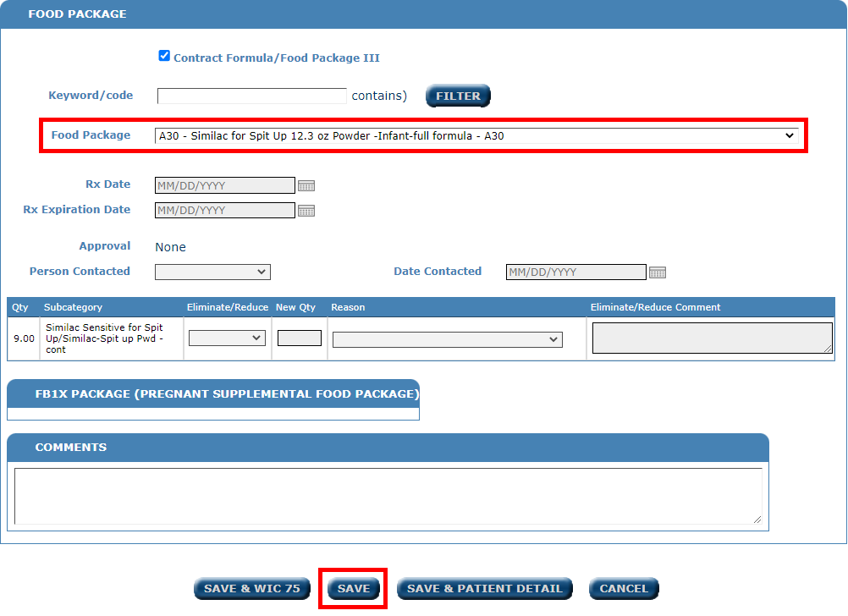
Change the food package, click SAVE

Slide 9
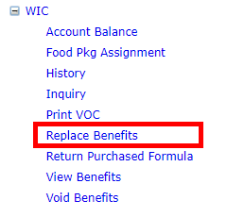
Front-End - From Patient Menu select Replace Benefits

Slide 10
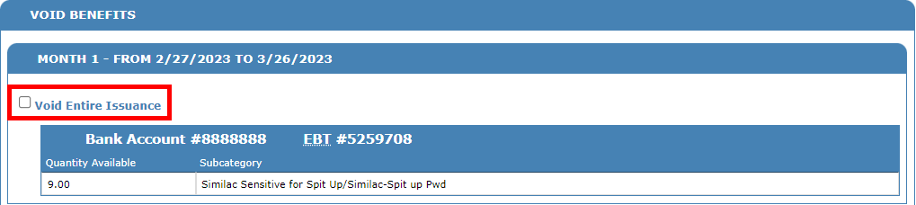
Select the months to void

Slide 11

Set void reason

Slide 12
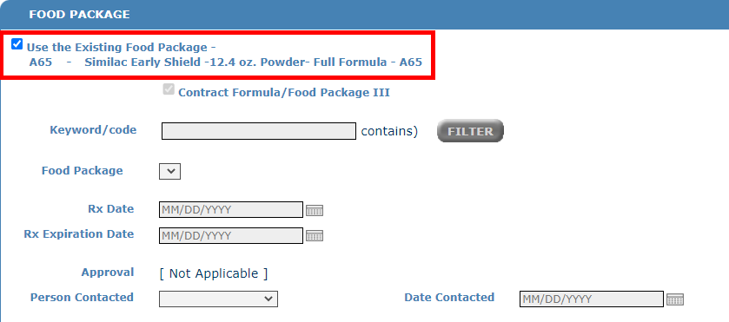
Check Use the Existing Food Package

Slide 13
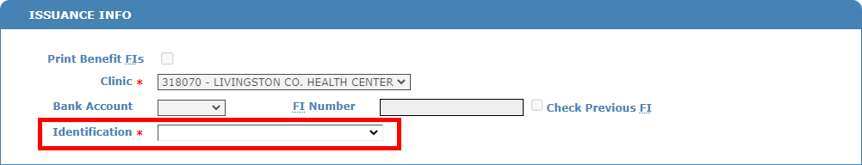
Select proof of identification

Slide 14

Click Replace Benefits

Slide 15
Option #2
Health Professional Only

Slide 16
From Patient Menu select Return Purchased Formula

Slide 17
Enter amount returned, click Return Benefits

Slide 18
From Patient Menu select Replace Benefits

Slide 19
Select the months to void

Slide 20
Set void reason

Slide 21
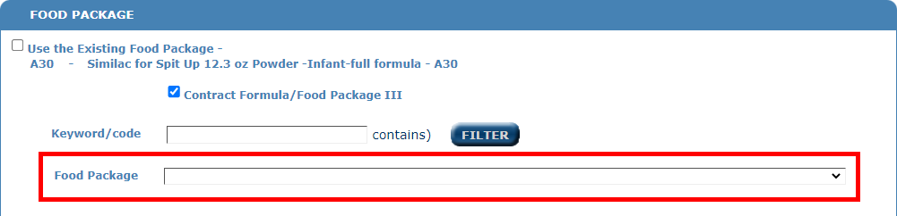
Select the new food package

Slide 22
Select proof of identification

Slide 23
Click Replace Benefits

Slide 24
WIC Certification and Food Delivery/Benefit Issuance
Things to consider
Topic #4 – WIC Certification & Food Delivery - Health Professional

Slide 25
WIC Recertifications
USDA allows for a 30-day recertification grace period.
The system is designed to allow for users to recertify within that 30-day grace period window before and after recertification due date.
Before completing a Certification/Recertification, Health Professionals can review the medical record or the system to be sure a certification is due on the WIC Inquiry Screen.
Recertifying outside of the Recertification window
  Changes the recert due date
  Increases administrative cost to the program
  Staff time and participant burden
  Does not meet federal requirements for certification periods
  Participant is terminated if not certified within 30 days after recert is due
Deleting certifications should be a rare occurrence

Slide 26
WIC Inquiry
Topic #4 – WIC Certification & Food Delivery - Health Professional

Slide 27
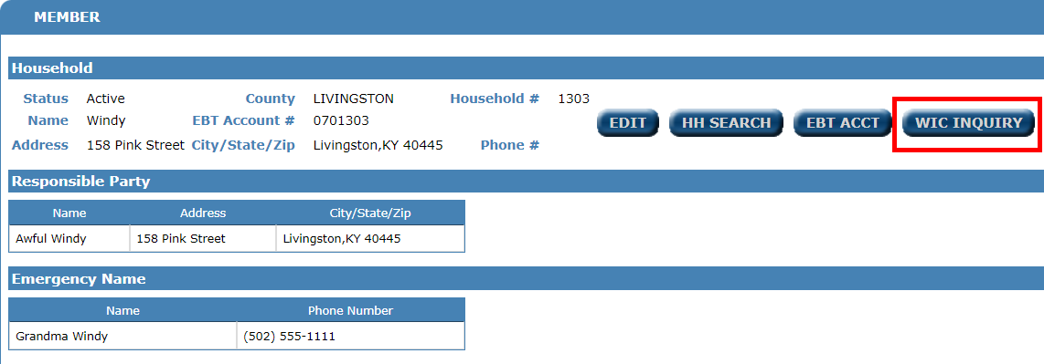
Household Page

Slide 28
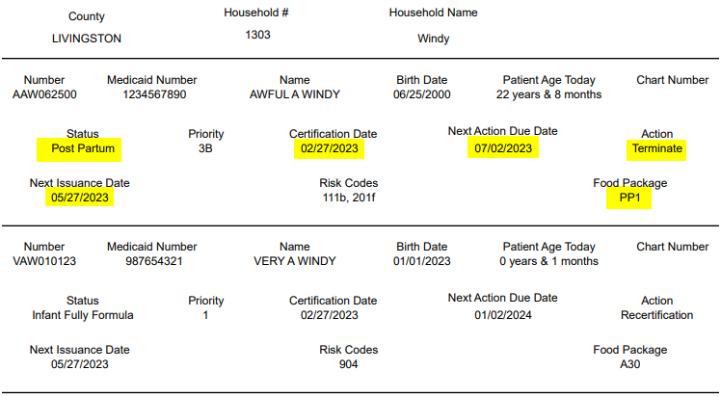
WIC Inquiry

Slide 29
Certification - Women
Topic #4 – WIC Certification & Food Delivery - Health Professional

Slide 30
Women Certification Periods and Status
Ages/Status | Eligibility/Certification Schedule | Recertification Schedule
Pregnant Woman | From certification up to six (6) weeks post-delivery | Recertify as postpartum or breastfeeding woman
Postpartum Woman | From certification to six (6) months from termination of Pregnancy | No recertification
Breastfeeding Woman | Birth of infant to one (1) year of age of child as long as breastfeeding Breastfeeding Certification Process | No recertification as certification period is one year post-delivery as long as breastfeeding the infant one time per day. Mid-Certification Health Assessment (MCHA) provided between the fifth and seventh month of certification period. If breastfeeding is discontinued and woman is: < six (6) months post-delivery, change to Postpartum woman, > six (6) months post-delivery, terminate from the program Note: Infant medical record must be reviewed. Determine if fully breastfed, supplemental or full formula package needs to be issued.

Slide 31
Pregnant to Postpartum Certification
& Benefit Issuance
Pregnant Certification period is valid thru 6 weeks post delivery.
Mom comes to clinic within 6 weeks of delivery with a valid Pregnant Certification.
  Mom is fully formula feeding her infant, No Breastfeeding
      Ensure she has issuance of the Pregnant Food Package thru the 6-week post partum period, if not, issue additional 1-2 months of Pregnant Food Package prior to PP recertification

Slide 32
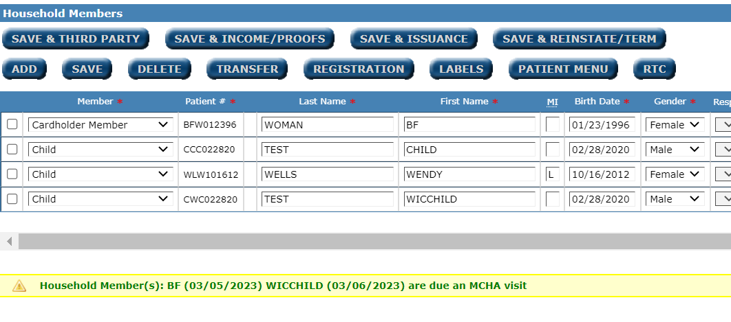
Breastfeeding Mid-Certification Health Assessment (MCHA)
Mid-Certification Health Assessment (MCHA) provided between the fifth and seventh month of certification period.
System will prompt on Member Screen that a MCHA is Due.

Slide 33
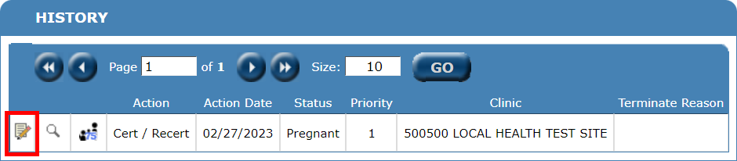
Mid-Certification Health Assessment (MCHA)
Enter measurements, if available, review and update WIC 75.

Slide 34
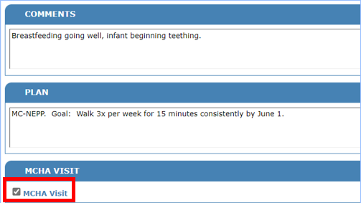
Mid-Certification Health Assessment (MCHA)
Check box to indicate a MCHA visit.
If box is not checked, it will appear as an edit/correction to the initial cert.

Slide 35
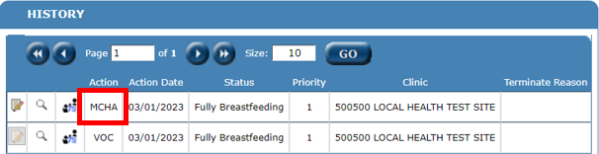
Mid-Certification Health Assessment (MCHA)
The system will now show a MCHA was completed in the History.

Slide 36
Certification – Infant & Child
Topic #4 – WIC Certification & Food Delivery - Health Professional

Slide 37
Certification Periods and Status
Ages/Status | Eligibility/Certification Schedule | Recertification Schedule
Infants Birth to < 6 months > 6 months old | To one (1) year of age For six (6) months | Recertify at one (1) year of age Mid-Certification Health Assessment (MCHA) provided between the fifth and seventh month of certification period. Recertify as child after six (6) months
Child 1 year to 5 years | For twelve (12) month periods up to five (5) years of age | Recertify at twelve (12) month intervals Mid-Certification Health Assessment (MCHA) provided between the fifth and seventh month of certification period

Slide 38
Child Recertification
11-month-old to 12-month-old
Certification End Date is the child’s first birthday
  Has the infant received the last month of formula?
    YES
      Complete the child certification, assign child food pkg, and issue benefits
    NO
      Issue the last month of infant benefits prior to completing Child Certification, assigning child food package and issuing child benefits.

Slide 39
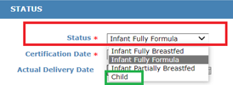
Child Recertification
11-month-old to 12-month-old
Confirm all infant benefits have been issued prior to completing the certification
Confirm Child Status is selected from the drop-down menu before entering certification data and responses.

Slide 40
Child Recertification
12-month-old to just under 13-months-old
  To allow for the 30-day grace period for an infant recertification to a child, the system has functionality to create a status change from Infant to Child, known as an Infant Child Transfer (ICT).

Slide 41
ICT – Infant Child Transfer
  What occurs?
  The system changes the infant status to child status and:
    changes infant food package to a child package
    changes infant risk code to an associated child risk code

Slide 42
ICT – Infant Child Transfer
    Some Specialty Formula Food Packages and Risk Codes do not allow for an ICT.
      For example, an infant on Neocate Infant may not be able to consume foods in the standard CB child food package, therefore the system will not generate an ICT with a food package.

Slide 43
ICT – Infant Child Transfer
When does the ICT occur?
When issuing benefits to an infant with a start date beyond their 1st birthday, the system will do an automatic ICT and issue a child's food package (CB).
OR
When an infant is 6 months or older at initial certification and benefits are being issued beyond the infant's 1st birthday with a first valid date after the 1st birthday.

Slide 44
ICT – Infant Child Transfer
An Example
Infant DOB 4-1-2022, Recert Due 4-1-23, benefits start on 3-2-23
Family is in clinic on 2-28-23 for follow up, will issue 2 months of benefits
The system will issue 1 month of infant formula (3-2-23) and an ICT to issue 1 month of Child Benefits (4-2-23)
The child must be recertified by 5-1-23 to avoid
auto-termination

Slide 45
ICT Considerations
Is the infant (near 12 months of age) on a Standard Formula Package?
YES
  Issue benefits up to 13 months of age
  Infant will receive infant benefits and
  ICT automatically occurs, changes status to child, assigns child food package, assigns child risk code and issues 1 month of the child package
  Schedule Recert appointment utilizing 30-day grace period

Slide 46
ICT Considerations
Is the infant (near 12 months of age) on a Standard Formula Package?
NO
  Issue last months of Infant food package (may attempt to issue benefits with start date beyond 1st birthday)
  ICT may not occur
  Determine appropriate child package, request prescription if needed
  Assign a child package and issue additional month, if appropriate
  Schedule Recert appointment in 1 to 3 months, as appropriate

Slide 47
ICT – Infant Child Transfer
The Infant Child Transfer (ICT) will occur when an infant’s issuance starts prior to first birthday and goes past the first birthday.
When does the ICT occur?
  Infant is certified after 6 months of age.
  The infant package has been assigned a child package.
  Most standard infant packages have a child package assigned.
  Most special formula packages DO NOT have a child package associated with them.

Slide 48
Limited English Proficiency
Topic #4 – WIC Food Delivery - Health Professional

Slide 49
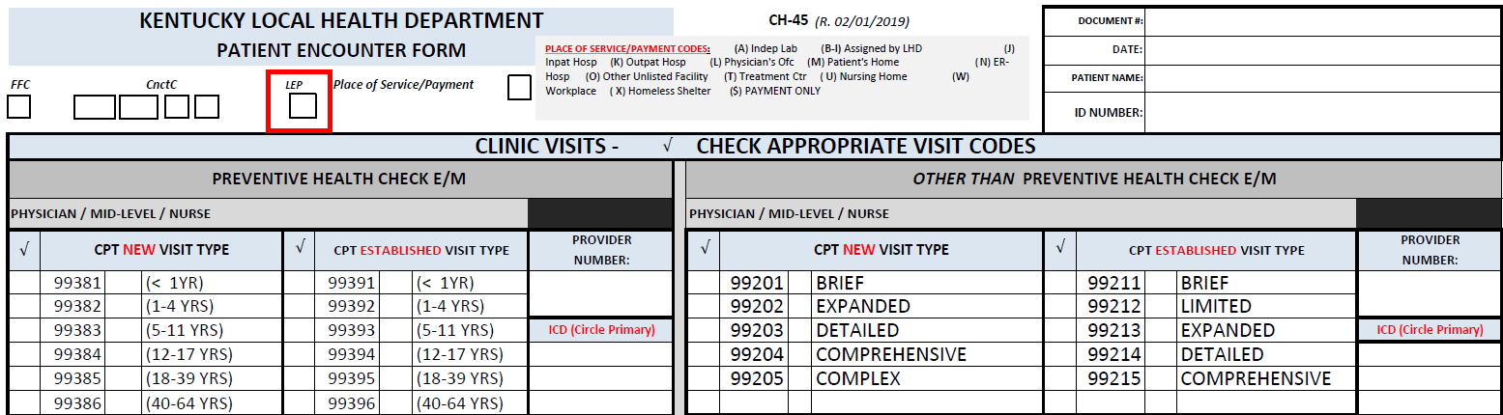
Limited English Proficiency (LEP)

Slide 50
Problems arise with Certification or Issuance
When problems happen that you can’t fix or if you can not issue the benefits for the participant
  Contact the WIC Help Desk, they will be glad to help. 1-877-597-0367
    WIC.Helpdesk@ky.gov
  Contact State WIC Program Staff for Program Policy Questions

Slide 51
Any Questions?
Topic #4 – WIC Food Delivery - Health Professional

