Slide 1
WIC Benefits
Topic #2 – WIC Food Delivery - Clerk

Slide 2
Topics
Receiving eWIC Cards
Assigning eWIC Cards
Issuing WIC Benefits
Additional Documentation

Slide 3
Receiving eWIC Cards
Purpose
To document the receipt of a shipment of eWIC cards from State WIC. This is required for WIC Program Integrity.

Slide 4
On Portal page, click FI/Card Range Search

Slide 5
Select your clinic from the drop-down

Slide 6
Set Bank Number to 606370

Slide 7
Click Search

Slide 8
Receiving eWIC Cards
My Shipment
I received 6063700003892995 - 6063700003894983

Slide 9
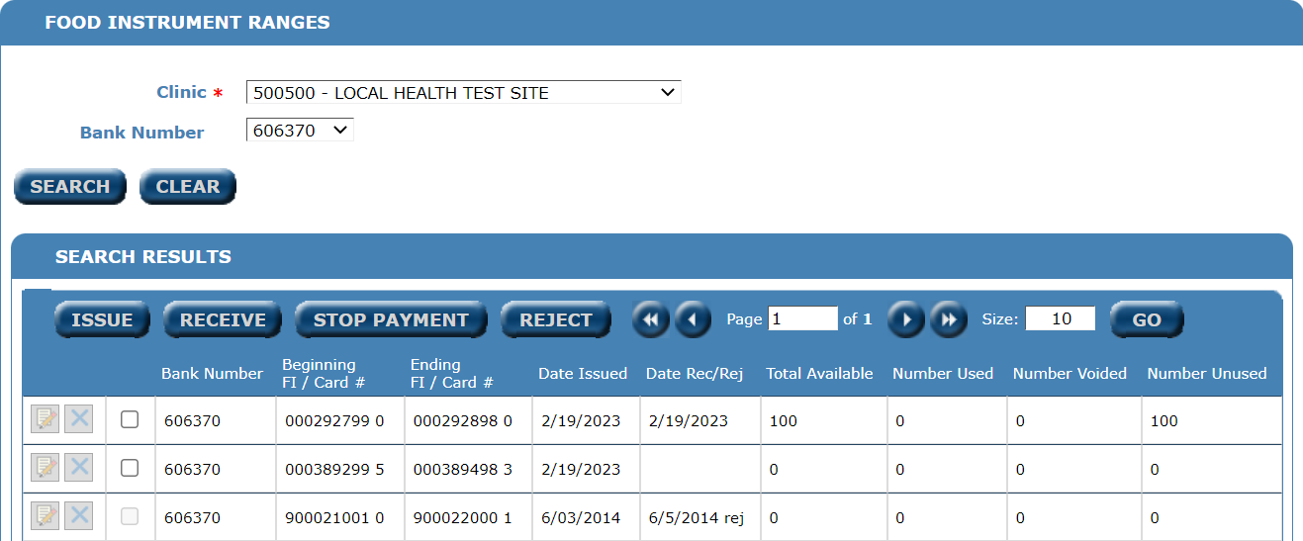
Review the records returned

Slide 10
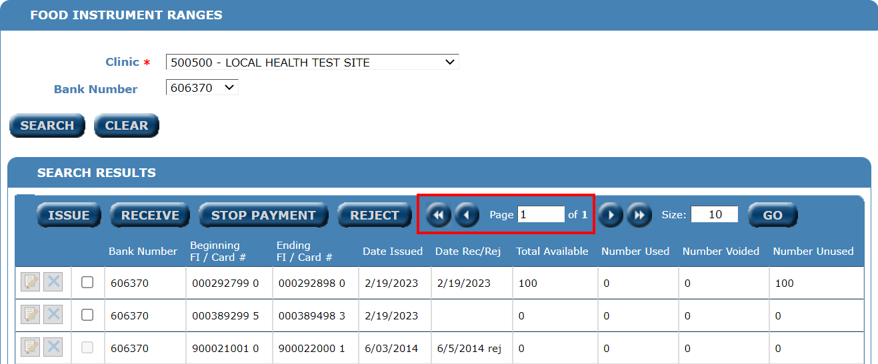
You may have multiple pages of card ranges.

Slide 11
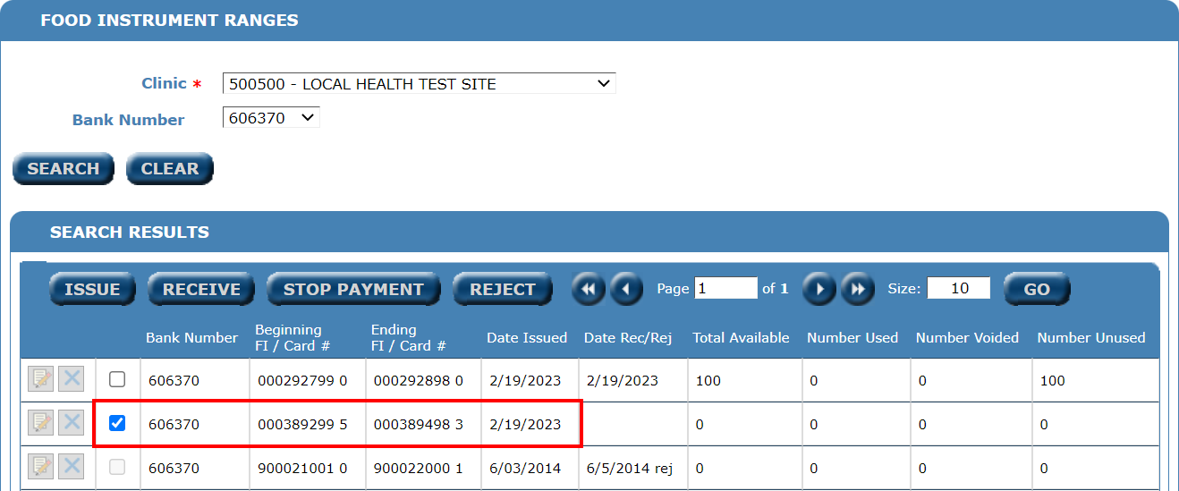
Verify the range you received matches.

Slide 12
If so, check the box next to the range.

Slide 13
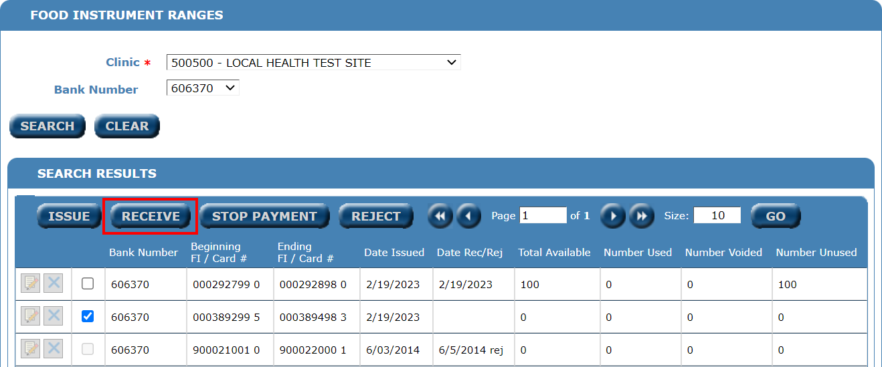
Click Receive

Slide 14
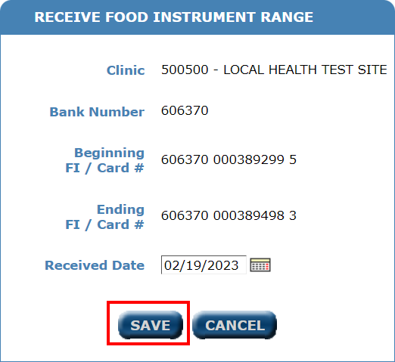
Verify again, click Save if all info matches.

Slide 15
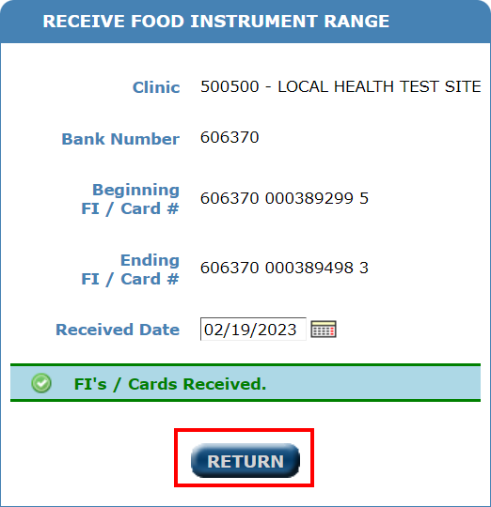
Click Return

Slide 16
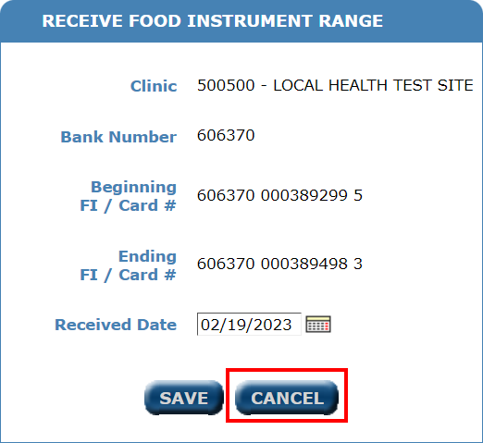
If they don’t match, click Cancel.

Slide 17
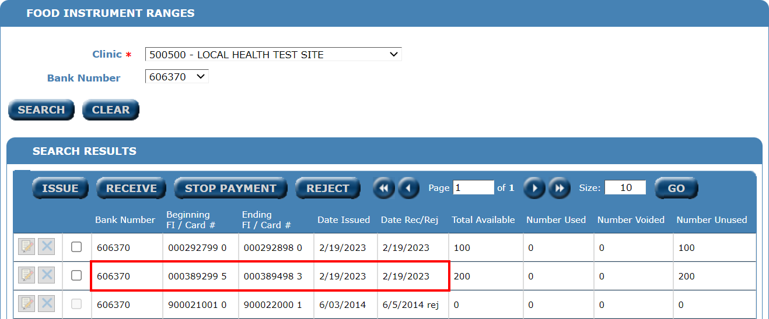
Range now shows as Received.

Slide 18
Range does not match
Topic #2 WIC Food Delivery

Slide 19
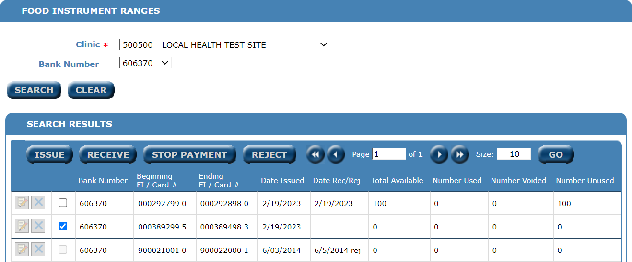
If the range does not match, contact State WIC

Slide 20
Assigning eWIC Cards
Topic #2 WIC Food Delivery – Clerk/Front End

Slide 21
Time to issue some benefits

Slide 22
Click SAVE & ISSUANCE

Slide 23
Check for EBT CARD

Slide 24
Click EBT CARD

Slide 25
Swipe the eWIC Card

Slide 26
Click Enter PIN
Enter 4-digit PIN and confirm.

Slide 27
Click SAVE

Slide 28
Information saved – return to Portal

Slide 29
Issuing WIC Benefits
Topic #2 WIC Food Delivery – Clerk/Front End

Slide 30
Issuance reflects acct # and eWIC #

Slide 31
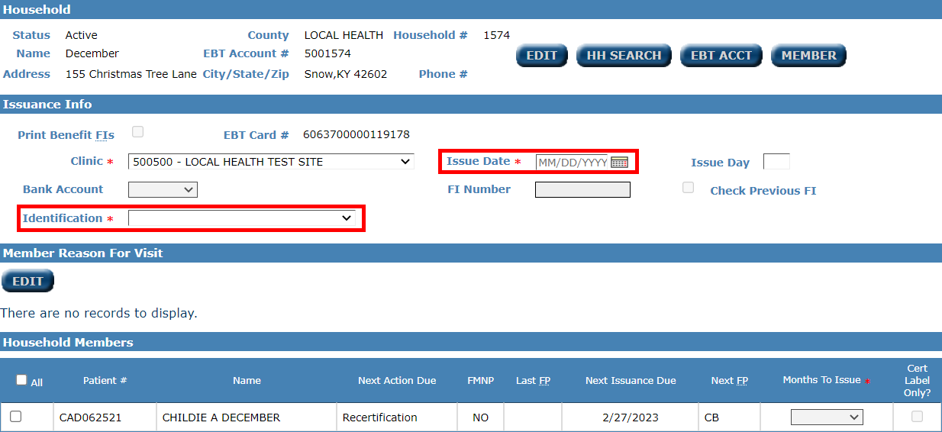
Set Issue Date and Identification

Slide 32
Check Patient# and Months to Issue

Slide 33
Click ISSUE BENEFITS

Slide 34
Benefits Issued

Slide 35
Household Benefits

Slide 36
Issuance Labels

Slide 37
Additional Documentation
Topic #2 WIC Food Delivery – Clerk/Front End

Slide 38
Available Documentation - WIC
Use your favorite internet browser and search
Kentucky WIC CHFS webpage

Slide 39
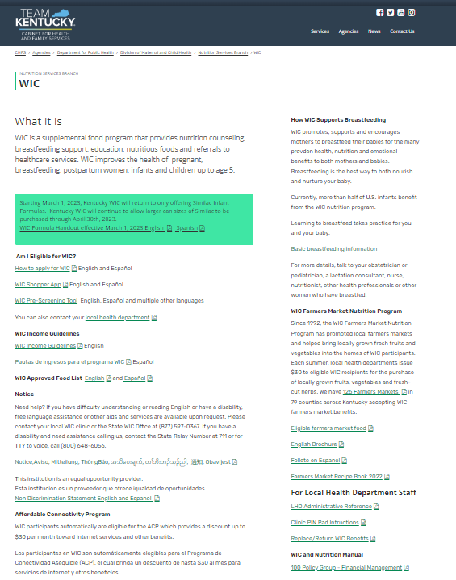
Available Documentation WIC

Slide 40
Available Documentation - WIC
WIC Participant Resources

Slide 41
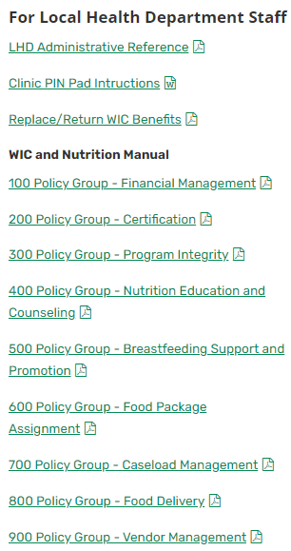
Available Documentation - WIC
WIC Staff Resources

Slide 42
Any Questions

