Slide 1
E-Reports
CDP User Meeting – Topic #4

Slide 2
Logging In
CDP User Meeting – Topic #4

Slide 3
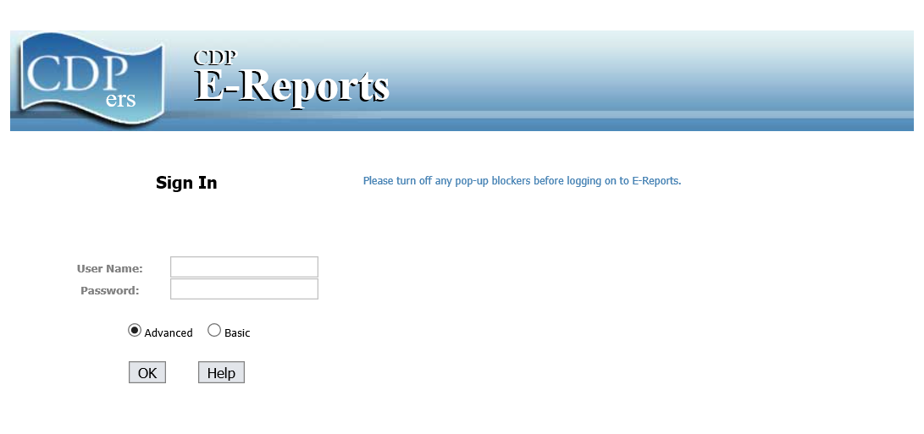
Website - https://portal.cdpehs.com/ers
Make sure pop-ups are allowed for the site

Slide 4
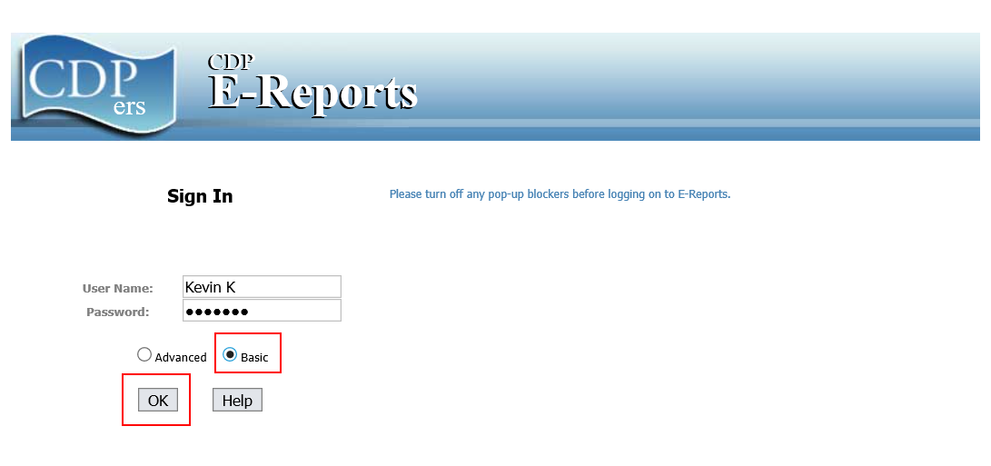
Enter your username and password
Select Basic
Click OK

Slide 5
E-Reports Main Menu
CDP User Meeting – Topic #4

Slide 6
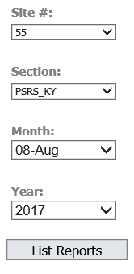
Main Menu
Select Site #
Select Section – PSRS_KY
Select Month & Year
Click List Reports

Slide 7
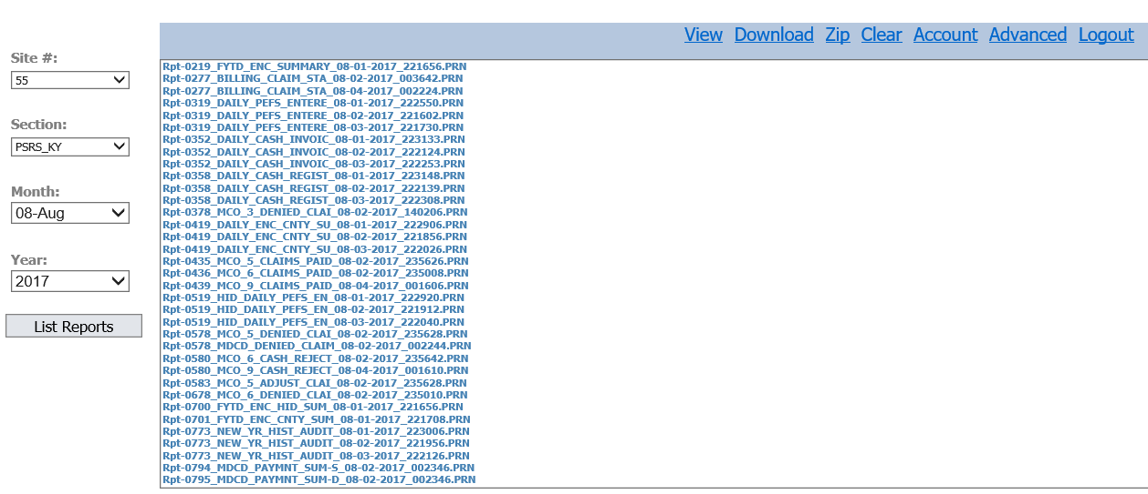
Main Menu
Reports for site, section, month, and year will be returned
Report are listed by report number and then date
Excel spreadsheets will be at the end of the list

Slide 8
Main Menu – Additional Options
View – allows the user to view a report
Download – allows the user to save the report on your computer
Zip – compresses selected reports into a zip folder
Clear – clears the list of reports shown
Account – allows the user to change password and see available sites
Advanced – changes to the advanced version of e-reports
Logout – logs the user out of e-reports

Slide 9
Viewing Reports
CDP User Meeting – Topic #4

Slide 10
To view a report
Click the report you would like to view
Click View

Slide 11
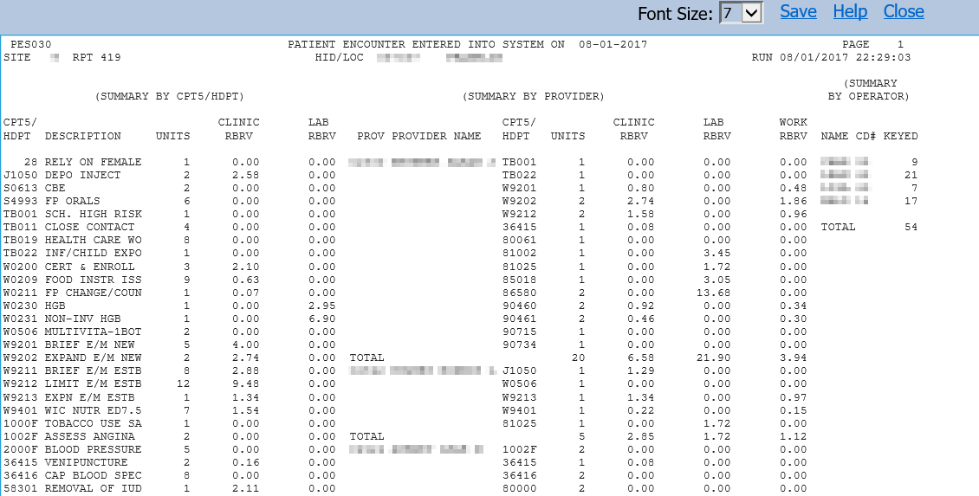
To view a report
This window allows for viewing the report.
Users can also save the report to their computer.

Slide 12
Downloading Reports
CDP User Meeting – Topic #4

Slide 13
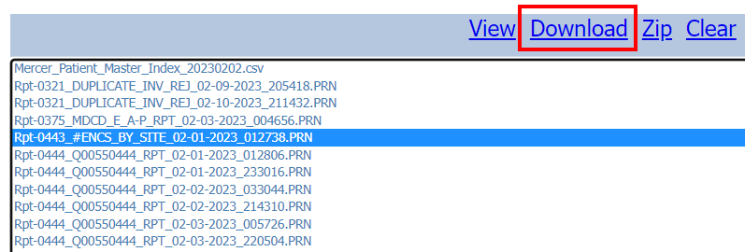
To download a report
Downloading the report allows you to save to your computer.
Select/click the report to download.
Click Download.

Slide 14
To download a report
Once you click download, a pop up will appear at bottom of page.
Double-click the file name to open.
Then save as you would with any excel file.

Slide 15
Zipping Reports
CDP User Meeting – Topic #4

Slide 16
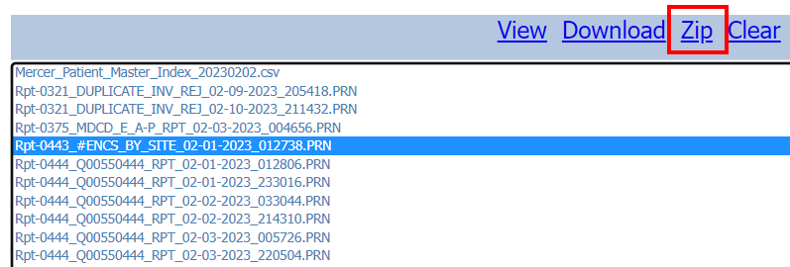
To zip reports
Zip a full month of reports to a DVD or a drive on your agency’s server.
To compress your files into a ZIP file, Click Zip.

Slide 17
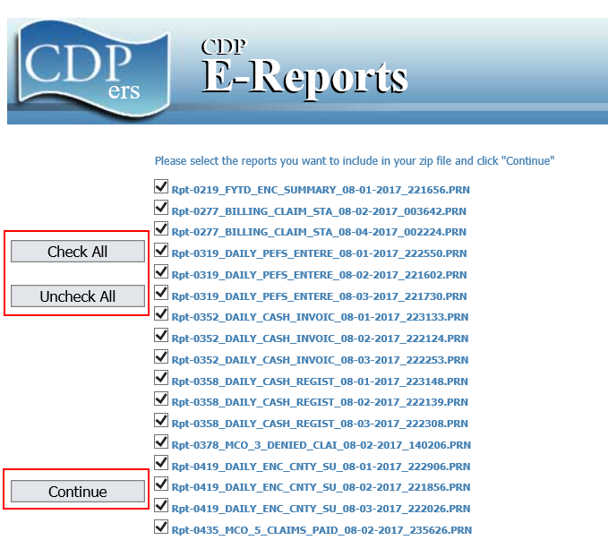
To zip reports
After clicking Zip, a new window will open
Select the reports you would like to put into the ZIP file
Buttons are available to select all reports or unselect all reports
Once reports are selected, click Continue

Slide 18
To zip reports
Once you click continue, a pop up will appear letting you know the file is being zipped. When it shows at the bottom of the page, it is ready.
The file will be found in the DOWNLOAD folder on your computer.

Slide 19
Why do I want to archive reports?
CDP only maintains reports on e-reports for 14 months.
Some reports are required to be retained for longer than 14 months
Archiving the reports on DVD or an agency server will take up less space than printing the reports. This will save the clinics on paper and storage.

Slide 20
Other Menu Options
CDP User Meeting – Topic #4

Slide 21
Clear
By clicking Clear, this will eliminate the list of reports shown on the screen.
Screen after clicking Clear

Slide 22
Account
To access Account, click Account
This screen is to change your password and view the site #’s you have access too. To return to Main Menu, click the Back button.

Slide 23
Advanced
Toggles you to the advanced version of e-reports.
Advanced just has a different look.

Slide 24
Logout
The logout button will log you out of e-reports.
You will be returned to the log in screen.

Slide 25
Printing Reports
CDP User Meeting – Topic #4

Slide 26
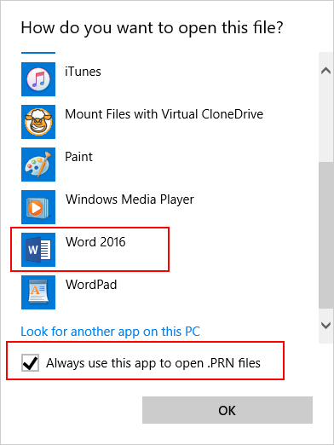
To print out an e-report
First download/save the report to your computer.
Go to your download folder, and right click the file and select Open With.
When options are shown, select Word and check Always use this app to open .PRN files. If Word is not shown, click More Options.

Slide 27
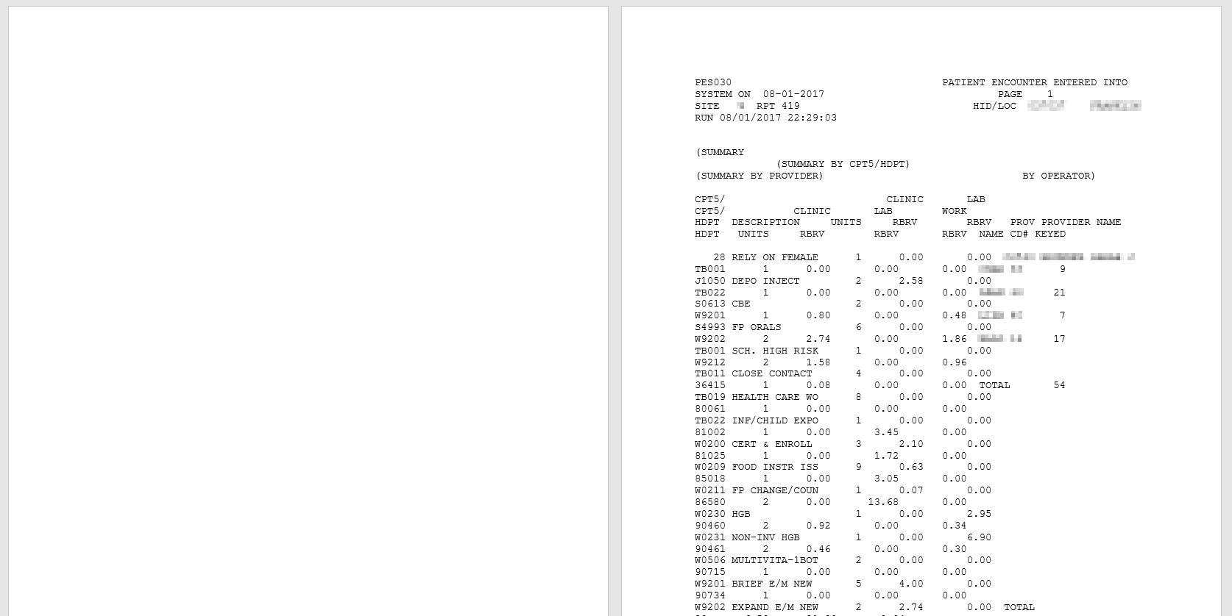
To print out an e-report
The report will open in Word but with a blank page first. Hit Delete one time and this will eliminate the blank page.

Slide 28
To print out an e-report
After the blank page is deleted, the report will not be formatted correctly to print.

Slide 29
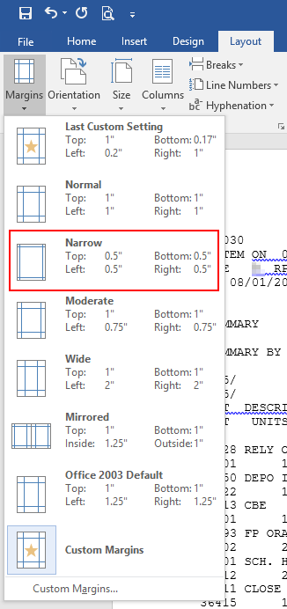
To print out an e-report
Click Layout, then click Margins, and select Narrow.

Slide 30
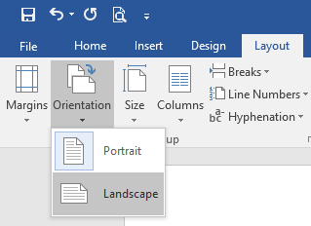
To print out an e-report
Next Click Layout, then click Orientation, and select Landscape.

Slide 31
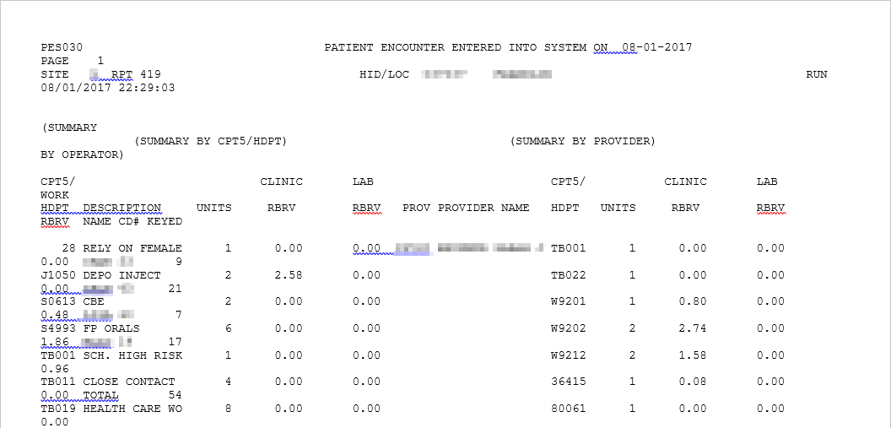
To print out an e-report
The report looks much better, but it still is not formatted correctly.

Slide 32
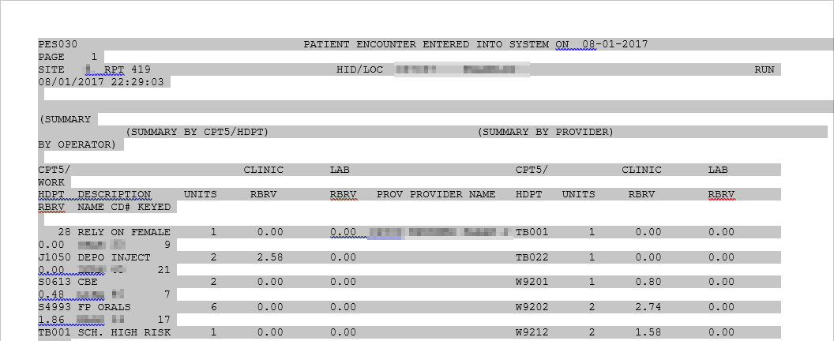
To print out an e-report
Click on the Home tab at the top. Hold down ctrl and A at the same time to select all. This will select all in the report.

Slide 33
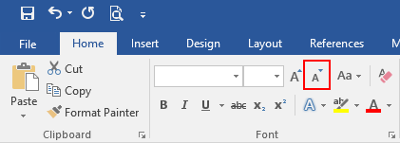
To print out an e-report
Now click shrink font button (uppercase A with small down arrow) slowly until you notice Page 1 is in the upper right corner of the screen.

Slide 34
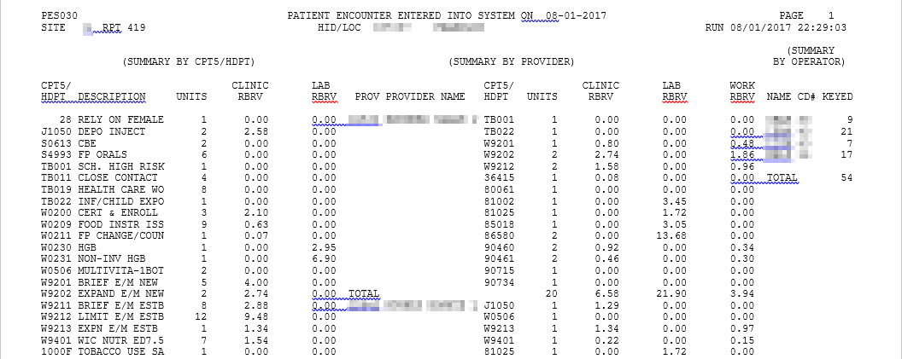
To print out an e-report
The report will look much better. Occasionally you may have to shrink the font just a bit more to get the page breaks to match up.

Slide 35
To print out an e-report
Once you have the report the way you want it, you will print the same as you would any other Word Document.
Make sure to save it before you close it.
This process will work on most of the reports.
It will not work for reports that are formatted forms, such as CMS1500 forms
It will not work for the Excel files

Slide 36
Where can I get help or ask questions?
CDP Customer Support
1-866-237-4814
customersupport@cdpehs.com

