Slide 1
Billing Report
Topic #4

Slide 2
Private Pay Reports
CDP User Meeting – Topic #4

Slide 3
597 – Private Pay Statements
Statements to send to the patient showing balance due for pay code 1 and 15
Plain paper or mailers
Statement amounts are determined by the agency

Slide 4
598 – Private Pay Statement labels
Labels for the private pay statements
Only receive if your statements are printed on plain paper
2898 – Private Pay Statement labels
Same as 598 but for Zebra printers

Slide 5
Insurance Billing Reports
CDP User Meeting – Topic #4

Slide 6
Pre-Billing Reports
729 – Insurance Pre-bill Register
(CMS1500)
733 – Pre-bill Reject Report
    (Electronic)
2729 – Pre-bill Invoice Register
(Electronic)

Slide 7
729 – Insurance Pre-bill Register
Run 1st and 3rd Sunday each month.
For reviewing the claims before they bill.
Shows claims that bill out on CMS1500.

Slide 8
733 – Insurance Rejects
Created when the 729, 730, 2729, and 2730 are created
Shows claims NOT BILLED due to missing information
Shows both paper and electronic claims
Created in .CSV format and must be opened with Excel
Report name –
Site-XXXX_Rpt-0733_Insurance_Rejects_MM-DD-YYYY

Slide 9
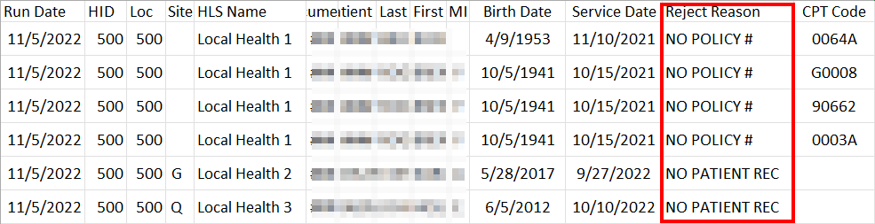
733 – Insurance Reject Report

Slide 10
2729 – Insurance Pre-bill Register
(Electronic)
Runs 1st and 3rd Sunday each month.
For reviewing claims before they bill out.
Only shows claims billed electronically.

Slide 11
Live Billing Reports
Created the 2nd and 4th weekend each month
730 – Invoice Register (Paper)
731 – CMS 1500 forms (HCFA’s)
732 – Labels for CMS 1500 forms
733 – Reject Report (paper & electronic)
2730 – Invoice Register (electronic)
2734 – Re-bill Invoice Register

Slide 12
1830 - Insurance Acknowledgment
Report is created when CDP receives a file.
Shows status of claims received by the clearinghouse.
Claim Status P = Processed (not paid).
Claim Status R = REJECTED.

Slide 13
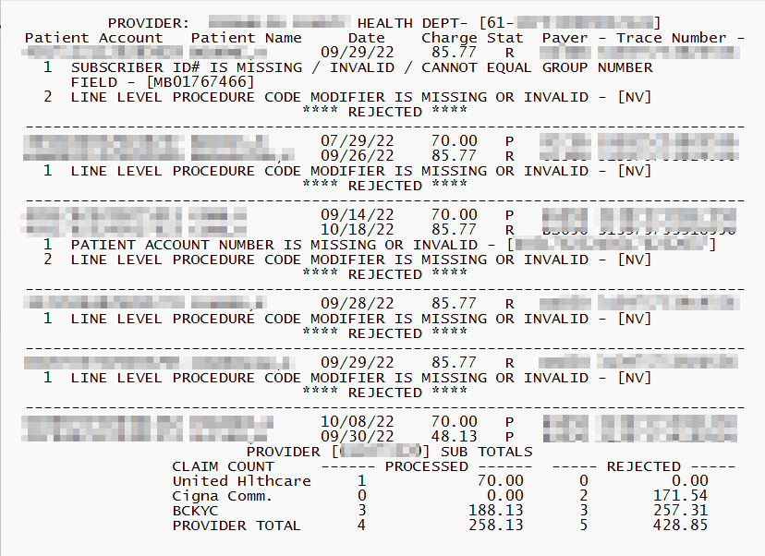
1830 – Insurance Acknowledgement

Slide 14
Insurance Remit Reports
CDP User Meeting – Topic #4

Slide 15
3150 - Anthem Private Insurance Paid Claims
Anthem Private Ins paid claims
Created when file is received from Anthem

Slide 16
3151 - Anthem Private Insurance Denied Claims
Anthem Private Insurance denied claims
Created when file is received from Anthem

Slide 17
977 – Insurance company listing
Listing of insurance companies for your district.
Report is available upon request.
Contact CustomerSupport@cdpehs.com

Slide 18
Medicaid/MCO Billing Reports
CDP User Meeting – Topic #4

Slide 19
Preventive Medicaid Billing Reports
3062 – Preventive Medicaid Rejects
3082 – KY Medicaid Invoice Register
3092 – KY Medicaid Rebill Invoice Register

Slide 20
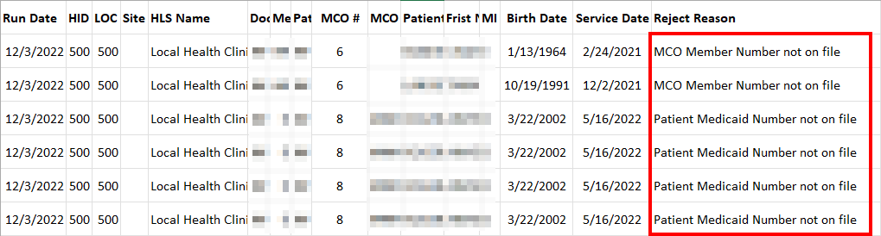
3062 – Medicaid/MCO Reject Report
List of PEFs missing needed billing information
This report is in a .CSV format and opened with Excel
Report will be named –
Site-XXXX_Rpt-3062_Medicaid_Rejects_MM-DD-YYYY

Slide 21
Molina (MCO) Billing Reports
3062 – Molina Claim Rejects
3080 – Molina Medicaid Invoice Register
3090 – Molina Medicaid Re-bill Invoice Register

Slide 22
United Healthcare (MCO) Billing Reports
3062 – United Healthcare Claim Rejects
3081 – United Healthcare Invoice Register
3091 – United Healthcare Re-bill Invoice Register

Slide 23
Passport (MCO) Billing Reports
3062 – Passport Claim Rejects
3083 – Passport (MCO) Invoice Register
3093 – Passport (MCO) Re-bill Invoice Register

Slide 24
Anthem (MCO) Billing Reports
3062 – Anthem Claim Rejects
3085 – Anthem (MCO) Invoice Register
3095 – Anthem (MCO) Re-bill Invoice Register

Slide 25
Aetna (MCO) Billing Reports
3062 – Aetna Claim Rejects
3086 – Aetna (MCO) Invoice Register
3096 – Aetna (MCO) Re-bill Invoice Register

Slide 26
WellCare (MCO) Billing Reports
3062 – WellCare Claim Rejects
3088 – WellCare (MCO) Invoice Register
3098 – WellCare (MCO) Re-bill Invoice Register

Slide 27
Humana CareSource (MCO) Billing Reports
3062 – Humana CareSource Claim Rejects
3089 – Humana CareSource (MCO) Invoice Register
3099 – Humana CareSource (MCO) Re-bill Invoice Register

Slide 28
Medicaid/MCO Remit Reports
CDP User Meeting – Topic #4

Slide 29
Preventive Medicaid Remit Reports
432 – Paid Medicaid claims report
578 – Denied Medicaid claims report
579 – Medicaid claims in suspense
580 – Medicaid A/R rejects
581 – Summary by Service and Cost Center – FYTD
582 – District Summary by Service and Cost Center – FYTD
794 – Payment Summary by Service and Cost Center - FYTD
795 – District Payment Summary by Service and Cost Center - FYTD

Slide 30
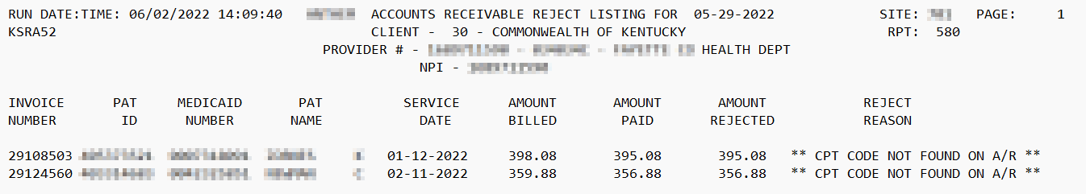
Example of A/R Reject Report

Slide 31
Lead Remit Reports
2532 – Paid Lead claims report
2578 – Denied Lead claims report
2579 – Lead claims in suspense
2580 – Lead A/R rejects
2581 – Lead Summary by Service and Cost Center – FYTD
2582 – Lead District Summary by Service and Cost Center – FYTD
2588 – Adjusted Lead claims report

Slide 32
Molina MCO Remit Reports
430 – Paid Molina claims report
178 – Denied Molina claims report
580 – A/R rejects
583 – Adjusted claims report
3181 – Summary by Service/Cost Center – FYTD
3182 – District Summary by Service/Cost Center – FYTD
3194 – Payment Summary by Service/Cost Center - FYTD
3195 – District Payment Summary by Service/Cost Center - FYTD

Slide 33
United Healthcare MCO Remit Reports
431 – Paid United Healthcare claims report
578 – Denied claims report
580 – A/R rejects
583 – Adjusted claims report
3281 – Summary by Service/Cost Center – FYTD
3282 – District Summary by Service/Cost Center – FYTD
3294 – Payment Summary by Service/Cost Center - FYTD
3295 – District Payment Summary by Service/Cost Center - FYTD

Slide 34
Anthem MCO Remit Reports
435 – Paid Anthem claims report
578 – Denied Anthem claims report
580 – Anthem A/R rejects
583 – Adjusted Anthem claims report
3581 – Summary by Service/Cost Center – FYTD
3582 – District Summary by Service/Cost Center – FYTD
3594 – Payment Summary by Service/Cost Center - FYTD
3595 – District Payment Summary by Service/Cost Center - FYTD

Slide 35
Aetna MCO Remit Reports
436 – Paid Aetna claims report
678 – Denied Aetna claims report
580 – Aetna A/R rejects
583 – Adjusted Aetna claims report
3681 – Summary by Service/Cost Center – FYTD
3682 – District Summary by Service/Cost Center – FYTD
3694 – Payment Summary by Service/Cost Center - FYTD
3695 – District Payment Summary by Service/Cost Center - FYTD

Slide 36
WellCare MCO Remit Reports
438 – Paid WellCare claims report
878 – Denied WellCare claims report
580 – WellCare A/R rejects
583 – Adjusted WellCare claims report
3881 – Summary by Service/Cost Center – FYTD
3882 – District Summary by Service/Cost Center – FYTD
3894 – Payment Summary by Service/Cost Center - FYTD
3895 – District Payment Summary by Service/Cost Center - FYTD

Slide 37
Humana CareSource MCO Remit Reports
439 – Paid Humana CareSource claims report
879 – Denied Humana CareSource claims report
580 – Humana CareSource A/R rejects
583 – Adjusted Humana CareSource claims report
3981 – Summary by Service/Cost Center – FYTD
3982 – District Summary by Service/Cost Center – FYTD
3994 – Payment Summary by Service/Cost Center - FYTD
3995 – District Payment Summary by Service/Cost Center - FYTD

Slide 38
277 – Billing Claim File Status Report
Shows Medicaid MCO and Medicare claim status for claims submitted electronically.
Runs Wednesday and Saturday.
Only receive if Medicaid MCO or Medicare claims were submitted electronically.

Slide 39
Medicare Billing Reports
CDP User Meeting – Topic #4

Slide 40
Billing Reports
533 – Medicare Invoice Register
534 – Railroad Medicare Invoice Register
536 - Acknowledgement Report
Ready to print on Thursday after 1st Sunday
537 - Reject Report
Claims CDP could not send due to problems
633 – Re-bill Invoice Register – Medicare
634 – Re-bill Invoice Register – Railroad Medicare

Slide 41
Medicare Remit Reports
CDP User Meeting – Topic #4

Slide 42
Medicare Remittance Reports
115 – Paid Medicare claims report
116 – Denied Medicare claims report
119 – A/R Reject Report

Slide 43
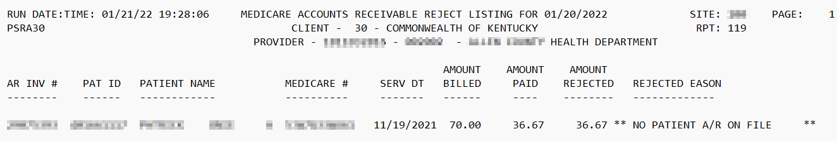
119 – Medicare A/R reject report

Slide 44
Contract Billing Reports
CDP User Meeting – Topic #4

Slide 45
Billing Reports
736 – Invoice Register
737 – CMS 1500 forms
735 – Mailing Labels for CMS 1500 forms

Slide 46
978 – Contract Payer listing
Listing of contract payers for your district.
Report is available upon request.
Contact CustomerSupport@cdpehs.com

Slide 47
If you have any questions
Contact CDP Customer Support
  1-866-237-4814
  customersupport@cdpehs.com

