Slide 1
Billing & Rebilling Process
Topic #3

Slide 2
Topics
Billing Process
What gets billed electronically?
When do PEFs get billed?
What is the process for billing?
Registration
Not in a household
In a household
PEF Entry
Did the PEF get billed?
Remittances
Rebilling Claims

Slide 3
Billing Process
Topic #3

Slide 4
3rd Party Payers
Medicaid – Payor code 2
Medicaid MCOs
Molina (Passport) – Payor code 21
United Healthcare – Payor code 22
Anthem – Payor code 25
Aetna – Payor code 26
WellCare – Payor code 28
Humana – Payor code 29
Medicare and Railroad Medicare – Payor code 3
Medicare Advantage Plans – Payor code 9
Private Contracts – Payor code 8
Private Insurance – Payor code 9

Slide 5
When does 3rd Party billing happen?
Medicaid, Medicaid MCO, Medicare, and Railroad Medicare
Runs every weekend
Reports and AR invoices are created
Private Contracts
First weekend of the month
Reports, CMS1500s, Mailing labels, and AR invoices are created
Medicare and Railroad Medicare
Runs every weekend
Reports and AR invoices are created

Slide 6
When does 3rd Party billing happen?
Private Insurance & Medicare Advantage Plans
Clinics decides if it runs once or twice a month
1st & 3rd weekend pre-bill reports will run
Invoice Register only
No AR invoices are created
2nd & 4th weekend live billing will run
Invoice Register
CMS1500 report for paper only claims
Mailing labels for CMS1500 claims
AR invoices are created

Slide 7
The Billing Process Medicaid/Medicaid MCO/Medicare
Billing job will scan through PEFs looking for the following:
Services going to Medicaid/Medicaid MCO/Medicare payor
The services (CPT codes) have not been flagged as billed
For some services, verifies the charge is not $0.00
Verify that all information needed to bill has been entered
Medicaid/Medicaid MCO/Medicare Number
Patient Demographics
PEFs missing information will not get billed
Create the electronic file to send to Payer
Create the reports and AR invoices

Slide 8
The Billing Process Private Contracts – payor code 8
Billing job will scan through PEFs looking for the following:
Services going to payor code 8
The services (CPT codes) have not been flagged as billed
Verifies the charge is not $0.00
Verify that all information needed to bill has been entered
NO PEFs will be rejected
Create the CMS1500 report that the clinic sends to payer
Create Invoice Register, mailing labels and AR invoices

Slide 9
The Billing Process Private Insurance – payor code 9
Billing job will scan through encounter looking for the following:
Services going to payor code 9
The services (CPT codes) have not been flagged as billed
Verifies the charge is not $0.00
Verify that all information needed to bill has been entered
Insurance Information
Patient Demographics
1st & 3rd Weekend – Pre-bill cycle
Invoice Register – to review claims that are billing and update if needed – NO AR is created
2nd & 4th Weekend – Live billing cycle
Invoice Registers – AR is created
CMS1500 for claims not sent electronically

Slide 10
Registration
Topic #3

Slide 11
Patient not in a Household
Verify
Name
Date of Birth
Gender

Slide 12
Third Party Section - Medicaid
Medicaid Information
Medicaid Eligible
Medicaid #
Presumptive Eligible Date
Medicaid MCO
MCD Member #

Slide 13
Third Party Section - Medicare
Medicare Information
Medicare Eligible?
Medicare #

Slide 14
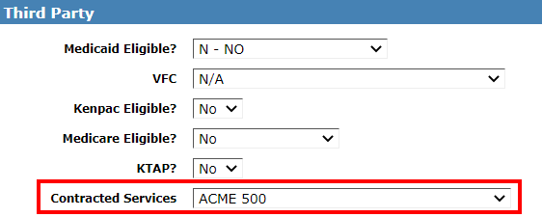
Third Party Section – Contracted
Use the drop-down to select the entity that will pay for the services performed.
Board of Educations
Fire Department
Local Industry

Slide 15
Third Party – Primary Insurance
Primary Insurance
Primary Insurance – select from drop-down
Subscriber Name
Group & Policy #
Subscriber Relation – select from drop-down
Insurance Member #

Slide 16
Third Party – Primary Insurance
Can’t update insurance information
Patient is in a household
Information will need to be updated in household screens

Slide 17
Third Party – Supplemental Insurance
Information can be captured, but it WILL NOT be billed.
DO NOT capture Medicare Advantage Plans as a supplemental Insurance.

Slide 18
Complete Registration
Request a PEF and other needed labels
Pick one of the SAVE buttons

Slide 19
Patient is in a Household
To capture/review third party information
Click Save & Third Party
Don’t have to check the check box on Household Member page

Slide 20
Household - Third Party Page

Slide 21
Third Party
Check the boxes for patients you want to add/update information.
All will check all patients.

Slide 22
Third Party - Medicaid
Medicaid Information
Medicaid Eligibility
Medicaid #
Medicaid MCO and Medicaid MCO # will be captured on the Registration page.

Slide 23
Third Party - Medicare
Medicare Information
Medicare Eligible?
Medicare #

Slide 24
Third Party - Insurance
Top of the page
List of Private Insurances entered for the household
The EDIT button will allow you to add/update insurance information

Slide 25
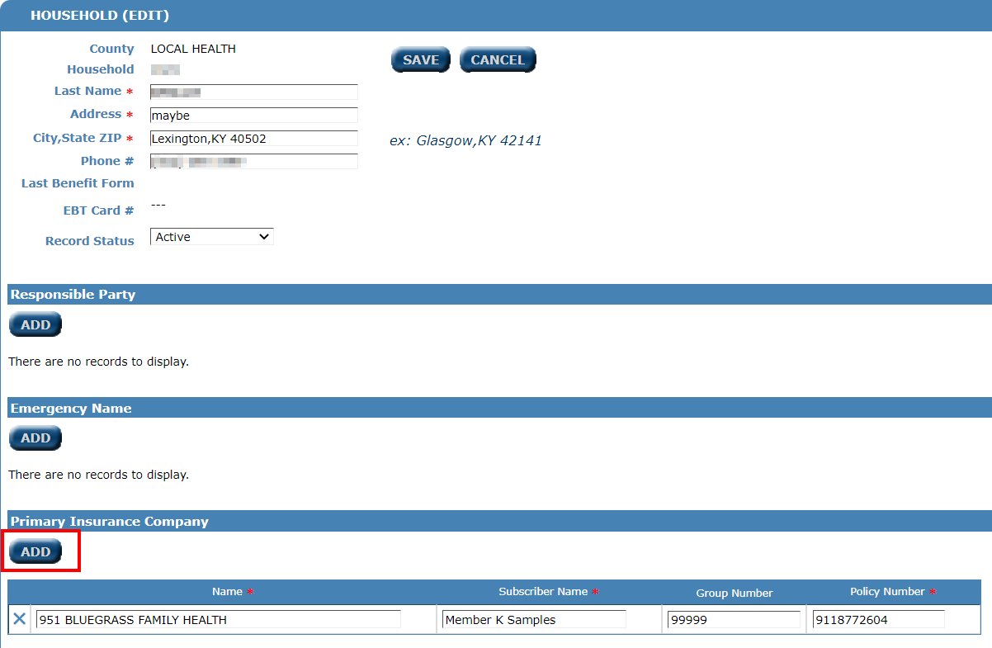
Third Party - Insurance
Click ADD to add a new family Insurance
Click the X to delete/inactivate a family Insurance
Or edit information within the line, then click SAVE

Slide 26
Third Party - Insurance
Insurance Information
Primary Ins. Subscriber – select from drop-down
Sub Relation – select from drop-down
Insurance member #

Slide 27
Third Party – Save & Member
Save your changes
Save & Member – returns to member page
Save & Income/Proofs – to go to income/proofs page

Slide 28
Complete Registration
Complete registration wCapture any additional information on Registration
MCO # and MCO Member #
Request a PEF label and other needed labels
Pick an appropriate SAVE button

Slide 29
PEF Entry
Topic #3

Slide 30
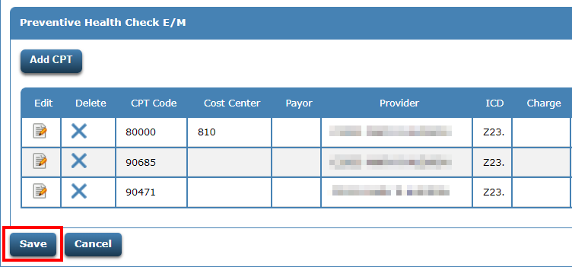
Entering PEF
Before clicking Save
Review that all CPT codes were entered
Enter any overrides, if needed

Slide 31
Receipt Page
Review the payor codes
If they are incorrect, information was missed on registration or PEF entry

Slide 32
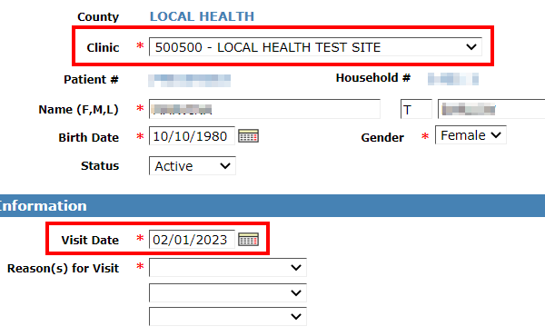
Review Registration
Verify visit date and clinic

Slide 33
Review Registration
Was all 3rd Party information entered?

Slide 34
Review Registration
Make sure you see the PEF already assigned for today message

Slide 35
Review Registration
Save even if you didn’t make any changes
Ask for PEF label, then click Save & Patient Menu
You DON’T have to print the PEF label!

Slide 36
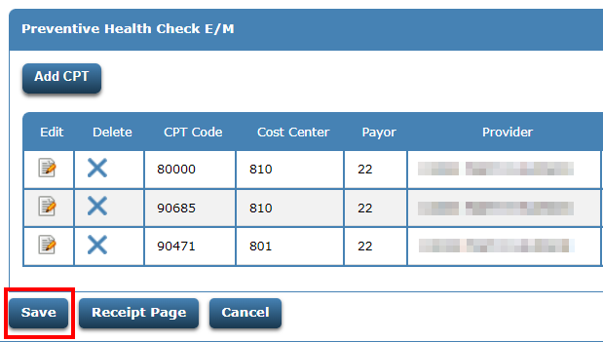
Review the PEF
Call up the PEF
Review information and make changes if needed
Payor codes will still be wrong
Save the PEF
Even if you didn’t make changes

Slide 37
Receipt Page
Review the payor codes
If they are incorrect, information was missed on registration or PEF entry

Slide 38
Did the PEF get billed?
Topic #3

Slide 39
How do I know the PEF billed?
Easy way – check to see if an AR has been created for the PEF.
Review the appropriate Invoice Register.
If no AR is built for the PEF or you don’t find it on an invoice register, check the claim reject report for the 3rd party payer.

Slide 40
Remittances
Topic #3

Slide 41
What are remittances?
Remittances are the way 3rd party payers let you know if they paid, denied, or suspended the claim.

Slide 42
Electronic Remittance Files
Which 3rd party payers provide electronic remittance files?
Medicaid and Medicaid MCO
Medicare and Railroad Medicare
Private Insurance – Anthem Only

Slide 43
Electronic Remittances
What if I am not receiving electronic remittance from the payers listed on the previous slide?????

Slide 44
Paper Remittance
Which 3rd party payers DON’T provide electronic remittance files?
Contract Payers
All Private Insurance, except for Anthem

Slide 45
Rebilling a Claims
Topic #3

Slide 46
Things to consider before rebilling
Rebilling because of a denial – Scenario #4
Billed claim to wrong 3rd party payer – Scenario #2 or 3
Rebilling due to services being left off – Scenario #4
Most scenarios will follow 1 of the 4 scenarios I am showing

Slide 47
Scenarios

Slide 48
Quick Reference Document
On LHO Webpage
Rebilling Steps for PEFs Entered on CMS Portal.docx

Slide 49
The PEF billed to the wrong Medicaid MCO
Scenario #1

Slide 50
Rebilling Steps for PEFs entered on CMS Portal.docx

Slide 51
On Patient Registration, set the Visit Date to the date the patient was originally seen.

Slide 52
Set the Reason for Visit.

Slide 53
Correct the Medicaid MCO and the MCO Member #.

Slide 54
Request a PEF label. DO NOT check Additional PEF?.

Slide 55
Only print the label if needed. Corrections may be hand-written on the CH-5 with the effective date and initial and date.

Slide 56
PEF Number Search - Enter the PEF # and click View Encounter.

Slide 57
Make changes, if necessary, then click the Save button. Save even if no changes were made.

Slide 58
Review the PEF and verify the services are going to the correct payor code.

Slide 59
Call up the AR invoice and transfer the charges to the new MCO payor code.

Slide 60
Transferring AR
When you transfer an AR invoice to a different payor code, the system WILL NOT automatically adjust off the AR invoice that was set up for the wrong MCO.
The AR invoice set up for the wrong MCO can be manually adjusted off at your agency’s discretion.

Slide 61
Call up the CMS1500 using the PEF # to rebill and the payor code we want to bill to.

Slide 62
Review the information on the CMS1500.

Slide 63
Enter the AR invoice number in the 26.Patient’s Account No field. Then click Print for a hard copy or Done to bill the claim electronically.

Slide 64
If the claim is re-billed electronically, verify that the PEF shows on the next Medicaid MCO Rebill Invoice Register.
3090 – Molina Rebill Invoice Register
3091 – United Rebill Invoice Register
3095 – Anthem Rebill Invoice Register
3096 – Aetna Rebill Invoice Register
3098 – WellCare Rebill Invoice Register
3099 – Humana CareSource Rebill Invoice Register

Slide 65
The PEF billed to regular Medicaid and needs to bill to a Medicaid MCO
Scenario #2

Slide 66
On Patient Registration, set the Visit Date to the date the patient was originally seen.

Slide 67
Set the Reason for Visit.

Slide 68
Enter the Medicaid MCO and the MCO Member #.

Slide 69
Request a PEF Label. DO NOT check Additional PEF?.

Slide 70
Only print the label if needed. Corrections may be hand-written on the CH-5 with the effective date and initial and date.

Slide 71
PEF Number Search - Enter the PEF # and click View Encounter.

Slide 72
Make changes, if necessary, then click the Save button. Save even if no changes were made.

Slide 73
Review the PEF and verify the services are going to the Medicaid MCO payor code.

Slide 74
Call up the AR invoice created for regular Medicaid and adjust off the balance.

Slide 75
This claim will bill off on the next Medicaid MCO billing cycle. An AR invoice will also be created. Verify that the PEF shows on the appropriate MCO Invoice Register.
3080 – Molina (MCO) Invoice Register
3081 – United Healthcare (MCO) Invoice Register
3085 – Anthem (MCO) Invoice Register
3086 – Aetna (MCO) Invoice Register
3088 – WellCare (MCO) Invoice Register
3089 – Humana CareSource (MCO) Invoice Register

Slide 76
The PEF went to private pay and needs to bill to Medicaid/MCO
Scenario #3

Slide 77
On Patient Registration, set the Visit Date to the date the patient was originally seen.

Slide 78
Set the Reason for Visit.

Slide 79
Enter the Medicaid MCO and the MCO Member #.

Slide 80
Request a PEF Label. DO NOT check Additional PEF?.

Slide 81
Only print the label if you need to. Corrections may be hand-written on the CH-5 with the effective date and initial and date.

Slide 82
PEF Number Search - Enter the PEF # and click View Encounter.

Slide 83
Make changes, if necessary, then click the Save button. Save even if no changes were made.

Slide 84
Review the PEF and verify the services are going to the correct Medicaid MCO payor code.

Slide 85
Call up the AR invoice created for private pay and adjust off the balance.

Slide 86
This claim will bill off on the next Medicaid MCO billing cycle. Verify that the PEF shows on the appropriate MCO Invoice Register.
3080 – Molina (MCO) Invoice Register
3081 – United Healthcare (MCO) Invoice Register
3085 – Anthem (MCO) Invoice Register
3086 – Aetna (MCO) Invoice Register
3088 – WellCare (MCO) Invoice Register
3089 – Humana CareSource (MCO) Invoice Register

Slide 87
The PEF billed to Medicaid/MCO but denied
Scenario #4

Slide 88
On Patient Registration, set the Visit Date to the date the patient was originally seen.

Slide 89
Set the Reason for Visit.

Slide 90
Review the information on Registration and make corrections if necessary.

Slide 91
If any corrections are made, request a PEF label. DO NOT check Additional PEF?.

Slide 92
Only print the label if you need to. The corrections may be hand-written on the CH-5 with the effective date and initial and date.

Slide 93
PEF Number Search - Enter the PEF # and click View Encounter.

Slide 94
Make changes, if necessary, then click the Save button. Save even if no changes were made.

Slide 95
Click the Save button.

Slide 96
Call up the CMS1500 using the PEF # to rebill and the payor code you want to bill to.

Slide 97
Review the information on the CMS1500.

Slide 98
Enter the AR invoice number for this claim in the 26.Patient’s Account No field. Click Print for a hard copy or Done to bill the claim electronically.
Don’t enter the PEF number in the Patient’s Account No field.

Slide 99
If the claim is re-billed electronically, verify that the PEF shows on the next Medicaid MCO Rebill Invoice Register.
3090 – Molina Rebill Invoice Register
3091 – United Rebill Invoice Register
3095 – Anthem Rebill Invoice Register
3096 – Aetna Rebill Invoice Register
3098 – WellCare Rebill Invoice Register
3099 – Humana CareSource Rebill Invoice Register

Slide 100
Medicaid MCO Information
MCO #s
Medicaid & MCO Payor Codes
1 – Molina (Passport)
2 – United Healthcare
5 – Anthem
6 – Aetna
8 - WellCare
9 – Humana CareSource
2 – Preventive Medicaid
21 – Molina
22 – United Healthcare
25 – Anthem
26 – Aetna
28 – WellCare
29 – Humana CareSource

