Slide 1
I Need Answers
Topic #1

Slide 2
Which Helpdesk?
Topic # 1 – I need answers!

Slide 3
CDP Help Desk
Contact Information
customersupport@cdpehs.com
networking@cdpehs.com
(866) 237-4814
How can they help?
Questions/Problems regarding Bridge or CDP Portal
Accounts Receivables
Scheduling
Household/Registration
Patient ID Change/Merge
Report and E-Report question/problems
PEF numbers showing on 850 that have been deleted.
Didn’t get a report when I should have.
Email/Computer unlocks – if IT contract is with CDP
Hardware issues
PIN Pads
Balance Inquiry devices

Slide 4
LHO Help Desk
Contact Information
Localhealth.helpdesk@ky.gov
(502) 564-6663
How can they help?
Administrative Regulations
Management/assistance with proper completion of the PEF
Manage CPT codes and charges
LHD claim investigations for Kentucky Medicaid and managed care organization errors in billing for preventive health services program.
Employee/Provider ID maintenance
Security for LHD employees
Bridge/Portal password resets and account unlocks
Clinic Demographics and Billing Information
Email address needs to be changed

Slide 5
WIC Help Desk
Contact Information
WIC.HelpDesk@ky.gov
(877) 597-0367, option 1
How can they help?
WIC Policy
WIC related questions
Certification/Recertifications
Reinstatement/Terminations
Return Formula
VOC
Food Package changes
Growth Chart

Slide 6
Security Forms
Topic # 1 – I need answers!

Slide 7
Security Forms
Portal Access
New employee’s access
Changing existing employee’s access
Revoke existing employee’s access
Use your favorite internet browser and search
Local Health Department Forms Kentucky

Slide 8
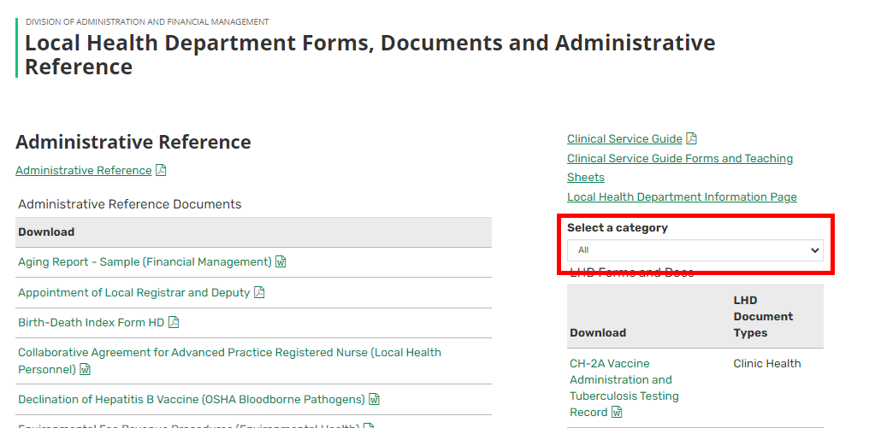
Security Forms
Use the drop-down to select the category
LHD Security Request

Slide 9
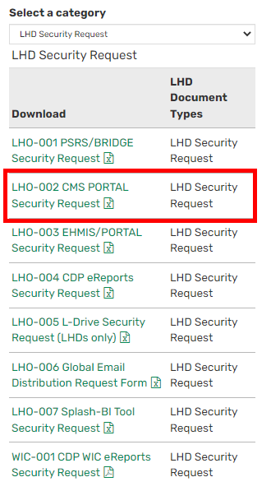
Security Forms
Double click on LHO-002 CMS Portal Security Request

Slide 10
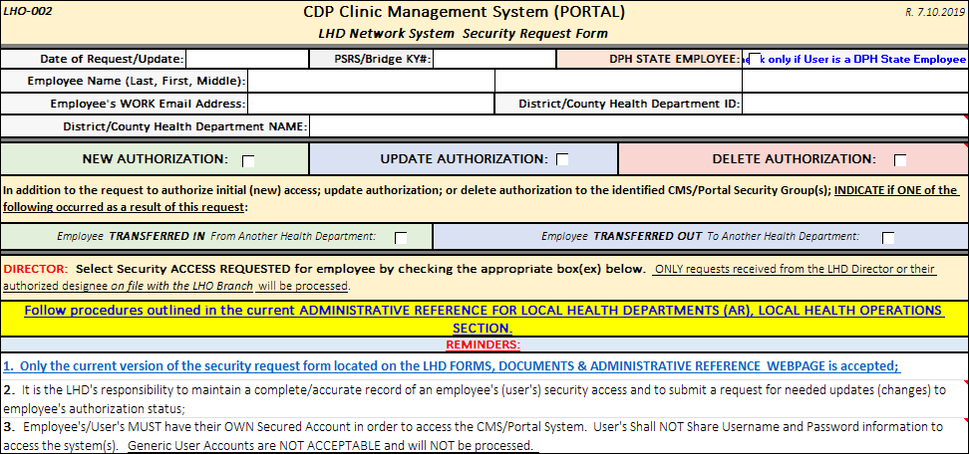
Security Forms
The top of the form will capture information on the employee that you are requesting new access, changes to existing access or deletion of access.
Make sure to read the small print and fill out form completely

Slide 11
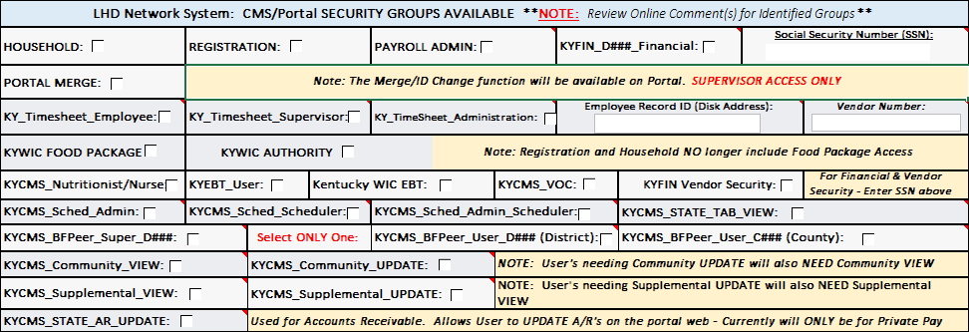
Security Forms
Select the groups that the employee needs access/or added to access. Some groups have additional comments on what the group gives access too. Hover mouse over red triangle in corner of box.

Slide 12
Security Forms - Groups
Household & Registration – check both if employee needs access to household and patient information.
Portal Merge – check if employee needs to do Patient ID changes or merges – This function is limited to one or two staff within a clinic, preferably a supervisor.

Slide 13
Security Forms - Groups
WIC Access
KYWIC Food Package & KYWIC Authority – State only
KYCMS_Nutritionist/Nurse – for nutritionist and nurses completing WIC services.
KYEBT_User & KY WIC EBT – for clinic staff issuing WIC benefits and eWIC cards.
KYCMS_VOC – for clinic staff needing to perform VOCs

Slide 14
Security Forms - Submitting
Once the form is completed
If the form does not contain SSN, it can be emailed to localhealth.helpdesk@ky.gov
If the form does contain SSN, it must be faxed to 502-564-4057
Request forms not accurately completed using the procedures outlined on the Request Form and Administrative Reference, LHO Section may not be processed.

Slide 15
Available Documentation
Topic # 1 – I need answers!

Slide 16
Available Documentation
Use your favorite internet browser and search
Local Health Operations Branch

Slide 17
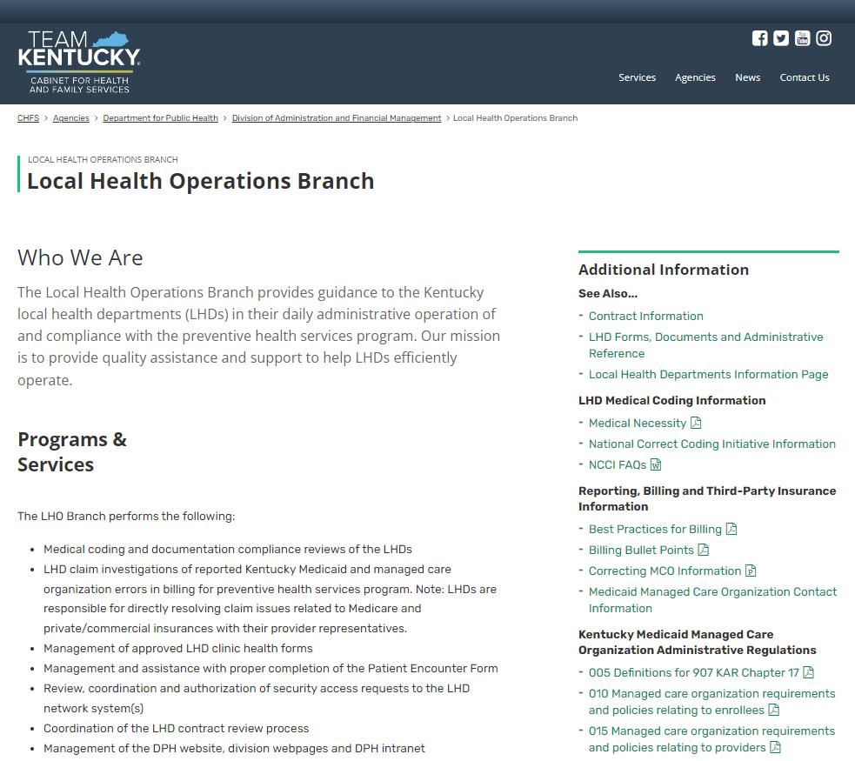
Available Documentation
Local Health Operations Branch Web Page

Slide 18
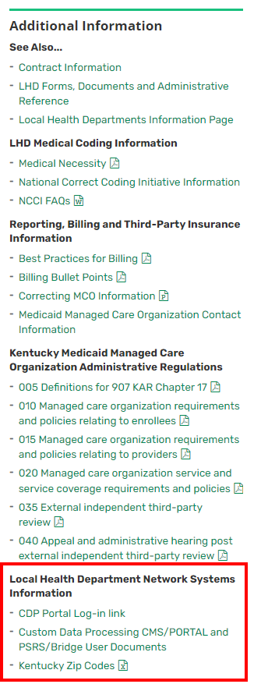
Available Documentation
Local Health Department Network Systems Information
CDP Portal Log-in link
Custom Data Processing CMS/PORTAL and PSRS/Bridge User Documents

Slide 19
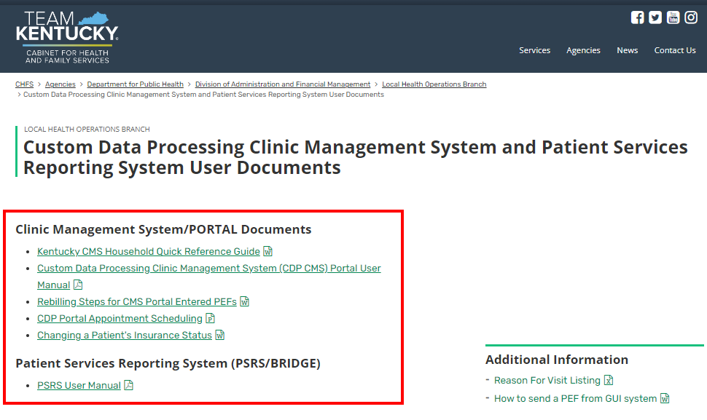
Available Documentation
Custom Data Processing Clinic Management System and Patient Service Reporting System User Documents

Slide 20
Training Accounts
Topic # 1 – I need answers!

Slide 21
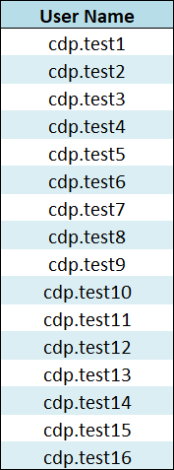
Training Accounts
16 Training Accounts connected to the test clinic – Local Health.
Use for training new staff or refresher for current staff.
Available Modules
Scheduling
Household Registration
WIC
Accounts Receivables
Password - December%%2022
If password expires or you lock the account, contact CDP customer support.

Slide 22
Any Questions
Up Next – Coding with Amy Dunn and Cynthia Robinson

