Slide 1
Accounts Receivables
Payments, Adjustments, and AR Scenarios

Slide 2
Table of Contents

Slide 3
Options for Posting Money
AR listing via the Patient Menu – The AR listing, available on the patient menu, allows staff to review AR invoices that have been set up. They can make adjustment and/or payments to the invoices.
Receipt Page via Encounter Entry - After entering the PEF and clicking save, the receipt page will be presented. This screen allows staff to collect payment from the patient at the time of services and/or give them a receipt of their balance.

Slide 4
AR Listing
Patient Menu

Slide 5
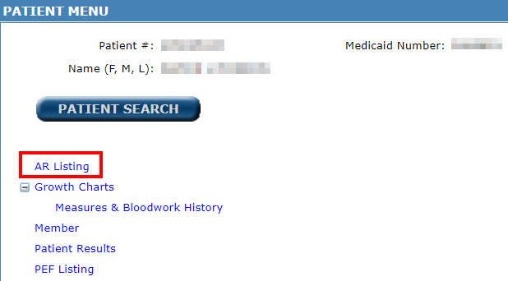
AR Listing
To reach the AR Listing, go to the Patient Menu and select AR Listing
The AR Listing shows all open AR and those that have recently been cleared.
Payment and adjustment posting can be completed through the AR Listing.

Slide 6
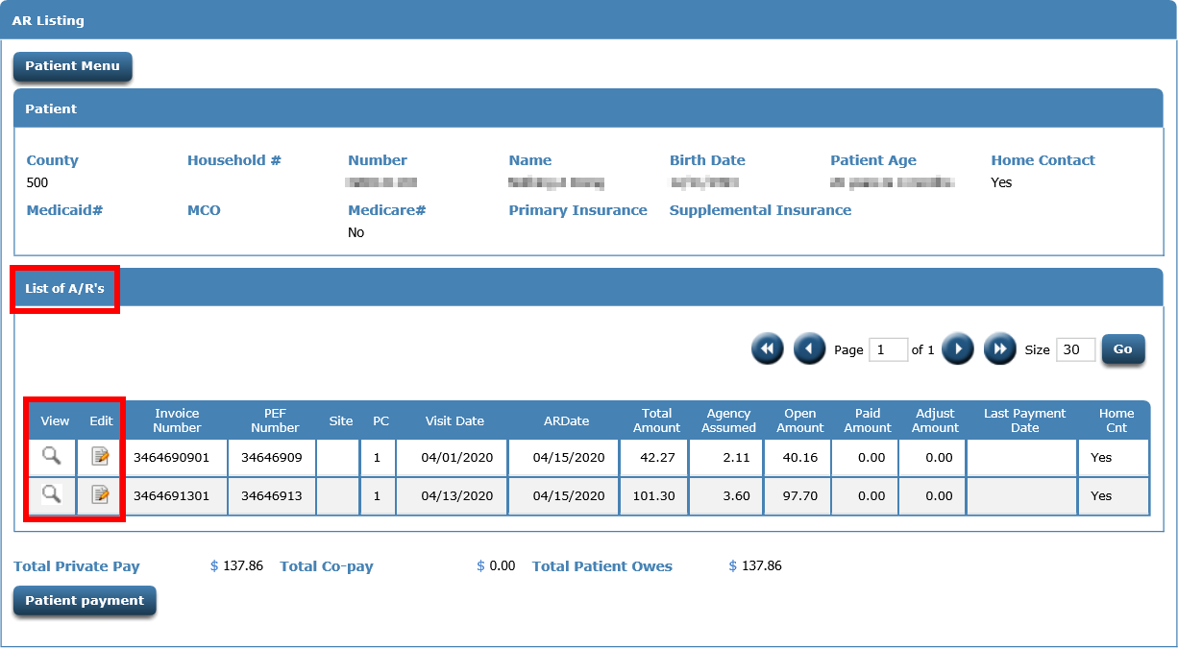
AR Listing
This page list all open and recently cleared invoices for a patient. The View icon allows you to view an individual invoice. An Edit icon allows for posting or adjusting payments.

Slide 7
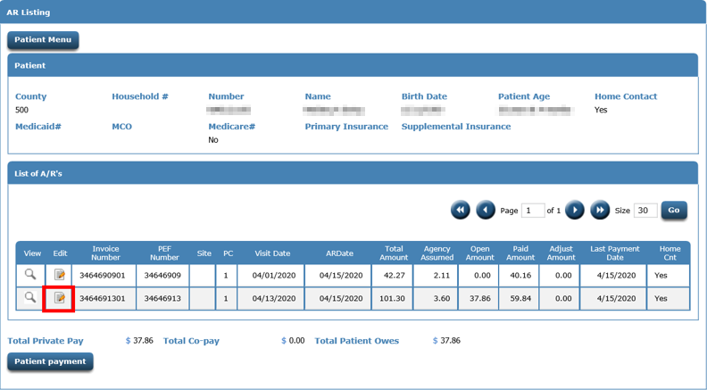
To begin posting or adjusting an AR invoice, click the EDIT icon.

Slide 8
AR Payment Page
AR Listing

Slide 9
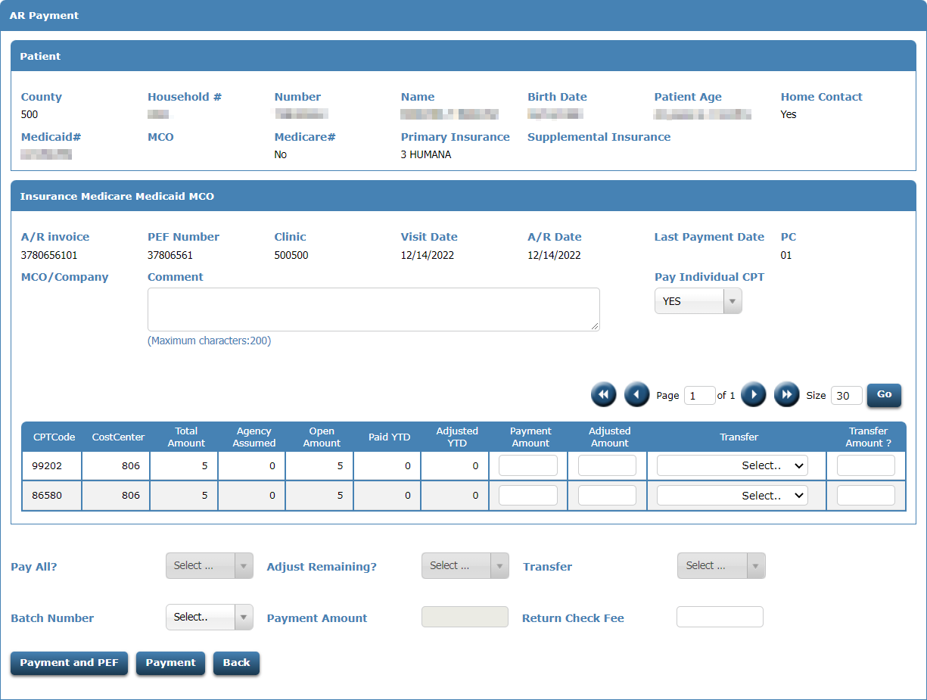
Payment Page

Slide 10
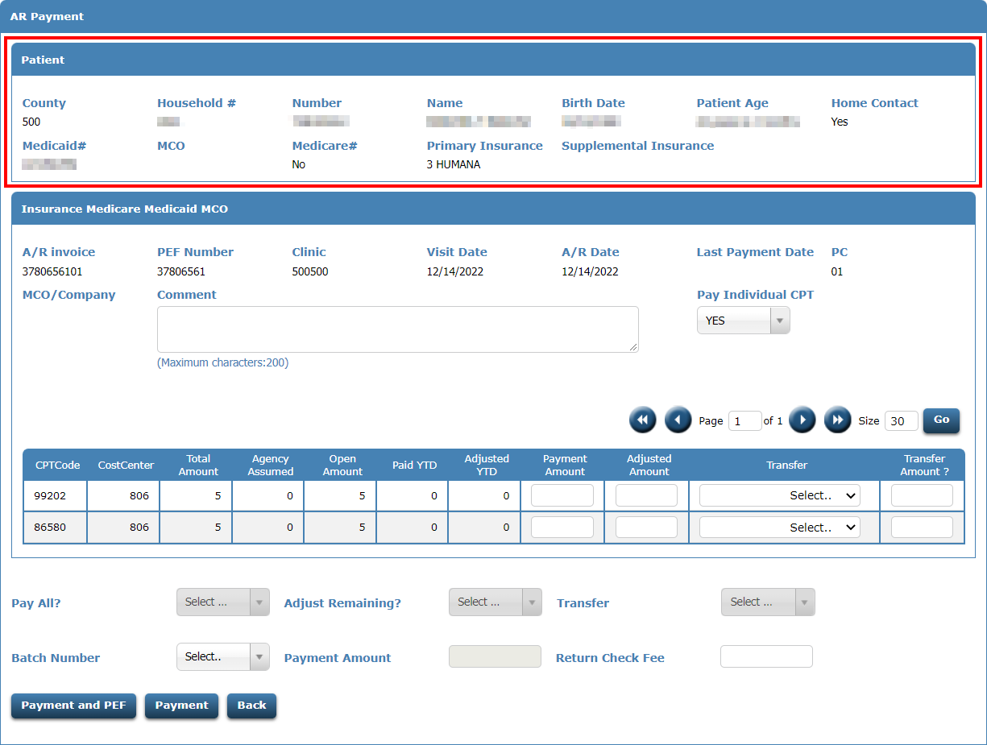
Payment Page – Patient Info

Slide 11
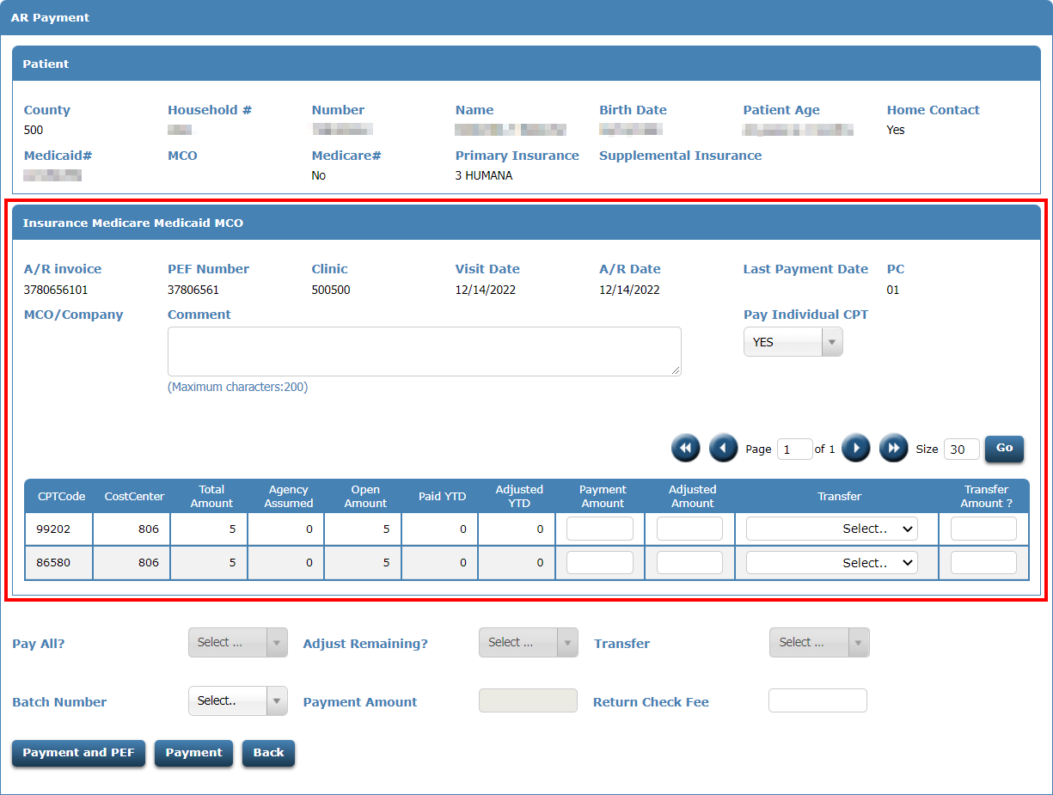
Payment Page – Invoice Details

Slide 12
Comments
Any information can be captured and saved on the invoice for future reference.

Slide 13
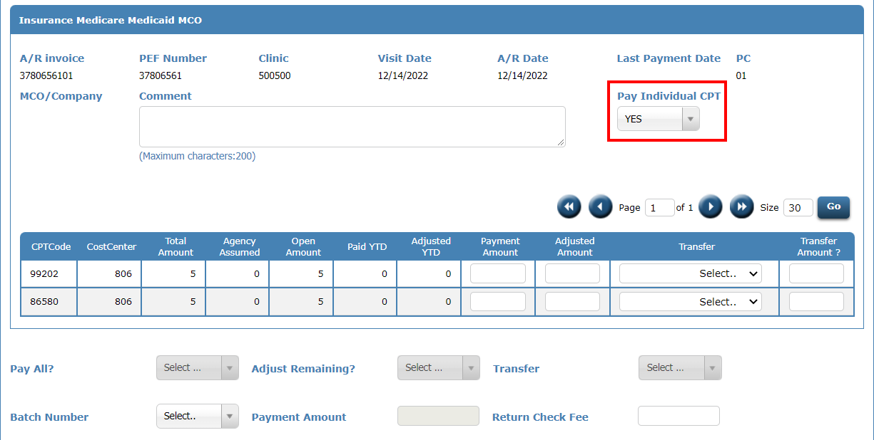
Pay Individual CPT
YES – Payments/adjustments are posted to the individual CPT codes.
NO – Payments/adjustments are posted to the invoice. Payments and adjustments will be spread across all CPT codes.

Slide 14
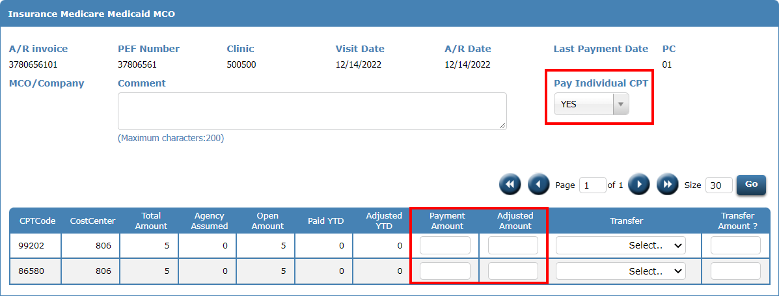
Pay Individual CPT = YES
Payments and adjustments are posted in the Payment Amount and Adjusted Amount fields

Slide 15
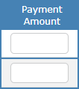
Payment Amount Field
Positive Payment Amount – A positive payment amount will add the amount to the Paid YTD amount for the CPT code. This will reduce the Open Amount.
Negative Payment Amount – A negative payment amount will subtract the amount from the Paid YTD amount for the CPT code. This will increase the Open Amount.

Slide 16
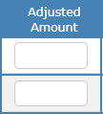
Adjusted Amount Field
Positive Adjusted Amount – A positive adjusted amount will add the amount to the Adjusted YTD amount for the CPT code. This will reduce the Open Amount.
Negative Adjusted Amount – A negative adjusted amount will subtract the amount from the Adjusted YTD amount for the CPT code. If Adjusted YTD is zero, this will increase the Open Amount.

Slide 17
Open Amount for an invoice is calculated using the following formula
Open Amount = Total Amount –
Agency Amount –
Adjusted YTD –
Paid YTD

Slide 18
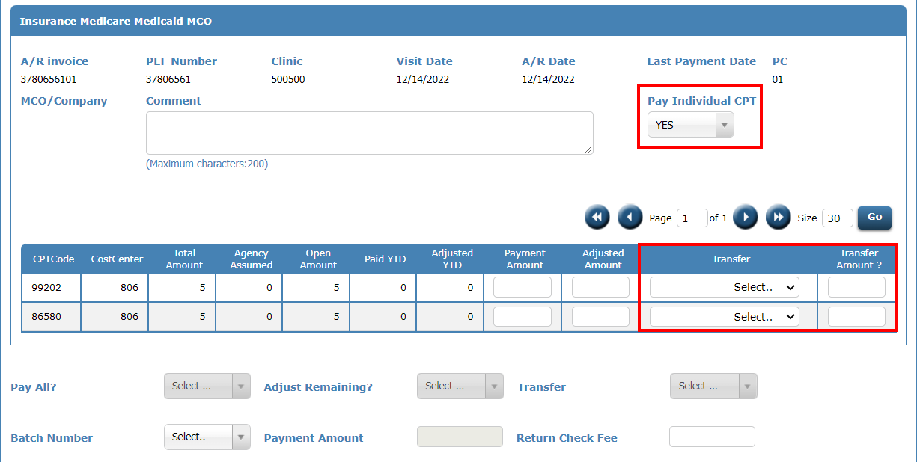
Pay Individual CPT = YES
If charges need to be transferred to another payor, use the Transfer field to select the payor and the Transfer Amount field for the amount. A new invoice will be created for the payor and amount entered. The current invoice balance WILL NOT be adjusted, unless you enter the adjusted amount.

Slide 19
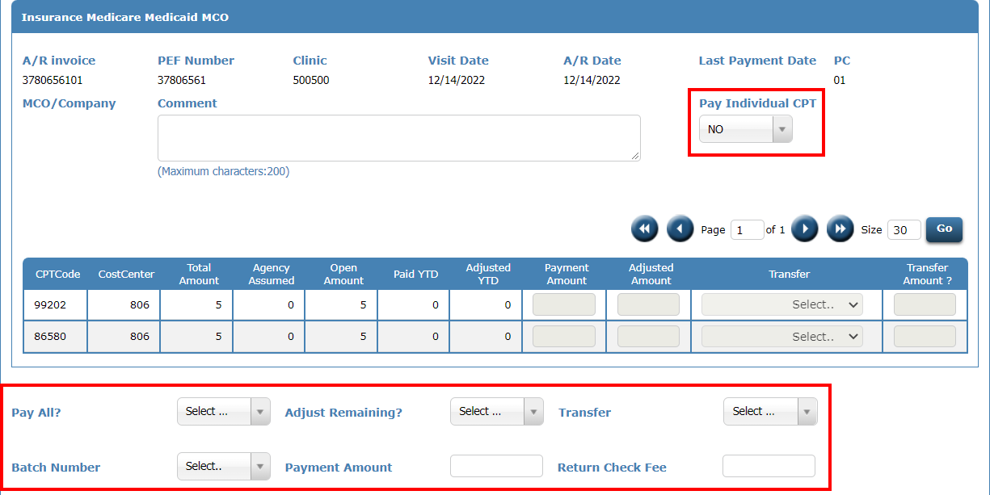
Pay Individual CPT = NO
Payments/adjustments are posted at the invoice level. Payments and adjustments will be spread across all CPT codes with a non-zero balance.

Slide 20
Pay All?
YES – Payment posted will clear the open amount for the invoice.
NO – Payment posted WILL NOT clear the open amount for the invoice.

Slide 21
Adjust Remaining?
YES – Any remaining balance will be adjusted to zero.
NO – Any remaining balance WILL NOT be adjusted to zero.

Slide 22
Transfer
Transfer, provides a drop-down list of other payer sources. The amount adjusted will be used to set up a new AR invoice to the selected payer source.

Slide 23
Batch Number
If posting using batch numbers, you will select your batch number from the drop down. Batch numbers are not required to post or adjust open amounts.

Slide 24
Payment Amount
The amount you are paying to this invoice. If Pay All = YES, the payment amount must be equal to the total open amount.

Slide 25
Return Check Fee
If a check is returned for insufficient funds, this field will allow you to add the Return Check fee your clinic charges to the invoice.

Slide 26
Payment Buttons
Payment and PEF – This button will post the payment or adjustment as you have selected. You will then be returned to the PEF listing page.
Payment – This button will post the payment or adjustment as you have selected. You will then be returned to the AR listing page.
Back – This button will return you to the AR Listing page. Anything entered on the screen WILL NOT be saved/posted.

Slide 27
Receipt Page
Encounter Entry

Slide 28
Receipt Page
After a PEF has been entered and you click Save, you will be directed to the Receipt Page.
The Receipt Page will show the CPT codes entered, the payor code and cost center assigned to each, and any payment due from the patient.
Payments can be collected and posted from this page.
Payments posted from this page will be reflected on the Patient’s AR immediately.

Slide 29
Receipt Page

Slide 30
Receipt Page – Charges for Today
This section shows:
CPT Codes performed
Cost Center assigned
Payor Code assigned
Total charges for each service
Patient Pay, the amount the patient is responsible to pay
Agency Assumed, the amount adjusted due to patient’s poverty level

Slide 31
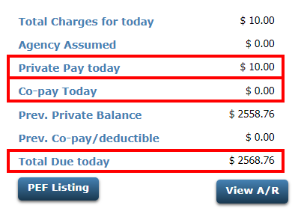
Receipt Page – Total Due
This section shows what the patient currently owes. It includes today’s charges, copay due, and previous balances.

Slide 32
Receipt Page – Payment
Enter the patient’s payment based on how they paid
Cash Collected
Check Payment & Number
Debit/Credit Payment & Confirmation
Donation
Buttons available
Save – saves and post the payment
Save with Receipt – saves payment and prints receipt
Print Receipt – for printing receipt if no payment captured

Slide 33
AR Reports
Daily/Monthly

Slide 34
Reports
319 – Patient Encounters Entered – This report shows the PEFs entered on the previous day along with any money that was collected via the receipt page.
352 – Daily Invoices – This report list all AR invoices that were created on the previous day.
358 – Daily Receipts – This report list all payments or adjustments entered the previous day.
359 – Monthly Aging Report – This will show all invoices that have an open amount not equal to zero and it’s age.

Slide 35
Scenarios
Accounts Receivables

Slide 36
Scenarios 1,2,3, and 7 will be shown with two options. One with Pay Individual CPT = YES and one with Pay Individual CPT = NO
Scenario # | Scenario | Starting Slide
1 | Posting Full Payment | 37
2 | Posting a Partial Payment | 46
3 | Posting a Partial Payment and Adjusting the remaining balance | 55
4 | Posting a payment to the oldest invoice | 65
5 | Correcting a Payment | 71
6 | Correcting an Adjustment | 77
7 | Transfer remaining balance to another Payor code | 83

Slide 37
Scenario 1 - Posting Full Payment
The patient received services which resulted in a $15.00 amount due. The patient did not have the money at the time of the service but has mailed you a check for the full amount.

Slide 38
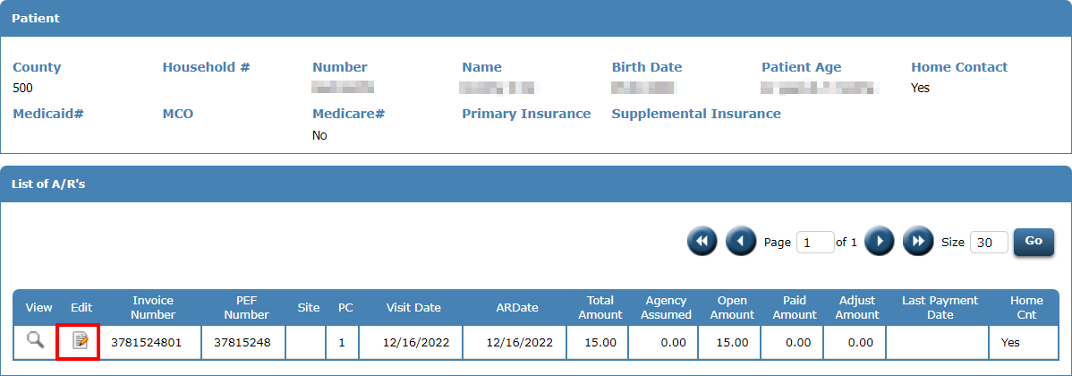
Full Payment – Option 1
From the AR Listing page for the patient, click the EDIT icon next to the Invoice you wish to post a payment.

Slide 39
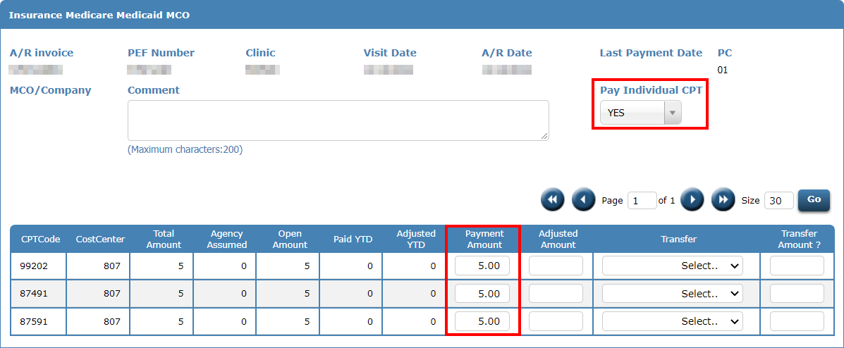
Full Payment – Option 1
Set Pay Individual CPT to YES. Then enter the full amount for each CPT code on the invoice in the payment amount field.

Slide 40
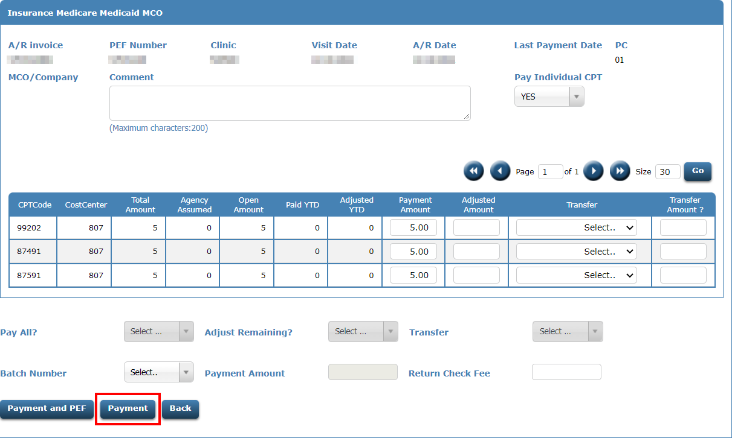
Full Payment – Option 1
Click the Payment button

Slide 41
Full Payment – Option 1
After posting, the invoice reflects a $0.00 open amount, and $15.00 has been paid towards the invoice.

Slide 42
Full Payment – Option 2
From the AR Listing page for the patient, click the EDIT icon next to the Invoice you wish to post a payment.

Slide 43
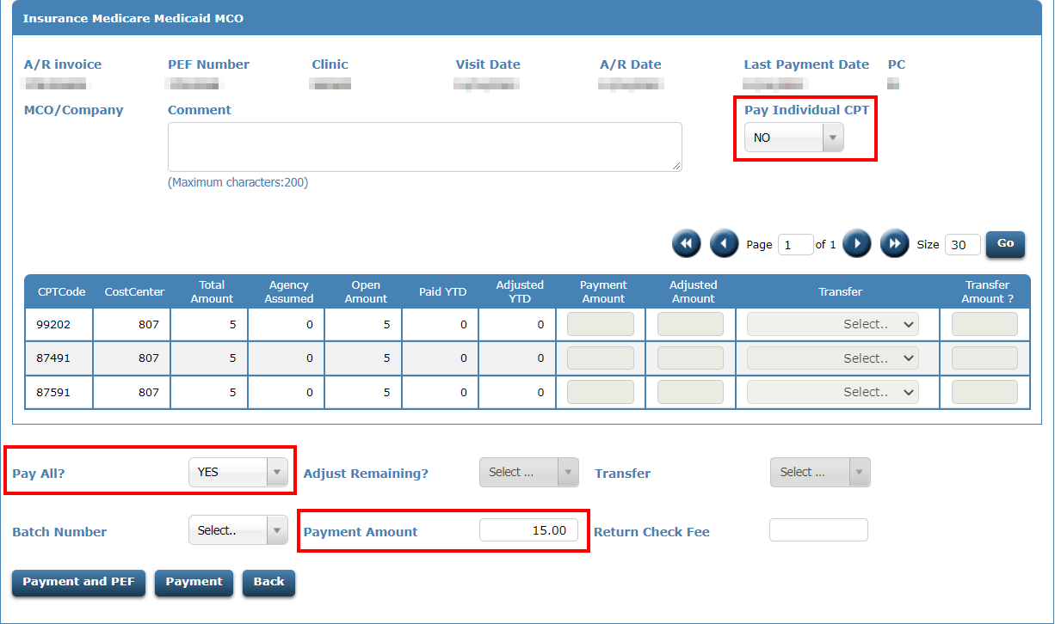
Full Payment – Option 2
Set Pay Individual CPT to NO. Set Pay All? to YES. Then enter the full payment amount in the payment amount field.

Slide 44
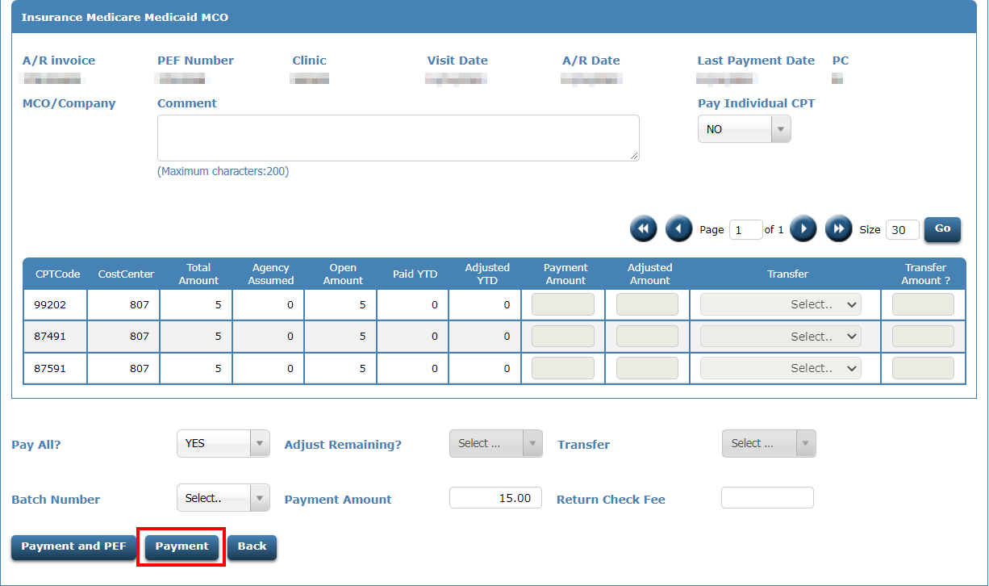
Full Payment – Option 2
Click the Payment button

Slide 45
Full Payment – Option 2
After posting, the invoice reflects a $0.00 open amount, and $15.00 has been paid towards the invoice.

Slide 46
Scenario 2 - Posting a partial payment
The patient received services which resulted in a $15.00 amount due. The patient did not have the money at the time of the service but has mailed you a check for $7.50.

Slide 47
Partial Payment – Option 1
From the AR Listing page for the patient, click the EDIT icon next to the Invoice you wish to post a payment.

Slide 48
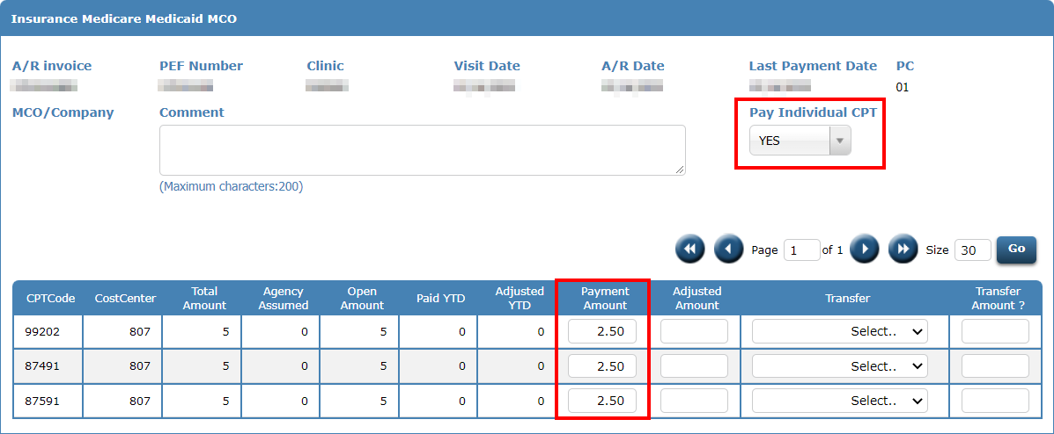
Partial Payment – Option 1
Set Pay Individual CPT to YES. Then enter the amount to post for each CPT code on the invoice in the payment amount field.

Slide 49
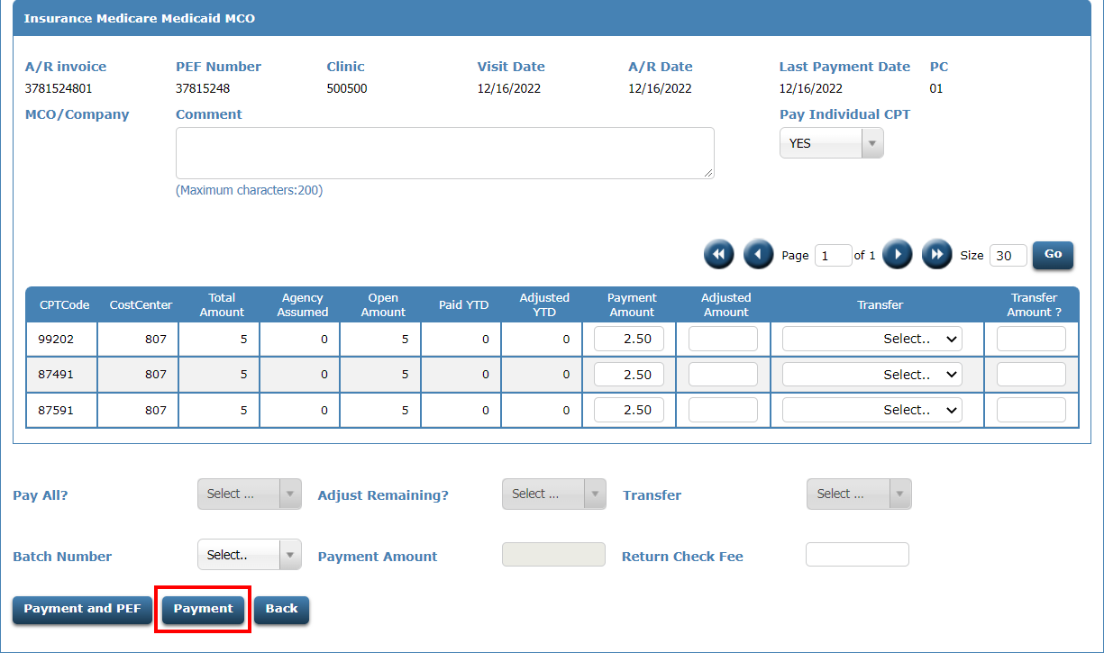
Partial Payment – Option 1
Click the Payment button

Slide 50
Partial Payment – Option 1
After posting, the invoice reflects a $7.50 open amount, and $7.50 has been paid towards the invoice.

Slide 51
Partial Payment – Option 2
From the AR Listing page for the patient, click the EDIT icon next to the Invoice you wish to post a payment.

Slide 52
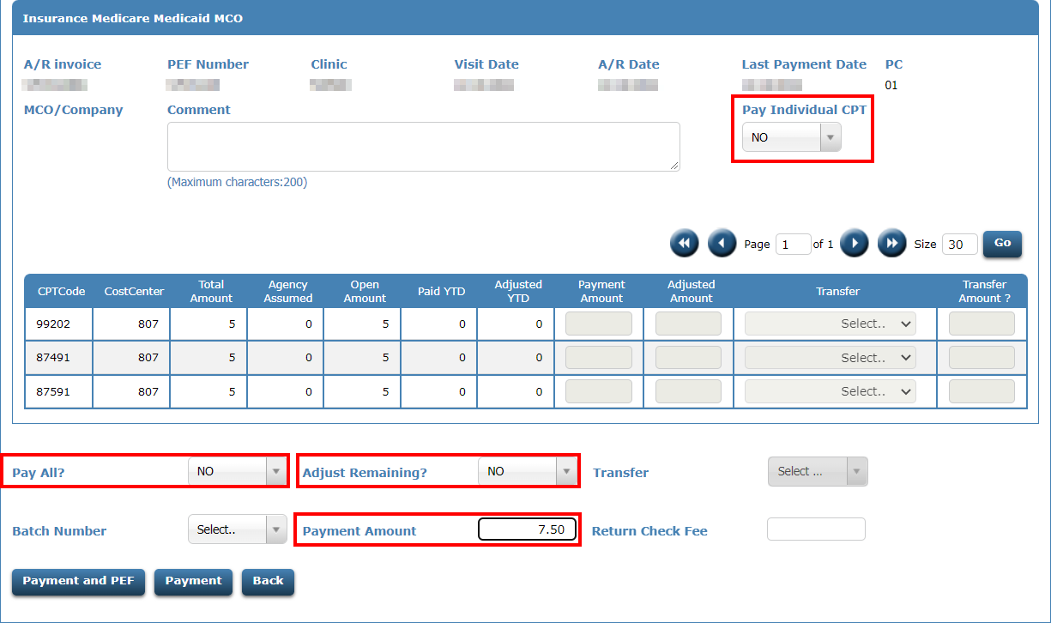
Partial Payment – Option 2
Set Pay Individual CPT to NO. Set Pay All? to NO. Set Adjust Remaining? to NO. Then enter the partial payment amount in the payment amount field.

Slide 53
Partial Payment – Option 2
Click the Payment button

Slide 54
Partial Payment – Option 2
After posting, the invoice reflects a $7.50 open amount, and $7.50 has been paid towards the invoice.

Slide 55
Scenario 3 - Posting a partial payment and adjusting the remaining balance
The patient received services that were billed to a private insurance for $30.00. Insurance only paid $25. The remaining balance will not be billed to the patient but adjusted off.

Slide 56
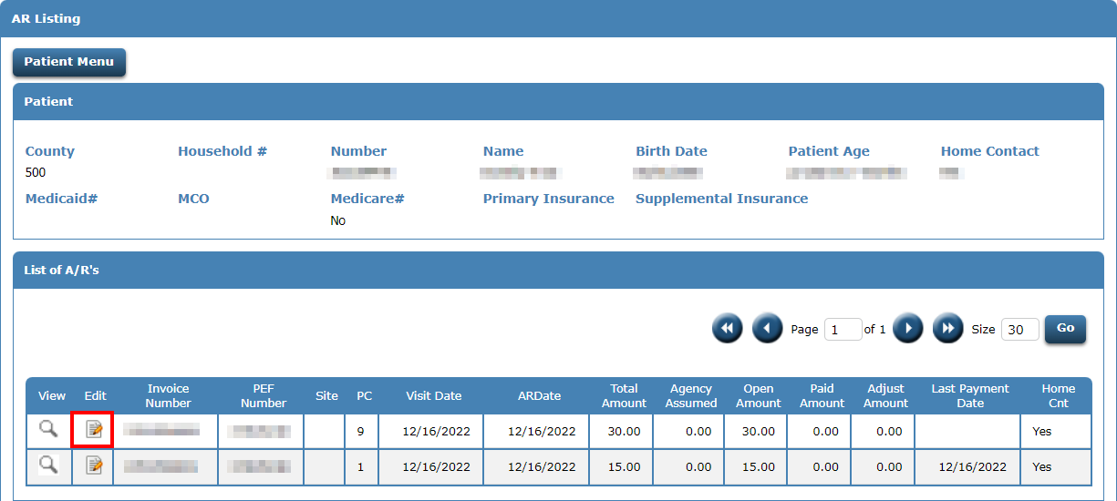
Partial Payment/Adjust Remaining – Option 1
From the AR Listing page for the patient, click the EDIT icon next to the Invoice you wish to post a payment.

Slide 57
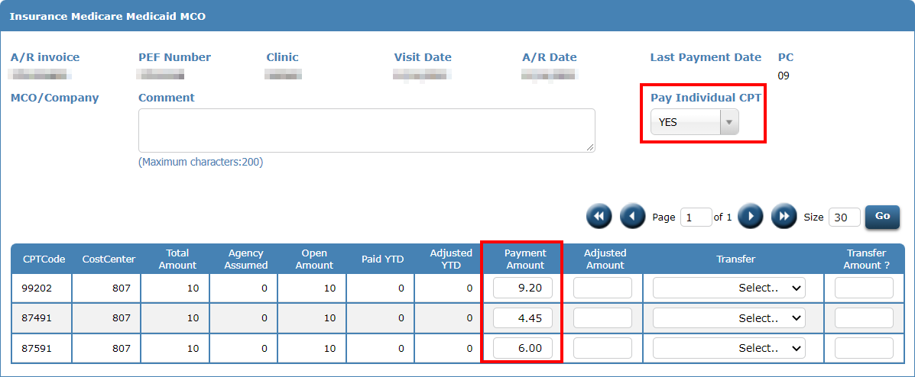
Partial Payment/Adjust Remaining – Option 1
Set Pay Individual CPT to YES. Then enter the amount paid for each CPT code on the invoice in the payment amount field.

Slide 58
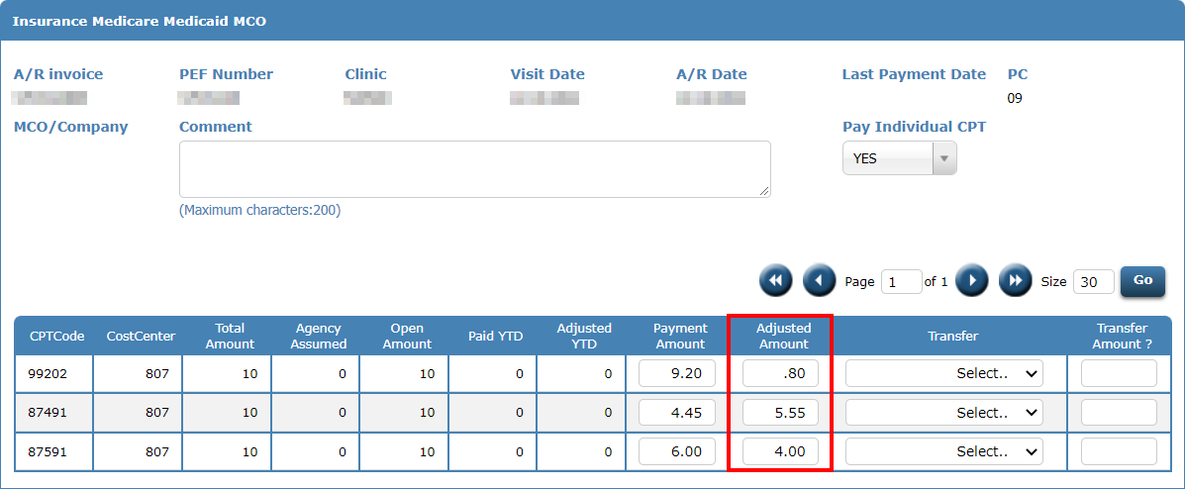
Partial Payment/Adjust Remaining – Option 1
For each CPT code on the invoice, in the Adjusted Amount field, enter the amount that will be adjusted off the remaining balance for that CPT code. For each CPT code, the payment amount plus the adjusted amount should equal the open amount.

Slide 59
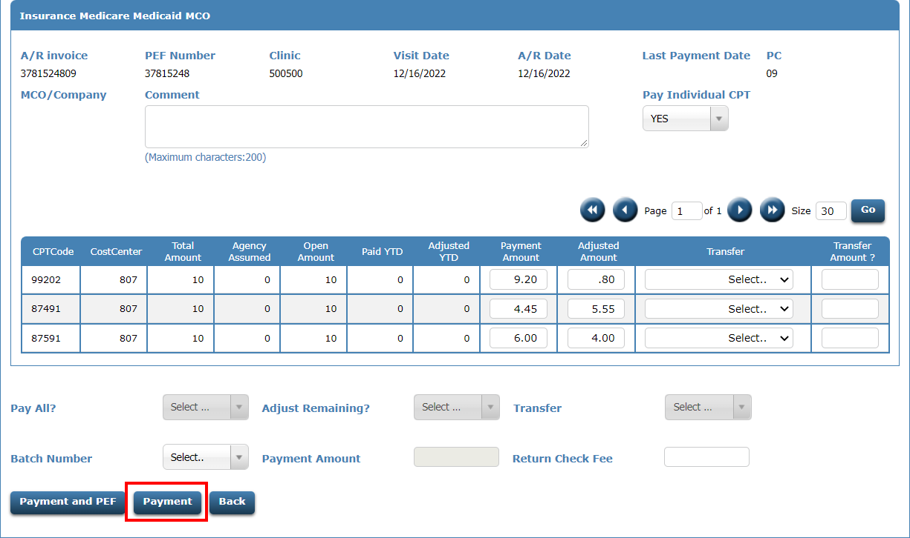
Partial Payment/Adjust Remaining – Option 1
Click the Payment button

Slide 60
Partial Payment/Adjust Remaining – Option 1
After posting, the invoice reflects a $0.00 open amount, a $19.65 paid amount, and $10.35 has been adjusted. The invoice is now cleared.

Slide 61
Partial Payment/Adjust Remaining – Option 2
From the AR Listing page for the patient, click the EDIT icon next to the Invoice you wish to post a payment.

Slide 62
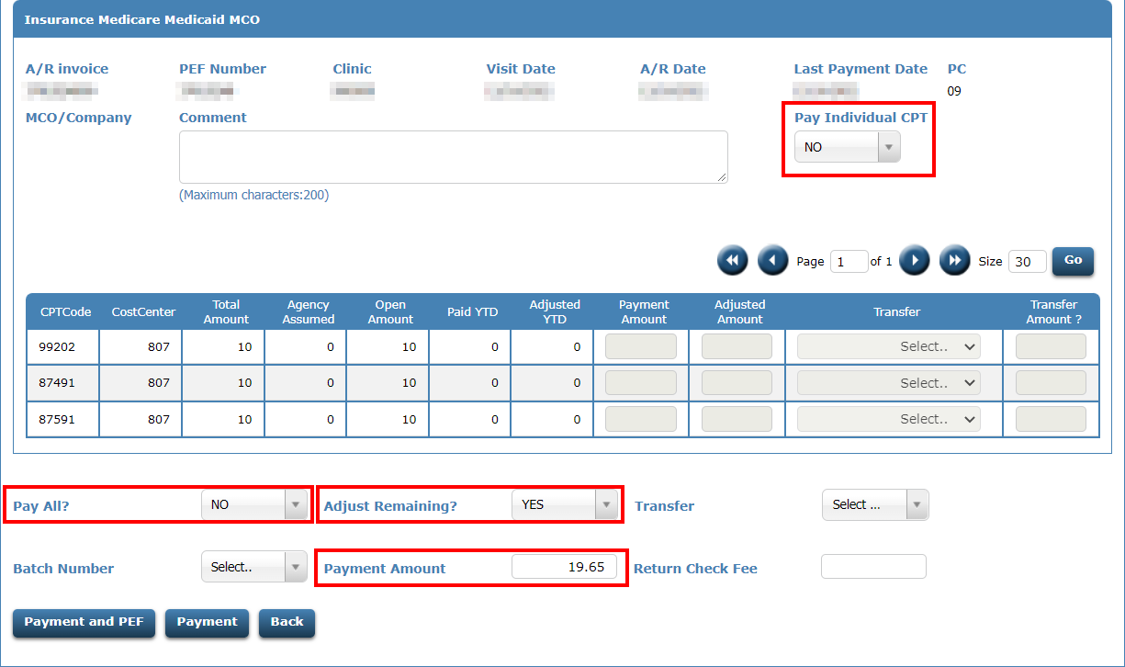
Partial Payment/Adjust Remaining – Option 2
Set Pay Individual CPT to NO. Set Adjust Remaining? to YES. Enter the amount that was paid in the payment amount field.

Slide 63
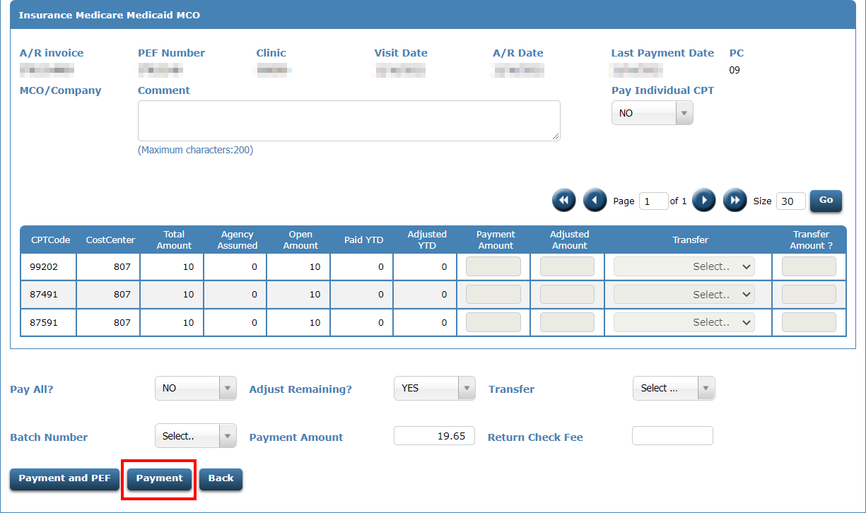
Partial Payment/Adjust Remaining – Option 2
Click the Payment button

Slide 64
Partial Payment/Adjust Remaining – Option 2
After posting, the invoice reflects a $0.00 open amount, a $19.65 paid amount, and $10.35 has been adjusted. The invoice is now cleared.

Slide 65
Scenario 4 - Posting a payment to the oldest invoice
The patient is responsible for $105.00 for services received. They send a check for $100.00. You want to post this money starting with the oldest invoice first. Oldest invoice is determined by AR Date.

Slide 66
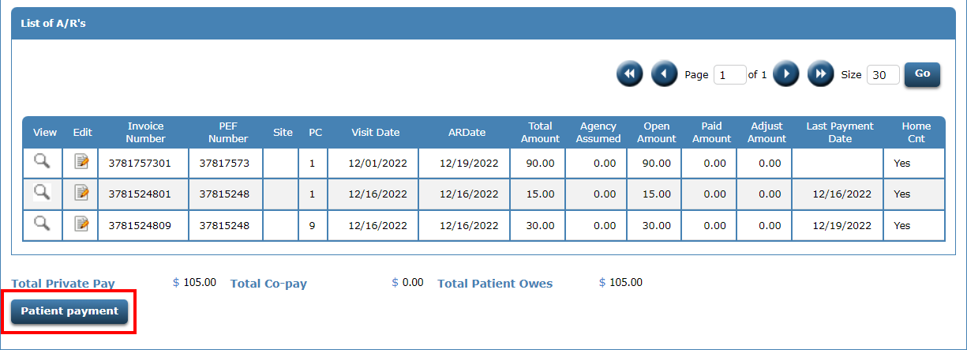
Post Payment to Oldest Invoice
Click Patient Payment at the bottom of the AR Listing page

Slide 67
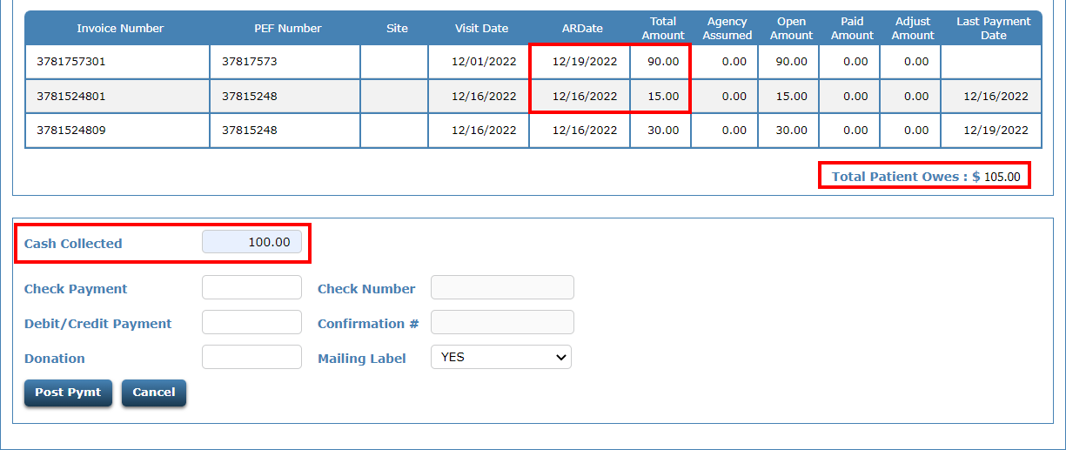
Post Payment to Oldest Invoice
If $100.00 is posted, $15.00 will post to invoice 3781524801 first since it is the oldest. The remaining $85.00 will be posted to invoice 3781757301. Invoice 3781524809 is Private Insurance and is not included in the Total Patient Owes.

Slide 68
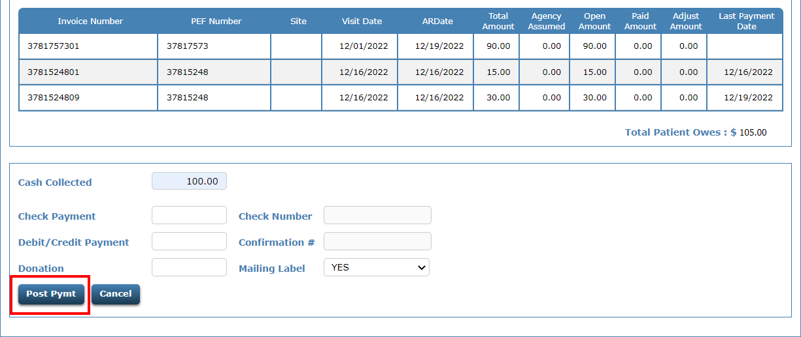
Post Payment to Oldest Invoice
Click Post Pymt

Slide 69
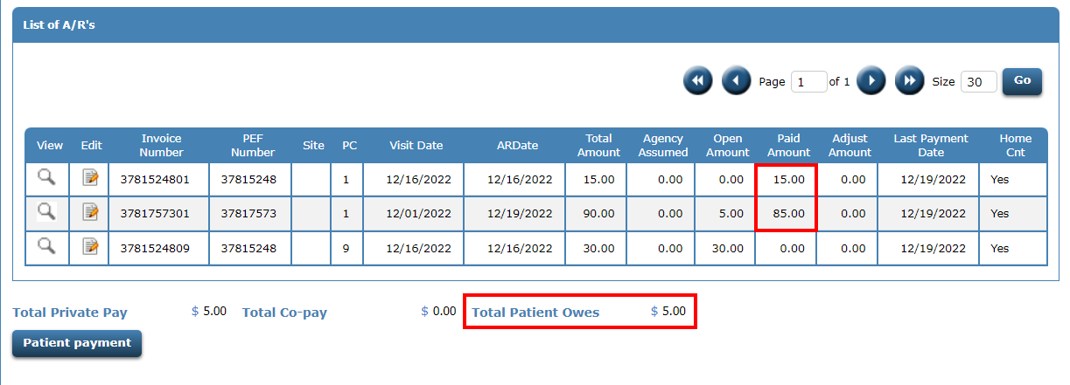
Post Payment to Oldest Invoice
After clicking Post Pymt, the $100.00 will post and reduces the Total Patient Owes to $5.00.

Slide 70
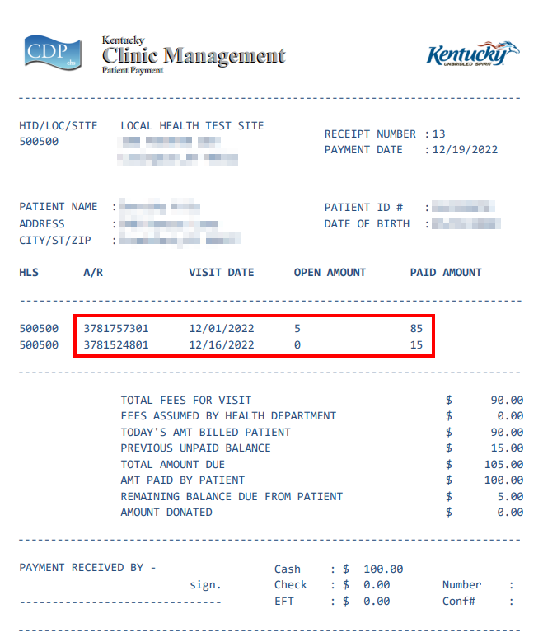
Post Payment to Oldest Invoice
A receipt will be created showing which invoices and amounts posted.

Slide 71
Scenario 5 – Correcting a payment
The patient has an invoice for $90 and $90 enter as the payment.. However, only $60 was paid. The patient still owes $30.

Slide 72
Correcting a Payment
From the AR Listing page for the patient, click the EDIT icon next to the Invoice that needs the correction.

Slide 73
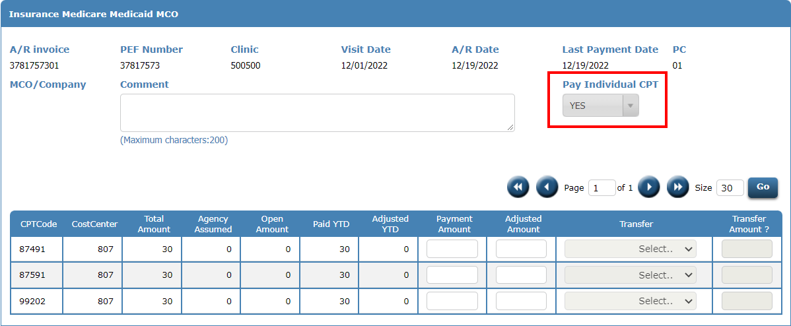
Correcting a Payment
Since the invoice is currently cleared, Pay Individual CPT defaults to YES and can’t be changed.

Slide 74
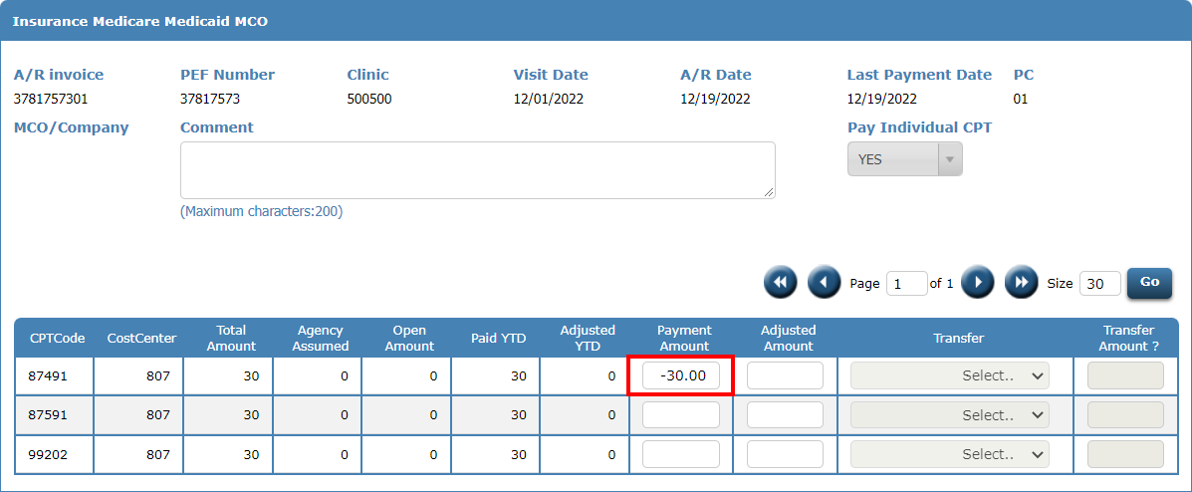
Correcting a Payment
To reduce the payment amount, you will enter a negative amount. In this example, $30 is taken away from the 87491 CPT code.

Slide 75
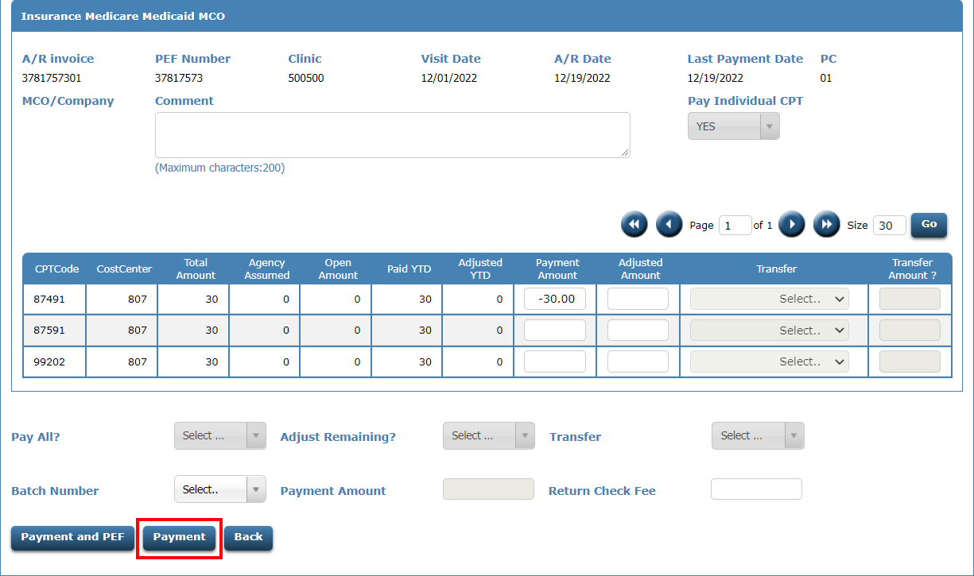
Correcting a Payment
Click the Payment button

Slide 76
Correcting a Payment
After posting, the invoice reflects a $30 open amount, and $60 has been paid towards the invoice.

Slide 77
Scenario 6 – Correcting an adjustment
The patient has an invoice for $90 and $60 has been adjusted leaving a $30 open amount. However, only $30 should have been adjusted. The patient should have a $60 open amount.

Slide 78
Correcting an adjustment
From the AR Listing page for the patient, click the EDIT icon next to the Invoice that needs the correction.

Slide 79
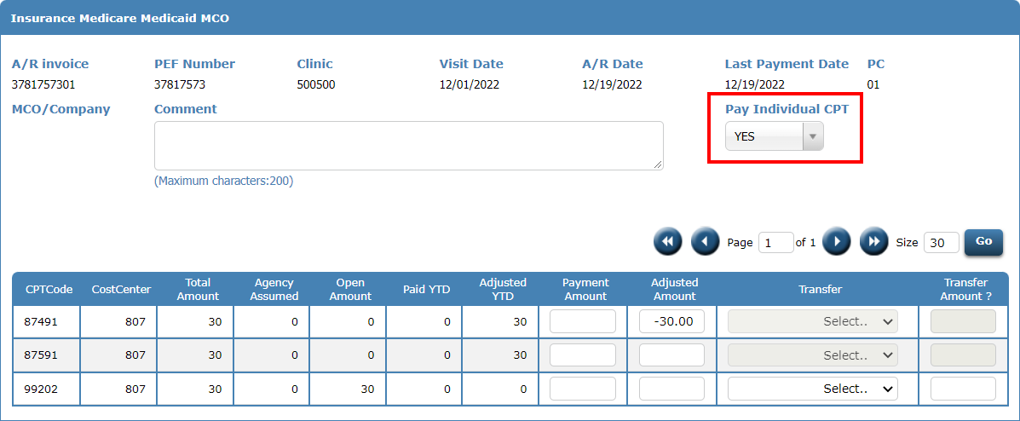
Correcting an adjustment
Set Pay Individual CPT to YES

Slide 80
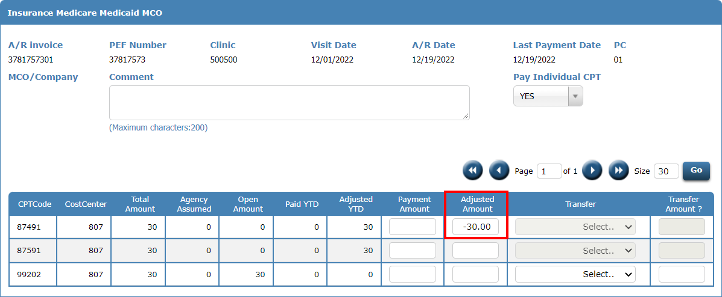
Correcting an adjustment
To reduce the adjustment amount, you will enter a negative amount in the adjustment amount field. In this example, $30 was previously adjusted and need to remove the adjustment from the 87491 CPT code.

Slide 81
Correcting an adjustment
Click the Payment button

Slide 82
Correcting an adjustment
After posting, the invoice reflects a $60 open amount, and the adjustment amount has been reduced to $30.

Slide 83
Scenario 7 – Transfer remaining balance to another Payor code
The patient received services that were billed to a private insurance for $30.00. Insurance only paid $25. The remaining balance will be transferred to the patient, payor code 1.

Slide 84
Transfer remaining balance to another Payor code – Option 1
From the AR Listing page for the patient, click the EDIT icon next to the Invoice you wish to transfer the remaining balance.

Slide 85
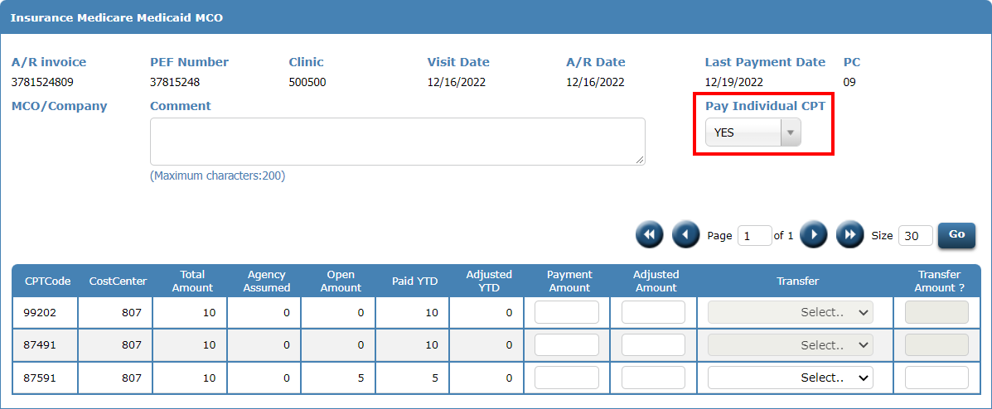
Transfer remaining balance to another Payor code – Option 1
Set Pay Individual CPT to YES.

Slide 86
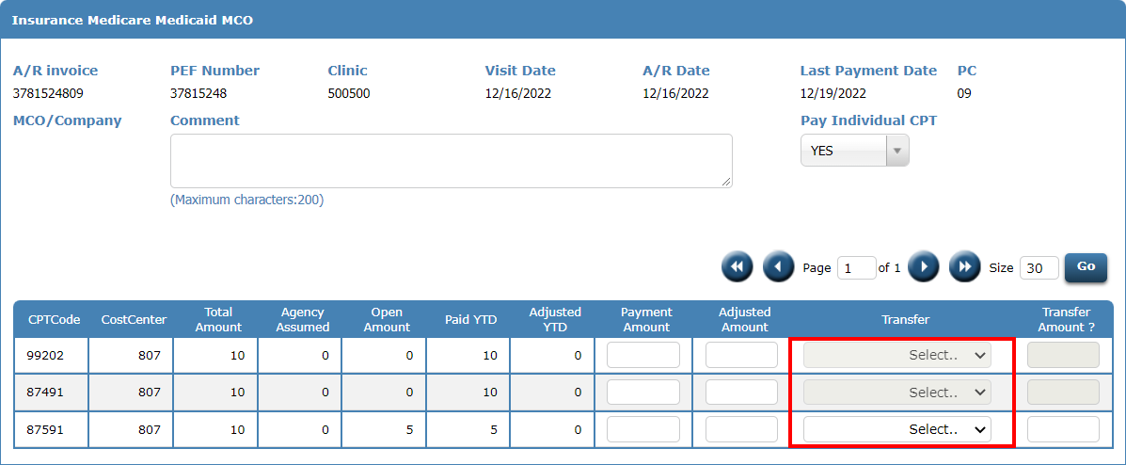
Transfer remaining balance to another Payor code – Option 1
The Transfer drop-down is only available for the CPT codes that have an open amount. In this case, only the 87591 has an open balance.

Slide 87
Transfer remaining balance to another Payor code – Option 1
From the Transfer drop-down, select PATIENT.

Slide 88
Transfer remaining balance to another Payor code – Option 1
Enter the amount to transfer to the new AR invoice, in this case it is $5.

Slide 89
Transfer remaining balance to another Payor code – Option 1
If you want to adjust off the $5 on the Private Insurance invoice, you can enter that in the Adjusted Amount field.

Slide 90
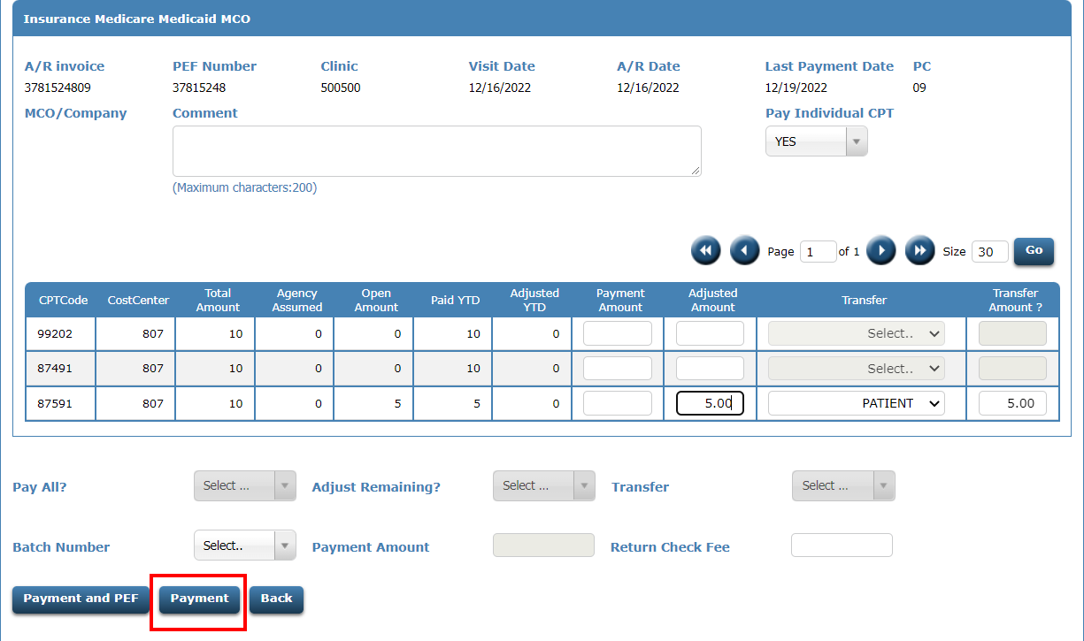
Transfer remaining balance to another Payor code – Option 1
Click the Payment button

Slide 91
Transfer remaining balance to another Payor code – Option 1
After posting, the Insurance invoice shows the remaining $5 has been adjusted off. And now a new PC 1 invoice has been set up for $5.

Slide 92
Transfer remaining balance to another Payor code – Option 2
From the AR Listing page for the patient, click the EDIT icon next to the Invoice you wish to transfer the remaining balance.

Slide 93
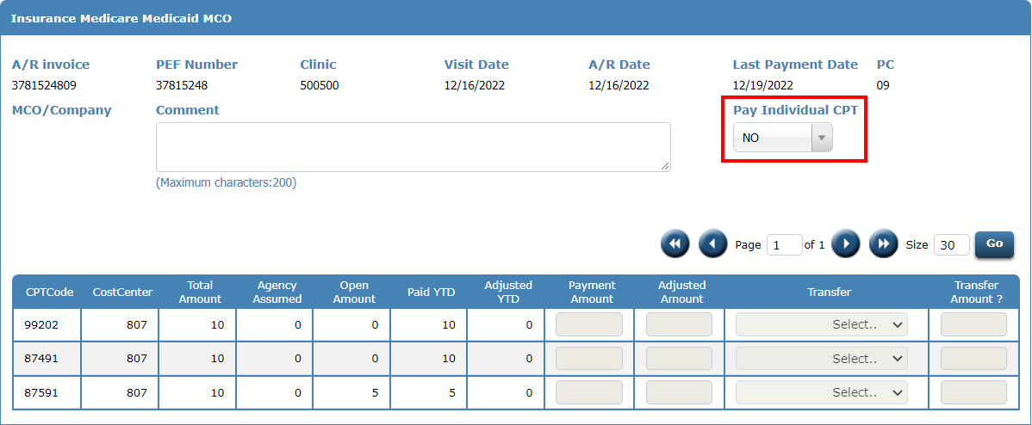
Transfer remaining balance to another Payor code – Option 2
Set Pay Individual CPT to NO.

Slide 94
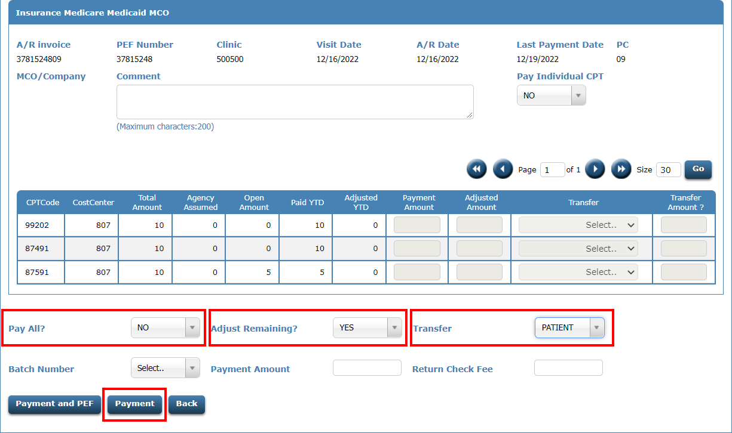
Transfer remaining balance to another Payor code – Option 2
Set Pay All? to NO. Set Adjust Remaining? to YES. Set Transfer to PATIENT. Then click Payment. The PC 1 invoice will be set up for the amount that is adjusted off.

Slide 95
Transfer remaining balance to another Payor code– Option 2
After posting, the Insurance invoice shows the remaining $5 has been adjusted off. And now a new PC 1 invoice has been set up for $5.

Slide 96
Any Questions????
Contact CDP Customer Support
1-866-237-4814
customersupport@cdpehs.com

