Slide 1
Accounts Receivables
CDP Portal

Slide 2
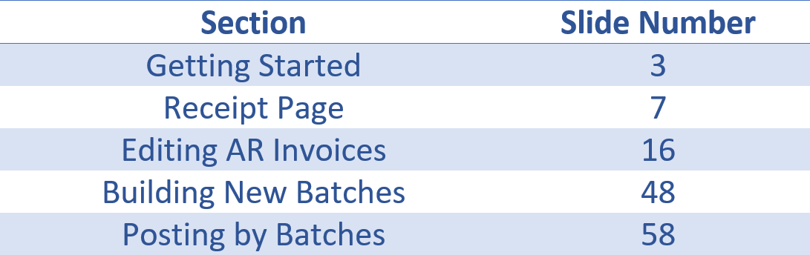
Table of Contents

Slide 3
Accounts Receivables
Getting Started

Slide 4
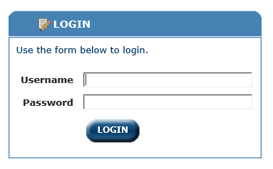
Log in to the CDP Portal

Slide 5
Verify that you have one of these two security groups in your memberships
To view Accounts Receivables
KYCMS_AR_View
To view and update Accounts Receivables
KYCMS_AR_Update

Slide 6
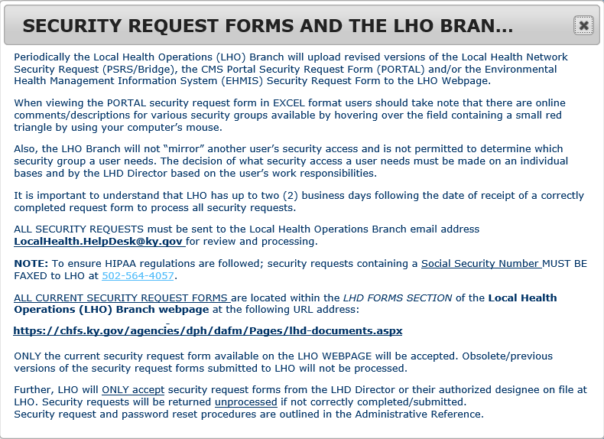
If you need to request access

Slide 7
Account Receivables
Receipt Page

Slide 8
Encounter Entry Receipt Page
After entering the patient’s PEF, you will receive the Receipt page showing any charges that are the patient’s responsibility
If money is collected, it can be posted, and a receipt will be generated.

Slide 9
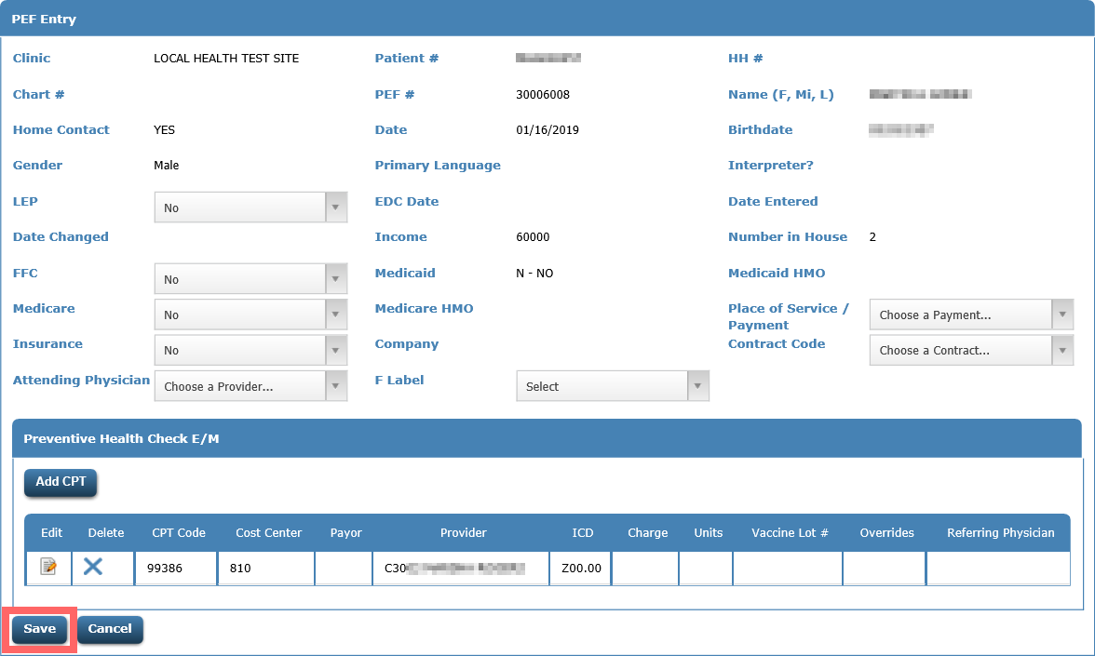
After entering PEF, you will click Save.

Slide 10
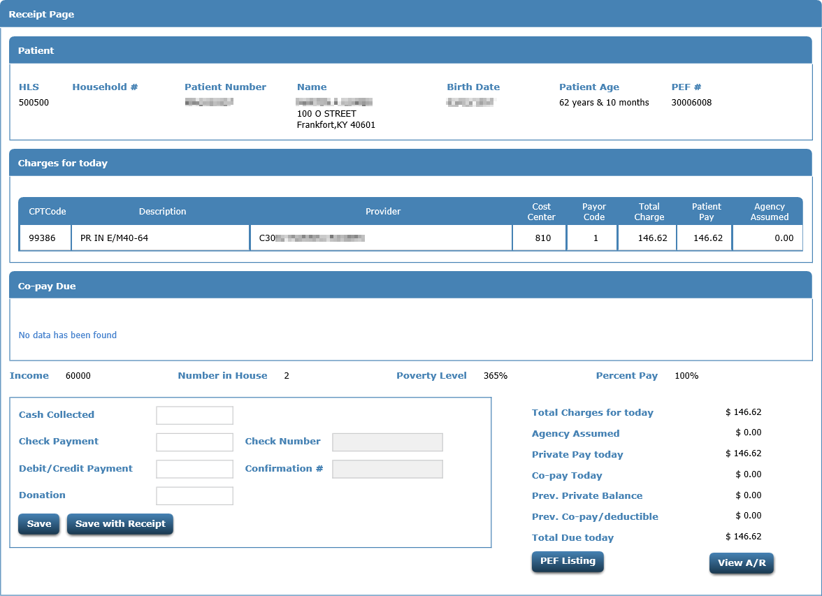
Receipt page will be returned

Slide 11
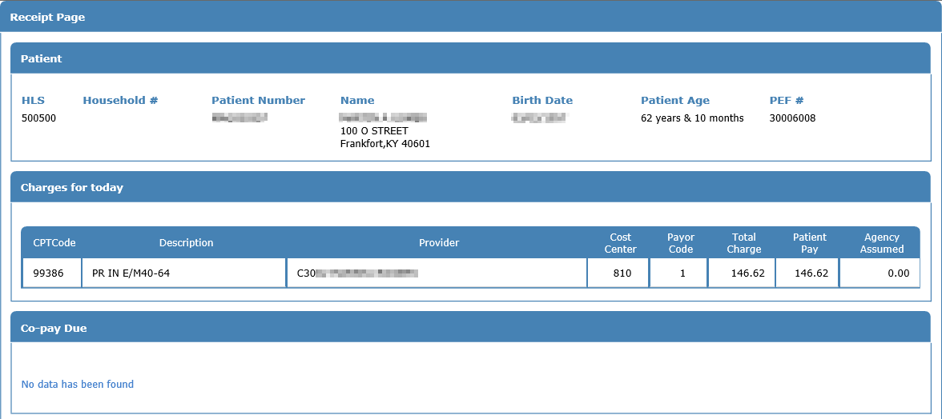
Top of the page will show patient info, charges for today and if any co-pay is due.

Slide 12
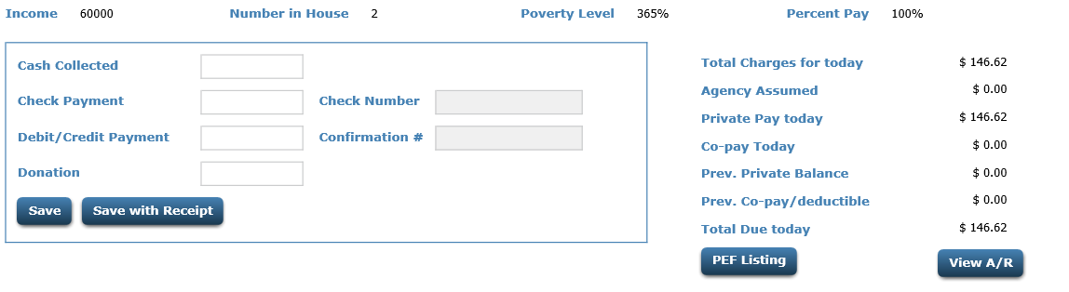
At the bottom you will see total charges, agency assumed, previous balance and total due today.

Slide 13
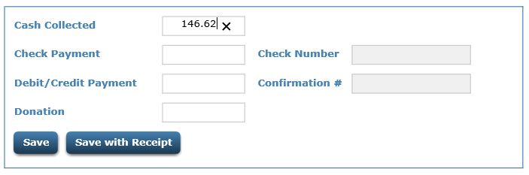
Cash, check, credit card, or donation information can be captured.
The Save button will save and post the payment.
The Save with Receipt will save and post the payment and produce a receipt.
Any money collected will be posted immediately.

Slide 14
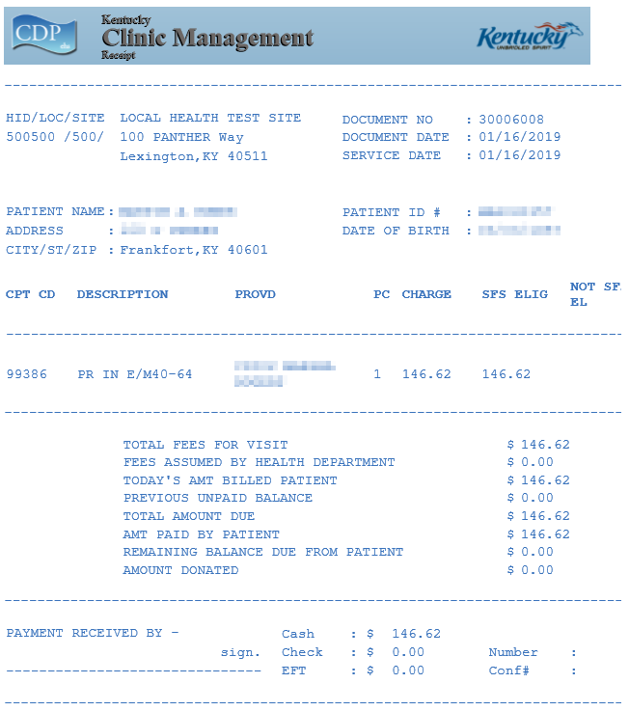
Receipt

Slide 15
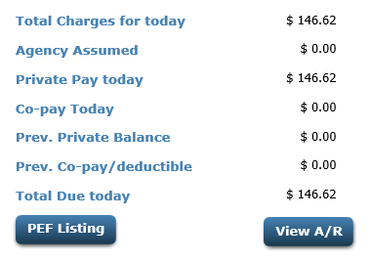
Totals for today along with previous portal balances are shown.
The PEF Listing button will return you to the listing of the patient’s PEFs.
The View A/R button will take you to the patient’s accounts receivables page.

Slide 16
Accounts Receivable
Viewing/Editing patient’s AR invoices

Slide 17
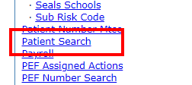
Click Patient Search

Slide 18
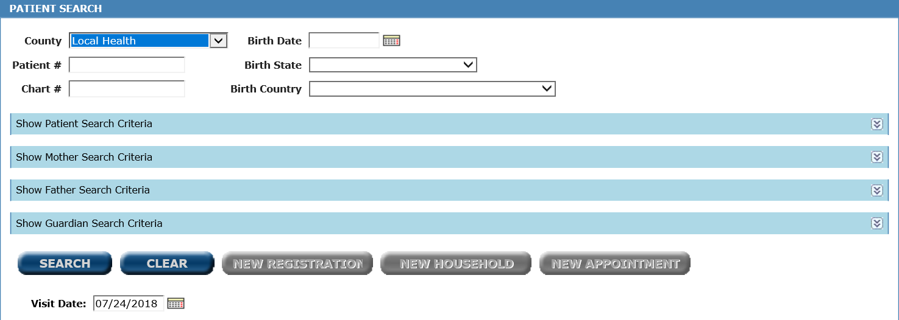
Search for your patient

Slide 19
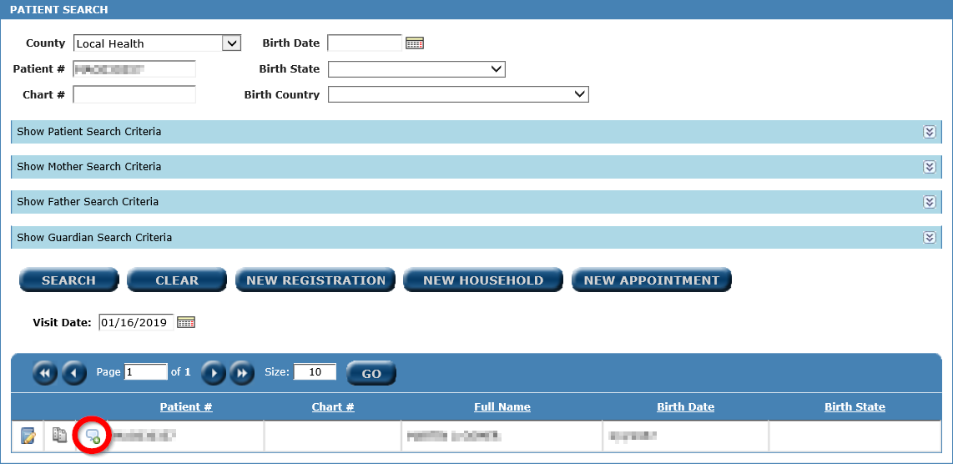
Once found, click the Patient Menu icon.

Slide 20
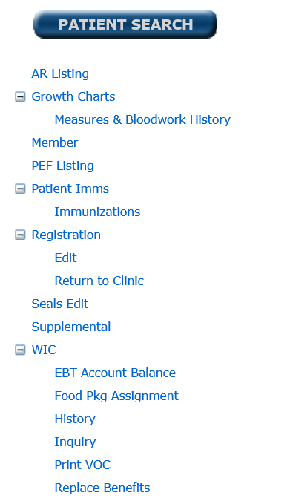
From the Patient Menu, click AR Listing

Slide 21
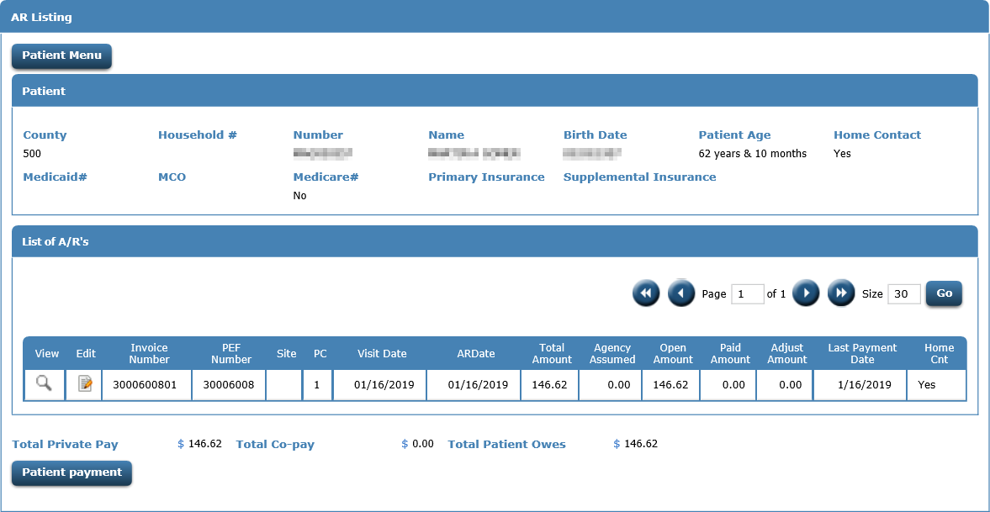
A screen returns showing all AR invoices for the patient.

Slide 22
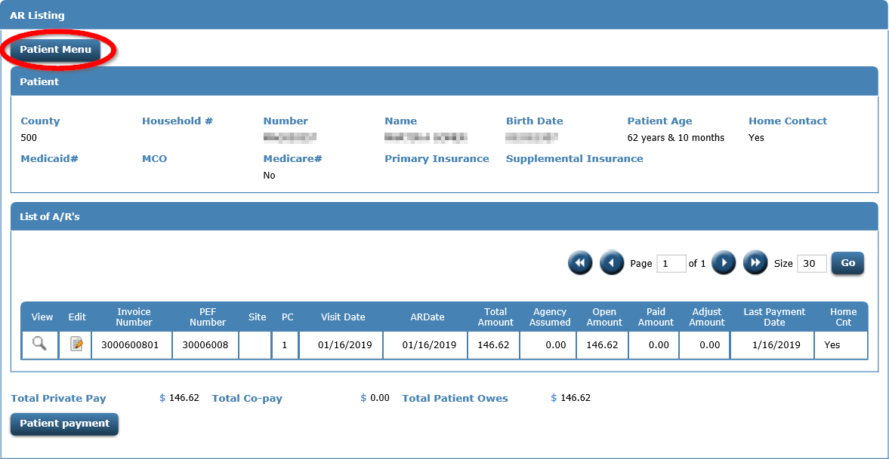
A Patient Menu button at top of page will take you back to the patient menu.

Slide 23
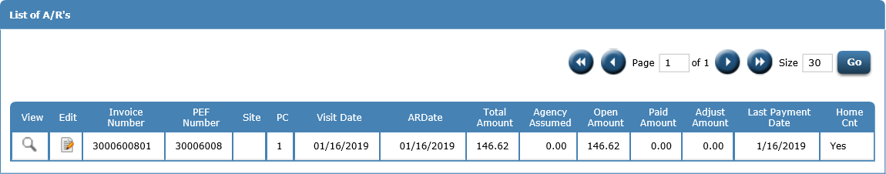
The List of A/Rs section will show the existing invoices and details.

Slide 24

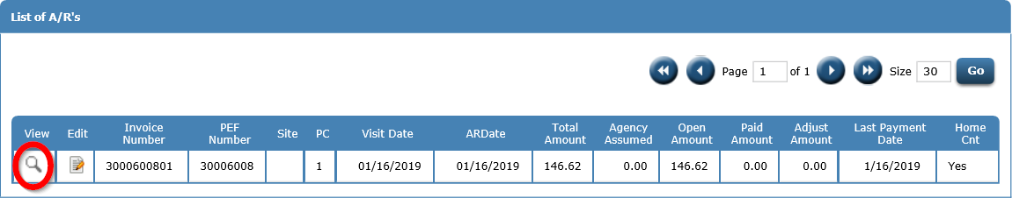
To view AR details, click the

Slide 25
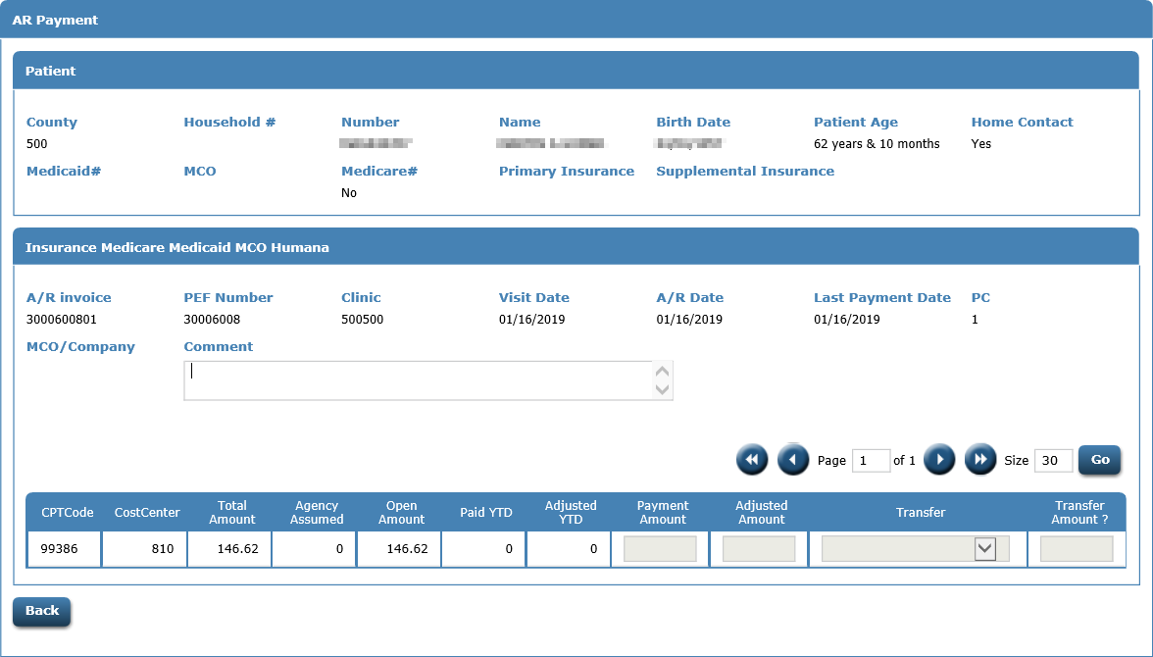
AR Invoice view

Slide 26
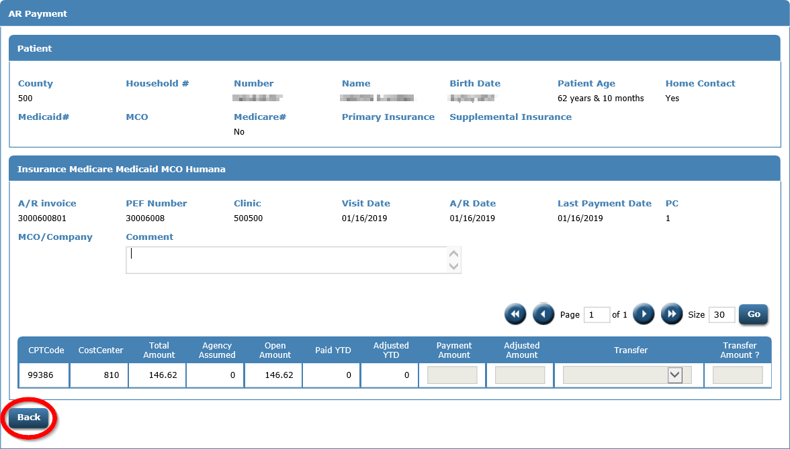
The Back button will return you to the AR listing

Slide 27

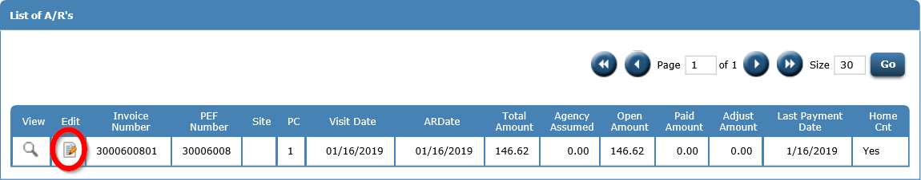
To edit an invoice, click the

Slide 28
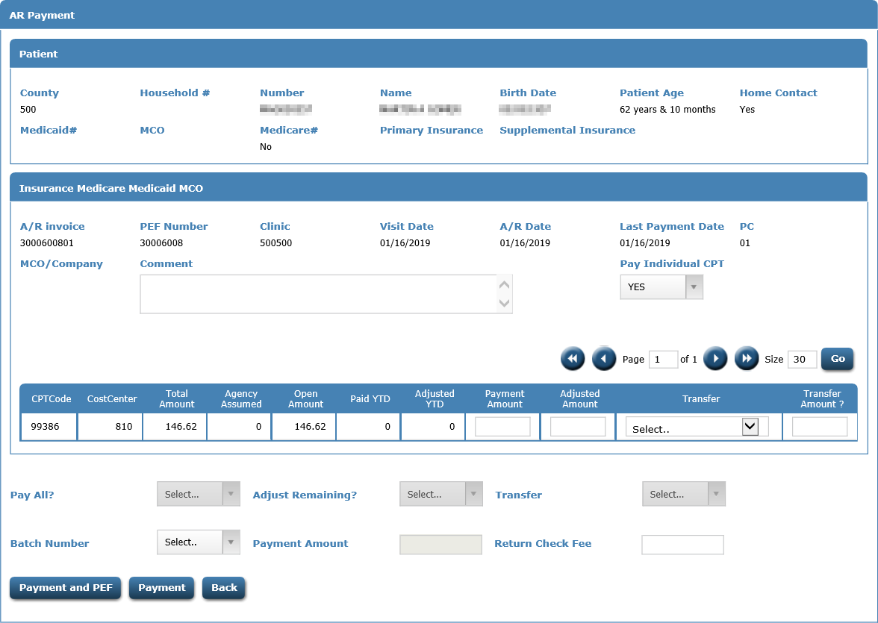
AR Invoice edit

Slide 29
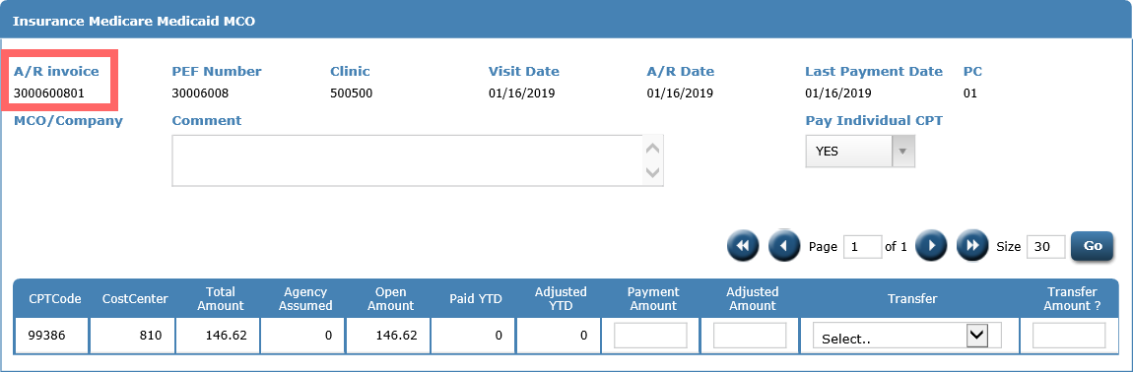
AR Invoice number is now the PEF number + payor code
PEF # 30006008, PC = 01
AR invoice = 3000600801

Slide 30
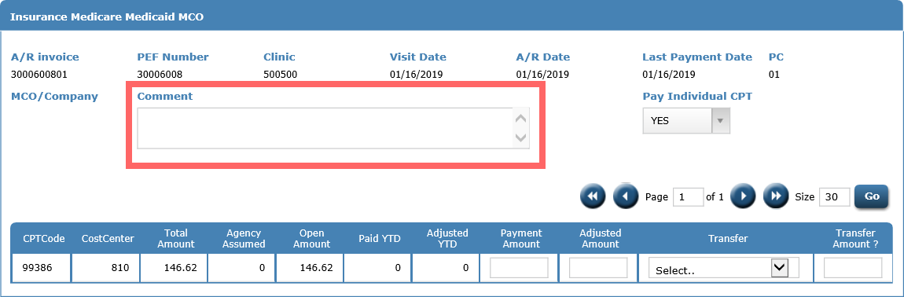
Comment can now be captured

Slide 31

Posting money by CPT code

Slide 32
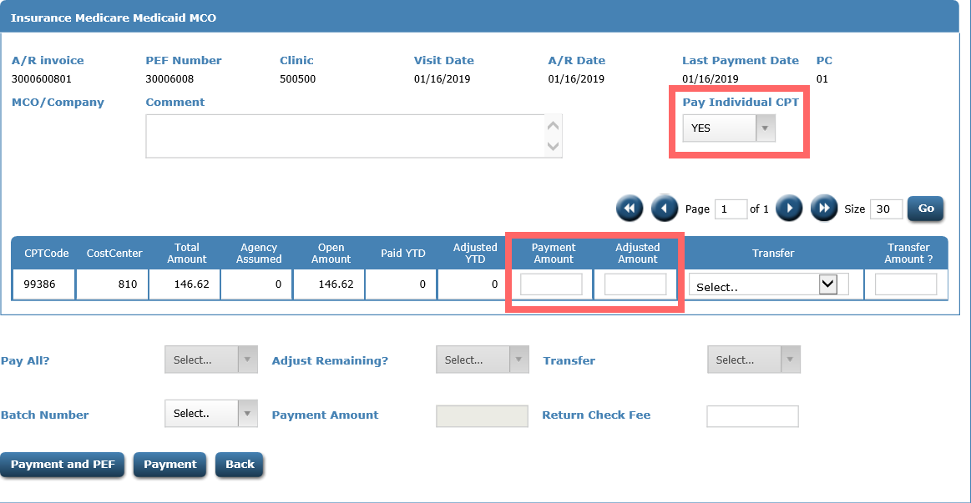
Pay Individual CPT set to YES, will allow money to be posted to the CPT code. Enter Payment Amount and Adjusted Amount if any.

Slide 33
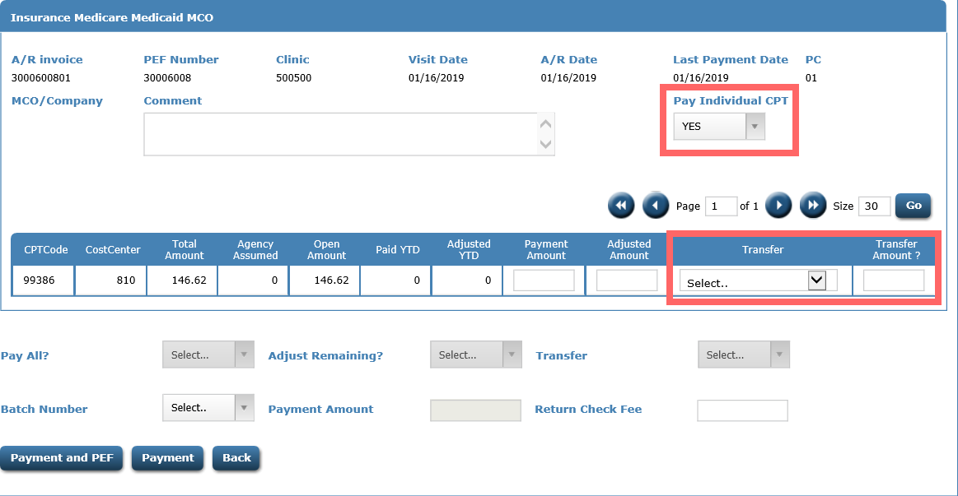
Adjusted amounts can now be transferred to a new invoice and payor, if needed. Multiple CPT codes can be adjusted and transferred at the same time.

Slide 34
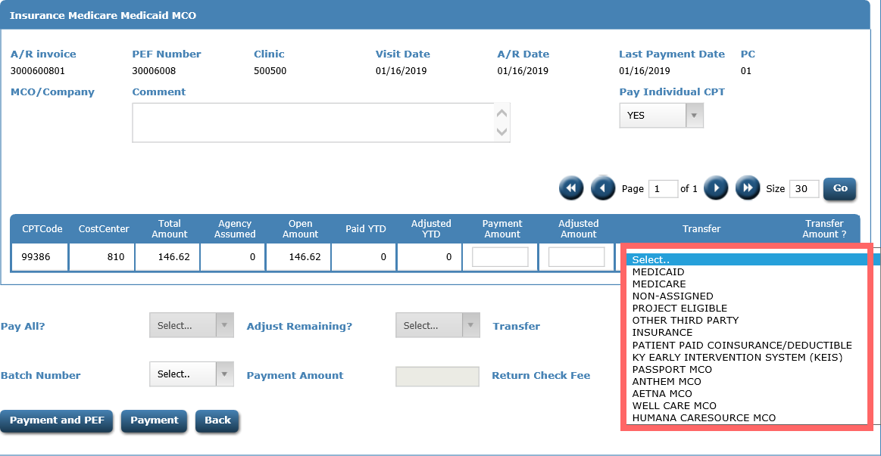
To transfer an amount, first click the drop down and select the payor to transfer too.

Slide 35
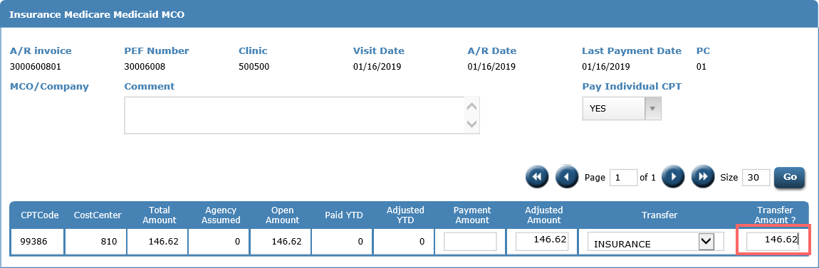
Next, enter the Transfer Amount. When the payment information is saved, the new invoice will be created. The invoice you are transferring from, will not automatically adjust off. You will adjust off if it should be cleared.

Slide 36
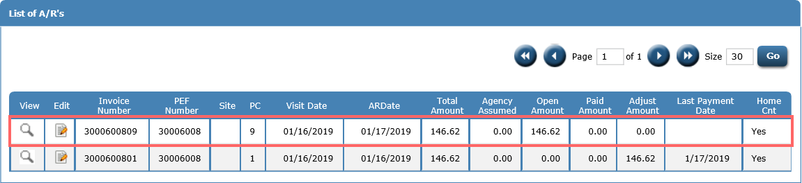
After saving, if we go back to the List of ARs, we see the new invoice transferred to Insurance. This function will not change the encounter or bill the claim.

Slide 37

Posting money by Invoice

Slide 38
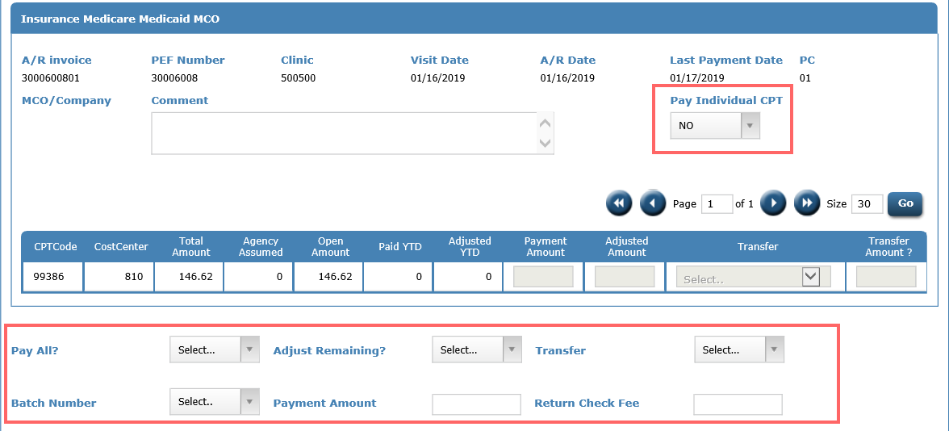
Pay Individual CPT set to NO, will post money at the invoice level. Payment/adjustments posted will be spread across all CPT codes with a non-zero open amount.

Slide 39
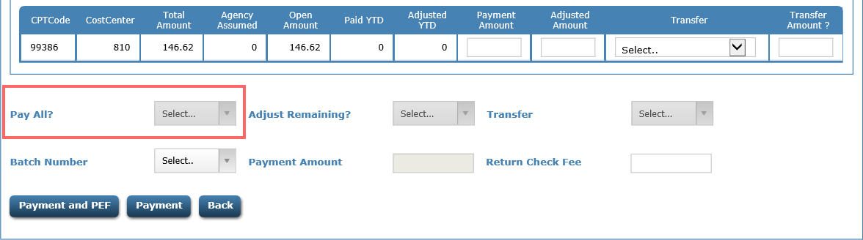
Pay All? YES or NO
Yes, when paying the remaining open amount.
No, when paying a portion of open amount. You will use this option if adjusting the remaining open amount.

Slide 40
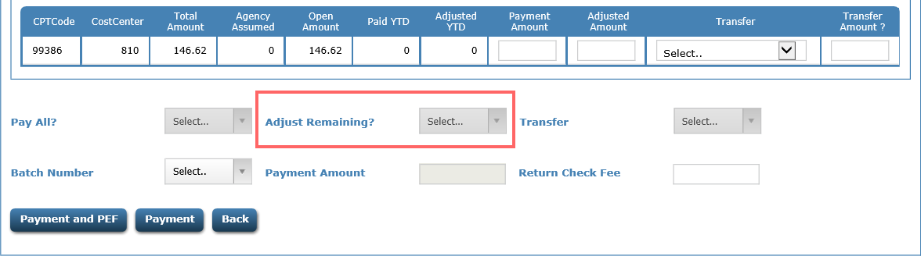
Adjust Remaining? YES or NO
Yes, any remaining balance will be adjusted to zero. You will use this option if transferring remaining balance to another payor code.
No, any remaining balance will NOT be adjusted to zero.

Slide 41
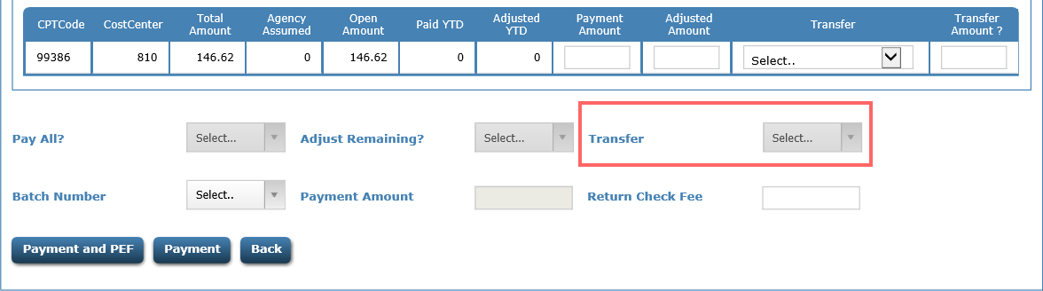
Transfer, provides a drop-down list of other payer sources. The amount adjusted will be used to set up a new AR invoice to the payer source selected and the amount adjusted.

Slide 42
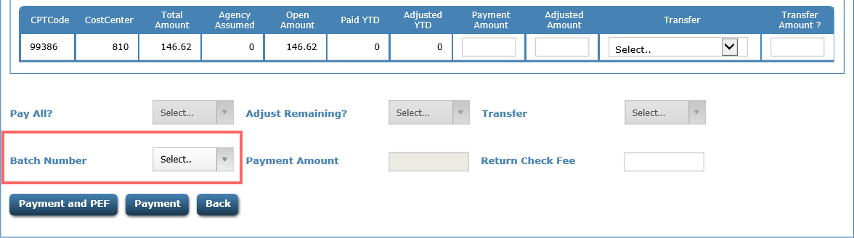
Batch Number – If posting using batch numbers, you will select your batch number from the drop down. Batch numbers are not required to post or adjust open amounts.

Slide 43
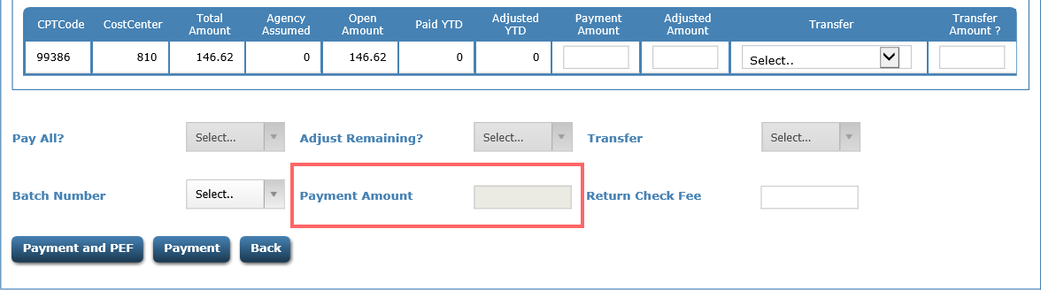
Payment Amount – The amount you are paying to this invoice. If Pay All is set to yes, this amount must be equal to the total open amount.

Slide 44
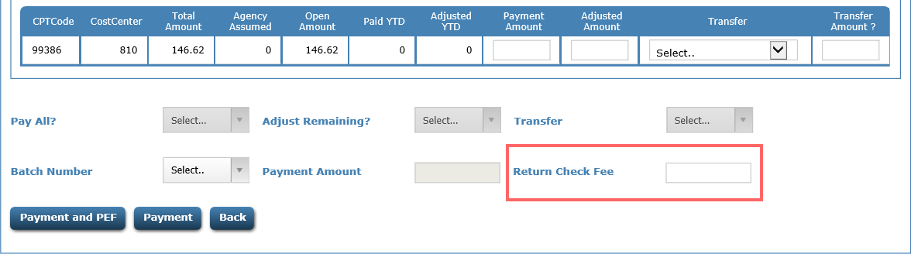
Return Check Fee – If a check is returned for insufficient funds, this field will allow you to add the fee your clinic charges to the invoice.

Slide 45
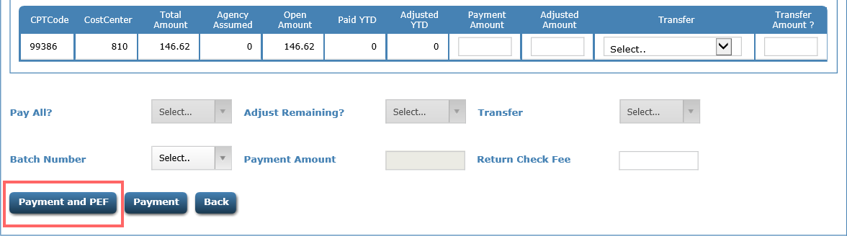
Payment and PEF – This button will post your payment and take you to the PEF listing page.

Slide 46
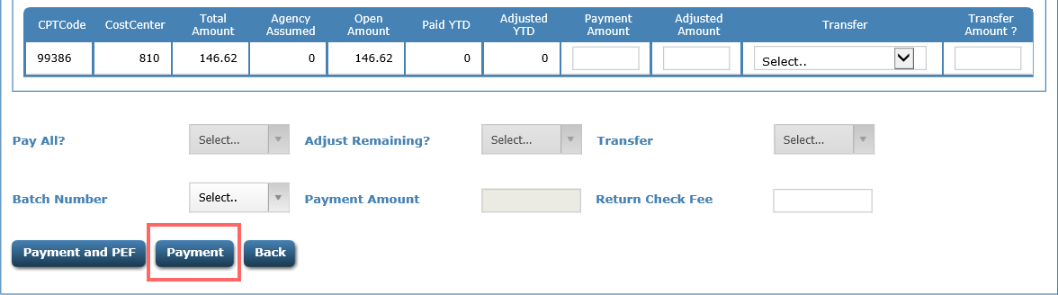
Payment – This button will post your payment and take you to the AR listing page.

Slide 47
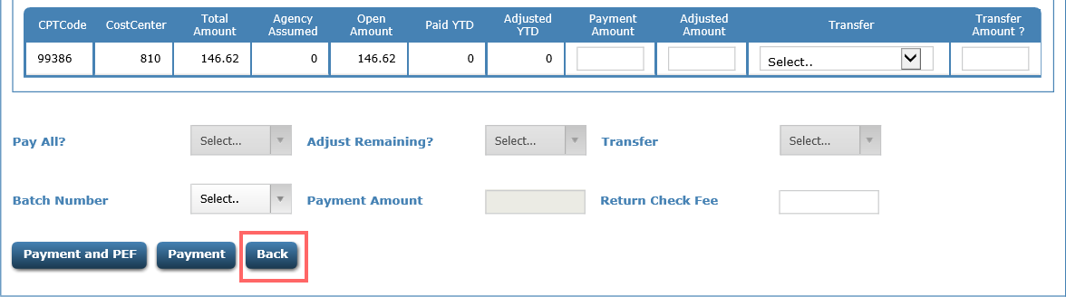
Back – This button return you to the AR listing. It will not post any payments or adjustments if they have been entered on the page.

Slide 48
Accounts Receivable
Building a new batches

Slide 49
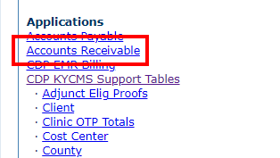
Click Accounts Receivable

Slide 50
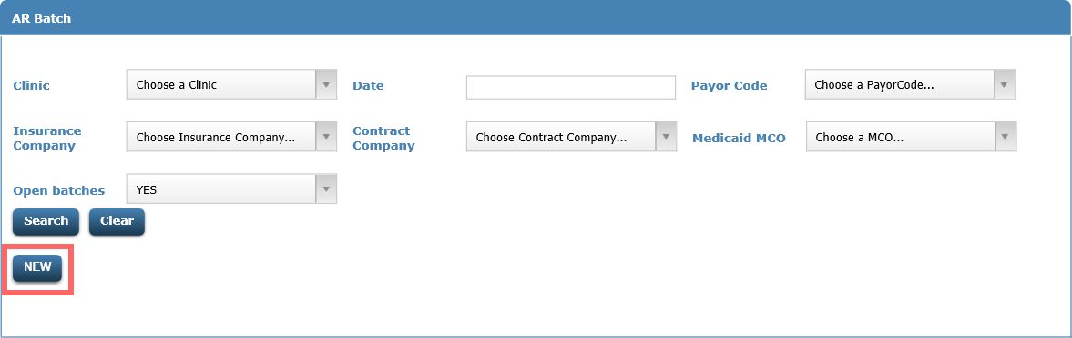
Click New

Slide 51
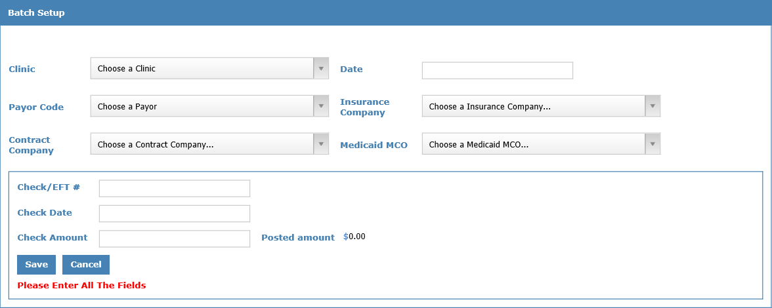
Batch Setup page

Slide 52
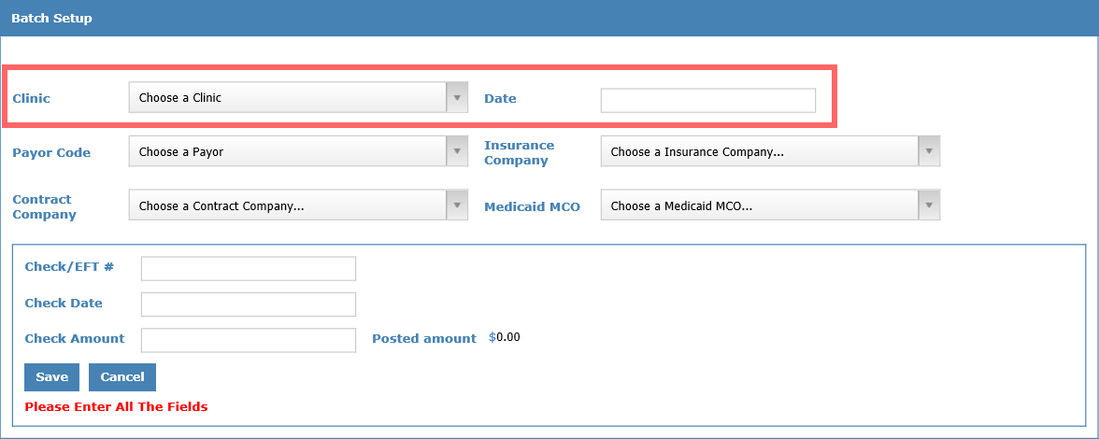
Clinic – use drop down to select
Date – click field and select date from calendar.

Slide 53
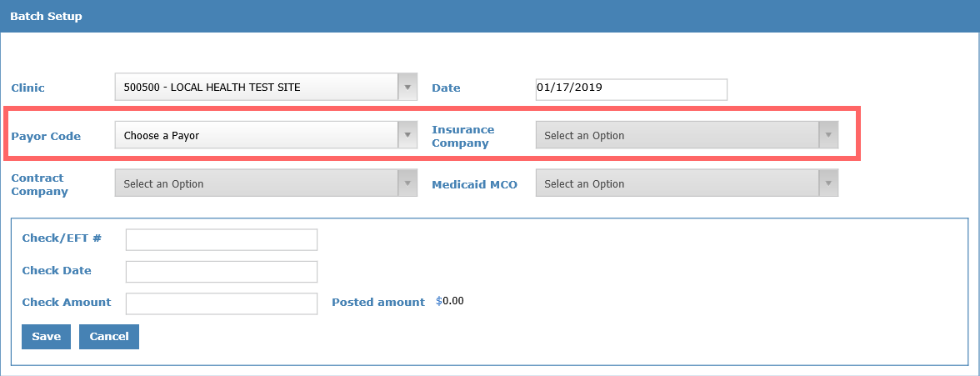
Payor Code – select from the drop down
Insurance Company – select from drop down. Can only be entered if payor code is Insurance.

Slide 54
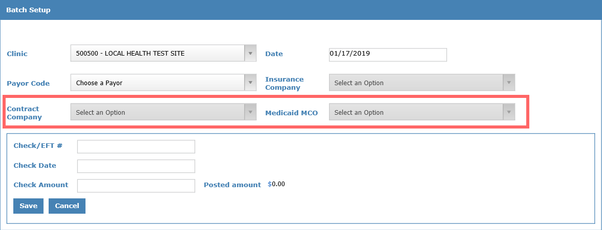
Contract Company – select from the drop down. Can only be entered if payor code is Contract.
Medicaid MCO – select from drop down. Can only be entered if payor code is Medicaid or Medicaid MCO.

Slide 55
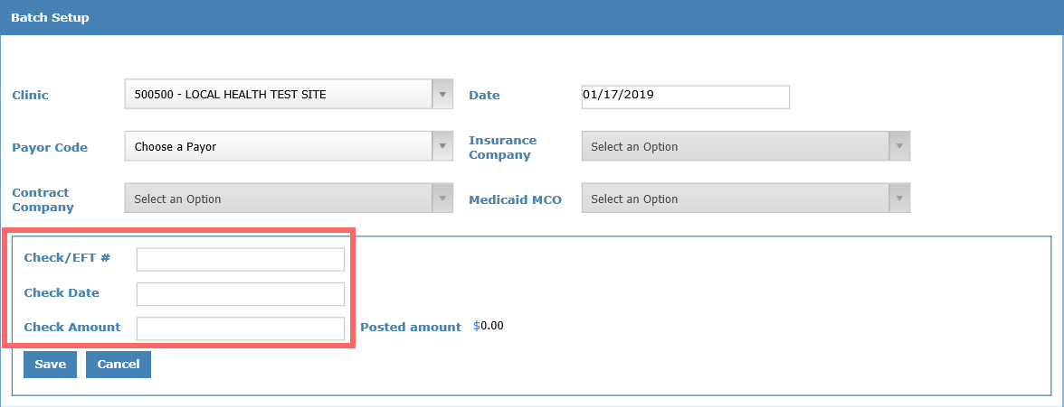
Check/EFT# – enter the check or EFT number you are posting.
Check Date – click the field and enter the date from the calendar drop down.
Check Amount – the amount of the check or EFT.

Slide 56
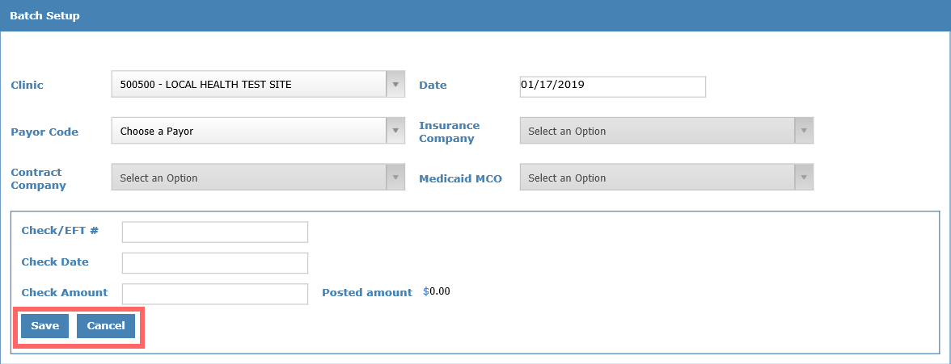
Save – will save the batch information and return you to the AR batch search page.
Cancel – will not save the batch information and return you to the AR batch search page.

Slide 57
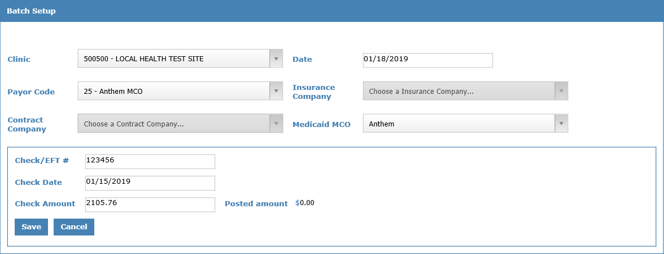
Batch Setup

Slide 58
Accounts Receivable
Searching for a batch

Slide 59
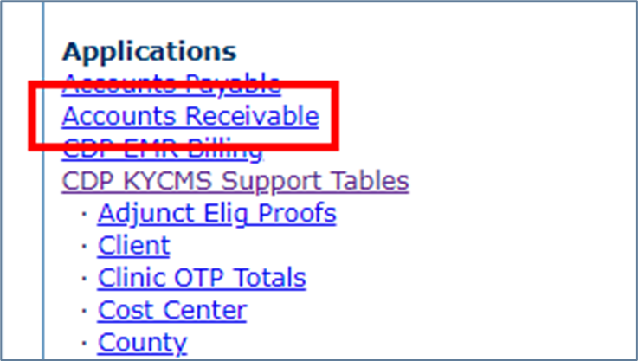
Click Accounts Receivable

Slide 60
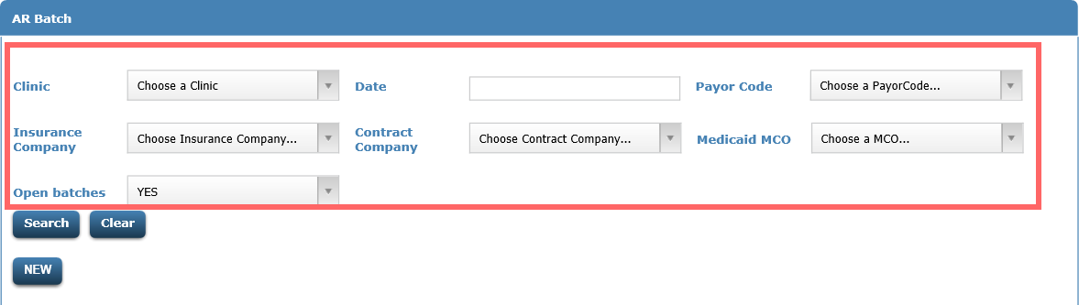
To search for a batch, fill in search filters. The more you enter, the more it will narrow your results.

Slide 61

Once filters are set, click Search to find desired batch or Clear to start your search over.

Slide 62

If you search, a list of batches matching your filters will be returned.

Slide 63


To edit the batch details, click

Slide 64


To delete the batch, click

Slide 65


To post to the batch, click

Slide 66

The Batch AR Pat Search allows you to search for patient’s invoices to post money. Also shows if money has been posted to the batch.

Slide 67

If search filters are left blank and you search, it will return all invoices posted to, from this batch.

Slide 68

You see the two invoice that make up the $40 that was posted.

Slide 69

You can use the search to locate other invoice that you need to post money.

Slide 70

Enter search filters and click search.

Slide 71

Invoices matching search will be added to the list.

Slide 72

To post to the invoice, click

Slide 73

You will enter your payment as you learned in previous slides

Slide 74

If you use the search filters, you will then click Post Payment/Next Patient. This will post the payment and take you to the search results.

Slide 75

To return to the batch search page after entering payment info, click Post Payment/Batch.

Slide 76
Any Questions????
Contact CDP Customer Support
1-866-237-4814
customersupport@cdpehs.com

