Slide 1

FRYSC Advisory Council Module(s)
Module 1: The Role of the Coordinator on the FRYSC Advisory Council.
Module 2: Your Role as an Advisory Council Member.
Division of Family Resources and Youth Services Centers

Slide 2

Module 1: The Role of the Coordinator on the FRYSC Advisory Council
Audience: FRYSC Coordinators
Goal: Reorient coordinators with council basics while also including ways to improve the council’s effectiveness and engagement.
Topics Covered:
Purpose and role of the council
Council functions and responsibilities
Operational basics
Prichard Committee’s 6 Principles of Effective Engagement
Council membership and recruitment
Building & Sustaining Effective Councils
Use of Data and Needs Assessment
Division of Family Resources and Youth Services Centers

Slide 3
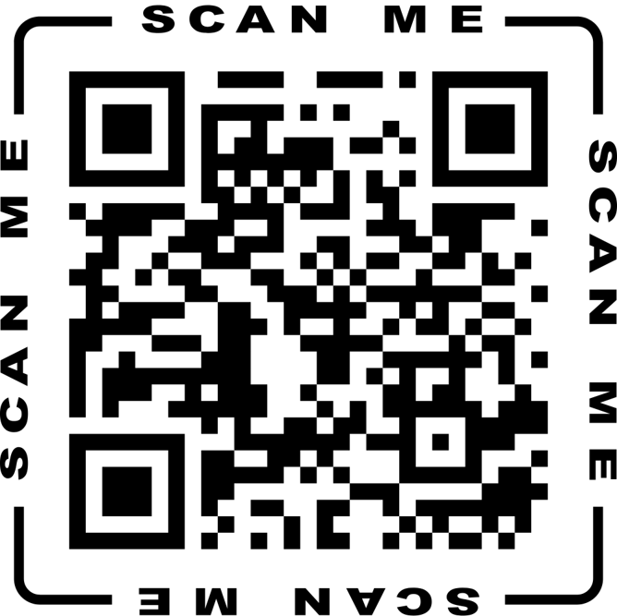
Please Complete the Pre-Test for Module 1
AC Module Pre-Test: The Role of the Coordinator on the FRYSC Advisory Council
Division of Family Resources and Youth Services Centers

Slide 4
Module 1 Video: The Role of the Coordinator on the FRYSC Advisory Council
The Role of the Coordinator on the FRYSC Advisory Council YouTube Video
Division of Family Resources and Youth Services Centers

Slide 5

Please Complete the Post-Test for Module 1
AC Module Post-Test: The Role of the Coordinator on the FRYSC Advisory Council
Division of Family Resources and Youth Services Centers

Slide 6

Module 2: Your Role as an Advisory Council Member
Audience: FRYSC AC members
It is recommended that the council view this together at a meeting. It is also a useful introductory tool for new members.
Goal: Tool to inform and set the tone for Advisory Council members; can also be used to orient new members.
Topics Covered:
FRYSC Mission and Vision
5 Keys to Effective Advisory Councils:
  The Players: Advisory Council Makeup
  Continuous Quality Improvement
  Advisory Council Responsibilities
  Advisory Council Bylaws
  Best Practices
The Standards of Quality for Family Strengthening and Support
Division of Family Resources and Youth Services Centers

Slide 7

Please Complete the Pre-Test for Module 2
AC Module Pre-Test: Your Role as an Advisory Council Member
Division of Family Resources and Youth Services Centers

Slide 8
Module 2 Video: Your Role as an Advisory Council Member
Your Role as an Advisory Council Member YouTube Video
Division of Family Resources and Youth Services Centers

Slide 9
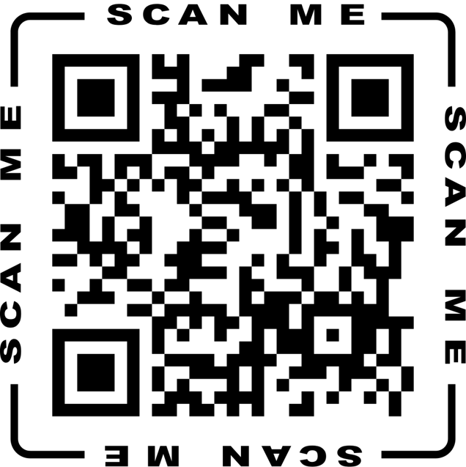
Please Complete the Post-Test for Module 2
AC Module Post-Test: Your Role as an Advisory Council Member
Division of Family Resources and Youth Services Centers

