Slide 1

SIS Assessment Overview
October 2025

Slide 2
Setting the Foundation- Use of Supports Intensity Scale (SIS) & Health Risk Screening Tool (HRST) Assessment Tools
Forming a successful person-centered service plan (PCSP) requires thoughtful planning and collaboration between the participant and his/her person-centered planning team.
The Supports Intensity Scare (SIS) and the Health Risk Screening Tool (HRST) assessments are essecial tools for gathering important information and insight prior to the person-centered service plan team meeting.

Slide 3
Supports Intensity Scale (SIS) Assessment

Slide 4
What SIS Measures
SIS measures the difference
Individual Being Assessed:
Expectations
Responsibilities
Involvement in the activity
Standard of a Typical Adult:
Expectations
Responsibilities
Involvement in the activity
Type of Support
Frequency of Support
Daily Support Time
Proprietary Information of AAIDD
American Association on Intellectual and Developmental Disabilities

Slide 5
Benefits of Focusing on Support Needs
The planning process shifts from fixing or changing the person to identifying or designing supports that enable the person to participate in his/her community.
The SIS focus is to ensure a diverse range of major life domains are considered in the planning process, thus decreasing the likelihood that an important facet of a person’s life (i.e. employment) is overlooked.
Home living, community living, lifelong learning activities
Employment activities, health and safety activities
Social activities, protection and advocacy activities
Medical supports and behavior supports
Additionally, critical supports related to exceptional medical & behavioral support needs are addressed.
Notes:
Team members commit to meeting as often as necessary instead one-shot annual meeting
Focus is on person’s capacity
Intended to promote & enhance self-determination
Future oriented & outcomes focused
Emphasizes community inclusion & integration

Slide 6
SIS Assessment Responsibilities

Slide 7
Case Management Supervisors
Train new Case Managers in the Case Management role for SIS.
Serve as contact or back-up contact for scheduling SIS assessments.
Troubleshoot scheduling, as needed.
Encourage Case Management attendance and participation in the SIS assessment.
Set positive tone/attitude regarding the SIS assessment.

Slide 8
Case Management Supervisors: Train
CM Supervisors will carry the torch for training new CMs who are onboarding, and for providing ongoing support for existing CMs.
Agency specific training regarding SIS assessments and its use with the Person-Centered Service plan can be requested from your SIS assessor, Quality Administrator, or other DDID staff.

Slide 9
Case Management Supervisors: Set the Tone
Leaders set the tone/culture of the agency.
Expect and encourage CMs to attend the SIS assessments.
Expect and encourage CMs to devote their attention to the assessment, whether they are a respondent or an observer.
Lead by example with positive attitude about SIS assessments and explain why it is worthwhile.

Slide 10
Roles and Responsibilities of Case Managers
Coordinate & schedule meetings
Support team members
Help team members understand the purpose and utilization of the SIS
Interpret/qualify responses
Use the SIS assessment to help team members develop outcomes in the person-centered planning process.
Follow-up and monitor the person-centered service plan
Distribute SIS report to team members who cannot access MWMA

Slide 11
SIS Process: Case Manager Role
Scheduling:
Provide a timely response to SIS assessor calls/emails.
Assist individuals to identify the best respondents.
Coordinate with the family/guardian, as applicable.
NOTE: CM should document the invitation to the family/guardian in the monthly summary note.
Coordinate with other respondents
Secure location

Slide 12
SIS Process: Case Manager Role
Identify SIS as a top priority!
During scheduling, be as flexible with the assessor as you can.
Once appointments are scheduled, cancellation should be used only in an unforeseeable emergency.
Prepare the individual for what to expect during the SIS.
Prepare respondents for their role in the SIS.

Slide 13
SIS Process: Case Manager Role
During the appointment, the CM may be a respondent, if qualified, or may be an observer.
The SIS assessment is an opportunity to provide advocacy for the individual.
Please be attentive during the appointment-no texting, checking emails, etc. Ask for a break if you need to return a call or check a message.
The SIS report is available via MWMA.
Each objective on the PCSP should be matched to 305 SIS questions that demonstrate the support need.
If you have questions, or need assistance, contact a SIS assessor, or Debra Hall at debra.hall@ky.gov.

Slide 14
SIS Process: Case Manager Role
Please let the SIS Assessor know in advance:
How the person communicates
Any sensitive topics for the individual
If any accommodations are needed.

Slide 15
What will an interview be like?

Slide 16
Interviewing Rules:
Complete all items even if the life activity is not applicable to the individual.
Complete items based on the supports that would be necessary for the individual with disabilities to be successful in each activity.
To determine appropriate ratings, include at least two respondents who know the individual.
If a person uses assistive devises, then rate them in place.
*AAIDD-American Association on Intellectual Disabilities

Slide 17
The interview may include:
The interviewer
The Individual
Case Manager
Guardians, significant others, or family members
Staff who provide supports in the home (which is very helpful to have)
Staff who provide support during the day

Slide 18
SIS Interview Participants
An invitee is called a “respondent” and is any person designated to answer questions about the support needs of the individual.
Respondents need to have known the person for at least 3 months.
Respondents need to have observed the person in one or more environments for substantial periods of time.
Respondents should be prepared to provide responses that accurately reflect the support need.

Slide 19
Using the SIS to Develop Individualized, Person-Centered Support Plans
Component 1:
Identify Desired Life Experiences and Goals
Component 2:
Determine the Pattern and Intensity of Support Needs
Use SIS results and information from person-centered planning to prioritize preference and identify supports needed.
Identify the support sources that are needed as well as those that are currently used.
Write an individualized plan that specifies the pattern and types of supports needed to participate in specific settings & activities.
Extent to which desired life experiences & goals are being realized.
Extent to which desired life experiences & goals remain relevant.
Extent to which individualized plan was implemented.
Evaluation of Person-Centered Service Plan
(Return to Components 1 & 2 as needed)

Slide 20
Component 1: Identify Desired Life Experiences and Goals
It is essential that a person’s current daily activities and environments be compared with what the person prefers or considers desirable everyday experiences and situations.
Achieve through information interviewing…self-assessment…
Notes:
Respect for the individual to assure that he/she remains in control of process
Participation of team of friends/supporters that recognize dreams/goals
A role for people in addition to professionals
Primary emphasis on community resources
Creation of strategies for achieving life experiences desired by the person

Slide 21
Component 2: Determine the Pattern & Intensity of Support Needs
For purposes of person-centered planning, SIS will be scheduled about 3 months prior to LOC end date.
Information from the SIS can be used in conjunction with person-centered planning to guide a team in development of an individualized plan to achieve the person’s desired goals.

Slide 22
Component 2: Determine the Pattern & Intensity of Support Needs
For example, a person may not need a lot of support getting into the community but may need extensive support in socializing appropriately while in the community. As you can see, this helps the coordinator isolate the actual areas of need(s) thus resulting in more effective, life impacting plans.

Slide 23
Component 3: Develop the Person-Centered Service Plan
Use SIS results and information from person-centered planning to prioritize preferences and identify supports needed.
Identify the support sources that are needed as well as those that are currently used.
Write person-centered service plan that specifies the pattern and types of supports needed to participate in specific settings and activities.

Slide 24
Component 4: Monitor Progress
Extent to which desired life experiences & goals are being realized
Extent to which desired life experiences & goals remain relevant
Extent to which Person-Centered Service Plan was implemented
Evaluation of Individualized Plan
(Return to components 1 & 2)

Slide 25
Plan is completed when team has identified:
Individual’s interest & preferences
Needed support areas & activities
The settings the person is most likely to be in
The specific support functions that will address the identified support needs
Natural supports available to the person
Valued personal outcomes
Mechanism to monitor the provision & effectiveness of supports provided.

Slide 26
Scoring
The overall score shows how the individual’s support needs compare to the sample group of people with developmental disabilities
The score in each section informs quality of life considerations.
Recognizes the support to address for medical and behavioral needs
-AAIDD American Association on Intellectual & Developmental Disabilities

Slide 27
How Scores Support Person-Centered Services
For each service requested on the PCSP, the Case Manager should identify 3-5 SIS questions that justify the need for the service.
Ask yourself why the person needs the service-what exactly will the service provide for the person? Why can the person not do the activity without the service?

Slide 28
How Scores Support Person-Centered Services
Skill training?
General supervision related to safety needs?
Support to successfully interact with others in an integrated setting?
Exceptional Medical Support Needs?
Safety concerns due to Exceptional Behavioral Support Needs?
Other specific supports?

Slide 29
How Scores Support Person-Centered Services
Then ask – what SIS questions show this need for support?
Support needs may come from Section 1 (any domain), Section 2, or Section 3. Think about how the requested service meets the support need.
Support needs in Health and Safety, and Social Settings domains often cross into every area of life.

Slide 30
How Do I Match SIS Questions to Support Needs?
During the assessment, think about areas of support that are discussed and take notes.
The SIS profile form lists each question in summary format for reference.
Ask SIS assessors and trainers for help as needed!

Slide 31
I Found the Questions - Now What?
The CM and team should consider the services requested in the context of the SIS scores.
Determine the questions that show the support need.
Review the scores on those questions to see what picture of support needs those scores reflect.

Slide 32
Determining Best Fit of Services
Are the services (type, frequency, and amount of time) on the PCSP the best fit for the individual?
Are there other services that would better match the individual’s support needs?
If so, consult with the individual and family/guardian (as applicable) to consider changing the request.
Notes:
Encourage CMs to consider the various new services in the new waiver and work with the individual and family to determine what would best meet the individual’s needs. Encourage CMs to not simply continue to request the services that were on the last plan. There are many new opportunities that should be explored.

Slide 33
Submit the Plan
Once the best fit of services is on the PCSP with 3-5 SIS questions listed to support each service, the plan can be submitted in MWMA.

Slide 34
Example
Linda is in her early 50s. She receives Case Management, Residential Level I (Staffed Residence), and Day Training supports.

Slide 35
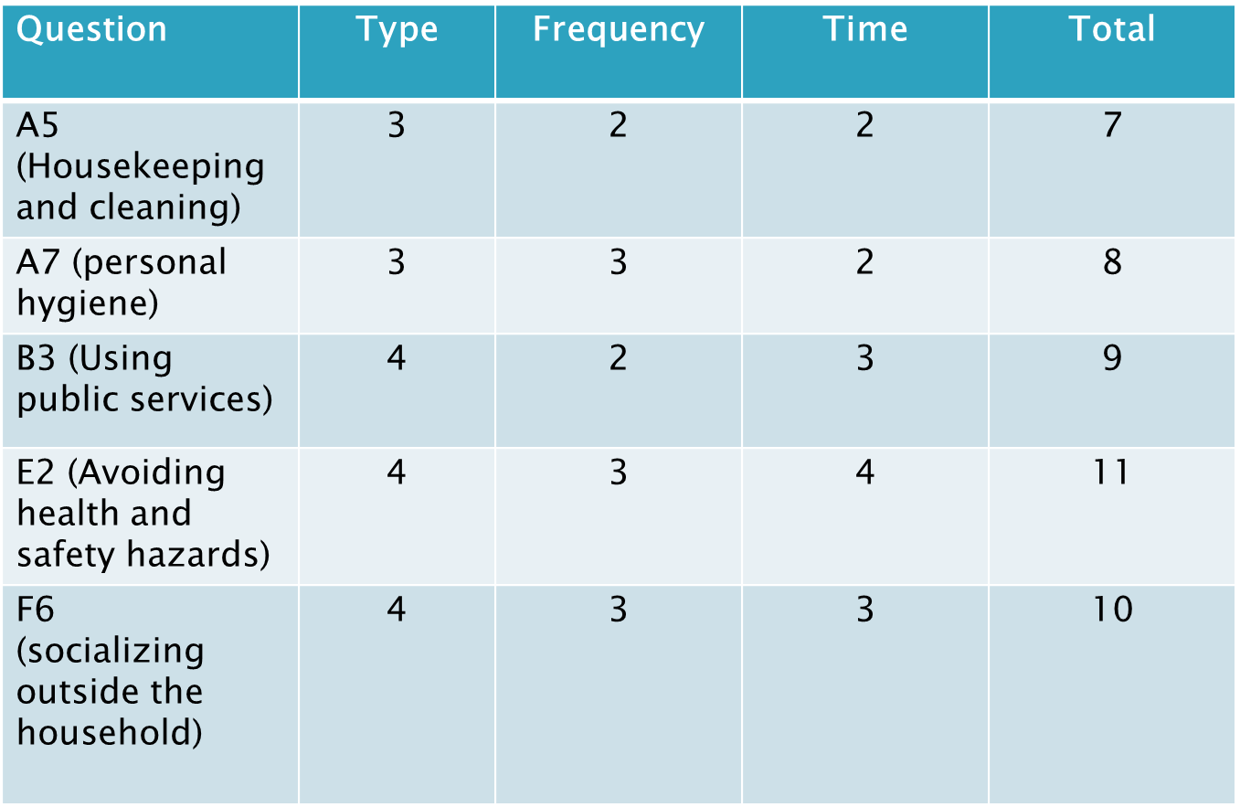
Scores on Supporting Questions

Slide 36
Scores from SIS Assessment
A: Home Living 75
B: Community Living 63
C: Lifelong Learning 84
D: Employment 63
E: Health and Safety 84
F: Social 50
SECTION 3
Medical: Score of 3, red flag due to 2 score on Lifting
Behavior: Score of 3, red flag due to 2 score on emotional outbursts

Slide 37
What Do the Scores Tell Us?
Linda requires physical assistance in several areas.
Linda’s support needs are highest in Lifelong Learning, Health and Safety, and Home Living activities.
The red flag triggers in Section 3 tell us that Linda may require more supports than someone else with similar numerical scores.

Slide 38
What Do the Scores Tell Us?
Linda’s request for 24 hour per day supports in staffed residence are appropriate based on her overall support need, and specific needs in home living, community living, health and safety, and social domains.
Linda’s request for Day Training is appropriate based on her overall support need, and specific needs in community living, health and safety, social, and lifelong learning domains.

Slide 39
Match the Questions to Objectives
Objective: Linda will play exercise games on the Wii.
SIS questions: E7, E4, E8
Objective: Linda will play board games, work puzzles, or other activities with housemates daily.
SIS questions: F6, F2, F1

Slide 40
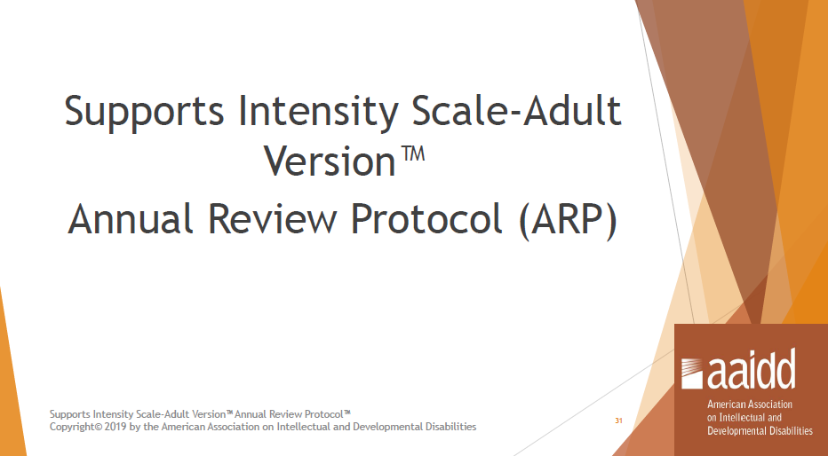

Slide 41
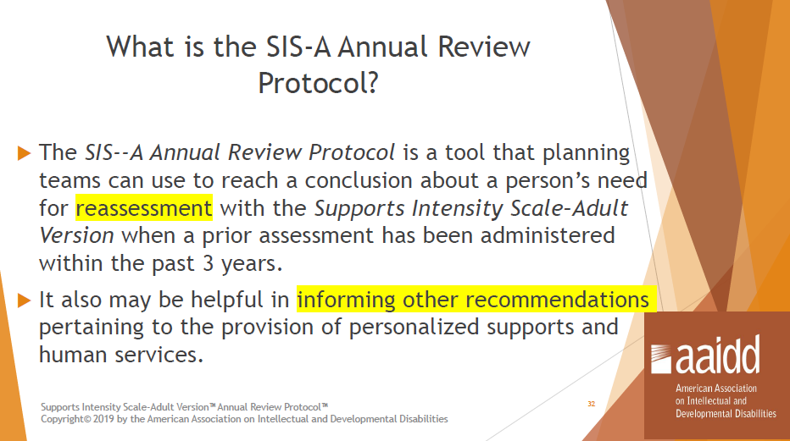

Slide 42
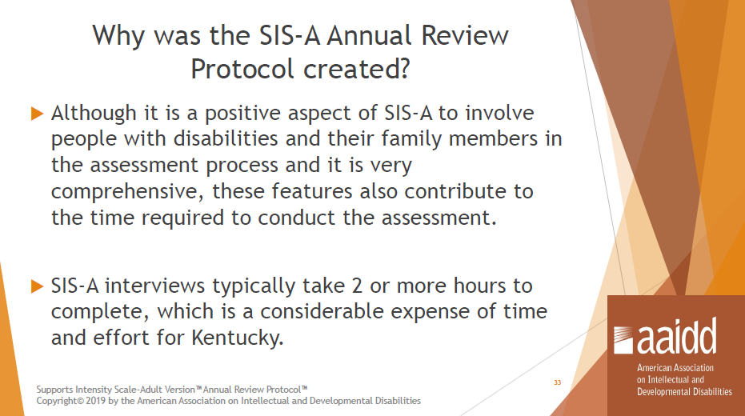

Slide 43
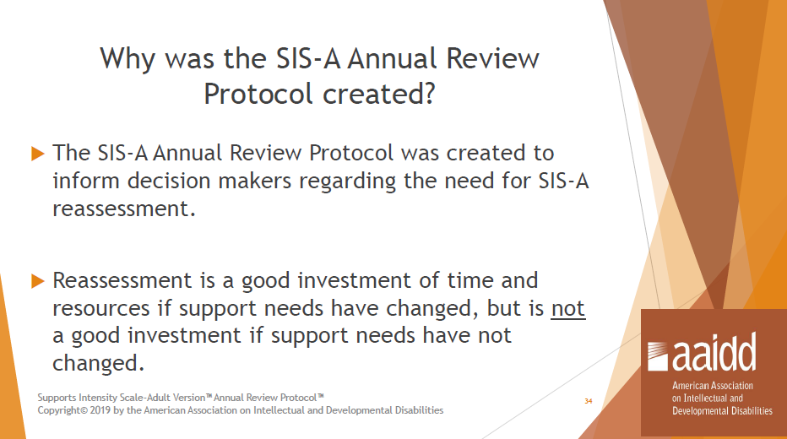

Slide 44
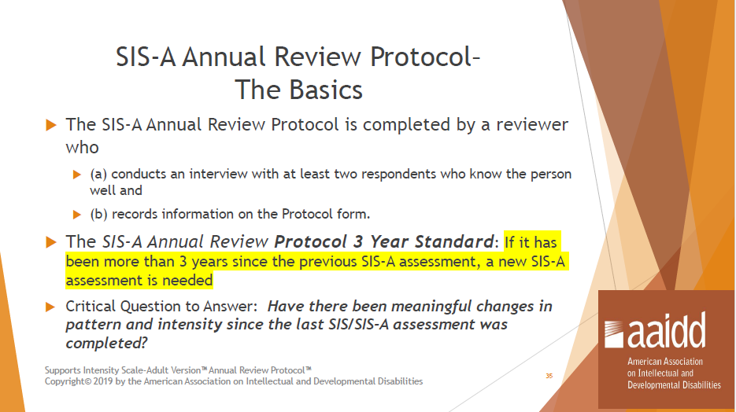

Slide 45
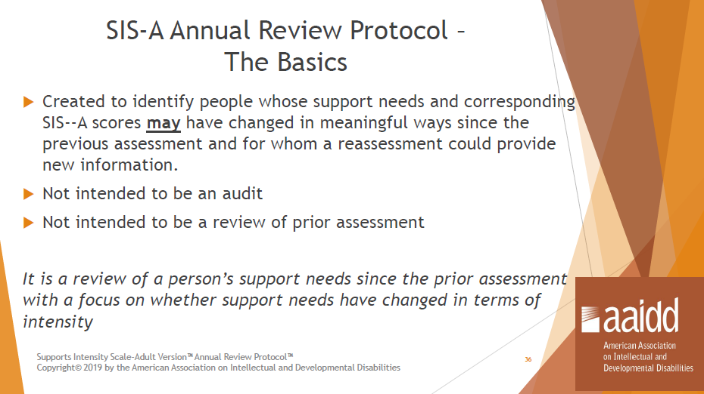

Slide 46
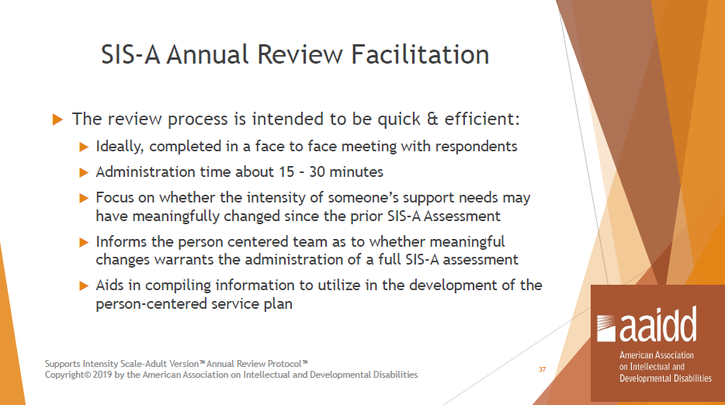

Slide 47
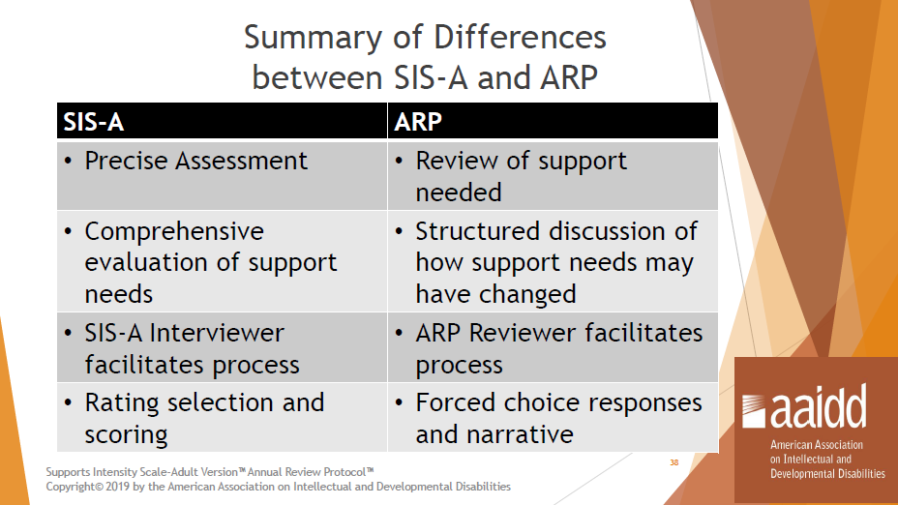

Slide 48
Where to Find the SIS-ARP
Copies of the SIS-A: Annual Review Protocol can be found here: https://dbhdid.ky.gov/ddid/clinical

Slide 49
Resources
DDID Staff will be happy to work with you as you seek to identify specific SIS questions that will support each service request. Please feel free to contact any of the following staff for assistance:
DDID Quality Administrator
DDID SIS Contact: Debbie Hall, MSSW, CSW debra.hall@ky.gov
AAIDD American Association on Intellectual & Developmental Disabilities: www.AAIDD.org
https://dbhdid.ky.gov/ddid/clinical

