Slide 1
PERSONAL CARE HOME DIRECT CARE STAFF TRAINING
ACTIVITES OF DAILY LIVING AND INSTRUMENTAL ACTIVITIES OF DAILY LIVING

Slide 2
INTRODUCTION
In this module you will learn about:
What serious mental illness (SMI) is;
SMI recovery;
What ADLs and IADLs are and why they are important;
Adult learning principles;
Ways that you can help a resident with everyday activities while supporting his or independence and helping the resident keep a sense of self-respect; and
908 KAR 2:065, and the process for community transition for individuals with SMI.
Notes:
The purpose of this module is to train personal care home direct care staff about what mental illness is and how to be an active participant in a resident’s recovery process.
Part of that recovery process may require providing assistance with activities of daily living and instrumental activities of daily living.
Helping a resident with everyday activities while supporting his or her independence allows the resident to keep a sense of self-respect and prepare for the process of transitioning from a personal care home, or other institutional setting, back into the community.

Slide 3
What is Serious Mental Illness (SMI)?
Serious mental illness is defined as a mental, behavioral, or emotional disorder resulting in serious functional impairment, which substantially interferes with or limits one or more major life activities.
Some serious mental illnesses, such as schizophrenia and schizoaffective disorder, produce delusions, unusual behaviors, distortions of perception, or disorganized thinking.
Other types of SMI, such as bipolar disorder, anxiety disorder and major depression, can impact energy level, ability to concentrate, and sleep patterns.
Notes:
Mental illness does not discriminate between age, race and socio-economic status.
In a given year, approximately 1 in 5 adults will experience mental illness nationally.
Living with a mental illness may affect areas of life including, but not limited to:
1. Physical health;
2. Getting or maintain steady employment;
3. Relationships with family members and friends;
4. Maintaining housing; and
5. Spirituality.
Mental illness is defined as a mental, behavioral, or emotional disorder resulting in serious functional impairment which substantially interferes with or limits one or more major life activities.
Serious mental illness, such as schizophrenia and schizoaffective disorder, can produce delusions, distortions of perception, disorganized thinking, or unusual behaviors.
Other types of serious mental illness, such as bipolar disorder, can impact energy level, ability to concentrate, and sleep patterns.

Slide 4
What does recovery mean for someone living with SMI?
Recovery is a process of change through which individuals improve their health and wellness, live a self-directed life, and strive to reach their full potential.
People with mental illness frequently state that recovery is a journey characterized by a growing sense of independence as well as greater participation in normal daily activities, such as employment, education, and community life.
Recovery can be enhanced by various evidence-based services, such as supported employment, as well as by clinical approaches, such as shared decision-making and peer support.
Notes:
Recovery is a process of change through which individuals improve their health and wellness, live a self-directed life, and strive to reach their full potential.
People in recovery often describe mental illness as a journey of growing independence and greater participation in normal daily activities, including employment, education, and community life.
Various evidence-based services and clinical approaches, including supported employment and shared decision-making, have been proven to enhance recovery.
Four major dimensions support a life in recovery:
Healthy choices that support emotional and physical well-being;
A stable and safe place in which to live;
Engagement in meaningful activities each day, such as a job or school; and
Building relationships and supportive social networks.
Individuals struggling with mental illness often benefit from a written recovery plan containing the following:
Identified goals for achieving wellness;
Specific activities, both daily and long-term, that can be done to help achieve those goals;
Any changes in mental health status; and
Identified triggers or other stressful events.
Most people with serious mental illness can get better with the help of treatment and recovery.

Slide 5
Key Points to Recovery
Mental health “recovery” refers to the process whereby people with severe mental illness progress to live independent, contributing, and satisfying lives in the community, even with persistent symptoms.
A key goal is to encourage recovery by providing support services to individuals with serious mental illness who are transitioning from institutional settings to community-integrated programs.
These programs are most successful when provided in preparation to transition (in the PCH) as well as after transition through on-going support services provided out in the community.
Working with residents to help them achieve their goals, including skills necessary for independent living, creates the best atmosphere for success.
Notes:
Recovery refers to the process whereby people with SMI progress to live independent, contributing and satisfying lives in the community, even with persistent symptoms.
Recovery is enhanced through support services to individuals with SMI who are transitioning from institutional settings to community-integrated living and treatment programs.
These programs are most beneficial when provided in preparation for transition as well as following transition through community-based treatment programs.
Most people diagnosed with a mental health condition can experience relief from their symptoms and live a satisfying life by actively participating in an individualized treatment plan.
A balanced diet, exercise, and sleep can also play a key role in mental health recovery.
Meaningful social opportunities also contribute to overall wellness and mental health recovery.

Slide 6
Living Independently
Individuals with serious mental illness can live independent and satisfying lives in the community, even with continuing symptoms, and there are services available to help support them.
An individual with SMI may be eligible for state-funded services such as housing assistance, supported employment, and behavioral health services if the resident:
1. Lives in a personal care home;
2. Wants to live in permanent housing in the community; and
3. Is eligible for Medicaid.
908 KAR 2:065 provides more information about the transition to independent living and services that are available.
As a direct care provider, you play an important role in helping residents of the personal care home learn and practice important skills necessary for independence.
The purpose of this training is to provide personal care home direct care providers with the skills needed to effectively assist residents with learning those skills whether they want to continue to live in the PCH or transition to independent living.
Notes:
Individuals with severe mental illness can live independent and satisfying lives in the community, even with continuing symptoms, and there are services in place to help support them. The state has a system in place to identify and support people with SMI who need help transitioning to independent living.
An individual with SMI may be eligible for state-funded services such as housing assistance, supported employment, and behavioral health services if the resident:
Lives in a personal care home;
Wants to live in permanent housing in the community; and
Is eligible for Medicaid.
The state regulation, 908 KAR 2:065, talks about the various types of services that are available to individuals with SMI who live in personal care homes but who would like to transition to living independently in the community. The services include:
Treatment, rehabilitation, and support services from the area ACT teams;
Case management;
Crisis services;
Peer support services; or
Supported employment services.
These services are provided as part of a plan developed by behavioral health professionals after identifying the individual’s unique strengths and needs.
908 KAR 2:065 provides more information about the transition to independent living and services that are available and we will talk more about that regulation and the ways that you can help and support an individual with SMI who wants to transition to independent living later in this training.

Slide 7
What are ADLs?
This stands for Activities of Daily Living. These are the most basic activities necessary for daily life. They include, but are not limited to, the following:
Eating and drinking;
Grooming;
Dressing; and
Bathing or showering.
Notes:
Activities of Daily Living are the most basic activities necessary for daily life.
For each ADL, a person can vary from needing just a little help (such as a reminder or “stand-by assist”) to full dependency, which requires others to do the task for them.
A person’s ability to remain independent depends upon their ability to perform ADLs.
Once someone begins to need help with some of the basic ADLs, it could mean that they are no longer safe to remain independent.
Providing instruction with basic ADLs will help a person regain their independence so that they can transition out of a personal care home or other institution, and into community integrated living.

Slide 8
What are IADLs?
This stands for Instrumental Activities of Daily Living. These activities are more complex and include, but are not limited to, activities such as:
Shopping;
Cooking;
Doing laundry;
Doing housework; and
Managing transportation.
Notes:
Instrumental Activities of Daily Living are different from ADLs in that the basic essential functions of survival are not threatened.
IADLs are activities that are not necessary for survival but do aid a person in living life to the fullest.
IADLs are the things that help an individual flourish as a person in the community, and be completely self-reliant in his or her care and health.

Slide 9
What is the importance of ADLs and IADLs?
ADLs and IADLs represent key life tasks that people need to manage in order to live at home and be fully independent.
Difficulties with performing ADLs and IADLs affect how much help, supervision, and hands-on care a person needs.
The ability to perform ADLs and IADLs can determine when someone is considered “safe” to live independently.
For each ADL or IADL, people can vary from needing just a little help (such as a reminder) to full dependency, which requires others to do the task for them.
Generally, adults need to be able to manage ADLs and IADLs in order to live independently without the assistance of another person.
Even if an individual chooses to reside in a personal care home or other congregate living setting, learning to manage ADLs and IADLs is still important to personal success and happiness.
Notes:
ADLs and IADLs represent key life tasks that people need to manage in order to live at home and be fully independent.
Difficulties with performing ADLs and IADLs affect how much help, supervision, and hands-on care a person needs.
The ability to perform ADLs and IADLs can determine when someone is considered “safe” to live independently.
Generally, adults need to be able to manage ADLs and IADLs in order to live independently without the assistance of another person.
Even if an individual chooses to reside in a personal care home or other congregate living setting, learning to manage ADLs and IADLs is still important to personal success and happiness.
What someone needs to be able to do to live or function on their own can vary from person to person.
A person’s physical and cognitive abilities can fluctuate from one day to the next or decline incrementally over time.
Because of this, ADLs and IADLs should be looked at periodically to spot any changes in function and verify that living and care arrangements are still appropriate.

Slide 10
What causes changes in ADLs and IADLs?
Many things can cause a change in a resident’s ability to perform these basic activities.
Difficulties with ADLs and IADLs can be caused by physical and mental health problems.
People who have lived in an institution, such as a hospital, personal care home, or prison, for an extended period of time may need to learn or relearn certain skills in order to safely transition back into the community.
Notes:
Many things can cause a change in a resident’s ability to perform these basic activities.
Difficulties with ADLs and IADLs can be caused by physical and mental health problems.
People who have lived in an institution, such as a hospital, personal care home, or prison, for an extended period of time may need to learn or relearn certain skills in order to safely transition back into the community.

Slide 11
Three basic things to know about changes in ADLs and IADLs
Some residents have been unable to perform some activities for quite some time and have had longer to adjust.
Other residents have experienced a recent loss of ability and may still be learning how they can best receive help.
Finally, some will be experiencing a temporary loss in their mental or physical abilities from which they will eventually recover.
Notes:
Changes in ADLs and IADLs can be gradual or sudden.
It is likely that some of the residents with whom you work will have experienced loss in the way their brain functions.
This loss may leave them unable to solve problems, remember important information, or make them unaware of what is taking place around them.
Your patience and understanding are critical elements of being a caring worker.

Slide 12
Why is helping residents with everyday activities so important?
The more ADLs and IADLs a person masters, the more independently they can live.
People who have difficulty performing ADLs and IADLs may feel frustrated, helpless, or vulnerable.
If the residents you serve have these kinds of feelings about everyday activities, you can be sure that the quality of their lives will not be as high as it could be.
This is important because a major part of what you do as a personal care home direct care staff person is aimed at helping people maintain or improve the quality of their lives.
Notes:
The more ADLs and IADLs a person masters, the more independently they can live.
People who have difficulty performing ADLs and IADLs may feel frustrated, helpless, or vulnerable.
To assist with ADLs and IADLs, caregivers need knowledge, skills and patience.
The following are general tips that can be followed when helping residents with ADLs and IADLs:
Establish a routine. For example, brush teeth after meals, or schedule baths for the mornings or evenings.
Respect privacy. Close doors and blinds. Cover the person with a towel or bathrobe.
Encourage independence as much as possible. This will help to promote a sense of accomplishment.
Keep the individual’s abilities in mind. Allow enough time for the individual to complete each task.
Give encouragement and support as he or she completes tasks, and acknowledge his or her efforts when completed.
Tell the person what you are doing.
Break down all grooming tasks into simple, step-by-step instructions.

Slide 13
General Helping Rules
1. When you are unsure about preferences or if help is needed, ask.
Sometimes you will observe a resident struggling with a task or you may not be sure of the resident’s needs or preferences.
While your immediate impulse might be to simply start helping, it is better to ask first.
Notes:
When you are unsure about preferences or if help is needed, ask.
Sometimes you will observe a resident struggling with a task or you may not be sure of the resident’s needs or preferences.
While your immediate impulse might be to simply start helping, it is better to ask first.
If you have a resident who doesn’t understand or cannot respond to your questions, try to find out preferences from family members or others who know about the resident’s preferences.

Slide 14
General Helping Rules (continued)
Try to use a “person-centered” approach.
A “person-centered” approach involves respecting and honoring the uniqueness of each person and respecting that person’s right to be involved in all decisions that impact his or her life.
These include the little decisions about how ADLs and IADLs are accomplished with your help.
Notes:
Try to use a “person-centered” approach.
A “person-centered” approach involves respecting and honoring the uniqueness of each person and respecting that person’s right to be involved in all decisions that impact his or her life.
These include the little decisions about how ADLs and IADLs are accomplished with your help.
Person-Centered Care incorporates the following principles:
Treat people with dignity, compassion, and respect.
a. You must always remember that residents have their own opinions, thoughts, feelings, beliefs, and values.
Provide coordinated care, support, and treatment.
a. Coordinate with other health and care workers so that the resident is not constantly having to rebuild an understanding
of their personal wants and needs.
Offer personalized care, support, and treatment.
a. Personalizing care to each resident allows them to retain some of their independence.
4. Involve patients in decision and help them take actions to support themselves.

Slide 15
General Helping Rules (continued)
If you believe a resident is in immediate danger, then move to help right away.
For example, if a resident has fallen asleep and is about to fall out of a chair, then move to help reposition him/her immediately.
It is not necessary to ask if help is needed in situations where the resident is in danger.
Notes:
If you believe a resident is in immediate danger, then move to help right away.
For example, if a resident has fallen asleep and is about to fall out of a chair, then move to help reposition him/her immediately.
It is not necessary to ask if help is needed in situations where the resident is in danger.

Slide 16
General Helping Rules (continued)
When working with an individual always be mindful of cultural diversity.
Avoid imposing your own values. Resist the urge to judge, and make a conscious effort to understand the other perspective. For example, in certain cultures it is acceptable to eat using your hands instead of utensils.
Learn what you can. Talking to members of another culture is a great way to increase your knowledge and overall acceptance. Cultural acceptance is not about changing others to be more like you, it is about exploring and honoring the differences of others.
Notes:
When working with an individual always be mindful of cultural diversity.
Avoid imposing your own values. Resist the urge to judge, and make a conscious effort to understand the other perspective. For example, in certain cultures it is acceptable to eat using your hands instead of utensils.
Learn what you can. Talking to members of another culture is a great way to increase your knowledge and overall acceptance. Cultural acceptance is not about changing others to be more like you, it is about exploring and honoring the differences of others.
By being mindful during exchanges with others, not only do you understand that there are differences, but you appreciate and welcome those differences.
Culturally mindful individuals recognize that there are differences in body language, tones of voice, ways of discussing topics and arriving at conclusions, and different ways of problem solving.

Slide 17
Examples of Differences in Cultural Norms
Mainstream American Culture | Other Cultures
Dress and Appearance: Wide range of accepted dress. A “dress for success” ideal. | Religious rules of dress. Dress often seen as a sign of wealth, prestige, or positions.
Food and Eating Habits: Fast food. Eating as necessity. | Religious rules for food and eating. Dining is often a social experience.
Values and Norms: Individual orientation, independence, and preference for direct confrontation during conflicts. | Group orientation, conformity, and preference for harmony.
Notes:
It can be very easy to stick with what you know, rather than trying to meet people who are different from you.
The main thing to remember is that everyone, no matter what their cultural background, has different opinions, habits and ways of life.
The sooner you accept that everyone is different, the easier it becomes to understand and embrace cultural differences.

Slide 18
Adult Learning Principles
Adults need to be involved in the planning and evaluation of their instruction.
Experience (including mistakes) provides the best basis for learning activities.
Adults are most interested in learning subjects that have immediate relevance.
Adult learning should be problem-centered.
Notes:
In 1968, Malcolm Shephard Knowles put forward a theory that distinguished adult learning from childhood learning.
Adults need to be involved in the planning and evaluation of their instruction.
Experience (including mistakes) provides the best basis for learning activities.
Adults are most interested in learning subjects that have immediate relevance.
Adult learning should be problem-centered.
Teaching adults often looks very different from teaching children because adults have had vastly different life experiences and come with their own unique sets of background knowledge.

Slide 19
Notable Facts and Tips About Adult
Learning Theory
Adults are internally motivated and self-directed.
Notes:
Adults should be actively involved in the learning process.
Adults should be given the opportunity to share their perspectives on the topics to be covered and allowed to work on projects that reflect their interests.
Adults should be given the freedom to assume responsibility for their own choices.
Keeping adults motivated to learn requires a tone that is friendly, open, and supportive.
It is critical to set the level of difficulty high enough to be challenging, but not so high that the resident becomes frustrated or overwhelmed.

Slide 20
Notable Facts and Tips About Adult
Learning Theory (continued)
Adults bring life experiences and knowledge to learning experiences.
Notes:
Encourage residents to connect past experiences with current knowledge and activities.
Encourage residents to share relevant experiences and knowledge.
Honoring the life experiences your residents bring to the learning experience is an important component of experiential learning.
It is important to tap into that wealth of wisdom whenever it is appropriate.

Slide 21
Notable Facts and Tips About Adult
Learning Theory (continued)
Adults are goal-oriented.
Notes:
Adults need to learn to solve real-life tasks or problems.
Adults need to see the relevance or real-world application of the task they are learning. How will this task benefit them in a real-life situation?
Adult learners are more likely to retain information they see as having meaning and/or purpose.

Slide 22
Notable Facts and Tips About Adult
Learning Theory (continued)
Adults are relevancy oriented.
Notes:
If it is clear that the activities in which they are engaged directly contribute to achieving a personal goal or objective, then residents will be inspired and motivated to engage in projects and successfully complete them.
Give real life scenarios so that the resident understands how this information can be used to their benefit in real-life situations outside of the institution.
Learning has to be applicable to their responsibilities to be of value to them.

Slide 23
Notable Facts and Tips About Adult
Learning Theory (continued)
Adults must have the freedom to learn in their own way.
Notes:
Adults may have different learning preferences which should be considered when providing instruction.
Visual learners prefer to be shown how to perform a task through watching someone else perform the task, or by viewing diagrams or illustrations.
Auditory learners listen carefully to all sounds associated with the task, including verbal instructions, sound of the instructor’s voice, and will actively participate in discussions.
Tactile learners need to physically do something to understand it.

Slide 24
Notable Facts and Tips About Adult
Learning Theory (continued)
Adult learning relies on readiness to learn.
Notes:
Listen carefully for teaching moments and take advantage of them.
When a resident says or does something that triggers a topic on your agenda, or if the topic comes up naturally during daily activities, be flexible and teach it right then.
Positivity, encouragement, and patience are important when providing instruction.
Recognize the contributions residents make, even when small.
Adult learners thrive in collaborative relationships with their educators.

Slide 25
Determining How Much Instruction
A Resident Needs
Using a person’s functioning level as it relates to Activities of Daily Living (ADLs) and Instrumental Activities of Daily Living (IADLs) can help with determining the level of assistance that person needs.
Residents can use the Self-Assessment worksheet attached to this presentation to evaluate their own ability to perform the ADLs and IADLs listed.
Once a resident has identified the ADLs and/or IADLs for which they need assistance, personal care home staff can provide the resident with additional instruction that is integrated into the normal rhythms of life.
Notes:
Using a person’s functioning level as it relates to Activities of Daily Living (ADLs) and Instrumental Activities of Daily Living (IADLs) can help with determining the level of assistance that person needs.
Residents can use the Self-Assessment worksheet attached to this presentation to evaluate their own ability to perform the ADLs and IADLs listed.
Once a resident has identified the ADLs and/or IADLs for which they need assistance, personal care home staff can provide the resident with additional instruction that is integrated into the normal rhythms of life.
“Normal rhythms of life” means that instead of setting aside organized instructional time, you can work with residents on ADLs and IADLs they need to learn when the task naturally needs to be performed during the course of the day. For example, by providing prompts or reminders to brush teeth in the evening before bed or to dress appropriately for the weather when getting dressed in the morning or leaving the personal care home for the day.

Slide 26
Self-Assessment of ADLs and IADLs
The “Self-Assessment of Activities of Daily Living (ADL)” and “Self-Assessment of Instrumental Activities of Daily Living (IADL)” worksheets provided with this module can be used by residents who desire to transition out of the PCH to indicate the areas in which they feel they need assistance.
Notes:
The supplemental handouts and worksheets accompanying this training module are examples.
The resident completes these self-assessments to indicate if help with ADLs or IADLs is desired, and if so, in which area(s) they would like to receive help.
PCH direct care staff should keep copies of these assessments in each transitioning resident’s chart for documentation and monitoring purposes.
Self re-assessments can be completed at any time at the resident’s request.

Slide 27
Topics to Cover in ADL Instruction
At a minimum, topics for ADL instruction should include:
Taking a shower
Personal grooming
Dressing
Eating and drinking
Toileting
Notes:
At a minimum, topics for ADL instruction should include:
Taking a shower
Personal grooming
Dressing
Eating and drinking
Toileting
Activities of daily living are both essential and routine aspects of self-care.
Inability to accomplish essential activities of daily living may lead to unsafe conditions and poor quality of life.

Slide 28
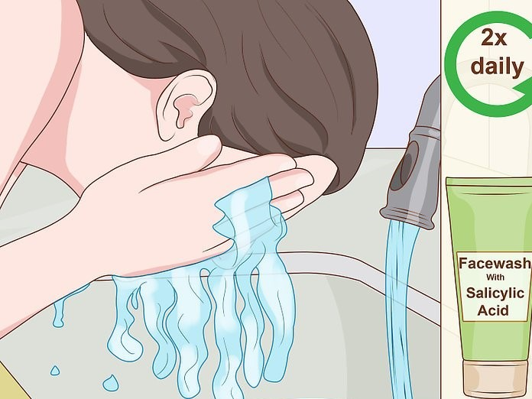
Personal Grooming Instruction
Grooming your face and skin:
Wash your face twice each day.
Gently pat your face dry with a clean washcloth.
Avoid scrubbing your face dry, which can damage your skin.
If you wear make-up, remember to always remove it every night.

Slide 29
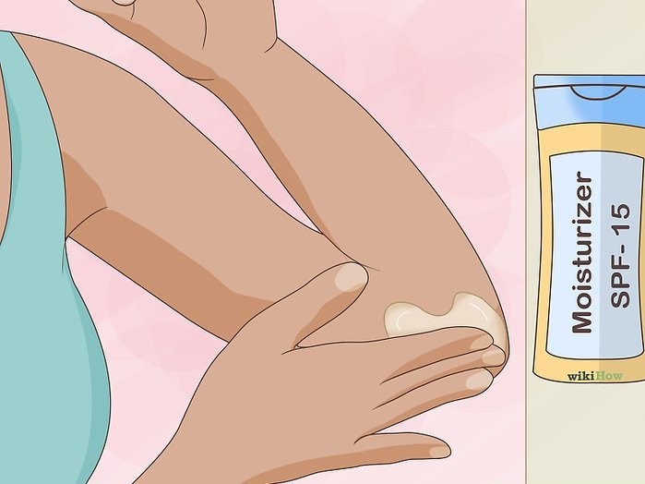
Personal Grooming Instruction
(continued)
Apply moisturizer with sunscreen daily.
After cleansing, moisturize your face.
Use a moisturizer that contains a minimum of SPF-15 sunscreen to protect your skin from sun damage.
Choose a moisturizer that matches your skin type.

Slide 30
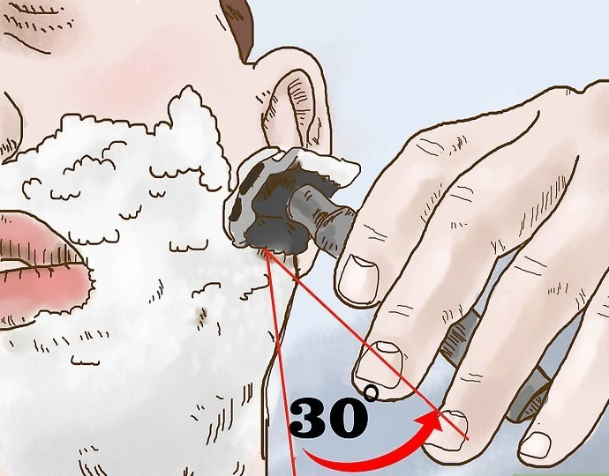
Personal Grooming Instruction
(continued)
Manage your facial hair.
When shaving, always use shaving cream to protect and lubricate your face.
Use a sharp razor that has no debris lodged between the blades.
Always shave in the same direction your facial hair grows.

Slide 31
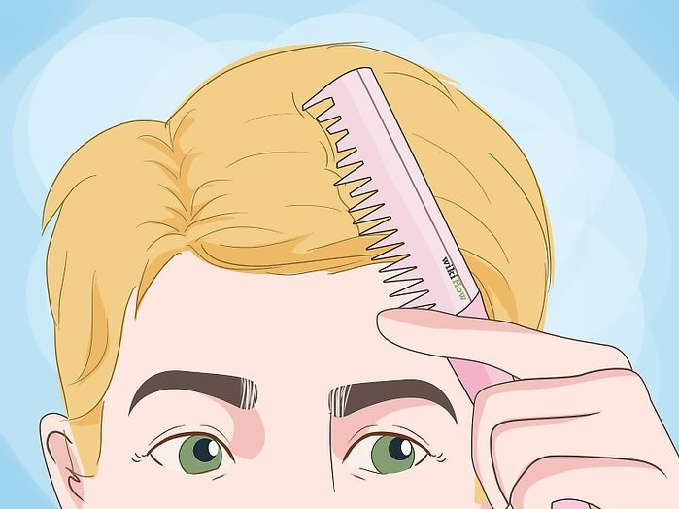
Personal Grooming Instruction
(continued)
Brush and style your hair every day.
After you get out of the shower, carefully comb through your hair to detangle it.
Style your hair as you normally would.
Avoid using too much hair product in your hair, which can make it look greasy.

Slide 32
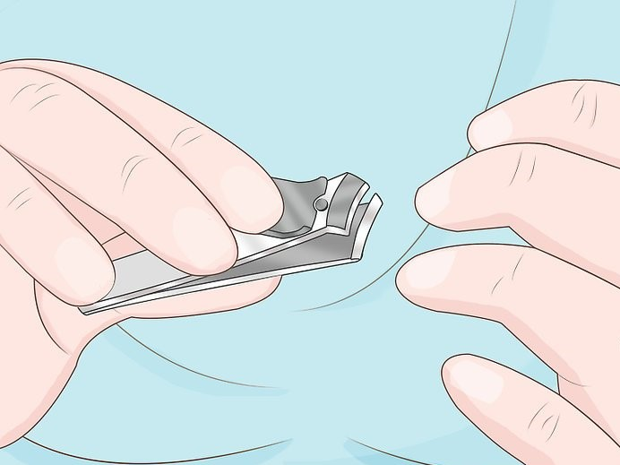
Personal Grooming Instruction
(continued)
Trim your fingernails regularly.
Keep your nails short, neat and clean.
Always round the edges.
Gently clip hangnails off with nail clippers.
If you have long nails, scrub under your fingernails every day using soap, water, and a nail brush or old toothbrush.

Slide 33
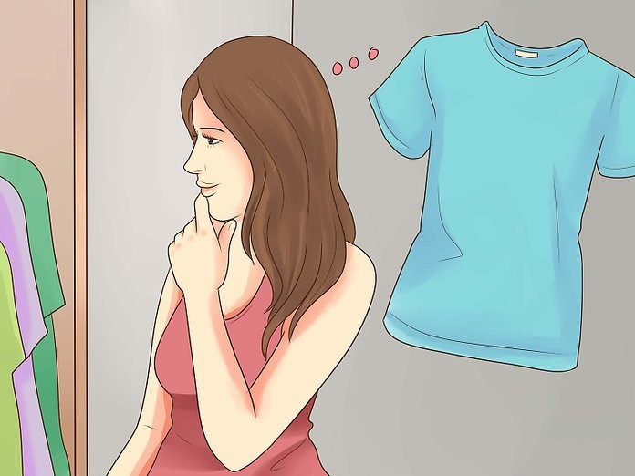
Dressing Instruction
Allow a realistic amount of time for getting dressed.
Choose appropriate clothing for the activities you will be doing that day.
Choose appropriate clothing for the weather.
Ensure that clothes are not backwards and that shirts with buttons are buttoned correctly.
Ensure that zippers are zipped and that belts are worn when needed.

Slide 34

Eating and Drinking
Choose a healthy diet that includes fruits and vegetables.
Watch your salt intake.
Practice moderation.
Drink plenty of water.
Avoid sugary drinks.
Don’t skip breakfast.
Eat three meals a day with healthy snacks in between meals.

Slide 35
Topics to Cover in IADL Instruction
At a minimum, topics should include:
Shopping
Cooking
Doing housework
Doing laundry
Managing transportation
Notes:
At a minimum, topics should include:
Shopping
Cooking
Doing housework
Doing laundry
Managing transportation
Instrumental Activities of Daily Living are another factor to consider when determining someone’s independence.
IADLs are key to a person’s ability to live independently and thrive.
Additional IADLs will be addressed by CMHC staff, including ACT team members, case managers, and others, who will be working with individuals prior to and after transition out of the personal care home.

Slide 36
Shopping
Many residents have not been responsible for their own shopping in quite some time.
One way a resident could practice this skill would be to have the resident write out a shopping list for a specific meal or dish.
Notes:
Many residents have not been responsible for their own shopping in quite some time.
One way a resident could practice this skill would be to have the resident write out a shopping list for a specific meal or dish.
Long-term residents may not be familiar with stores near where they are moving; therefore, they may not know where to shop for the items they need.
One way a resident could learn about their neighborhood or residential area would be to focus an outing on where to go to find specific items.
The attached written instructions can be provided to the resident as a visual learning tool, and should be used with verbal and hands-on instruction provided by PCH staff.

Slide 37
Meal Planning and Preparation
Meal prepping is a practice designed to make meals one day per week that will last for the rest of the week.
It is a great way to save time and money, and to ensure a healthy diet each week.
Notes:
Meal prepping is a practice designed to make meals one day per week that will last for the rest of the week.
It is a great way to save time and money, and to ensure a healthy diet each week.
Developing a planning, shopping, and cooking routine will help minimize meal boredom and improve health.
Residents of personal care homes have not had to plan or prepare for meals, so this is a skill that will usually need refreshing prior to transition into the community.
The attached written instructions can be provided to the resident as a visual learning tool, and should be used with verbal and hands-on instruction provided by PCH staff.

Slide 38
Microwave Cooking
Cooking with a microwave oven is highly convenient, simple, and incredibly fast.
Food cooked in a microwave oven is as safe, and has the same nutrient value, as food cooked in a conventional oven.
Notes:
Cooking with a microwave oven is highly convenient, simple, and incredibly fast.
Food cooked in a microwave oven is as safe, and has the same nutrient value, as food cooked in a conventional oven.
Residents in personal care homes often have not been responsible for preparing their own meals for quite some time, and microwave ovens offer a safe means of food preparation.
The attached written instructions can be provided to the resident as a visual learning tool, and should be used with verbal and hands-on instruction provided by PCH staff.

Slide 39
How to Clean Your House or Apartment Quickly and Effectively
When providing instruction to a resident on how to clean his or her room, house, or apartment, provide simple step-by-step instructions as you lead the resident through the process.
He or she can practice the steps by cleaning their room in preparation for their transition to their own house or apartment.
Notes:
Learning to clean up after themselves is a necessary skill that will provide the resident with a sense of structure and control once they are living independently.
The attached written instructions can be provided to the resident as a visual learning tool, and should be used with verbal and hands-on instruction provided by PCH staff.

Slide 40
Managing Transportation: Asking someone for a ride
Many residents aren’t able to drive, or are able to drive but do not own a car.
While there are plenty of alternate ways of getting around, such as walking, biking, or taking a bus, these methods aren’t always available or convenient.
Notes:
Asking someone for a ride can feel overwhelming, but with a little thoughtfulness, the process can actually be relatively painless for both the resident and the other person.
The attached written instructions can be provided to the resident as a visual learning tool, and should be used with verbal and hands-on instruction provided by PCH staff.

Slide 41
Managing Transportation: Use of public transportation
While learning how to ride the bus to get from point A to point B may seem overwhelming, it’s usually relatively simple.
After taking a couple of trips on the bus, the resident will be riding like a pro.
Many residents return to a PCH because they lack a means of transportation to get them to places they need to go, such as a doctor’s office, the grocery store, or to visit friends and family.
Notes:
While learning how to ride the bus to get from point A to point B may seem overwhelming, it’s usually relatively simple.
After taking a couple of trips on the bus, the resident will be riding like a pro.
Many residents return to a PCH because they lack a means of transportation to get them to places they need to go, such as a doctor’s office, the grocery store, or to visit friends and family.
For those who live in urban areas with public transportation systems, learning to understand bus routes can decrease some of the stress of living independently.
The attached written instructions can be provided to the resident as a visual learning tool, and should be used with verbal and hands-on instruction provided by PCH staff.

Slide 42
Communicating with Others
At times, residents may find it difficult to convey their needs to family, friends, work colleagues, staff, and others.
Teaching residents how to effectively communicate with others to get their needs met will enhance their life satisfaction.
Notes:
At times, residents may find it difficult to convey their needs to family, friends, work colleagues, staff, and others.
Teaching residents how to effectively communicate with others to get their needs met will enhance their life satisfaction.
It is important to provide residents with effective strategies to help improve respectful communication styles with others by establishing boundaries to ensure they get their needs met.
The attached written instructions can be provided to the resident as a visual learning tool, and should be used with verbal and hands-on instruction provided by PCH staff.

Slide 43
Transition Process – 908 KAR 2:065
If a resident with SMI wants to transition to independent living, he or she must be evaluated by a qualified mental health provider to determine whether:
1. He or she is eligible to transition; and
2. The transition would be clinically appropriate.
Notes:
If a resident with SMI wants to transition to independent living, he or she must be evaluated by a qualified mental health provider to determine whether:
1. He or she is eligible to transition; and
2. The transition would be clinically appropriate.
If transition is appropriate, the resident will receive information about services and will receive assistance to develop a person-centered recovery plan that includes all necessary services; objectives, plans, and interventions.
Behavioral health professionals will work with the resident to achieve the plan objectives, help the resident gain confidence, and determine when the resident is ready for transition.
PCH staff should work with individuals to teach skills which will help them achieve their goals.
PCH direct care staff play a key role in a transitioning resident’s success by providing assistance with certain ADLs and IADLs that are necessary for a happy and satisfying life.
As I mentioned earlier in this presentation, 908 KAR 2:065 also talks about the transition process.

Slide 44
How You Can Help
If a resident with SMI wants to move out of the personal care home and live independently, you can help the resident request evaluation and services by:
  Calling 1-800-374-9146;
  Using wwww.dbhdid.ky.gov/ISA; or
  Talking to the in-reach worker who visits the personal care home where you work.
After the resident submits a request, share information with the in-reach worker, targeted case manager, Assertive Community Treatment (ACT) team members, or other behavioral health professionals who visit the resident to assist with transition.
Provide support for the resident and instruction as coordinated by the behavioral health staff as the resident works to transition and learn new skills.
You can help them succeed!
Notes:
If a resident with SMI wants to move out of the personal care home and live independently, you can help the resident request evaluation and services by:
Calling 1-800-374-9146;
Using www.dbhdid.ky.gov/ISA ; or
Talking to the in-reach worker who visits the personal care home where you work.
Once the resident submits a request for evaluation, you should share information with the in-reach worker and other behavioral health professionals who visit the resident. As someone who sees the resident every day and knows them well, you will have important information about the resident’s abilities and preferences. That information will be necessary for the behavioral health staff to know in order to help the resident succeed.
After the behavioral health professionals have put together a plan for the resident, they will work with him or her to learn the skills they need. As a person who sees the resident every day, you will be in an important and unique position to reinforce the work the behavioral staff is doing.
As the resident works to transition and learn new skills, you should provide support for the resident and instruction as coordinated by the behavioral health staff. The behavioral health team will be working with the resident to master ADLs and IADLs, but the behavioral health staff don’t work at the personal care home and so they very have limited time with the resident. As a personal care home employee, you can reinforce their work by providing reminders about when and how to perform these skills during the natural course of the day.
You can be a great influence on the residents and help them master the skills they need to succeed and live independently.

Slide 45
Conclusion
Difficulty performing ADLs and IADLs can cause serious problems for patients with SMI who want to live in the community.
Assisting clients with learning skills for self-care activities can improve quality of life for residents, reduce stress and anxiety, and decrease risk of re-entry to a personal care home.
Individuals with SMI generally want to live independently, be in society with dignity, have a job with self-esteem, have a partner for love and affection, have a home for safety, hope for a future, and have all civil rights like everyone else.
By learning these important skills, residents will have a better quality of life and a brighter future.

