Slide 1

KORE Data Portal Training
October 2024

Slide 2
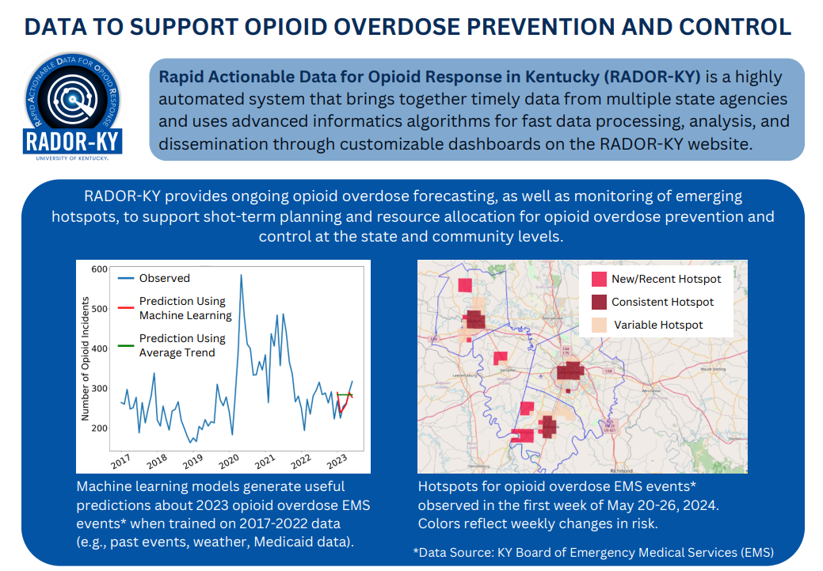

Slide 3


RADOR-KY has partnered with KORE to build them a system that will improve the data entry process.
How does this help KORE?
It will take them substantially less time to process and use the data you send them.
How will this help you?
The web-based form makes it much easier for you to track your data in one spot, allowing your team members to collaborate on the go.
Entering data as its collected, using the web form, can take a lot of pressure off your team when data is due.
KORE Training Contact: Laura Middleton laura.middleton@ky.gov
RADOR-KY Training Contact: Lindsey Hammerslag L.Hammerslag@uky.edu

Slide 4
Introduction to What’s New

Slide 5
The Data is Online Now!
We’ve created a web-based system that lets you access and interact with your data.
Your team will have two options for entering data – the web-based form and bulk upload.
As data goes into the system, we’ll automatically check it for any errors.
You’ll get instructions on how to fix issues as you enter your data.
Once data is validated and loaded into the system, you and your teammates can view and download it.
Notes:
You can enter data in real time, using a simple and easy web-based form.
You can also upload bulk data, if your agency is keeping their records in another system and exporting them.

Slide 6
Automatic Data Delivery
Deidentified data will be automatically passed to KORE for reporting each month.
We remove name and date of birth.
KORE will be able to see the remaining visit information without these identifiers.
Please remember not to put any identifying information into the notes field.
Your agency and KORE will be able to run reports on your submitted data.
For now, we are limiting reports to a few pre-made options, but stay tuned for more customizability in the future!

Slide 7
New information you can submit
Optional (not submitted to KORE)
Name – this is optional but helps you tell clients apart.
DOB – this is also optional, but again helps you tell clients apart.
Optional (will be used by KORE but can be missing)
County – This is useful for allowing KORE to track data at the county level.
Recovery service referral information - We’re adding this to look at whether agencies are providing referrals to recovery services, not just whether they’re providing direct services.
Mandatory (needed by the system to process file)
Visit date - This reduces your workload by allowing KORE to automatically de-duplicate and summarize data over time periods.
It also lets you get a look at how much work you’re doing!
Unique ID – These must be totally unique within your agency to let us tally your data.
Agency Name – We’ll tell you how to enter this in the next week.

Slide 8
What does the system look like?

Slide 9
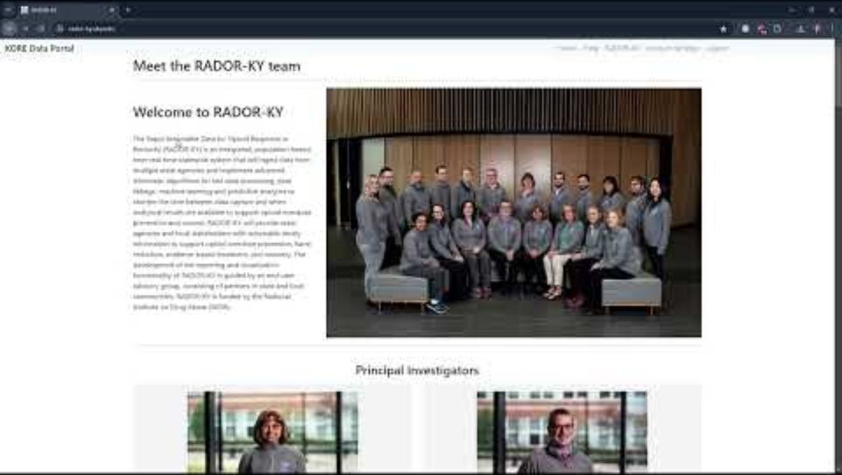
Video - Getting Started with the KORE Data Portal
Link to Youtube Video

Slide 10
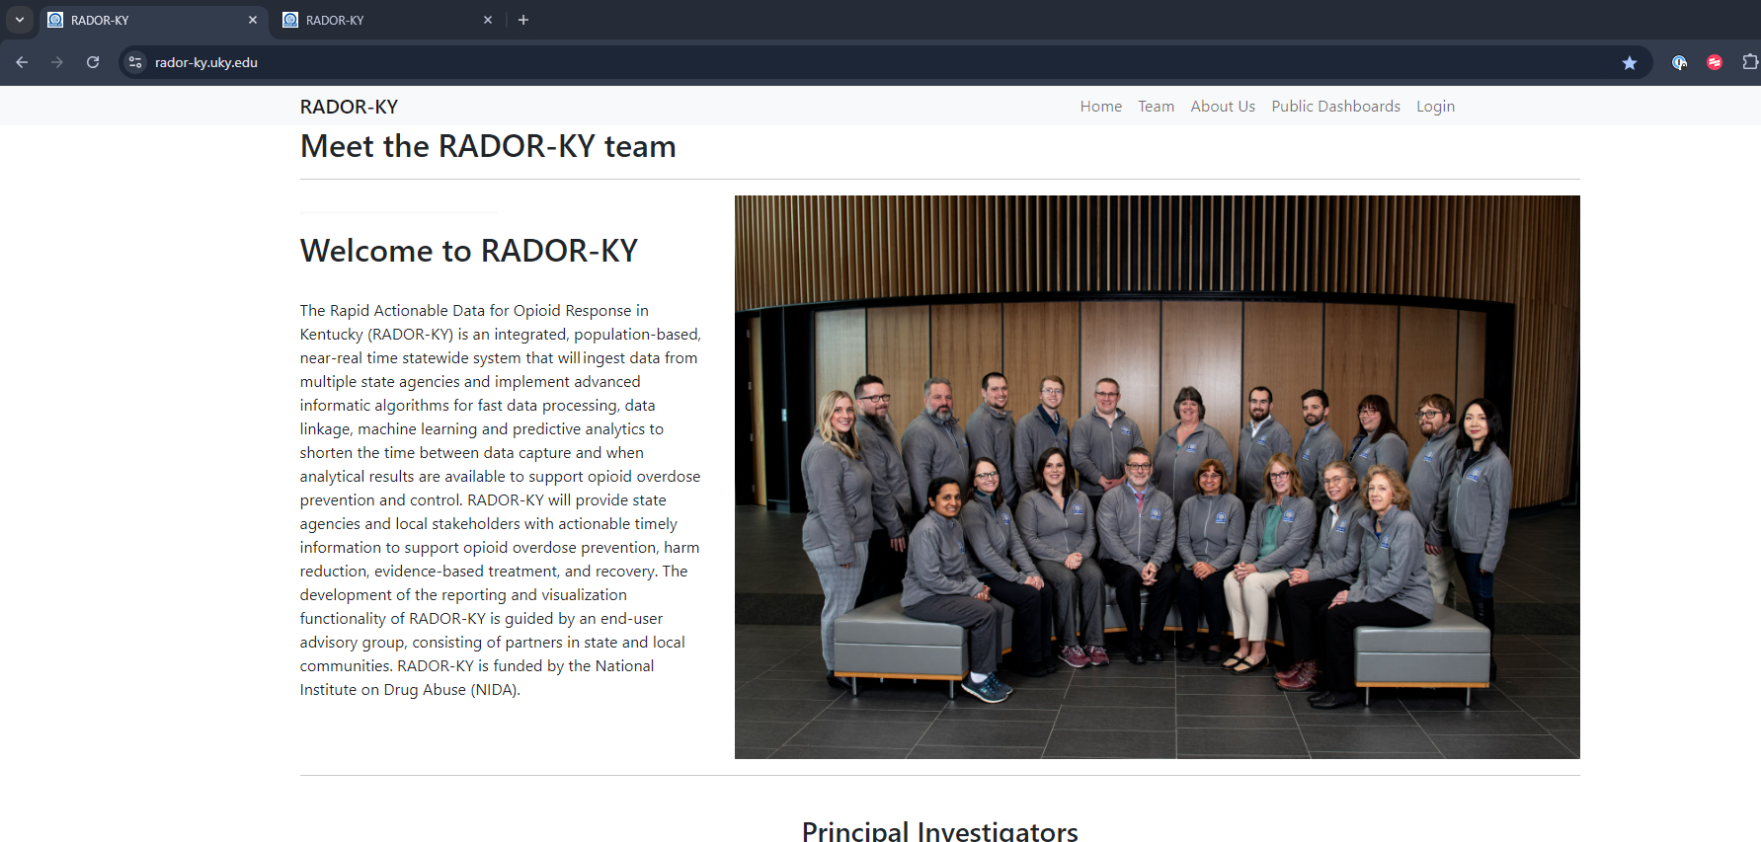
Home Page – navigate to rador-ky.uky.edu

Slide 11
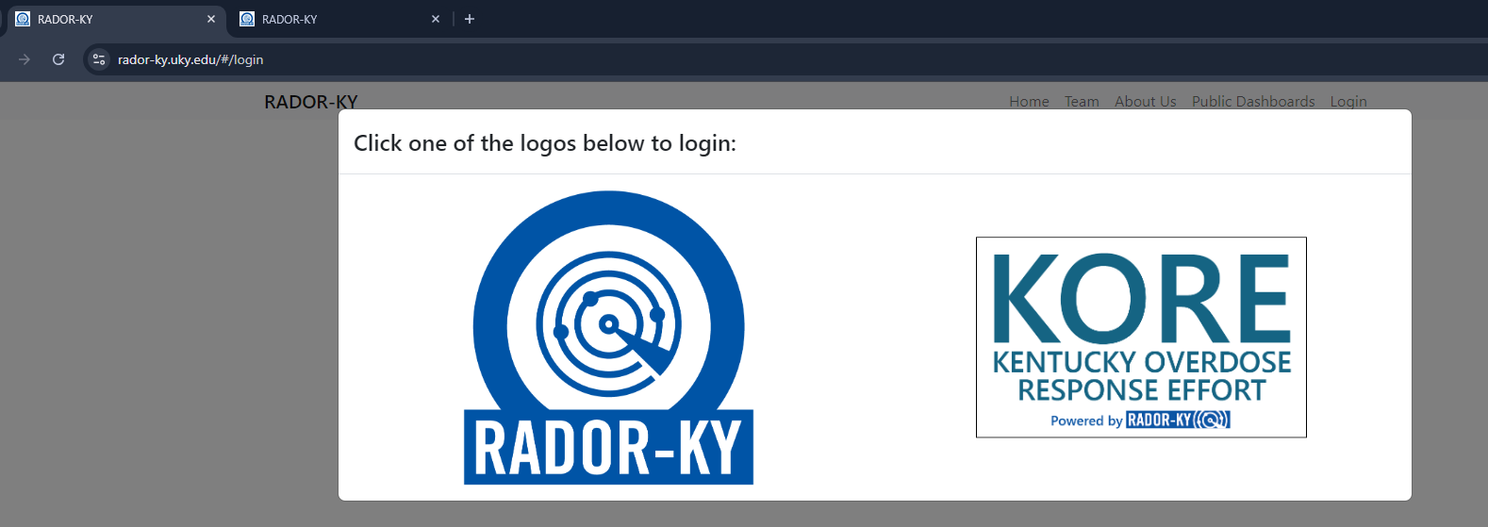
Login Page – be sure to click “KORE”

Slide 12
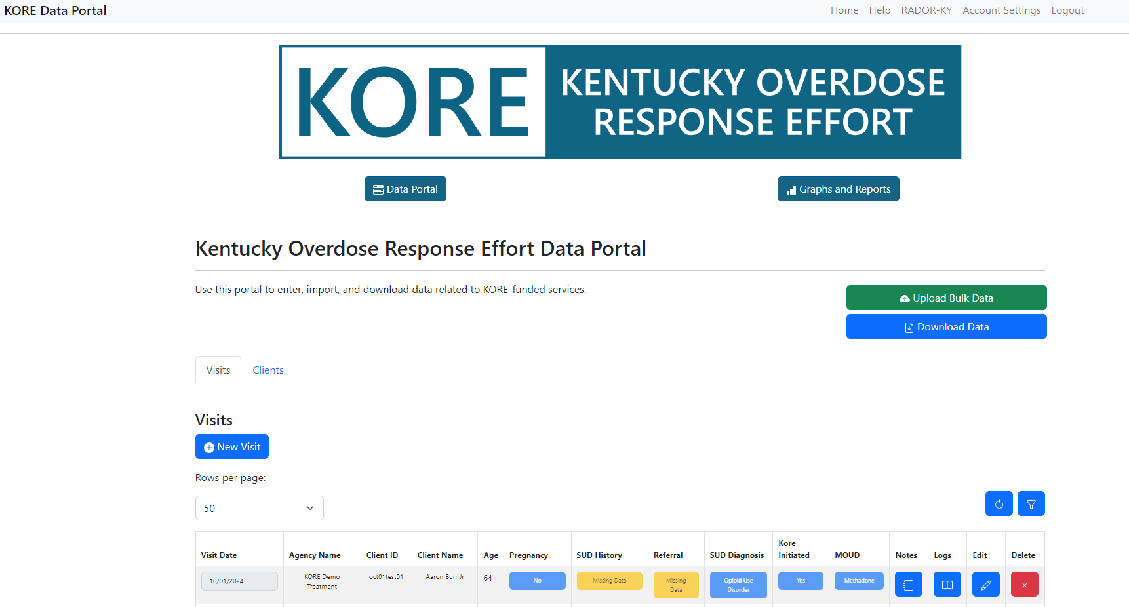
Visits Page – The first thing you see after logging in

Slide 13
Visits Page – The first thing you see after logging in
Buttons to Return to Portal
Import Bulk Data
Export Your Data
View Client Information
Add Visit Information (new or existing clients)
Filters to Control What you See
Visit Data Table
Edit and Review Edits
One row per visit

Slide 14
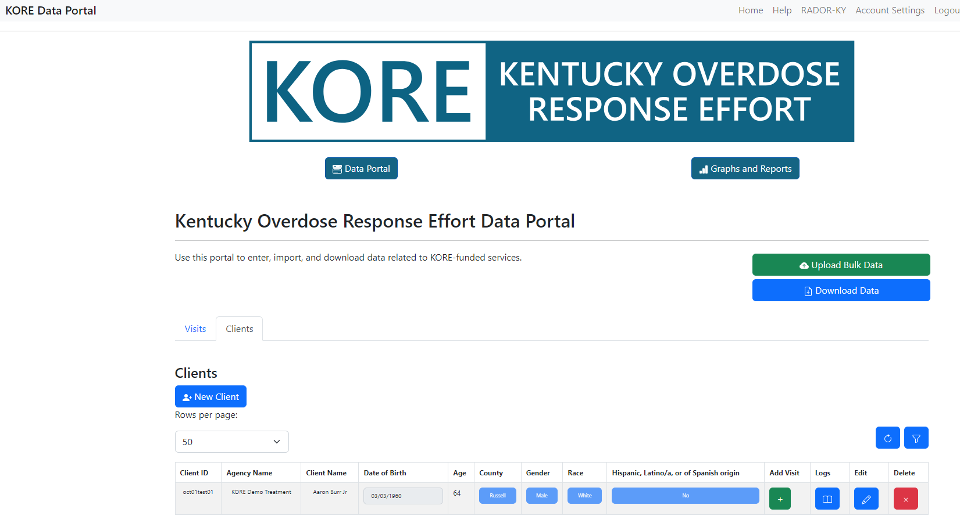
Clients Page – One record for each individual

Slide 15
Clients Page – One record for each individual
Buttons to Return to Visits Page
Import Bulk Data
Export Your Data
Add Visit for Existing Client
Find Client by Name or Filter
Add New Client
Client Data Table
Edit and Review Edits
One row per client

Slide 16
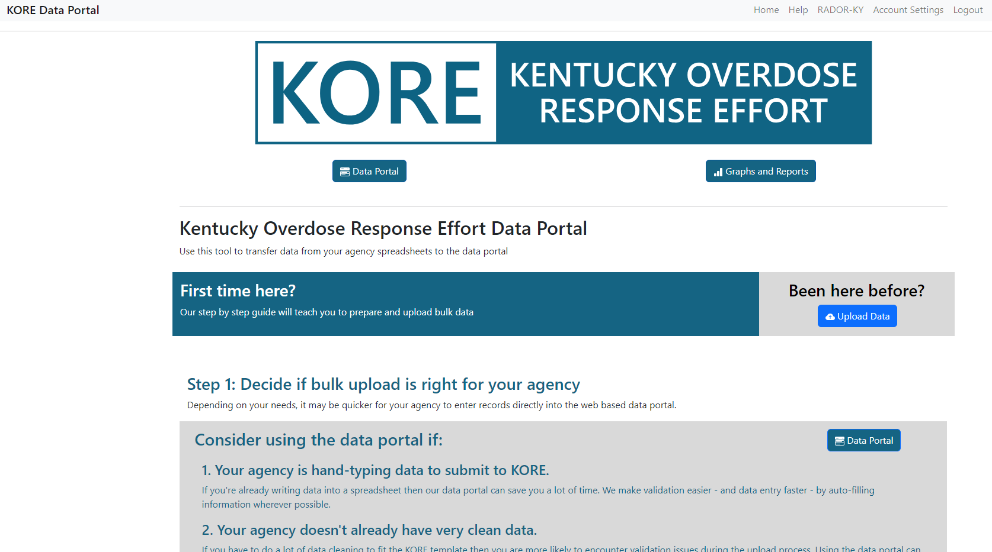
Bulk Upload Page – Review this page before attempting

Slide 17
Bulk Upload Page – Review this page before attempting
Buttons to Return to Visits Page
Import Data (can also be found at bottom of page)
Instructions. Very important to read completely before trying a bulk upload

Slide 18
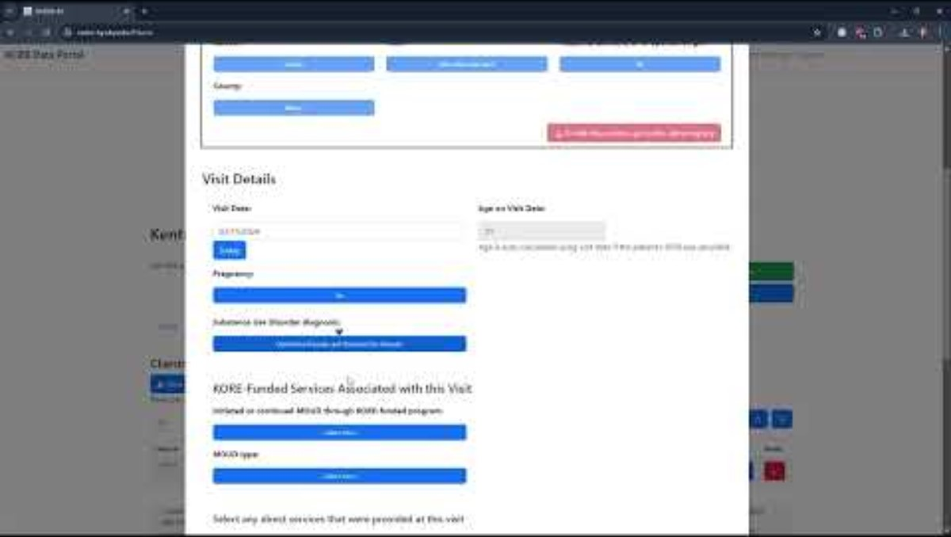
Video - Adding Visits
I accidentally put the client’s name in the notes here. Do not do this!
Link to Youtube Video

Slide 19
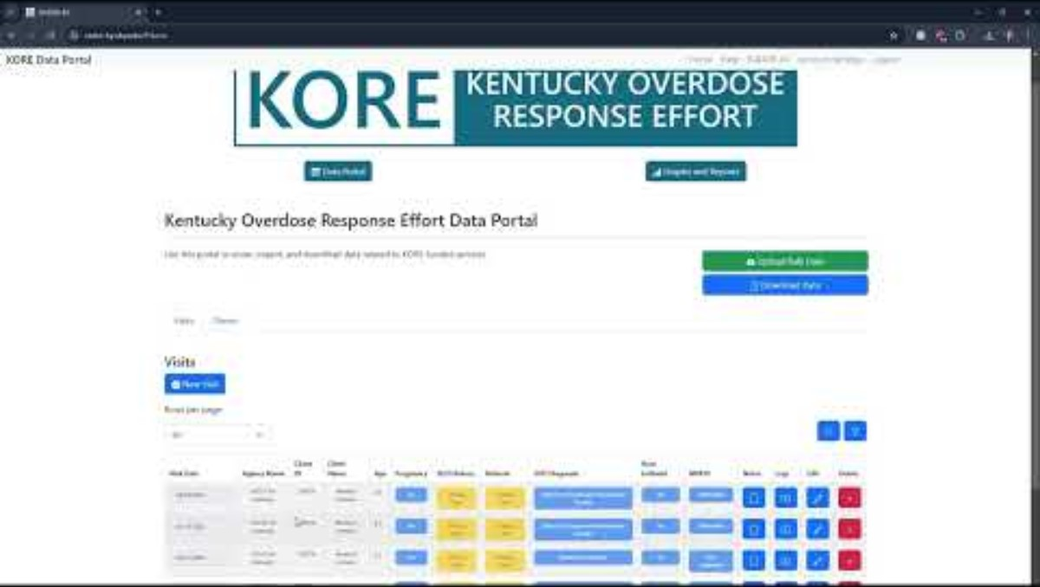
Video – Visits (continued) and How We Check Your Data
I accidentally put the client’s name in the notes here. Do not do this!
Link to Youtube Video

Slide 20
Visits Page – The first thing you see after logging in
Add Visit Information (new or existing clients)

Slide 21
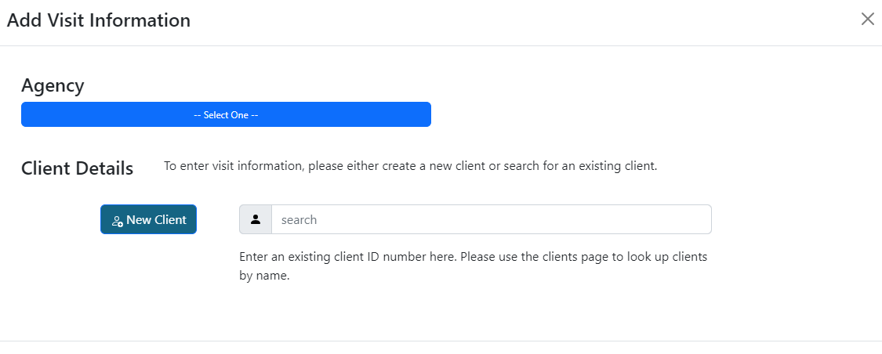
Visits form, for new and returning clients
If you’re associated with multiple agencies/programs, you’ll need to select agency for each new record
Find an existing client by ID
Add a new client

Slide 22
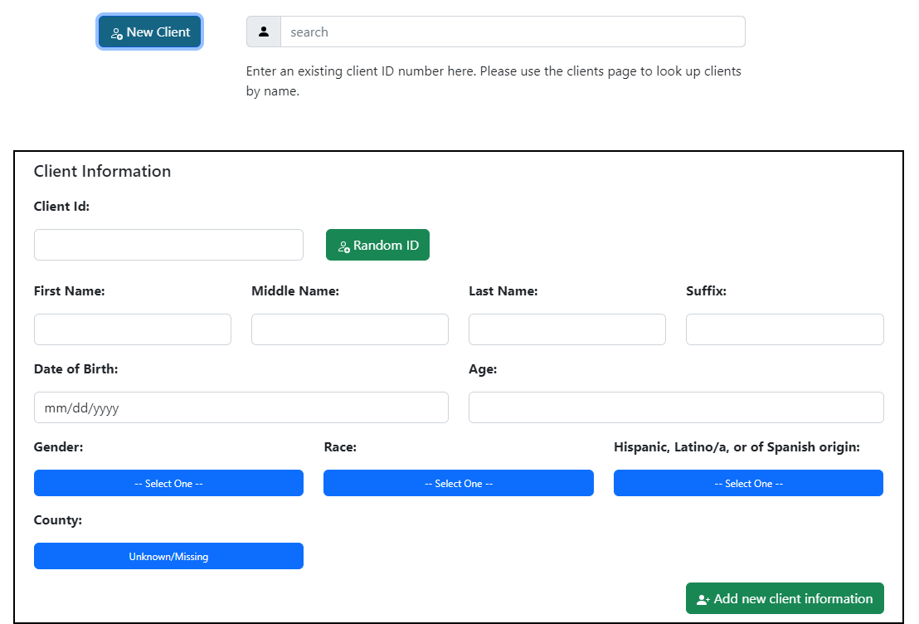
Visits form, new client selected
Type your own unique ID
Mandatory
Have us generate an ID
Scroll to visit info
Click when done

Slide 23
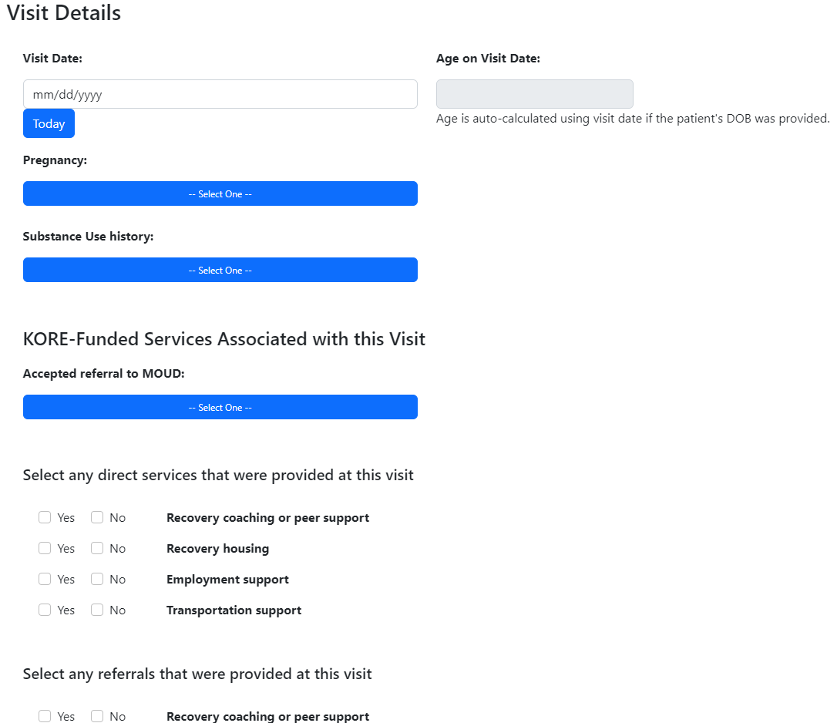
QRT and Recovery Version of Form
Mandatory
Questions only for QRT and Recovery Agencies
Services you provided
Scroll Down to Complete!
Referrals to other agencies / programs

Slide 24
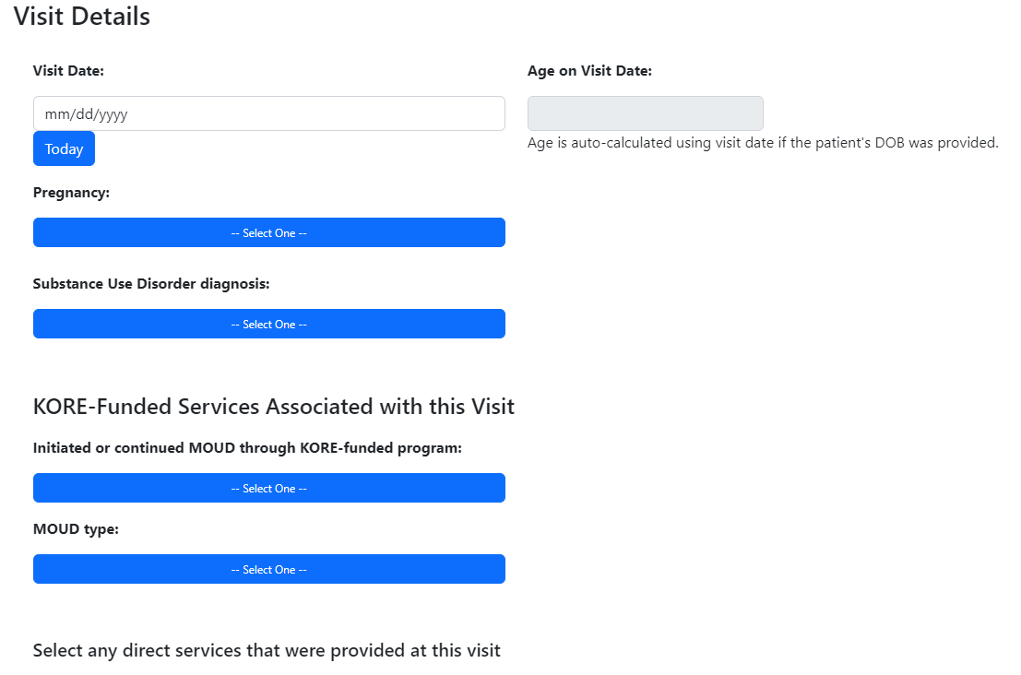
Treatment and MOUD Version of Form
Mandatory
Questions only for Treatment and MOUD-Providing Programs
Scroll Down to Complete!
Services you provided
Referrals to other agencies / programs

Slide 25
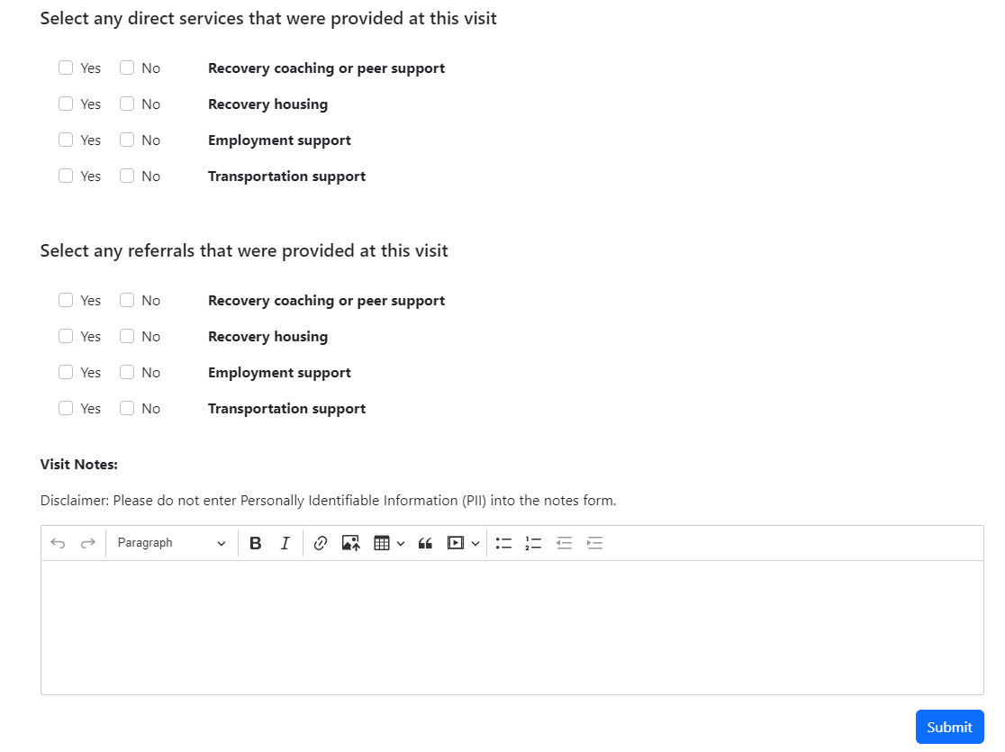
Both versions of the form
Services you provided
Referrals to other agencies / programs
You must click submit when done!
Add notes here – remember KORE will see whatever you type here so no identifiers!

Slide 26
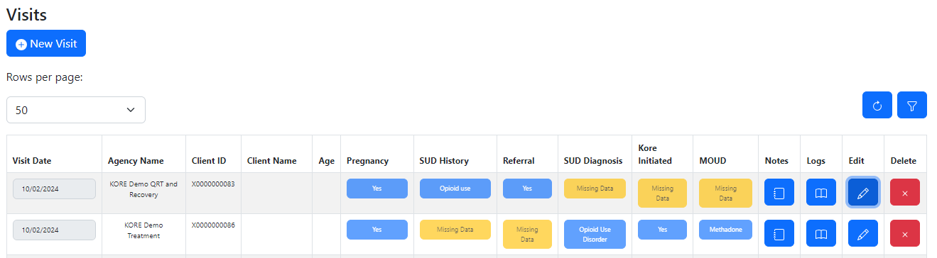
A quick note: Your agency will see missing data for anything you aren’t asked to submit
QRT and Recovery Fields
Treatment and MOUD Fields

Slide 27
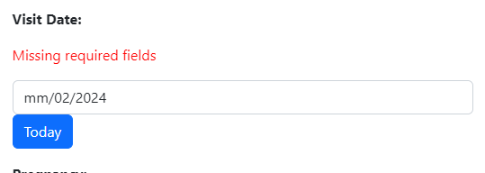
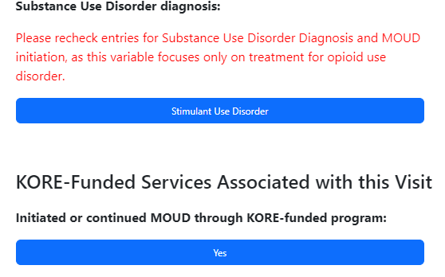
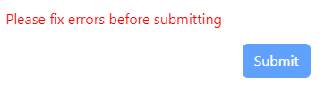
Errors on your form will be indicated with red

Slide 28
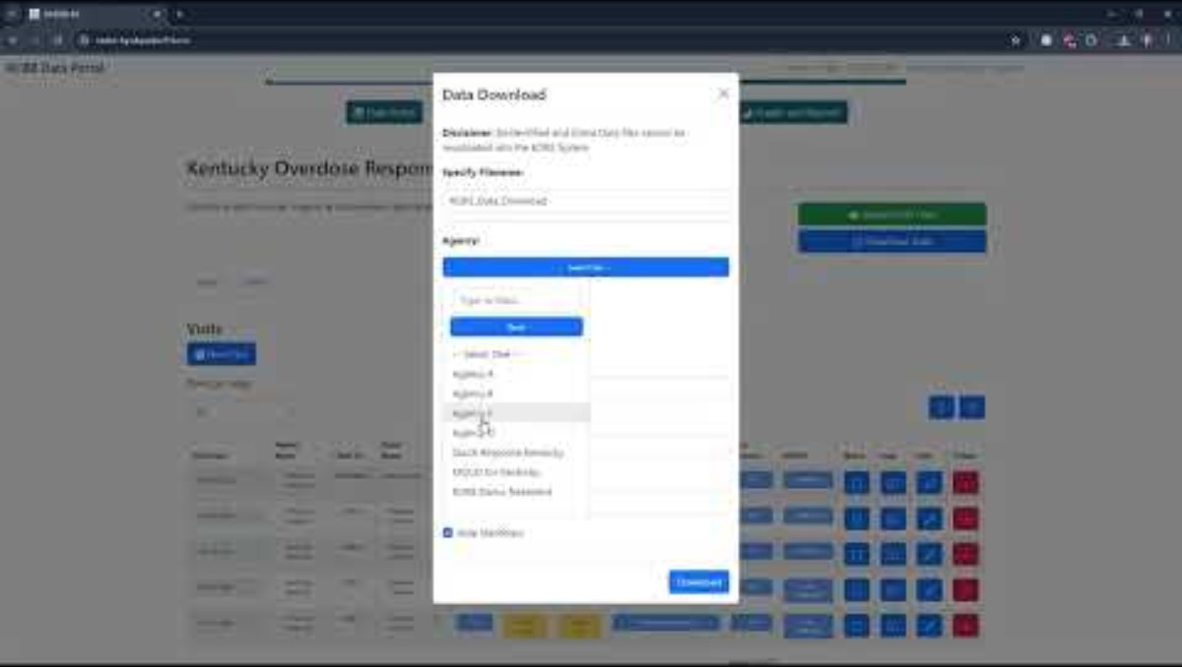
Reviewing and Downloading Your Data
Link to Youtube Video

Slide 29
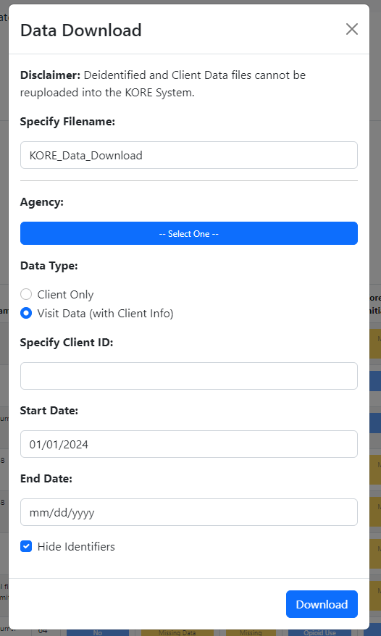
Downloads Screen - Download your data often!
If you have multiple agencies, download one file at a time
Choose between the client registry (one row per person) and the full visit data (one row per visit)
Optional filters
Uncheck this to download your complete dataset

Slide 30
Before we review bulk upload, a reminder
Bulk upload is not appropriate for all agencies
The validation process may be more time consuming for your team, as we now will not accept files that do not meet minimum standards.
Talk to your implementation specialist to make the best choice for your team.
Data in the KORE system will have already undergone validation, so it should be the basis for your recordkeeping.
If you have to use the bulk upload approach, we recommend you only submit new data.
You should be in the habit of downloading your data periodically.

Slide 31
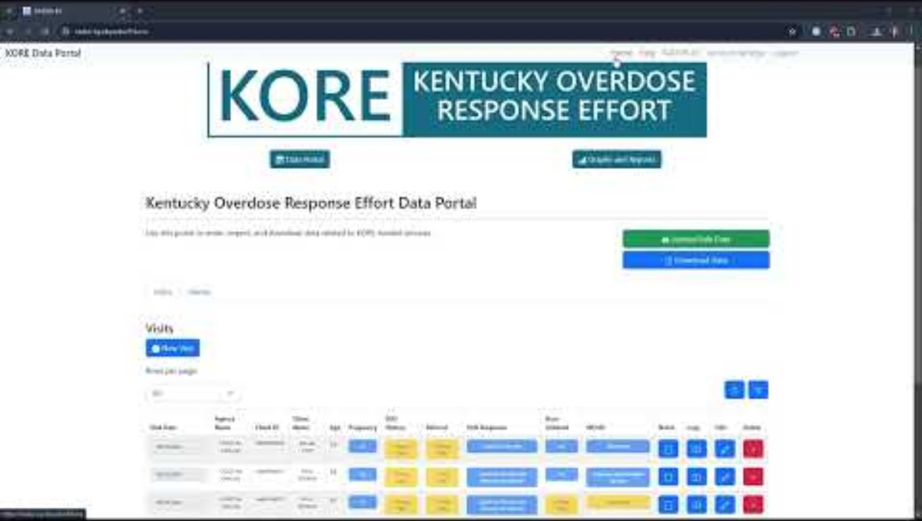
Bulk Uploading For Very Large Agencies
Link to Youtube Video

Slide 32
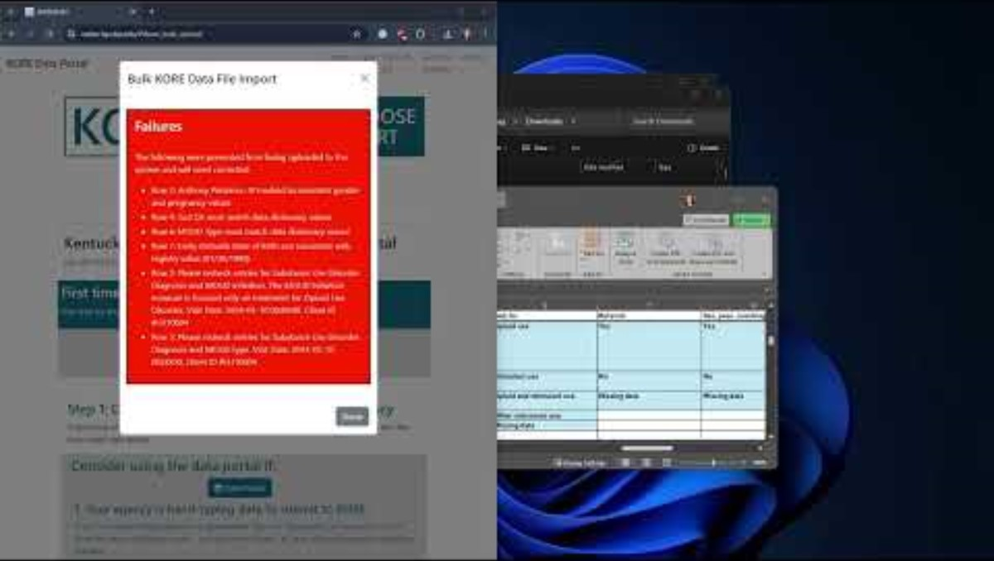
Checking and Fixing Bulk Uploads
Link to Youtube Video

Slide 33
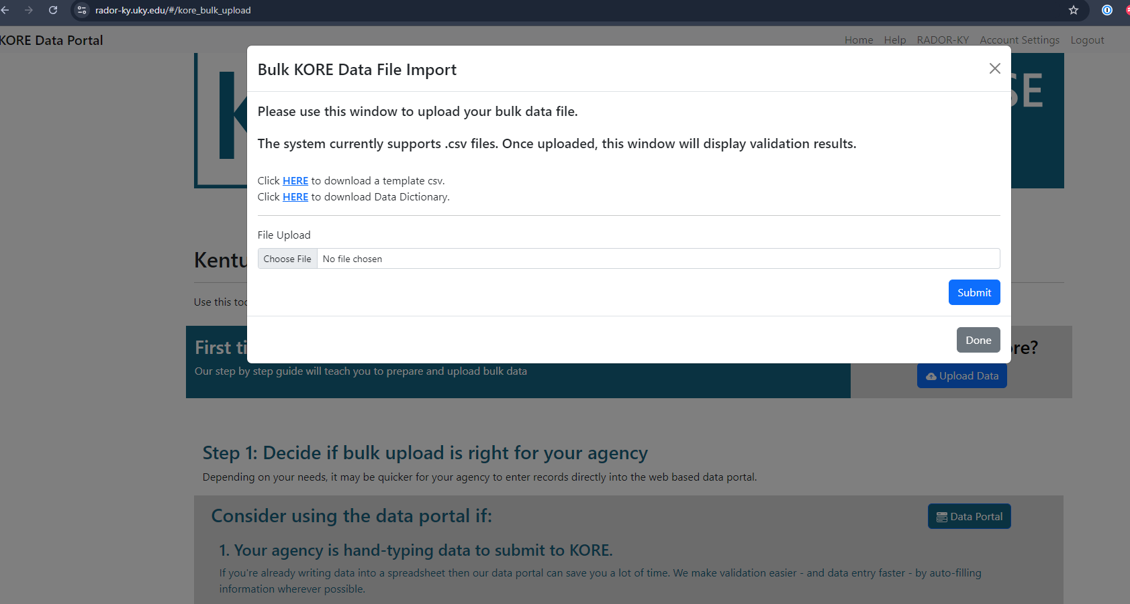
Visual Guide to the “Bulk Upload” Page

Slide 34
Access Template File and Data Dictionary
Select File to Upload
Submit File for Validation

Slide 35
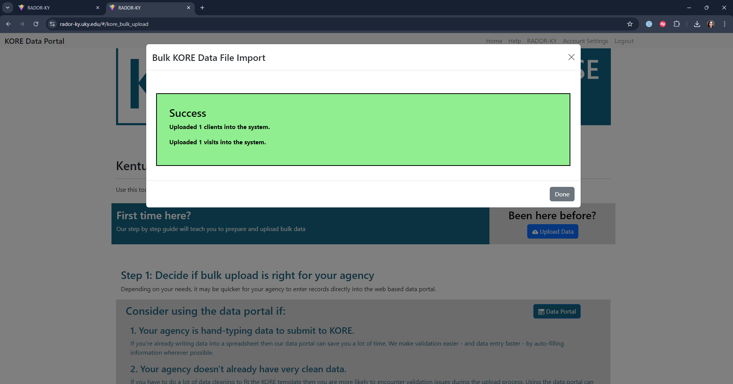

Slide 36
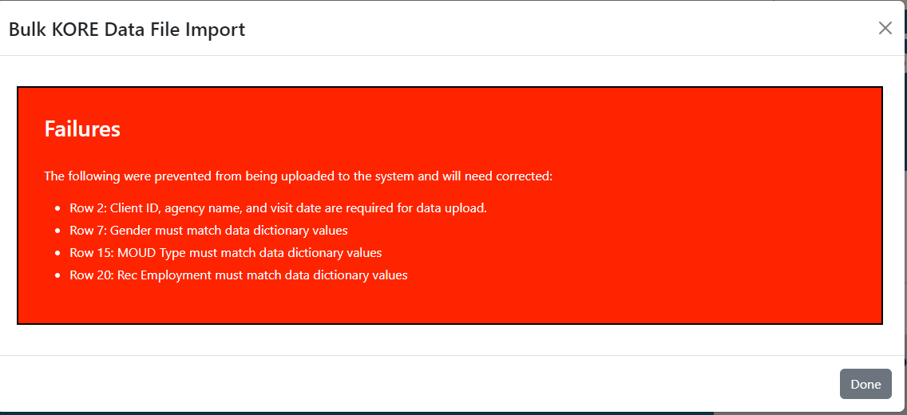

Slide 37
Features Still Under Development
Community engagement
For now, continue to submit community engagement information with your excel sheet
Reports and graphs
We are still building out reports and graphs and expect to have these live in the next month.

Slide 38
Special situations
Your team may do things a little differently from others, we’re going to cover some less common scenarios that may pop up for you.

Slide 39
What if I’m submitting data for more than one program?
If you’re a user that submits data for more than one program, there are a couple of things to keep in mind:
1. There’s no data sharing between programs, for any reason.
Clients cannot be transferred across programs.
If you don’t have access to an agency, you cannot enter or download data for that agency.
2. You need to select which agency a client is affiliated with when creating a new client. Remember, clients can’t be moved later.
3. The client IDs are unique within each agency, but two agencies can use the same ID.

Slide 40
What if I can’t submit client name or DOB?
Just use the system as it’s designed and pay close attention to your client ID information.
We won’t be able to check DOB to make sure you’ve got the right client, so it’ll all be on you!

Slide 41
What if I want to combine bulk upload with the data portal?
That’s fine!
Make sure you’re downloading the latest version of your data periodically.
Any edits to visit or client information must go through the web portal.

Slide 42
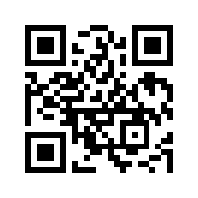
KORE Training Contact:
Laura Middleton laura.middleton@ky.gov
Your implementation specialist will also be able to provide you with help and access to information
RADOR-KY Training Contact:
Lindsey Hammerslag L.Hammerslag@uky.edu
Visit the site: https://rador-ky.uky.edu/

