Slide 1
2025 Certified Community Behavioral Health Clinics (CCBHC) Demonstration Applicant Touchbase Meeting
April 15, 2025
Presented in
partnership with:

Slide 2
Discussion Items
Introductions
Kentucky (KY) CCBHC Governance- Roles and Responsibilities
Department for Medicaid Services (DMS)
Myers and Stauffer LC
Department for Behavioral Health, Developmental and Intellectual Disabilities (DBHDID)
KY CCBHC Website
KY CCBHC Demonstration Expansion Timeline
CCBHC Provider Quality Measures and Reporting
CCBHC Provider Cost Reporting Requirements
Question & Answers
Open Discussion

Slide 3
KY CCBHC Demonstration Webpage
Visit the Kentucky CCBHC Website for essential materials, including:
CCBHC Provider Application
KY CCBHC Provider Readiness Assessment
Mandatory CCBHC New Provider Trainings
Attestation Forms
DCO Request and Termination Forms
Kentucky CCBHC Documents and Information
SAMHSA CCBHC Documents and Information

Slide 4
KY CCBHC Demonstration Webpage
https://www.chfs.ky.gov/agencies/dms/Pages/CCBHC.aspx

Slide 5
Kentucky CCBHC Expansion and Implementation Timeline
 | 2025 |  |  |  |  |  |  |  |  | 2026
Activities | Apr | May | Jun | Jul | Aug | Sep | Oct | Nov | Dec | Jan
Complete Application |  |  |  |  |  |  |  |  |  | GO LIVE
New Provider Trainings (Followed by on-going bi-monthly technical assistance)
Quality Measures & Electronic Health Record (EHR) Clinic Preparation
Cost Reports Submission
Review of Cost Report Submission
Providers submit required documentation for Certification
Community Needs Assessment Due
Provider Certification Desk Reviews
State on-site reviews
DMS review and approval; submit to CMS
Certification Recommendation
04/01 –
05/02
05/02 –
05/30
06/01 – 10/31
05/03 - 07/18
07/18 – 11/21
07/01 – 07/31
08/14
08/01 – 09/15
09/01 – 11/15
11/21 –
11/30
11/15 –
11/22
Dates and tasks subject to change
Notes:
END JULY – GOVERNANCE FOR STATEWIDE MOBILE CRISIS INTERVENTION SERVICES WILL BE REEVALUTED THROUGH JULY AND A NEW MEETING CADANCE AND ACTIVITIES WILL COMMENCE.
BRAD- NEED TO UPDATE DATES

Slide 6
Quality Measures

Slide 7
KY CCBHC Quality Measures (QM)
To prepare for QM Quality Measure collection, clinics need review the following:
KY DMS CCBHC Quality Measures Training (must be completed prior to submitting application)
KY DMS CCBHC QM Documents (available on our webpage)
Kentucky CCBHC Quality Measures Manual V3
CCBHC Quality Measures Data Submission Instructions
KY CCBHC QM Value Sets & Demonstration Service Codes
SAMSHA Quality Measures Trainings and Documents
Additional details can be found in the KY DMS QM Training
Source: Adapted from - SAMHSA Presentation - Introducing Quality Measurement for CCBHC’s and SAMHSA-funded CCBHC PDI and IA grantees (5/11/2023)

Slide 8
KY CCBHC Quality Measures Training
The KY DMS CCBHC Quality Measures Training provides:
Quality Measures Overview
Quality Measure Collection, Calculation, and Submission Timeline
Clinic-collected QM Process & Measure Overview
KY CCBHC QM Program Requirements & Resources
State-collected QM Process Overview

Slide 9
Quality Measures Program Manual
Section 223 Waiver Demonstration for CCBHC, Provider Type 16, Quality Measures Manual
This manual serves as the source document for the collection and transmission of CCBHC Quality Measures within the KY CCBHC Demonstration.
The manual includes the following:
Technical specifications
Calculation workflows
Data submission process
Annual timelines for preparation, calculation, and submission of quality measures

Slide 10
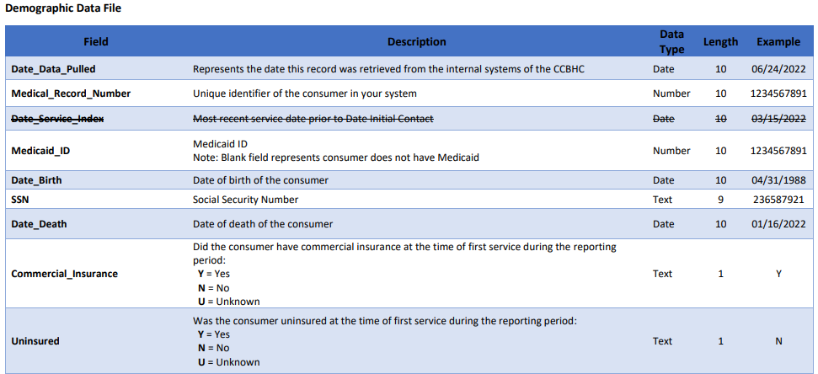
Quality Measures Data Requirements
CCBHC Data Fields & Data Submission Instructions provides a list of all required fields that need to be collected and submitted to KY DMS for QM collection and calculation.
All EHR systems must be able to collect this information prior to entry into the demonstration.

Slide 11
Quality Measures — Next Steps
Have all applicable staff review the KY DMS Quality Measures Training and complete the attestation
After submitting your application, KY DMS will reach out to schedule and complete a QM Introductory Meeting (1 hour)
Schedule and complete a QM EHR Assessment (2 hours, additional sessions may be needed)
Complete a QM Data Use Agreement
Send QM Test Data to KY DMS
Finalize QMs for your Organization

Slide 12
Cost Report

Slide 13
Cost Report — Next Steps/Timeline
Upcoming events and timeline for CCBHC cost reporting and rate setting:
05/02/2025 – View the recorded cost report training prior to application submission.
05/14/2025 – Live virtual training session for more detail and Q&As.
05/16/2025 - Cost Report Request Letter to follow shortly after training.
07/25/2025 – Cost reports and requested support due to DMS/MSLC.
12/01/2025 – Rates finalized prior to sending to CMS.
Additional TA will be available to providers and provided as needed.

Slide 14
Cost Report — Submission & Support
The following items will need to be included with the cost report when submitted:
CCBHC Cost report in electronic format, formatted in Excel, completed using the accrual method of accounting
Detailed trial balance and lead schedules (including revenue, expenses, etc.)
Daily visits supporting documentation which includes claims detail
Crosswalk between trial balance and cost report lines
Federal indirect rate support, if applicable
Certification by Officer or Administrator of the cost report with original signature
Explanations and support for cost report allocations, adjustments, and reclassifications
Explanations and support for both anticipated costs & visits reported
Support for any DCO costs/visits reported, if applicable
Separate summary of and identification and support for costs and visits due to providing primary care services (please note, primary care screening and monitoring costs and visits should not be included in these separate costs identified)
Detailed support on FTE and number of services provided per staff description
Listing of all sites with one of the following designations (CCBHC, Non-CCBHC, Combination of CCBHC & Non-CCBHC)

Slide 15
Cost Report — Communication/Contacts
When completing the contact information, please also complete the following:
Indicate the contact that should be addressed in official letter communications.
Indicate one or two contacts that will be responsible for uploading and downloading items through the SFTP website.
The SFTP website will be used by providers to upload the cost report and supporting documentation. MSLC uses it to deliver official communications to the provider.
If you already have a SFTP established with MSLC, and do not need to update who has access for CCBHC, please leave a note addressing that on the contact sheet.

Slide 16
Cost Report Specific Questions
Questions regarding the cost report can be submitted to:
James Wright, JWright@mslc.com
Matt Lee, MLee@mslc.com
Questions sent in advance of the training on 05/14/2025 will allow us to be prepared and are more likely to be answered during the training, rather than follow up.

Slide 17
Q & A

Slide 18
Q & A
Evidence-Based Practices (EBPs): Do CCBHCs need to have staff trained in all of the services and supports or modalities listed under the EBP requirements? For example, we have many clinicians trained in TF-CBT and EMDR, both of which focus on trauma. Would we also be expected to have clinicians trained in other trauma-focused models such as TARGET or the Nurturing Parenting Program?
988 Integration: In reviewing the application materials, it appears that most current 988 connections are with CMHCs and existing CCBHCs. Was there a state-supported process to help with these integrations? Will there be support available for new CCBHCs to connect with 988?
How quickly after an application packet is accepted will data collection meetings begin?

Slide 19
Cost Report Q & A
Allowable Services and Visits: I’m looking for more clarification on what qualifies as “CCBHC allowable services and visits.” I do have the list of CPT codes, but as I break down our costs by division, program, and service, I’m unsure which ones should be included or excluded for cost reporting purposes.
Cost Reporting Time Period: For the initial cost report, should we use calendar year (CY) 2024 as the reporting period since we can tie it back to our audit? Just want to be sure we’re aligned on the correct timeframe.
Cost Attribution (e.g., KSTEP): We have programs like KSTEP where the services might be CCBHC-allowable, but the associated costs are fully covered by KSTEP. The guidance mentions including all costs for allowable services regardless of payer—does that mean we should include KSTEP contract costs in our CCBHC cost report?
How will PDS be treated on the cost report? It is such a large pass-thru of payroll that we worry it could skew our rate.
Instructions state: “Additional support staff may also be considered direct, including interpreters or linguistic counselors, case managers, and care coordinators.” It looks likes the care coordinators can be considered direct expenses. We would like to confirm how Care Coordinators are treated on the cost report?
Is there a specific methodology that we should use to split costs between CCBHC and CMHC?

Slide 20
For any additional questions or SharePoint access, please contact:
CCBHC@ky.gov

